Slide 1
Attack-Resilient Thermal Control System
EE502 project
Oluwafemi Ajeigbe

Slide 2
Introduction
Notes:
The framework is a method for improving the security of Industrial Control Systems (ICS) against cyber attacks. The framework's goal is to detect attacks and reconfigure the control system in real-time to prevent the attack from significantly impacting the system's operations.
In this framework, the first step is to detect attacks using various monitoring and detection techniques, such as intrusion detection systems, network traffic analysis, and data integrity checks.
Once an attack is detected, the framework proposes reconfiguring the control system to prevent the attacker from achieving their goals. This can be done by redirecting network traffic, changing control parameters, or even shutting down specific system components.
The framework's critical aspect is ensuring that the control system's reconfiguration does not negatively impact the system's operations. This requires a deep understanding of the control system's architecture, dynamics, and behavior and a well-designed reconfiguration strategy.
The results of the study demonstrate the effectiveness of the proposed framework in detecting cyber attacks and mitigating their impact on the system, even in the presence of false alarms and detection delays.

Slide 3
Industrial Control Systems
Industrial Control Systems (ICSs) are specialized computer-based systems that control and monitor industrial processes, such as manufacturing, energy production, and transportation. They are designed to manage physical processes and are often used in critical infrastructure, such as power plants, oil refineries, and chemical facilities.
Benefits: securing industrial control systems is crucial for ensuring the safety, reliability, confidentiality, compliance, and reputation of these systems. By investing in cyber-physical security solutions, organizations can mitigate the risks posed by cyber attacks and enhance the security of their ICSs.
Limitation: Low speed and limited scenarios caused by the system‘s spatial complexity and devices design defect. Also, the robot is most modeled by non-linear system, it may be a complicated controller design problem.
Notes:
Benefits
Safety: ICSs are often used in critical infrastructure and any disruption to these systems can result in serious consequences, such as equipment damage, service interruption, and safety concerns. By securing ICSs, organizations can ensure the safe and reliable operation of these systems, and minimize the risk of accidents and incidents.
Reliability: ICSs play a crucial role in the functioning of critical infrastructure, and any disruption to these systems can result in service interruption, equipment damage, and financial implications. Securing ICSs can ensure the reliability of these systems and minimize the risk of downtime and disruptions.
Confidentiality: ICSs often handle sensitive and confidential information, such as trade secrets, process control algorithms, and critical data. By securing ICSs, organizations can ensure the confidentiality of this information and prevent unauthorized access and theft.
Compliance: Many organizations are subject to regulations and standards that require them to secure their ICSs. Failing to comply with these regulations can result in fines and legal penalties. Securing ICSs can help organizations comply with these regulations and avoid these consequences.
Reputation: A breach or disruption of an ICS can result in negative publicity and damage to an organization's reputation. Securing ICSs can help organizations maintain their reputation and avoid the negative consequences of a security breach.
Limitations
Complexity: ICSs are often complex systems, consisting of multiple components, such as programmable logic controllers (PLCs), human-machine interfaces (HMIs), and supervisory control and data acquisition (SCADA) systems. This complexity can make it challenging to design robust controllers that can effectively manage and control these systems.
Real-time requirements: ICSs are often real-time systems, meaning that control decisions must be made and executed in a timely manner to ensure the stability and reliability of these systems. This can make it challenging to design controllers that can respond quickly to changing conditions and ensure system stability.
Uncertainty: ICSs often operate in complex and uncertain environments, where the behavior of these systems can be affected by factors such as sensor errors, process variability, and unmodeled dynamics. This uncertainty can make it challenging to design robust controllers that can effectively manage and control these systems.
Interoperability: ICSs often consist of multiple components from different manufacturers, and these components may not be designed to work together seamlessly. This can make it challenging to design controllers that can effectively manage and control these systems, especially when these components use different communication protocols and data formats.
Cybersecurity: ICSs are vulnerable to cyber attacks, and any disruption to these systems can result in serious consequences, such as equipment damage, service interruption, and safety concerns. This makes it challenging to design controllers that can ensure the security and reliability of these systems in the face of cyber attacks.

Slide 4
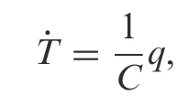
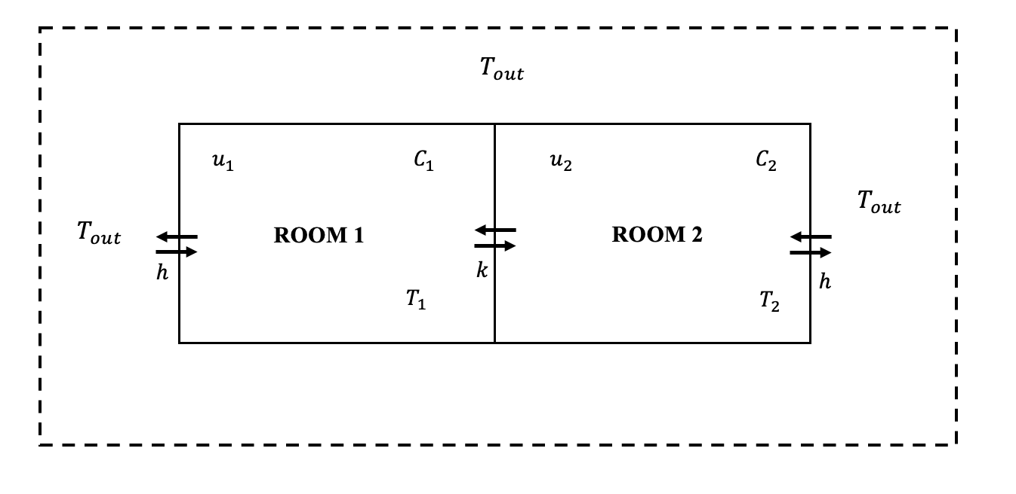
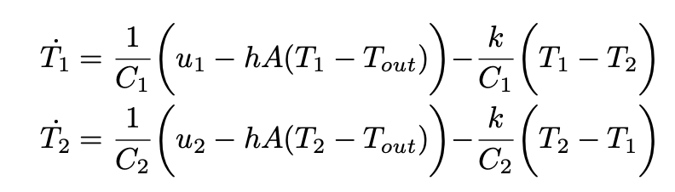
Dynamic Modeling
(Gene Franklin, J. Powell, Abbas Emami-Naeini - Feedback Control of Dynamic Systems (2018)
Notes:
Dynamic Modeling
Q = heat energy flow, joules per second (J/sec) - the sum of heat flows into or out of a substance..
T = Temperature
T_out = Temp Outside
h = heat transfer coefficient with the outside temperature
A = Area of the room
U1 = input, u2 = input
C= thermal capacity
K = heat transfer coefficient between the rooms

Slide 5
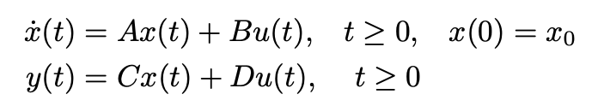
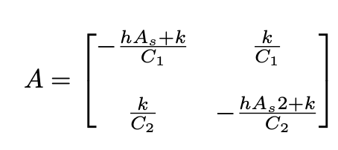
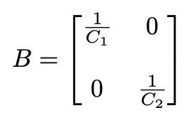
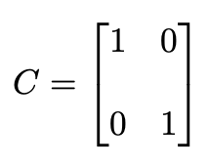

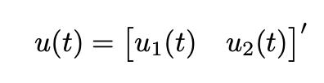


State Space Representation
MATLAB
% Calculate the controllability matrix
CO = ctrb(A, B);
% Check the rank of the contollabilty matrix
if rank(CO) == size(A,1)
disp('System is controllable');
else
disp('System is not controllable’);
end
Output: System is Controllable
Notes:
X(t) = state vector = (2 x 1)
U(t) = input vector = 2 x 1
Y(t) = output vector = 2 x 1
A = System matrix (2 x 2)
B = Input matrix (2 x 2)
C= output matrix 2 x 2
D = feedthrough/ feedforward matrix 2 x 2
From linear system theory knowledge, we know that we must first verify that the system is controllable before we can design a controller. Satisfaction with this property means that we can drive the system’s state anywhere we like in a finite time (under the physical constraints of the system). For the system to completely state controllable, the controllability matrix must have rank n where the rank of a matrix is the number of linearly independent rows (or columns)
The controllability matrix of the system takes the form shown below.
Ctrb command in MATLAB

Slide 6
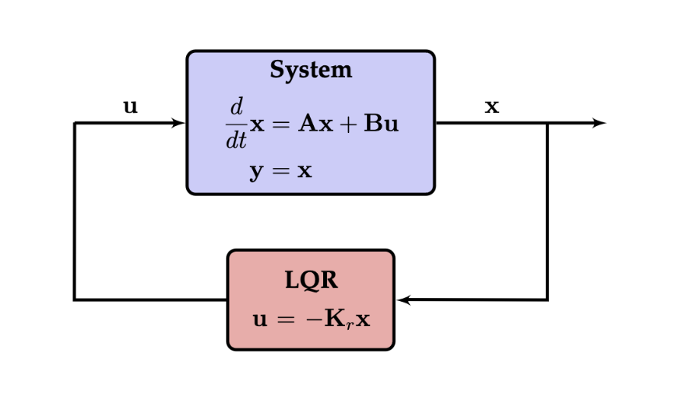
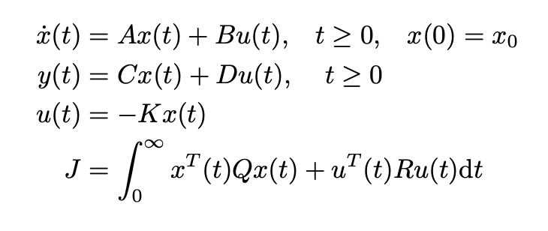
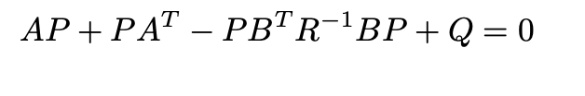

Linear Quadratic Regulator
Notes:
The next step in the design process is to find the vector of state-feedback control gains K, assuming that we have access (i.e., can measure) to all four state variables.
LQR is a widely used control method in optimal control problems.
A conventional LQR problem is to find the Q and R matrix, which minimizes the cost function (performance index) based on the input “u”.
Given the A and B matrices of a plant, designing a LQR controller consists of the following steps:
Initialise state weighting matrix Q and control force weighting matrix R.
Solve the algebraic riccati equation, given in (8) to obtain Riccati coefficient P
Compute control input gain K .
Compute optimal control action by u(t) = −Kx(t)
Obtain the quadratic performance index J as in (17)
Q = 2 x 2
R = 2 x 2
The lqr command in matlab returns the optimal control gain.

Slide 7
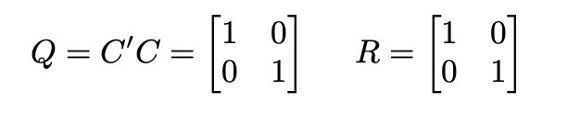
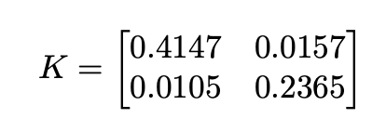
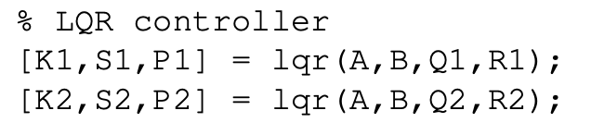
Linear Quadratic Regulator
Notes:
The next step in the design process is to find the vector of state-feedback control gains K, assuming that we have access (i.e., can measure) to all four state variables.
LQR is a widely used control method in optimal control problems.
A conventional LQR problem is to find the Q and R matrix, which minimizes the cost function (performance index) based on the input “u”.
Q = 2 x 2
R = 2 x 2
The lqr command in matlab returns the optimal control gain.

Slide 8
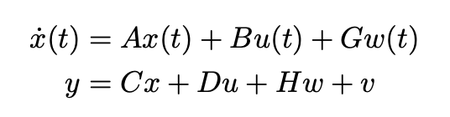
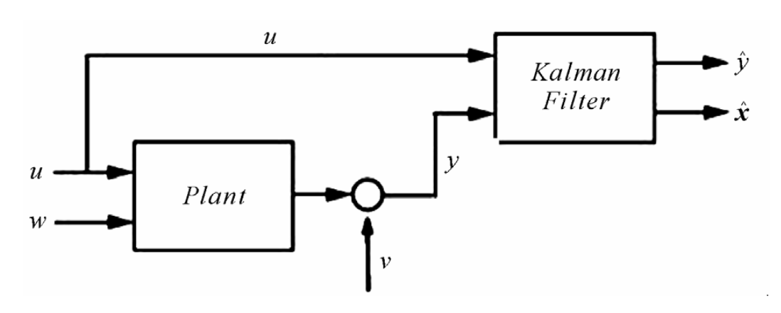


Linear Quadratic Estimator (Kalman)
MATLAB
% Calculate the observability matrix
O = obsv(A, C);
% Check the rank of the observability matrix
if rank(O) == size(A,1)
disp('System is observable');
else
disp('System is not observable’);
end
Output: System is Observable
Notes:
$x(t)$ is the state vector of the system, which represents the internal state of the system at time $t$.
$\dot{x}(t)$ is the time derivative of the state vector, which represents how the internal state of the system is changing over time.
$u(t)$ is the input vector, which represents the external input to the system at time $t$.
$w(t)$ is the disturbance vector, which represents any external disturbances acting on the system at time $t$.
$y$ is the output vector, which represents the measured or observed output of the system.
$A$, $B$, $C$, and $D$ are matrices that define the dynamics of the system.
A is the system matrix, which describes how the state of the system evolves over time in the absence of inputs and disturbances.
B is the input matrix, which describes how the inputs affect the state of the system.
C is the output matrix, which describes how the state of the system maps to the output.
D is the feedforward matrix, which describes how the inputs directly affect the output.
$G$, $H$, and $v$ are matrices that describe how the disturbances affect the system.
G is the disturbance input matrix, which describes how the disturbances affect the state of the system.
H is the disturbance output matrix, which describes how the disturbances affect the output of the system.
v is the measurement noise vector, which represents any measurement noise that affects the output.
(A,C) are observable if we want to design a full state estimation.
The Kalman filter is the most commonly used full-state estimator, as it optimally balances the competing effects of measurement noise, distur- bances.
The Kalman filter estimates the state vector based on the measurements and the dynamic model in continuous time. The filter has two stages: the prediction stage and the update stage.
In the prediction stage, the filter predicts the state vector at any time t based on the previous estimate and the dynamic model
In the update stage, the filter updates the predicted state estimate based on the new measurement:
L is the Kalman gain

Slide 9
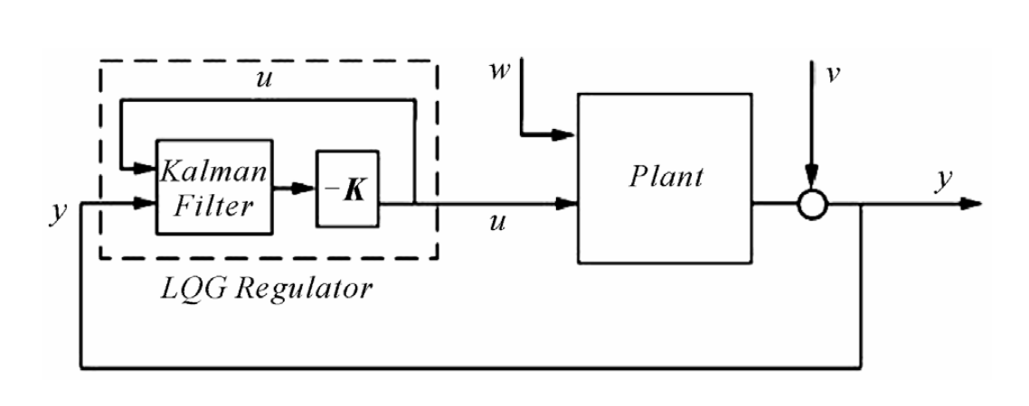
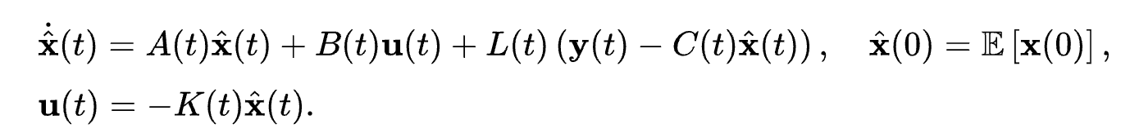
Linear Quadratic Gaussian control (LQG)
Notes:
The LQG controller, is unique combination of a Kalman filter (a linear–quadratic state estimator (LQE)) together with a linear–quadratic regulator (LQR).
The separation principle states that the state estimator and the state feedback can be designed independently.
The LQG controller that solves the LQG control problem is specified by the following equations:
The matrix L is called the Kalman gain of the associated Kalman filter represented by the first equation. At each time this filter generates estimates x(hat) of the state x(t) using the past measurements and inputs.
The Kalman gain L is computed from the matrices

Slide 10
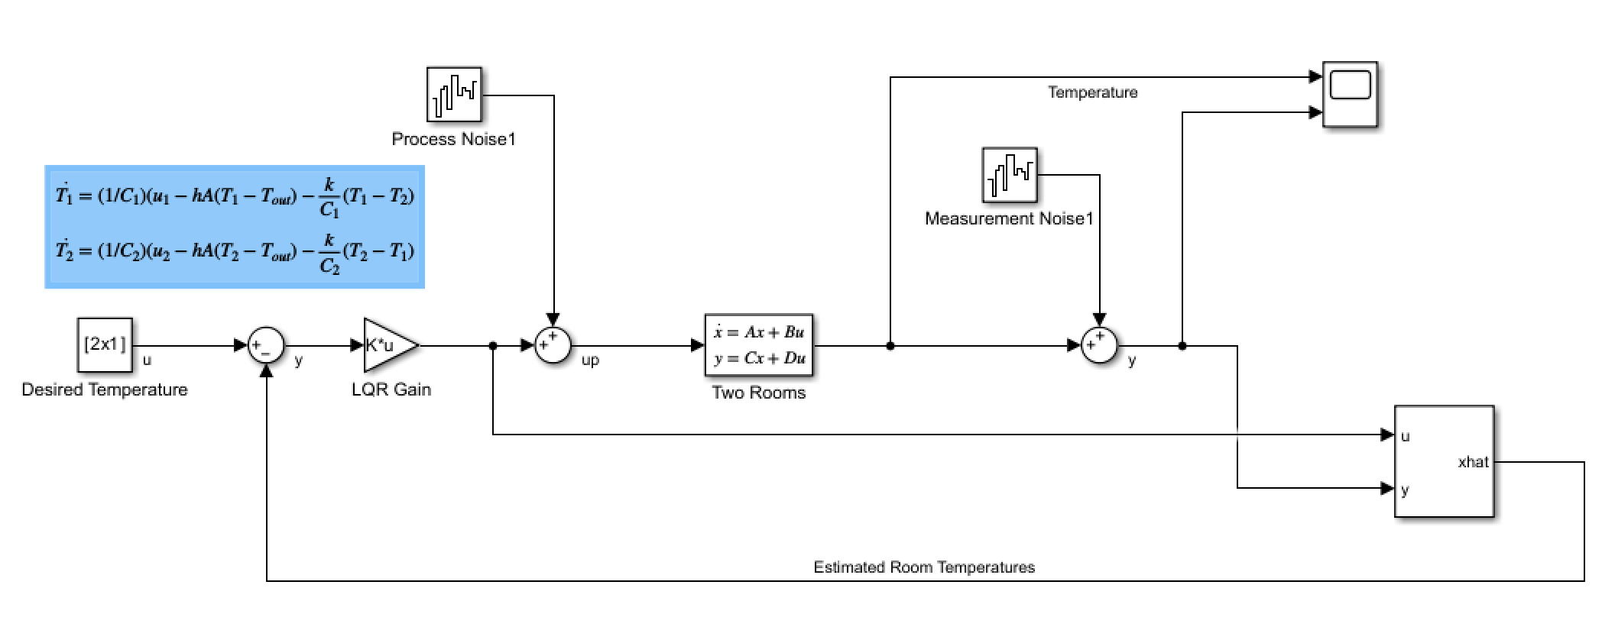
SIMULATIONS
Notes:
Simulink Diagram

Slide 11
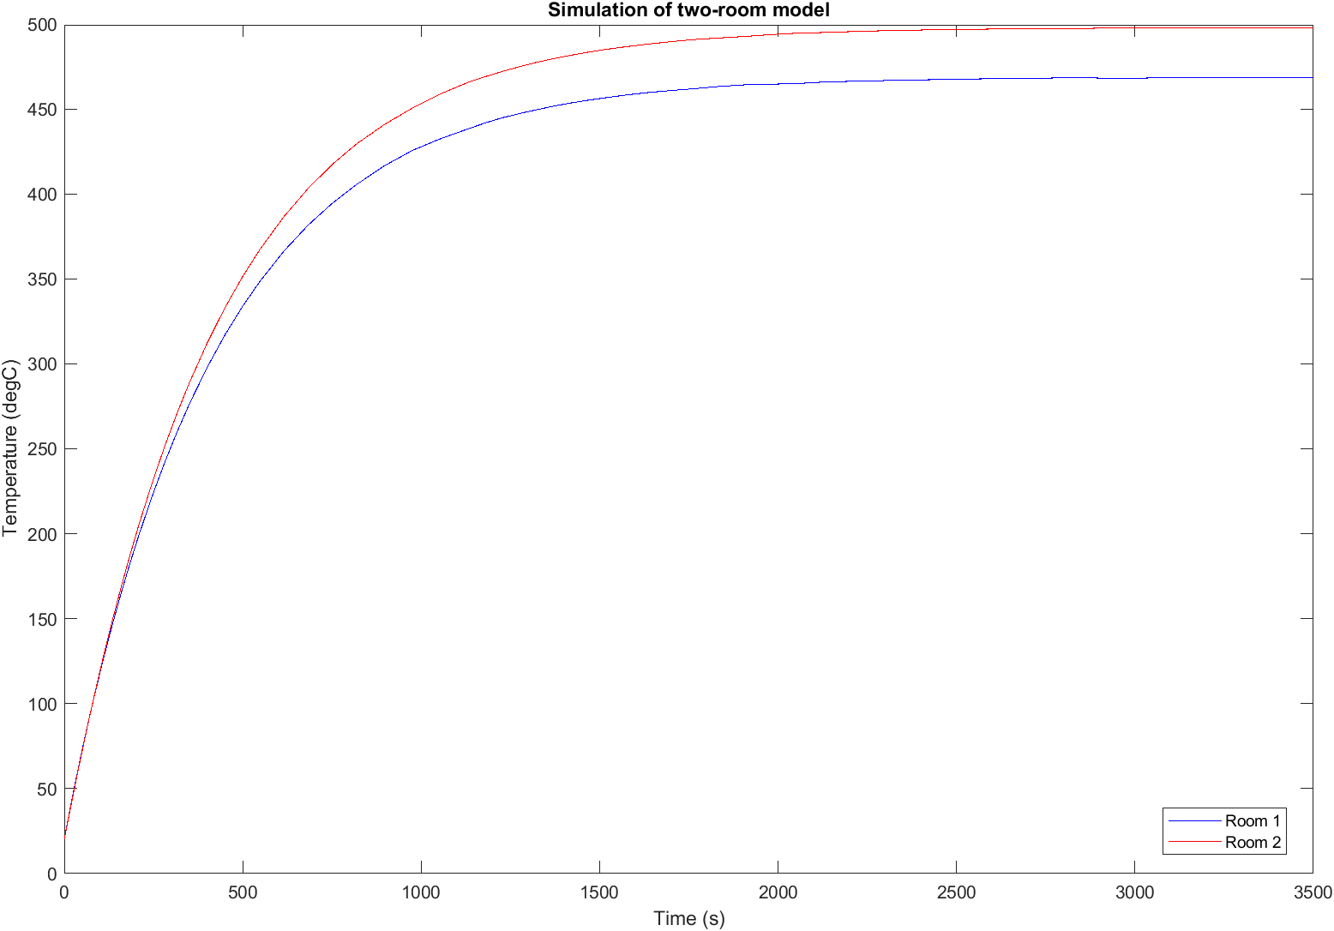
SIMULATIONS
Notes:
Figure 4 shows the simulation results of a two- room model, where the temperature of each room is plotted against time. The blue line represents the temperature of room 1, while the red line represents the temperature of room 2. Initially, both rooms start at 20 degrees Celsius, with a heat input of 100W and 150W to room 1 and room 2, respectively. As time progresses, the temperature of both rooms increases due to the heat input.
Around 2000 seconds, the temperature of room 1 starts to stabilize at around 24 degrees Celsius, while the temperature of room 2 continues to increase. This behavior is due to the difference in the two rooms’ heat capacity and surface area. At around 3000 seconds, the temperature of room 2 also starts to stabilize at around 28 degrees Celsius, and the system reaches a steady state.

Slide 12
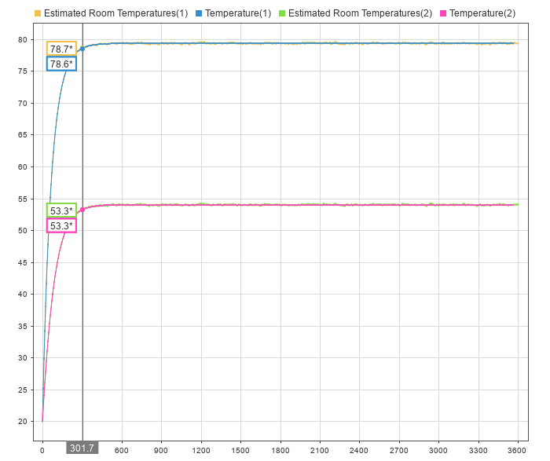
SIMULATIONS
Notes:
The LQG controller was able to maintain the temperature of both rooms within an acceptable range despite disturbances and noise in the system. Initially, both rooms start at 20 degrees Celsius, with a heat input of 100W and 150W to room 1 and room 2, respectively. As time progresses, the temperature of both rooms increases due to the heat input, but the LQG controller is able to maintain the temperature difference between the two rooms within a narrow range. Around 301.7 seconds, the temperature of room 1 stabilizes at around 53.3 degrees Celsius, while the temperature of room 2 continues to increase. However, the LQG controller is able to quickly detect this temperature difference and adjust the heat input to room 2, bringing the temperature back within the acceptable range. At around 500 seconds, the temperature of room 2 also stabilizes at around 78.6 degrees Celsius, and the system reaches a steady state.

Slide 13
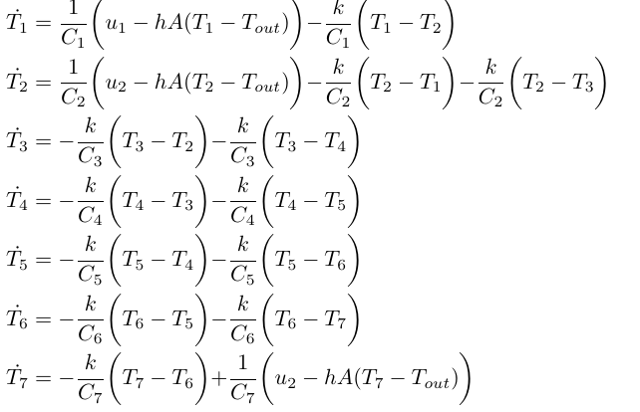
FUTURE WORK
Directions
Seven Rooms
Make the ambient temperature non-constant
Design an optimal control for 7 rooms with two inputs
Design this to include non-linearity
Design a nonlinear controller for (2)

Slide 14
Reference
[1] Paridari, K., O’Mahony, N., Mady, A. E. D., Chabukswar, R., Boubekeur, M., & Sandberg, H. (2017). A framework for attack-resilient industrial control systems: Attack detection and controller reconfiguration. Proceedings of the IEEE, 106(1), 113-128.

Slide 15
Future Work
Notes:
evaluate the framework under more realistic attack scenarios and to investigate ways to optimize the trade-off between detection performance and system resilience.
Additionally, the development of algorithms for automatically selecting a subset of measurements to be protected will be an important area of future work.

