Slide 1

Dialogue Systems 1
Final Project
Andreas Johansson

Slide 2

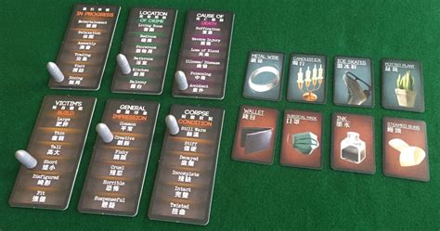
The game
User is a detective
Loosely adapts/implements the social board game Deception

Slide 3
Implementation
Xstate, Azure
Need for relatively extensive NLU
Much use of base Javascript architecture that is used by Xstate

Slide 4
Challenges
Xstate
Xstate-Javascript interface/interaction
NLU*

Slide 5
Relation to course contents
Base Javascript
Dialogue management (theory)
Dialogue management (Xstate)
NLU
State machine implementation seems appropriate, but…

Slide 6
Development process and ethical concerns
Documentation
Googling
Some peer interaction
→ implementation
Implementation of another IP

Slide 7

Future work
Integrate all the half-finished puzzle pieces to one app
Expand the size of the “content”

Slide 8
Image references
Top image slide 2:
Charlene at Hexagamers.com
url: https://hexagamers.com/deception-murder-hong-kong
Bottom image slide 2, image slide 3:
theboardgamefamily.com
url: https://www.theboardgamefamily.com/2016/09/deception-murder-in- hong-kong-board-game-review/

