Slide 1
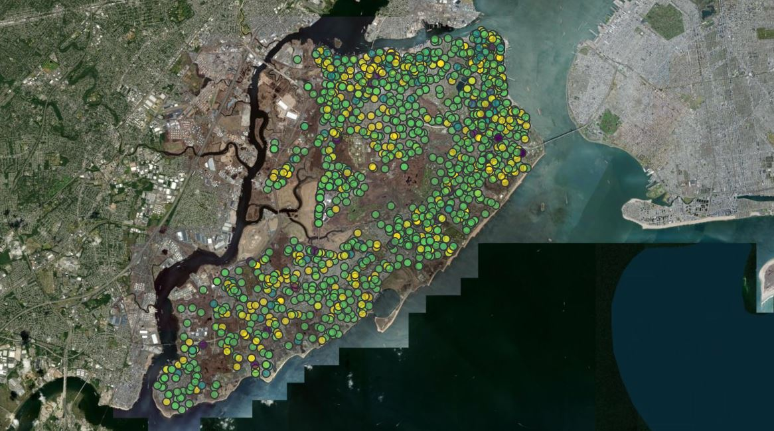
Environmental Site Characterization: 2018 Staten Island Felonies
Andrea Elhajj

Slide 2


Slide 3
FELONY
Major crime punishable by imprisonment of 1 year or longer or death.
Murder
Burglary
Arson
MISDEMEANOR
Less serious crime with a less severe penalty, such as a fine or a brief imprisonment of < 1 year.
Petty Theft
Public Intoxication
Disorderly Conduct

Slide 4
# Bring in crime data.
TheData <- read_csv("NYPD_Complaint_Data_Current__Year_To_Date_.csv")
# Select columns of interest and restrict data to crimes in 2018 on Staten Island
TheData <- TheData %>%
filter(str_detect(CMPLNT_FR_DT, "2018"), BORO_NM == "STATEN ISLAND", LAW_CAT_CD == "FELONY",
OFNS_DESC == "NYS LAWS-UNCLASSIFIED FELONY" | OFNS_DESC == "HOMICIDE-NEGLIGENT,UNCLASSIFIE" |
OFNS_DESC == "KIDNAPPING & RELATED OFFENSES" | OFNS_DESC == "KIDNAPPING" | OFNS_DESC == "DANGEROUS WEAPONS" | OFNS_DESC == "GRAND LARCENY" | OFNS_DESC == "GRAND LARCENY OF MOTOR VEHICLE" | OFNS_DESC == "CRIMINAL MISCHIEF & RELATED OF") %>%
dplyr::select(KY_CD, OFNS_DESC, Latitude, Longitude)
# Remove any rows with missing coordinates:
TheData <- na.omit(TheData)
#Create "Severity Column," containing a numeric value corresponding to the severity of the crime:
TheData$Severity <- revalue(TheData$OFNS_DESC, c("NYS LAWS-UNCLASSIFIED FELONY" = 1, "HOMICIDE-NEGLIGENT,UNCLASSIFIE" = 1,
"KIDNAPPING & RELATED OFFENSES" = 2, "KIDNAPPING" = 2,
"DANGEROUS WEAPONS" = 3, "GRAND LARCENY" = 4,
"GRAND LARCENY OF MOTOR VEHICLE" = 4, "CRIMINAL MISCHIEF & RELATED OF" = 5))

Slide 5
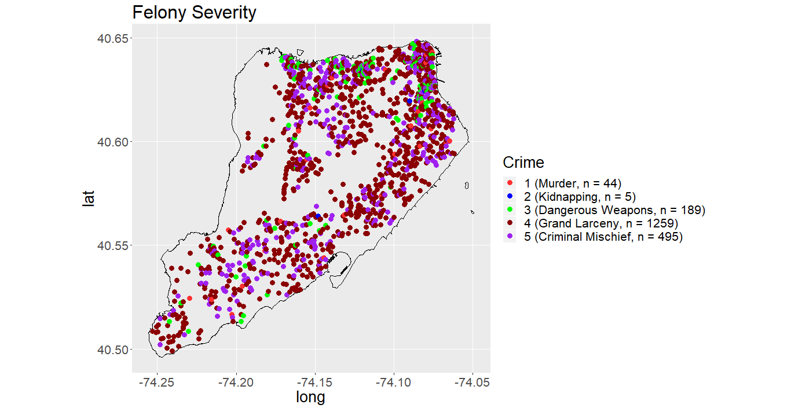

Slide 6







gender?
race?
Is suspect age correlated to the type of felony committed?

Slide 7
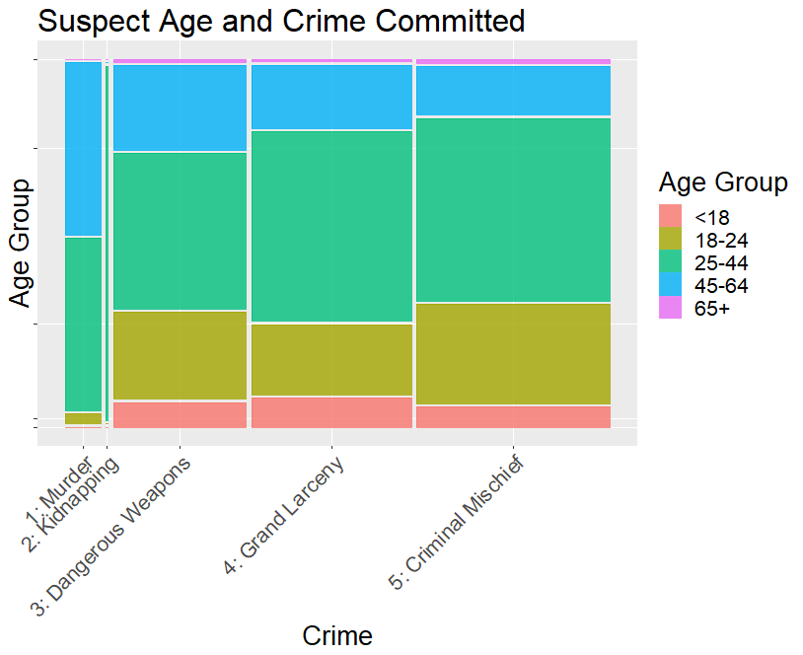
Pearson's Chi-squared test
Null Hypothesis: Suspect age group is independent of type of crime committed.
𝛘²= 40.79
p-value = 0.003964 < 0.05,
Reject the null

Slide 8
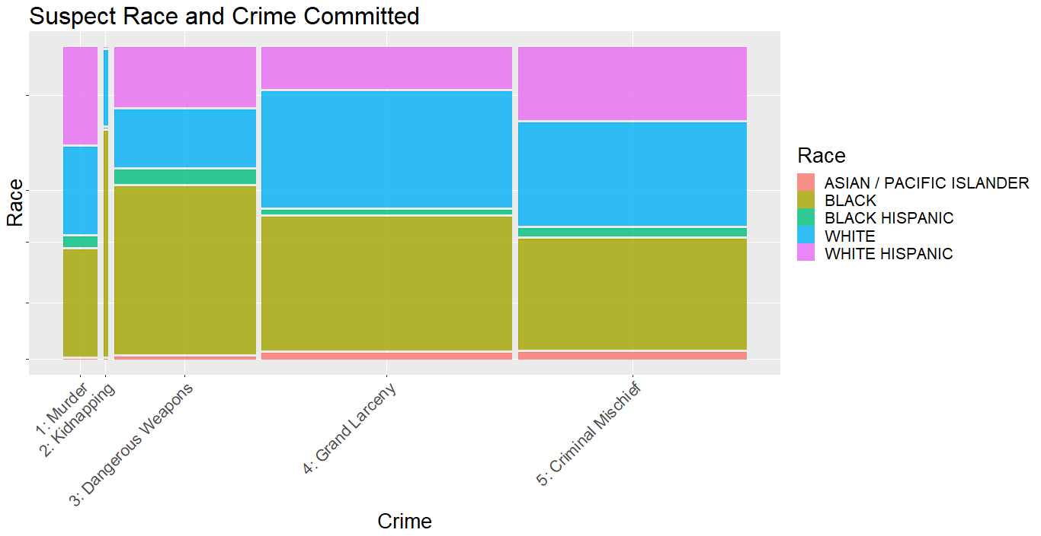
Pearson's Chi-squared test
Null Hypothesis: Suspect race is independent of type of crime committed.
𝛘² = 36.482, p-value = 0.01349 < 0.05, Reject the null

Slide 9
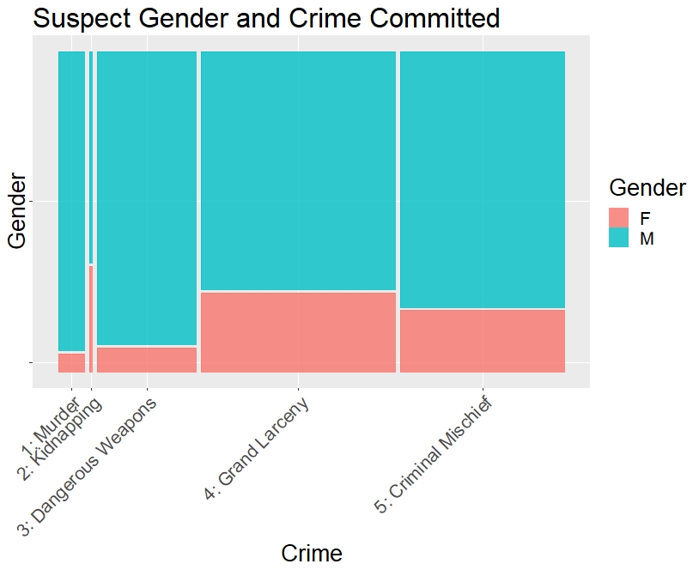
Pearson's Chi-squared test
Null Hypothesis: Suspect gender is independent of type of crime committed.
𝛘² = 31.7
p-value = 6.813e-06 < 0.05
Reject the null

Slide 10

Does the data exhibit spatial structure?

Slide 11
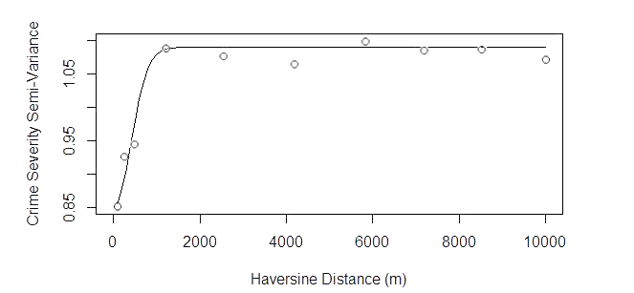
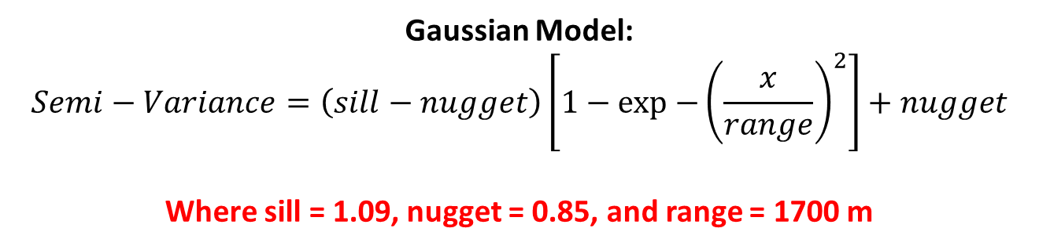
Gaussian Model:
$$Semi−Variance=\left(sill−nugget\right)\left[1−exp−{{\left(\frac{x}{range}\right)}^{2}}\right]+nugget$$
Where sill = 1.09, nugget = 0.85, and range = 1700 m

Slide 12
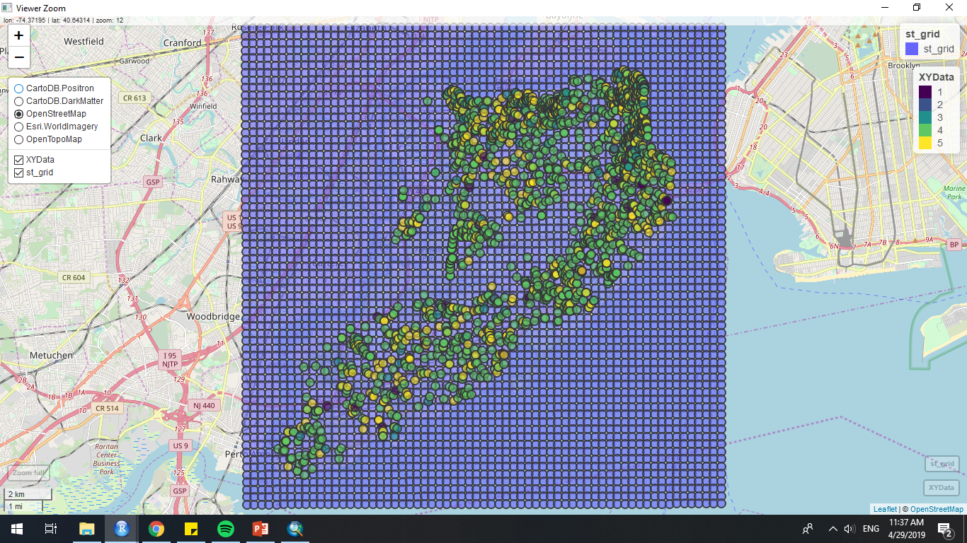

Slide 13
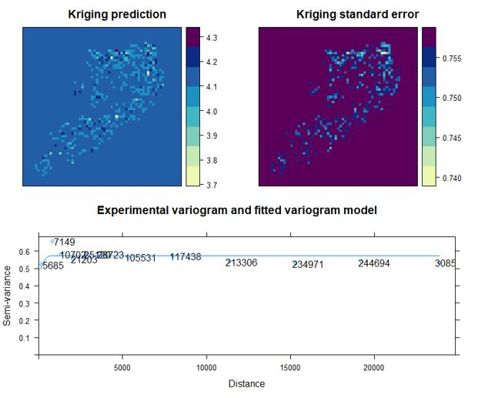

Slide 14
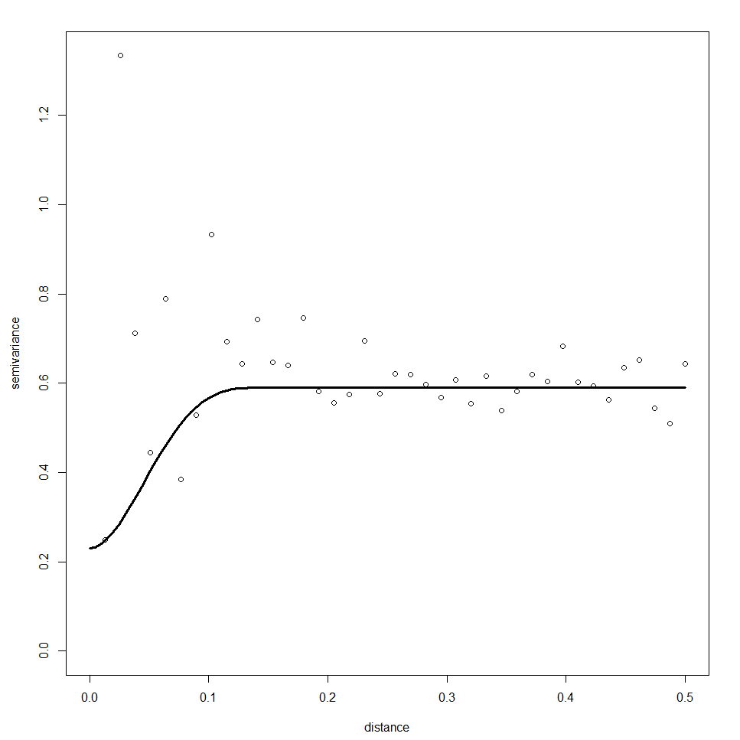
(km)

Slide 15
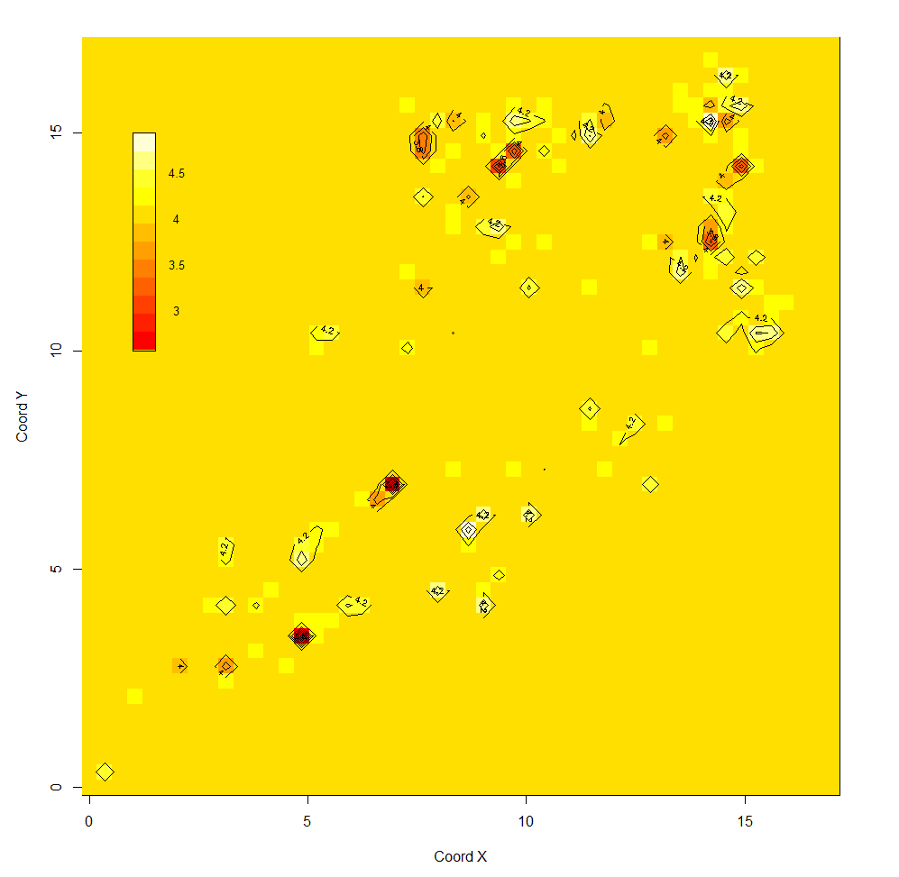
(km)
(km)

Slide 16
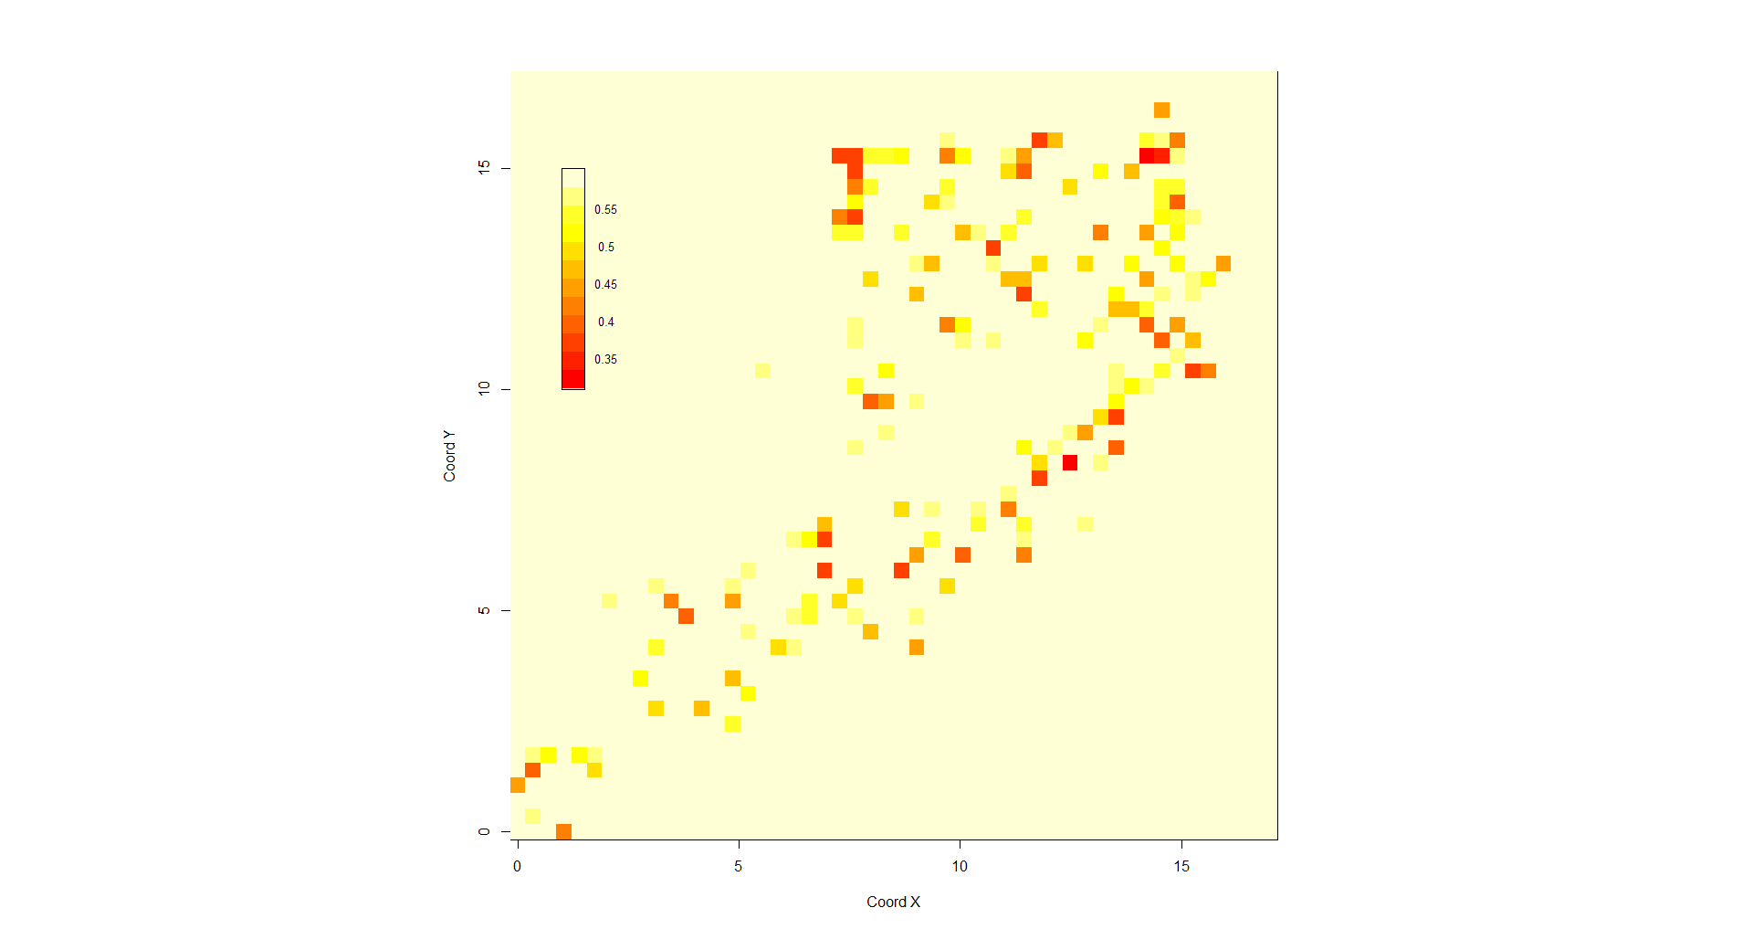
(km)
(km)

Slide 17
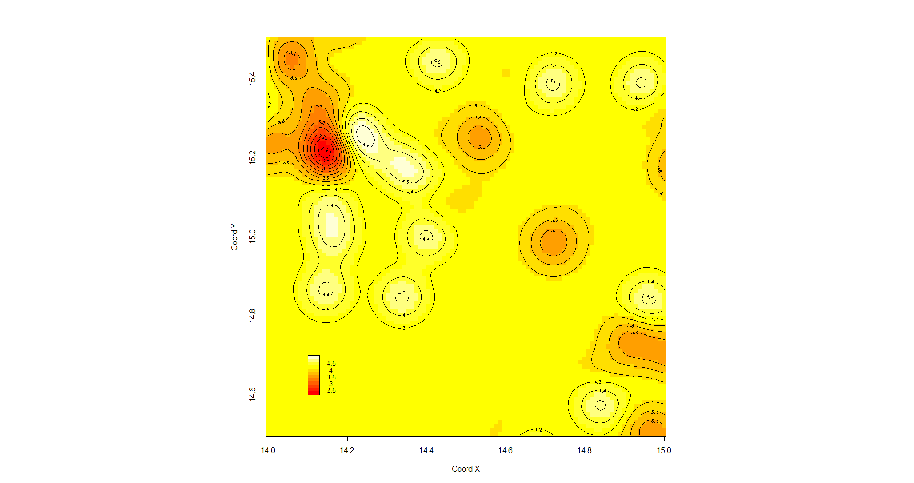
(km)
(km)

Slide 18
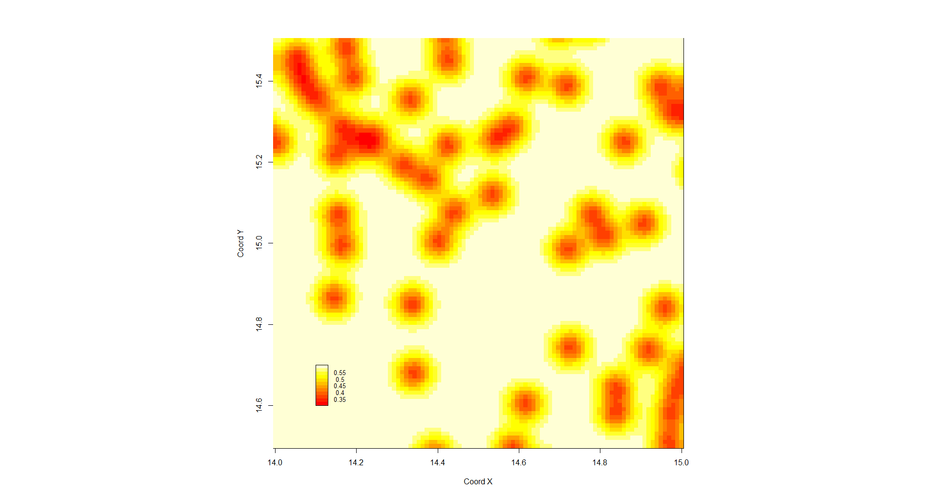
(km)
(km)

