Slide 1
Design and Development of Embedded System and GUI for Pulsating Sensor Based Instrumentation
Jency Rufina A (23BEL1037)
Vellore Institute of Technology, Chennai

Slide 2
CONTENTS
Introduction
Internship Objectives
Embedded System Design
GUI Design
Summary

Slide 3
INTRODUCTION
Internship at IGCAR: The Electronics and Instrumentation Group develops sensors and systems for fast breeder reactors.
The Need: Many sensors output TTL pulses where frequency corresponds to a physical parameter (e.g., pH, turbidity, level). There was a need to develop instrumentation to read, process, and display this data effectively.
Project Goal: To utilize modern, cost-effective, open-source tools (Arduino, Python) for robust instrumentation development.

Slide 4
Project Objectives
Design a 4-Channel Frequency Meter: Develop an embedded system to simultaneously measure frequencies from four different pulsating sensors.
Develop a Spirometer: Create an embedded system for a spirometer to measure key pulmonary diagnostic parameters.
Create Graphical User Interfaces (GUIs): Build user-friendly desktop applications using Python (PyQt5) to interface with both embedded systems for:
1. Real-time data visualization and plotting.
2. Statistical analysis.
3. Data logging and exporting.

Slide 5
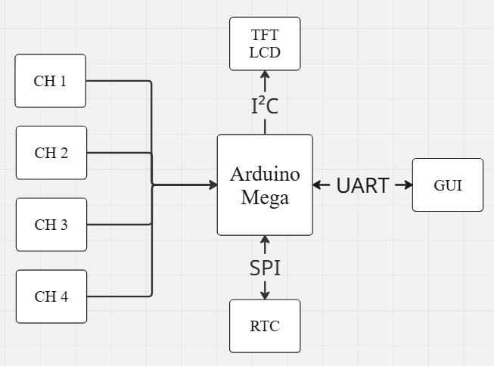
Project 1: 4 channel frequency meter – system architecture
Goal: To create an instrument that reads TTL pulse frequencies from four sensors, displays them locally, and sends data to a PC for advanced analysis.
Components:
Inputs: 4 Channels for TTL Pulse Signals
Processing: Arduino Mega 2560
Peripherals: DS3231 RTC, TFT LCD Shield,
Micro SD Card
Communication: UART to PC
PC Application: PyQt5 GUI

Slide 6
Project 1: Embedded System Design
Microcontroller: Arduino Mega 2560 (16MHz clock).
Frequency Measurement: Utilized four of the 16-bit hardware timers (Timer1, Timer3, Timer4, Timer5) for precise, non-blocking frequency counting. This approach is more accurate and efficient than software-based methods.
Communication Protocols:
I2C: For interfacing with the DS3231 Real-Time Clock.
Parallel (8-bit): For driving the TFT LCD Display.
UART: For sending processed data to the GUI on the PC.

Slide 7
Project 1: GUI for Sensor Monitoring
Framework: Python with PyQt5.
Key Features:
  UART Port Configuration: Easy selection of COM port and baud rate.
  Live Plotting: A "Full Plot" showing all four channels simultaneously and individual "Moving Plots" for a clear view of recent data.
  Parameter Conversion: A user-defined polynomial (Af³+ Bf²+ Cf + D) to convert raw frequency into a meaningful physical parameter.
  Statistical Analysis: On-demand calculation of Mean, Min, Max, Standard Deviation, Skewness, and Kurtosis.
  Data Export: Save time-stamped data and statistics to an Excel file.

Slide 8
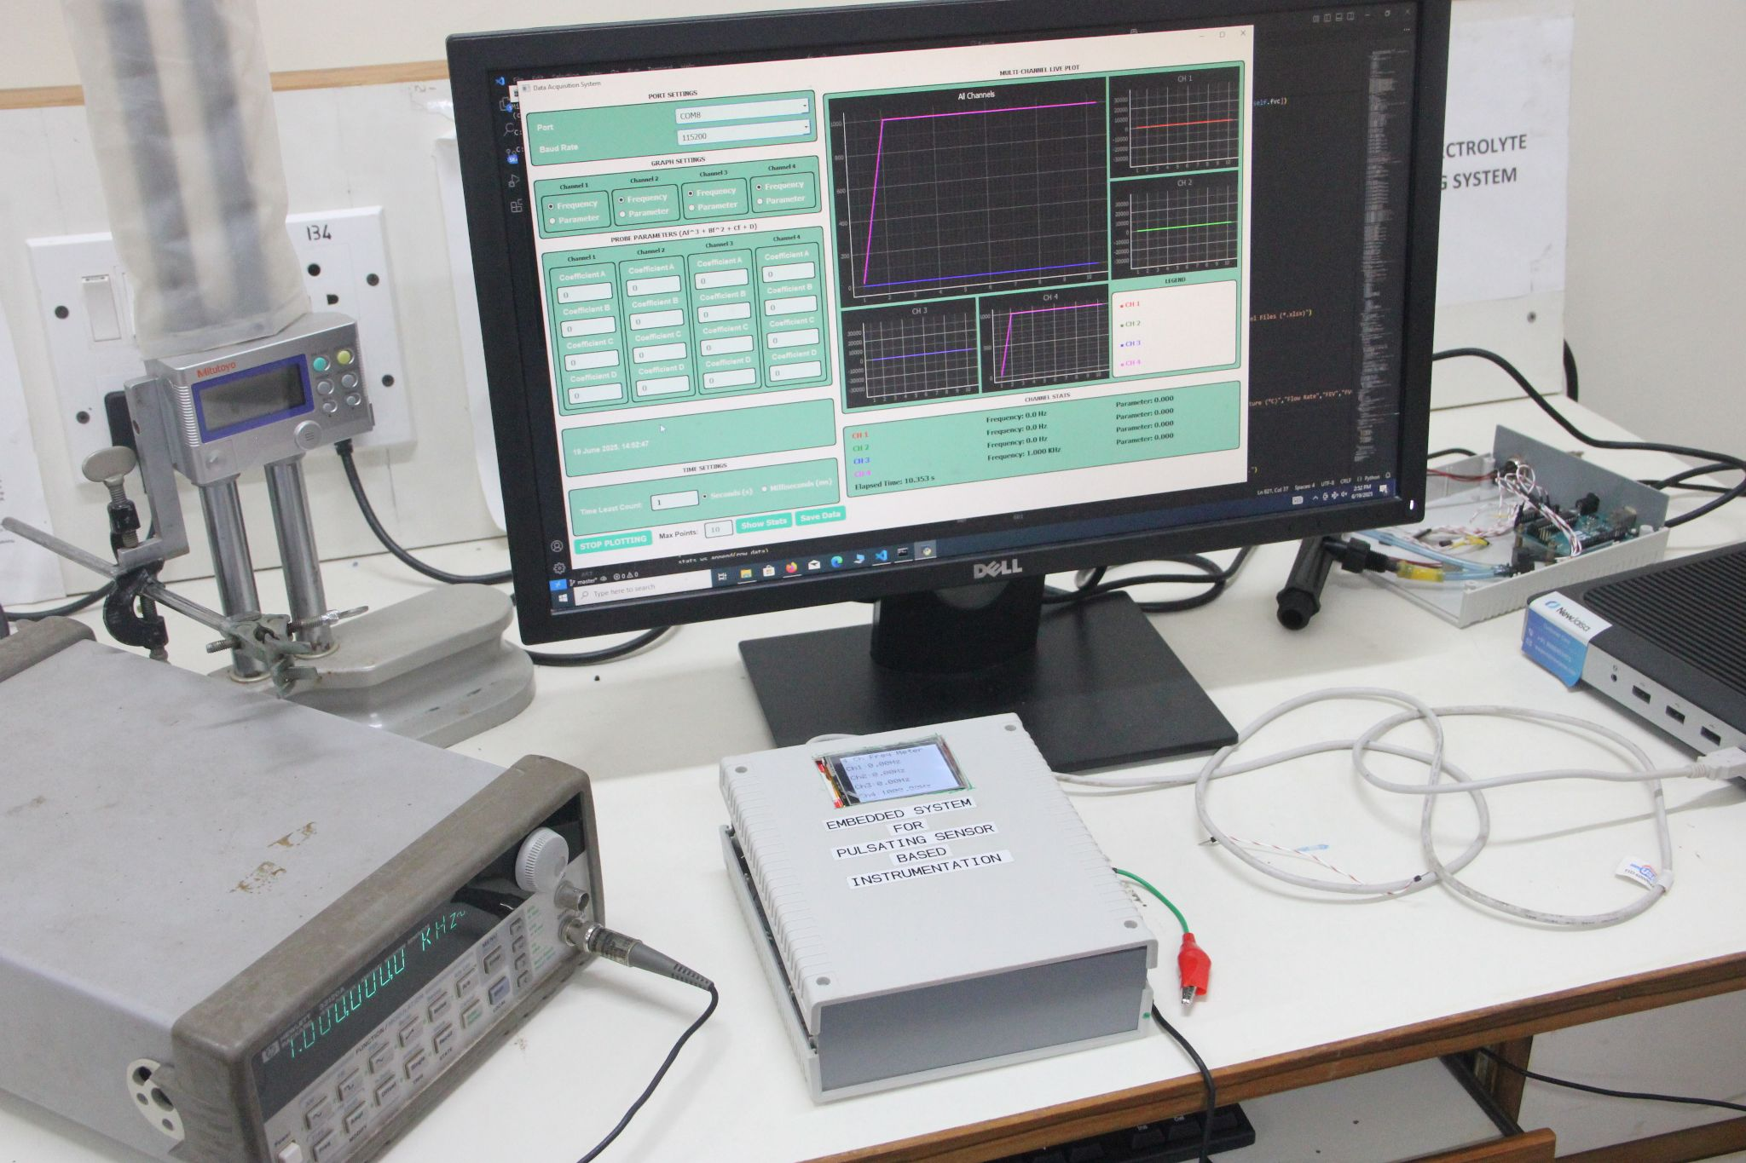
Project 1: Results & Demonstration

Slide 9
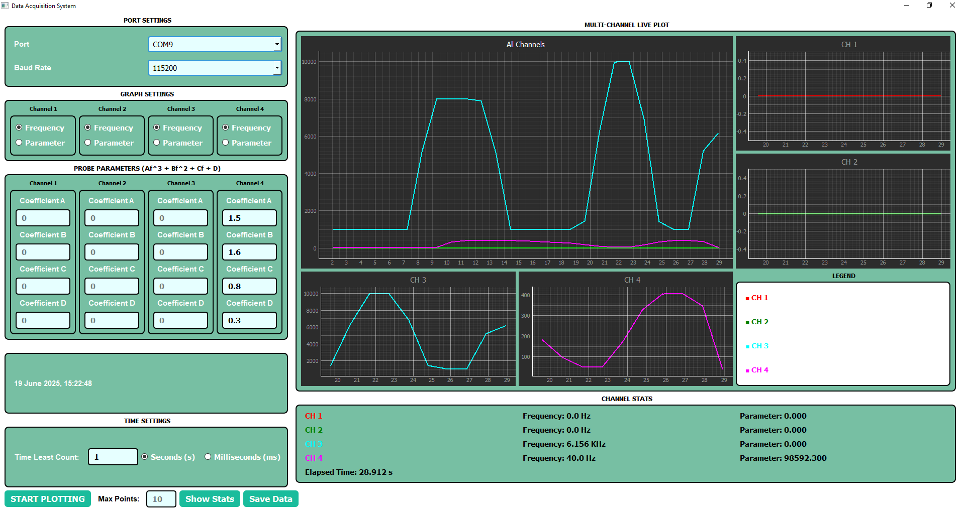

Slide 10
Project 2: Spirometer for Pulmonary Diagnostics
What is a Spirometer?
A medical device that measures lung function. It's crucial for diagnosing conditions like Asthma and COPD.
Key Parameters Measured:
  FVC (Forced Vital Capacity): Total air exhaled forcefully.
  FEV1 (Forced Expiratory Volume in 1 sec): Air exhaled in the first second.
  FEV1/FVC Ratio: The primary indicator to distinguish between obstructive and restrictive lung diseases.
    Less than 0.7 – Airflow Obstruction : Chronic Obstructive Pulmonary Disorder (COPD)

Slide 11
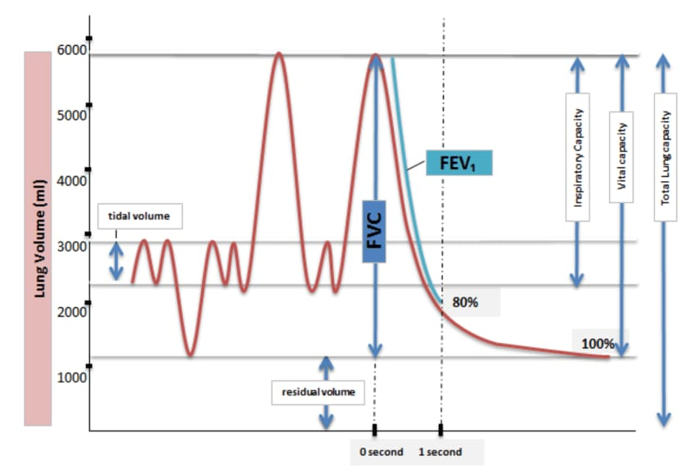
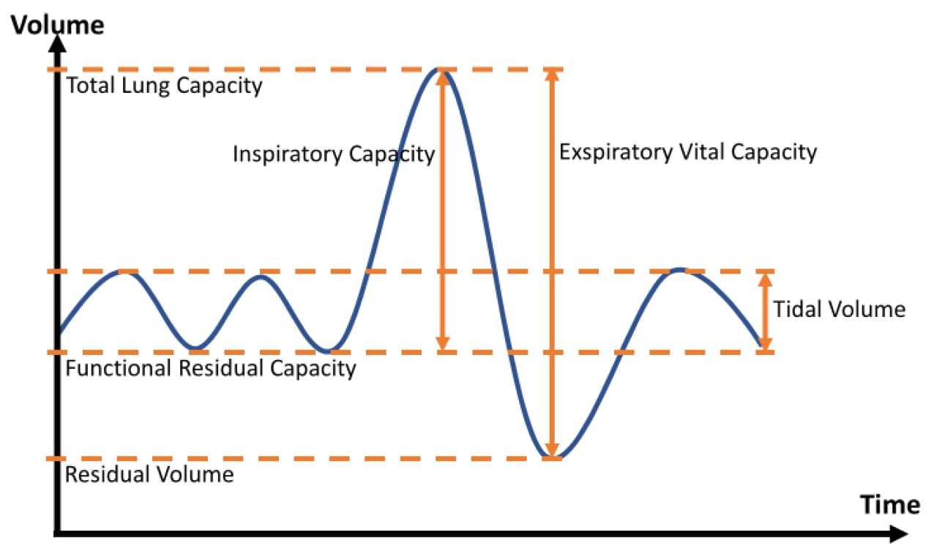

Slide 12
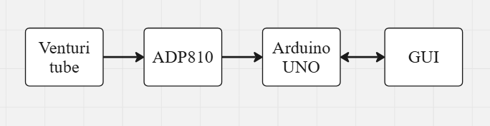
Project 2: Spirometer - System Design
Working Principle: Based on Bernoulli's principle.
  User exhales through a Venturi Tube.
  This creates a pressure difference.
  An ADP810 differential pressure sensor measures this difference.
  The Arduino UNO reads the pressure data via I2C and sends it to the PC via UART.
  The GUI calculates flow rate, volume, and other diagnostic parameters.
Data Integrity: A CRC-8 algorithm was implemented on the Arduino to ensure data from the sensor was not corrupted

Slide 13
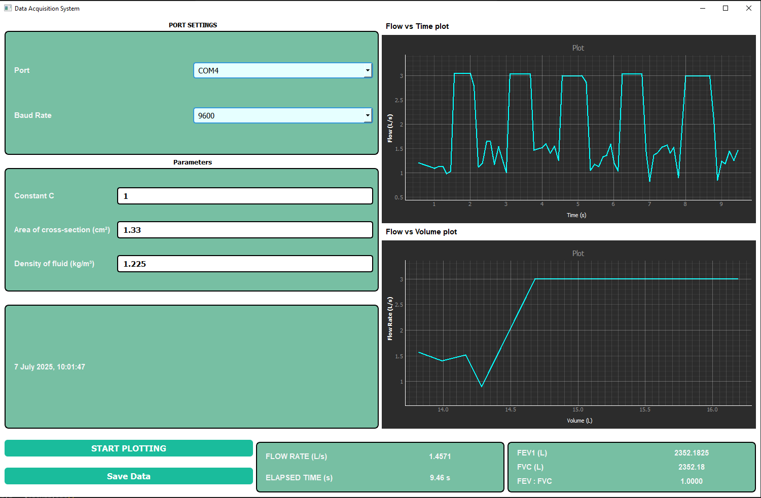
Project 2: Spirometer GUI & Results
Framework: Python with PyQt5.
Key Features:
  Real-time Visualization: Flow vs. Time Plot and the standard diagnostic Flow vs. Volume loop.
  Parameter Calculation: Displays calculated FEV1, FVC, and the FEV1/FVC Ratio.
  Data Export: Saves the session data to an Excel file for records.

Slide 14
Conclusion & Learnings
Successfully Developed: Two complete, functional instrumentation systems combining embedded hardware and PC-based software.
Demonstrated: The effectiveness of open-source tools (Arduino, Python) for rapid and cost-effective development in scientific and medical applications.
Key Learnings:
  Embedded C programming for Arduino and hardware timer configuration.
  Interfacing with peripherals using UART, I2C, and Parallel protocols.
  GUI development with Python and PyQt5.
  End-to-end system integration from sensor to user interface.

Slide 15
Acknowledgements
I would like to express my sincere gratitude to:
Dr. Ramesh Sanga for his invaluable guidance, mentorship, and technical insight.
Shri M. Sivaramakrishna, Head, SISD/EIG, for his support and encouragement.
Indira Gandhi Centre for Atomic Research (IGCAR) for providing this incredible internship opportunity.
Vellore Institute of Technology (VIT), Chennai for laying the academic foundation that made this project possible.

Slide 16
THANK YOU
Jency Rufina A
23BEL1037
ajencyrufina@gmail.com

