Slide 1


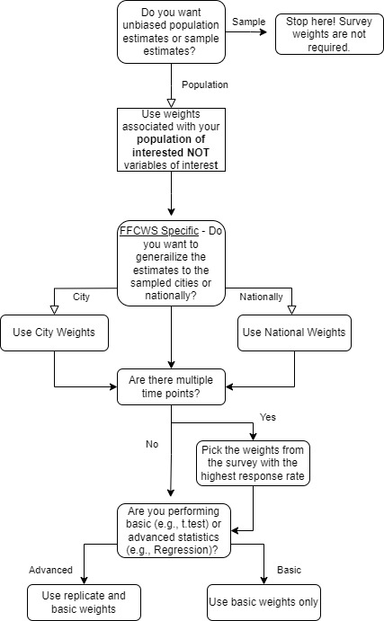
A Methodology Template for Constructing Variables and Applying Survey Weights in Complex Survey Design Studies Using R
Andrew Jergel, MPH¹; Scott Gillespie, MS, MPH¹; Lilian Zapata, MD²; Kiesha Fraser Doh, MD^{3,4}
¹Pediatric Biostatistics Core, Department of Pediatrics, Emory University, Atlanta, GA, USA.; ²Emory University School of Medicine, Atlanta, GA, USA.; ³Department of Pediatrics, Emory University School of Medicine, Atlanta, GA, USA.; ⁴Children's Healthcare of Atlanta, Atlanta, GA, USA.
Background
Methods – Survey Weighting
Variable Selection and Construction
Purpose: Literature and general information relating to complex survey design (CSD) studies are not readily available. The purpose of this is to provide investigators and statisticians with a starting place in working with these databases.
Study Aim: assess the relationship between Healthcare Utilization (HU), Adverse Childhood Experience (ACE) scores, and Gun Violence Exposure (GVE) in Adolescents
Database: The Future of Families and Child Wellbeing Study (FFCWS) database
FFCWS Quick Facts
Complex longitudinal survey design
Follows 4,898 teens and their families
Data currently available for 6 different time points in the focal child’s life (Birth and ages 1, 3, 5, 9, 15)
The focal child, both parents (if applicable), primary caregiver, and teachers are surveyed but not at every time point
National and City Survey Weights for each survey and years are available
Provide data for GVE from the Gun Violence Archive
Overview of Tools and Methods Used:
R Studio
Essential R Packages: survey and gtsummary
Essential Functions: svydesign(), tbl_svysummary() and svyby()
Statistics: Means with standard deviations (SD), counts with percentages, and 95% Confidence Intervals.
Selecting and constructing variables in CSD studies is the same as any other study. The difference is you might be using variables across multiple survey types and time points.
It is OKAY to select variables across multiple survey types and time points if it fits your research question.
It is OKAY to construct variables using variables obtained from multiple survey types and time points.
Results
Final Dataset
7 final variables constructed from 200+ variables across nine surveys from parents and focal teen from birth, year 5, 9, and 15.
Survey Object
The “dataset” is converted to a “survey object” using the svydesign() function in the survey package. Use svyrepdesign() with replicate weights
Analysis
Survey weighted summary and inferential statistics like means (SD) and n (%) can be produced using tbl_svysummary() from gtsummary package
However, if replicate weights were used other functions like svyby() from survey package would need to be used
Used basic national-level survey weights for teens in year 9
No subjects are removed yet.
Subjects who should be excluded are done so in this step using the subset() function as the survey object will adjust survey weights appropriately
Tools Utilized and Methods
Additional Information

