Slide 1


Slide 2
Topics to discuss
Types of version control systems
What is git
What is Github, gitlab & git bash
Three main states of a Git
Recording Changes to the Repository
Checking the status of Your files
Git basic comands
Steps to get devops project into Git

Slide 3
version control systems
What is version control?
Version control is a system that records changes to a file or set of files.
version control System Types –
A) Centralized VCS (CVCS) -
With centralized version control systems, you have a single “central” copy of your project on a server and commit your changes to this central copy. You pull the files that you need, but you never have a full copy of your project locally.
(Ex) CVS, Subversion, Perforce
B) Distributed VCS (DVCS) -
With distributed version control systems, you don't rely on a central server to store all the versions of a project’s files. Instead, you clone a copy of a repository locally so that you have the full history of the project.
(Ex) Git, Mercurial, Mercurial, Bazaar

Slide 4
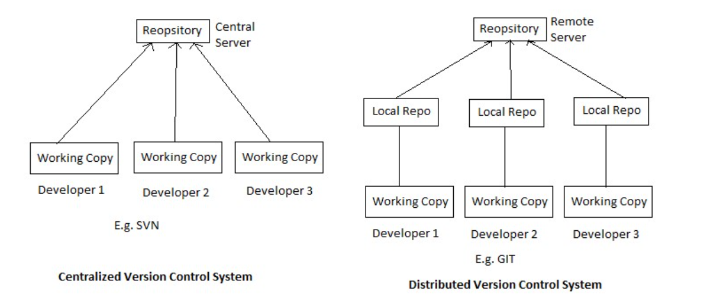
CVCS DVCS

Slide 5
What is git
Git is a DevOps tool used for source code management. It is a free and open-source version control system used to handle small to very large projects efficiently.
Git is used to tracking changes in the source code, enabling multiple developers to work together on non-linear development.
Linus Torvalds created Git in 2005 for the development of the Linux kernel.

Slide 6
What is Github, gitlab & git bash
GitHub is a Git repository hosting service, but it adds many of its own features. While Git is a command line tool, GitHub provides a Web-based graphical interface. It also provides access control and several collaboration features, such as a wikis and basic task management tools for every project.
What is difference between GitHub and GitLab?
GitLab is open-source for community edition. GitHub is not open source. It allows users to make public repository. It allows users to have unlimited free repository.
Git Bash is an application for Microsoft Windows environments which provides an emulation layer for a Git command line experience (CLI- Command line interface)

Slide 7
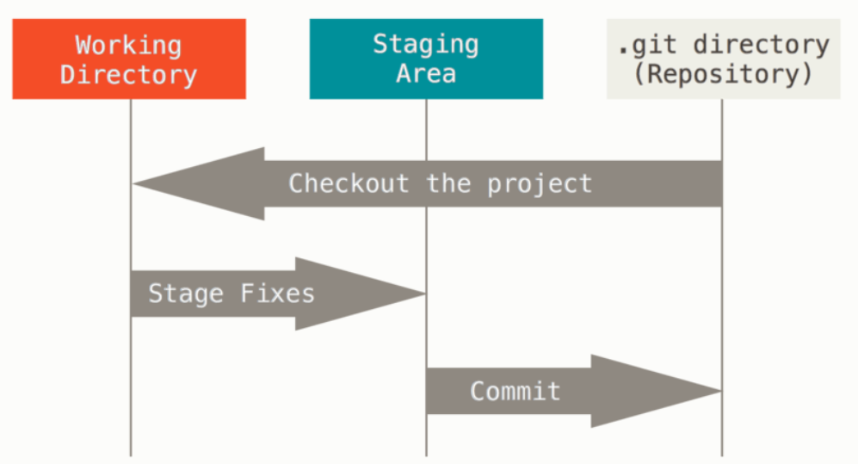
Three main states of a Git
Modified means that you have changed the file but have not committed it to your database yet.
Staged means that you have marked a modified file in its current version to go into your next commit snapshot.
Committed means that the data is safely stored in your local database.

Slide 8
Recording Changes to the Repository
Each file in your working directory can be in one of the following two states: Tracked or Untracked File
Checking the status of Your files
Command : git status
Untracked Files - Files in your working directory that are not present in your last snapshot and staging area.
Tracked Files - Files that are present in the last snapshot The following command is used to make the file status as trackable
Command : git add filename
3. Staging Modified Files – A File which is already tracked and has been modified in the working directory, but not yet staged.
4. Unstaging Modified Files - A File that is out of the staging area. The following command is used to make the file unstaged
Command : git reset HEAD filename

Slide 9
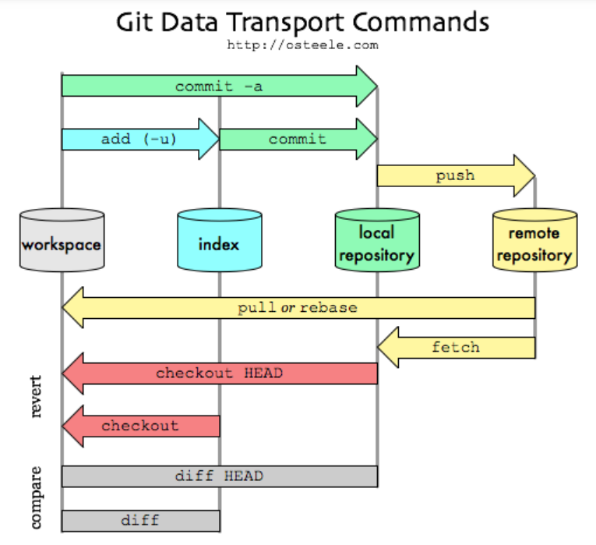

Slide 10
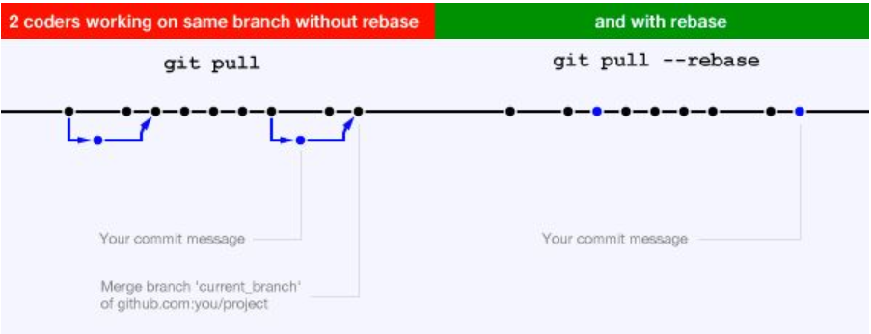
Git Data Transfer command
- git pull
- git pull = git fetch + git merge
- git pull --rebase

Slide 11
Contd…
To make the Staged file to a Unstaged file
Command : git reset HEAD filename
To make the Modified file to an unmodified file
Command : git checkout filename
To push our code to the remote server (actual git repository)
Command : git push origin branchname
To pull the code from the remote server (actual git repository)
Command : git pull
To get the newly created branches in our local repository
Command : git fetch

Slide 12
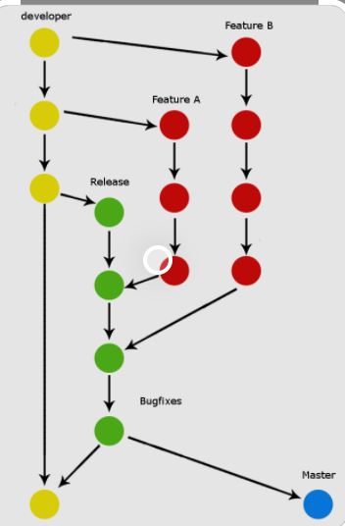
Branching and Merging
To create a branch in local repository
Command : git checkout –b branchname
To delete a branch in local repository
Command : git branch –d branchname
Merging brings two lines of development together while preserving the ancestry of each commit history.
Command : git merge branchname

Slide 13
Basic commond
To view the difference between staged and unstaged files
Command : git diff
Commiting Your Changes Command : git commit
To commit along with comments
Command : git commit –m “Comments”
To view the commit history
Command : git log
Removing Files To remove the file
Command : git rm filename
Create git repository
Command : git init

Slide 14
Questions ?
Refer this link for more details –
https://www.simplilearn.com/tutorials/git-tutorial/git-tutorial-for-beginner

