Slide 1

DEVOPS

Slide 2
Tools

Slide 3
Container Tools
Docker
LXC
AWS Fargate
AWS ECS

Slide 4
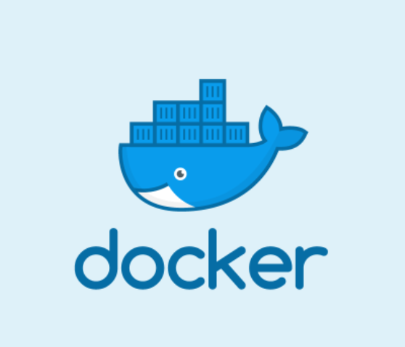
Container Tools
Docker

Slide 5
Container Orchestration Tools
Docker Swarm
Kubernetes
Mesos

Slide 6
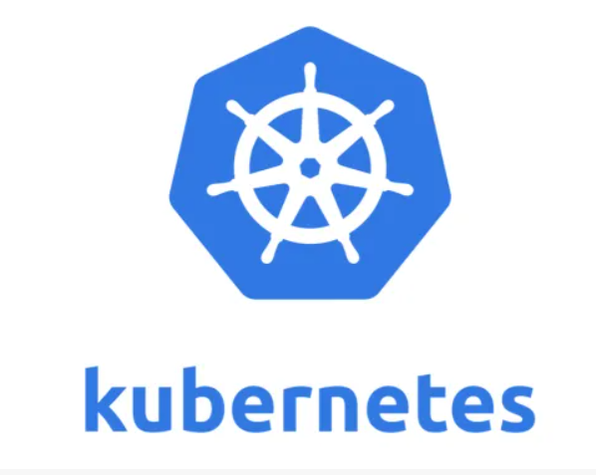
Container Orchestration Tools
Kubernetes

Slide 7
Configuration Management Tools
Ansible
Chef
Puppet

Slide 8
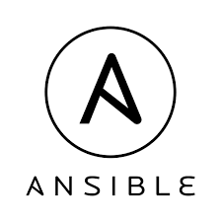
Configuration Management Tools
Ansible

Slide 9
CICD Tools
Jenkins
CircleCi
Gitlab
Bamboo
TeamCity

Slide 10

CICD Tools
Jenkins

Slide 11


Version Control System
Git & GitHub

Slide 12
Cloud Providers
AWS
GCP
Azure

Slide 13

Cloud Providers
AWS

Slide 14
Infrastructure as code
Terraform
Cloudformation

Slide 15
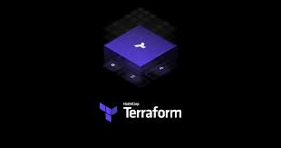
Infrastructure as code
Terraform

Slide 16
Tools

