Slide 1

Pasa Tu Entrevista: SOLID (1/2)
Write future-proof code

Slide 2
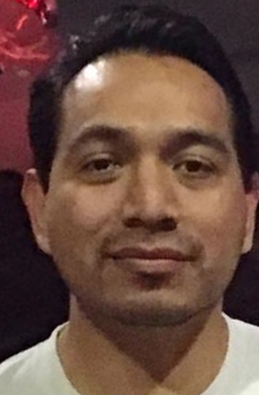
Jesus Flores
Senior Software Engineer
a.jesus.flores@gmail.com
Github.com/ajesusflores
Linkedin.com/in/ajesusflores
Twitter.com/ajesusflores

Slide 3

Pasa Tu Entrevista: SOLID (1/2)
Mnemonic acronym for five design principles intended to make software designs more understandable, flexible and maintainable.

Slide 4


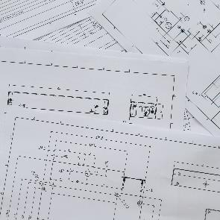



Agenda
Single Responsibility
Open/Close
Liskov Substitution
Interface Segregation
Dependency Inversion
1
2
3
4
5
6

Slide 5
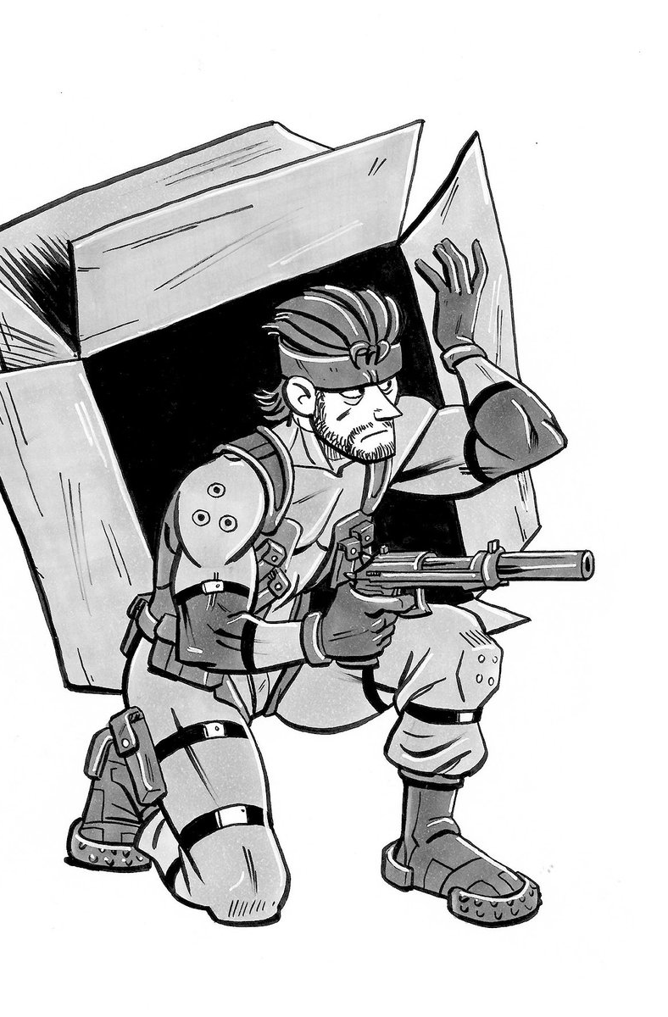
SOLID

Slide 6
After reviewing the software development life cycle as I understood it, I concluded that the only software documentation that actually seems to satisfy the criteria of an engineering design is the source code listings.
-Jack Reeves

Slide 7
SOLID - Overview
Proposed in:
Agile Software Development, Principles, Patterns, and Practices – Robert Martin (Uncle Bob)
“The first five principles”
Help to avoid code smells
Easy code refactoring
Testable code
Acronym for:
Single Responsibility
Open/Close
Liskov Substitution
Interface Segregation
Dependency Inversion
https://www.amazon.com.mx/Software-Development-Principles-Patterns-Practices/dp/0135974445/

Slide 8

3.1 Single Responsibility (SRP)
“A class should have only one reason to change.”

Slide 9
3.2 Cohesion
“The functional relatedness of the elements of a module”
“The forces that cause a module to change”

Slide 10
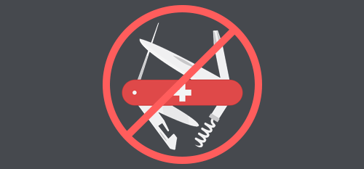
3.1 Single Responsibility (SRP)
A class should have only one reason to change.
If a class has more than one reason to change, it has more than one responsibility
Classes with more than one responsibility should be broken down into smaller classes

Slide 11
Demo
-Move code to separated methods
Output from one method is the input for the next one
-Separate behavior into clases
Keep separating until each class has only one single responsibility

Slide 12
3.2 Open/Closed (OCP)
Meyer:
Martin:
software entities (classes, modules, functions, etc.) should be open for extension, but closed for modification
“Open For Extension”. This means that the behavior of the module can be extended. That we can make the module behave in new and different ways as the requirements of the application change, or to meet the needs of new applications
“Closed for Modification”. Extending the behavior of a module does not result in changes to the source code or binaries.

Slide 13
Client Awareness / Close for modification
Any change to existing code is allowed as long as it does not require any chante to the clients depending on it.
If a change in a class forces a change in other, those classes are tightly coupled.

Slide 14
Extension Points / Open for extension
Classes should be open for extensión by containing defined extension points where new functionality can be added and provide new behavior to existing code.
Interface Inheritance

Slide 15
3.3 Liskov Substitution (LSP)
if S is a subtype of T, then objects of type T may be replaced with objects of type S without altering any of the desirable properties of the program
-Barbara Liskov

Slide 16
LSP
T = Parent Class (Human)
S = Derived Class (Teacher)
Subtype = Inheritance
if Teacher is a subtype of Human, then objects of type Human may be replaced with objects of type Teacher without screw up things

Slide 17
LSP - Restrictions
Preconditions can’t be strengthened in a subtype
Conditions required by a method to run without fault
Postconditions can’t be weakened in a subtype
Conditions required by a method to ensure the result is valid
Invariants (Conditions that must remain true) of the supertype must be preserved in a subtype
Internal State of objects
Avoid NotImplementedException!!!

Slide 18
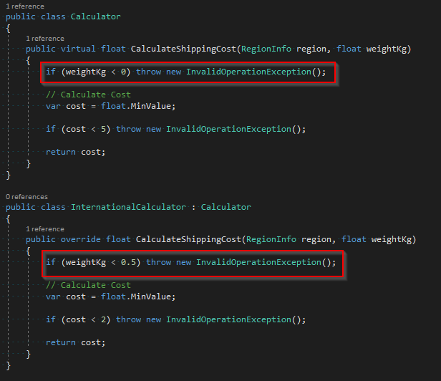
Preconditions can’t be strengthened in a subtype

Slide 19
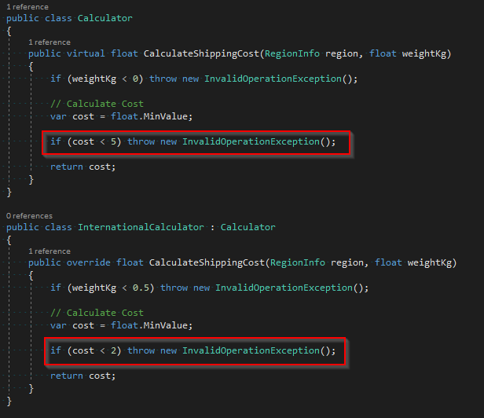
Postconditions can’t be weakened in a subtype

Slide 20
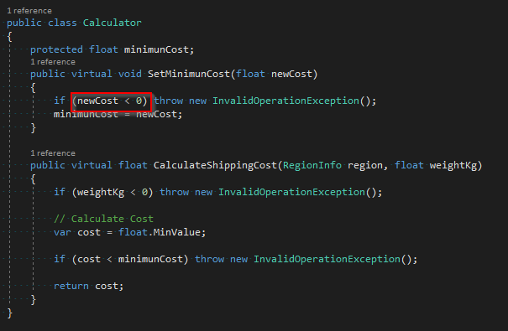
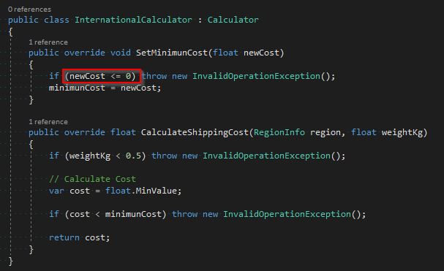
Invariants of the supertype must be preserved in a subtype

Slide 21
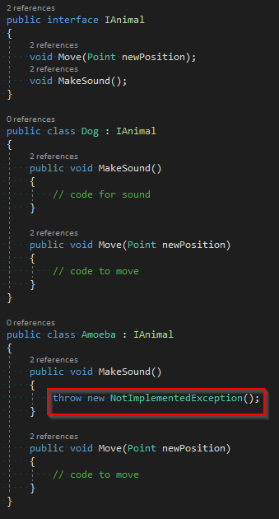
NotImplentedException()

Slide 22
3.4 Interface Segregation (ISP)
Interfaces should be small

Slide 23
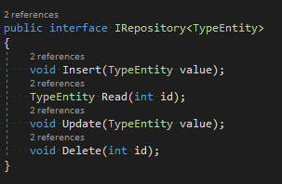
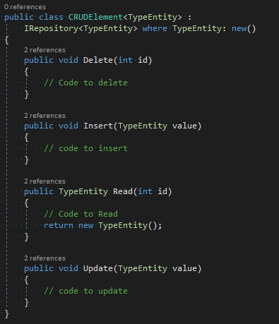
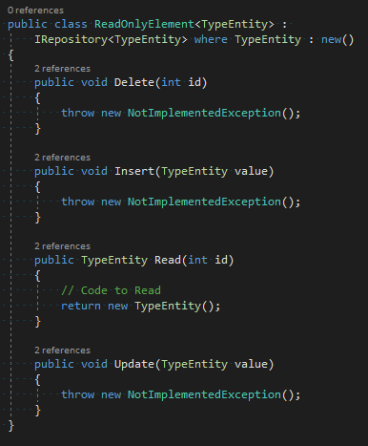
Before

Slide 24
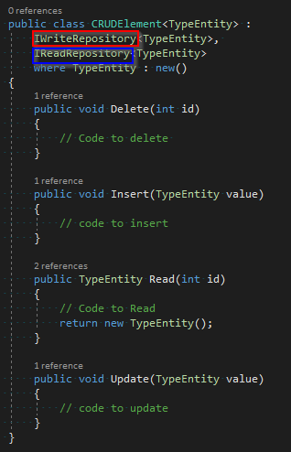
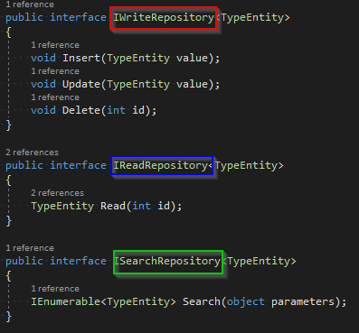
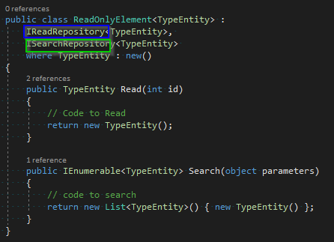
After

Slide 25
3.5 Dependency Inversion (DIP)
High-level modules should not depend on low-level modules. Both should depend on abstractions.
Abstractions should not depend on details. Details should depend on abstractions
High-level modules should not depend on low-level modules. Both should depend on abstractions.
Interfaces should not depend on classes. Classes should depend on Interfaces.

Slide 26





Thank You!
Jesus Flores
a.jesus.flores@gmail.com
Github.com/ajesusflores
Linkedin.com/in/ajesusflores
Twitter.com/ajesusflores

