Slide 1
Airport Delays
Mid-term Project

Slide 2
Motivation

Slide 3
Outliers
Data imbalance
Summary statistics
Distributions
Relationships
EDA
Features
Model
Test
Evaluate
Accuracy
R²
RMSE
MAE
Origin
Destination
Carrier
Weather
Accuracy
Confusion Matrix
Precision
Recall
Regression
Classification

Slide 4
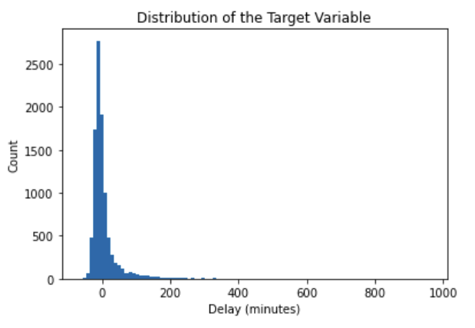
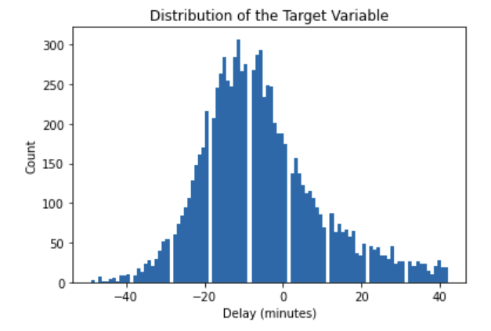
Outliers

Slide 5
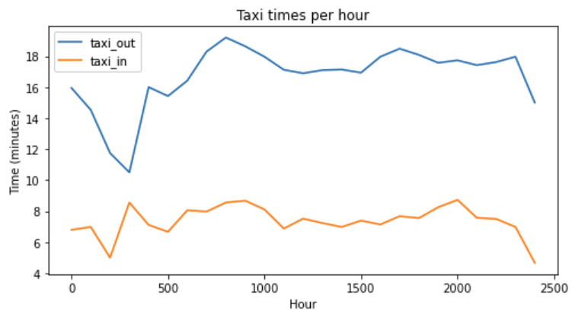
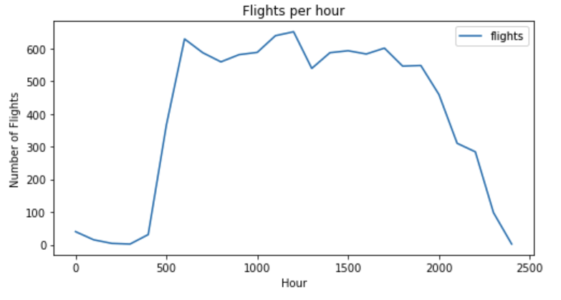
Time of the Day

Slide 6
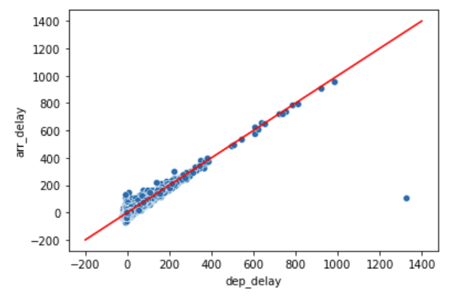
Departure Delay vs Arrival Delay (minutes)

Slide 7
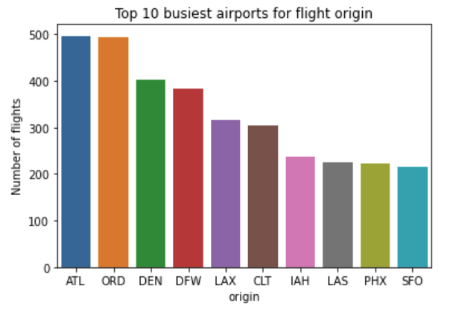
Busiest Airports

Slide 8
Regression
Trial | Base Model (month, day) Dataset = 10K | Removed Outliers Dataset = 10K | Features (historical delays for origin, dest, month, dep_h, arr_h) Dataset = 10K | Features (route) Dataset = 10K | Features (taxi_in, taxi_out, flights_per_h) Dataset = 100K | Balanced data Dataset = 100K
R2 | 0.0077 | 0.0097 | 0.0914 | 0.3926 | 0.1018 | 0.1026
RMSE | 54.8165 | 14.8973 | 14.5629 | 11.7461 | 14.5422 | 19.3516
MAE | - | - | - | - | - | 15.0416
Training Accuracy | 0.0164 | 0.0164 | 0.0940 | 0.4139 | 0.1113 | 0.1057
Test Accuracy | 0.0077 | 0.0249 | 0.0914 | 0.3926 | 0.1018 | 0.1026

Slide 9
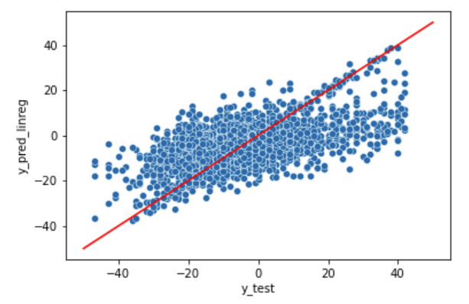
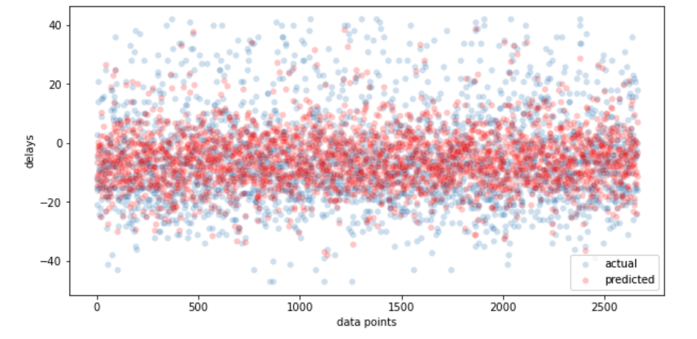
Regression (10K datapoints)

Slide 10
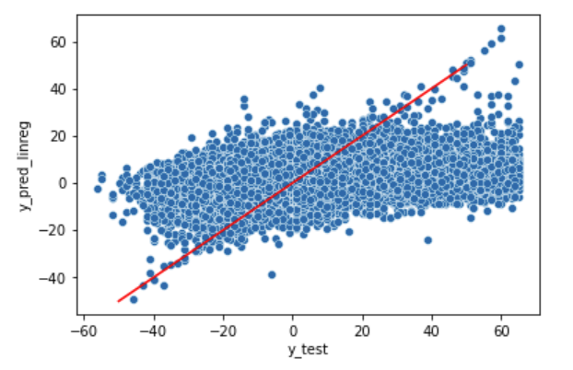
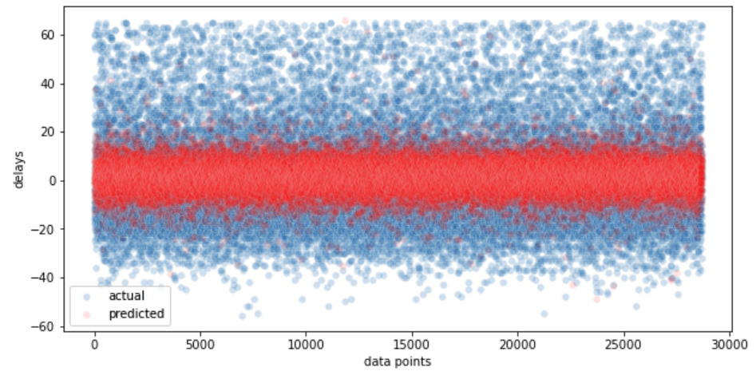
Regression (100K datapoints)

Slide 11
Classification
 | Dataset = 100K Features (+ Weather) Random Forest Classifier | Dataset = 100K Features (+ Weather) XGB Classifier
Accuracy | 0.5787 | 0.5934
Precision | 0.5690 | 0.5758
Recall | 0.4551 | 0.5377

Slide 12
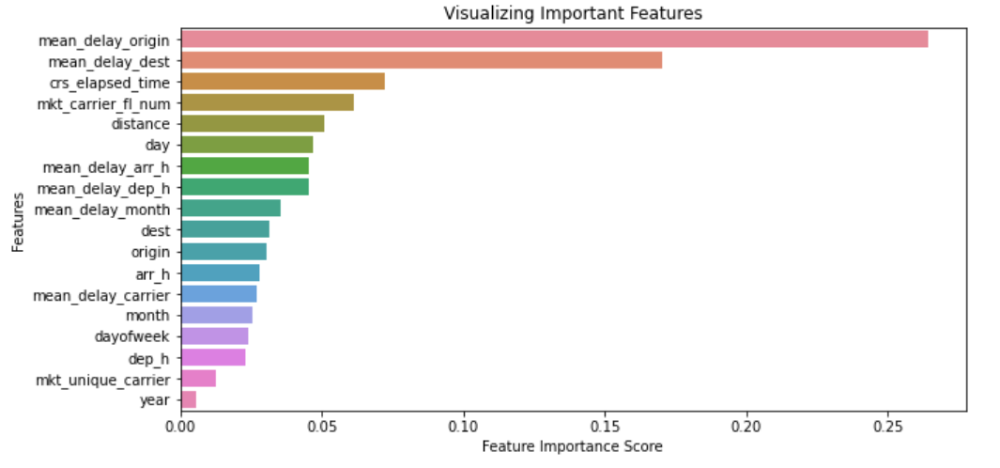
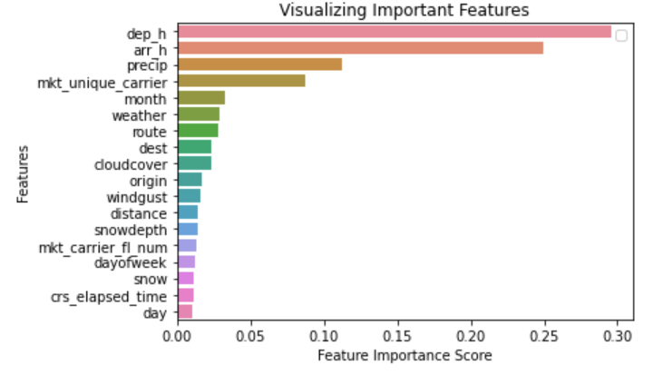
Feature Importance
Regressor
Classifier

Slide 13
Challenges

