Slide 1
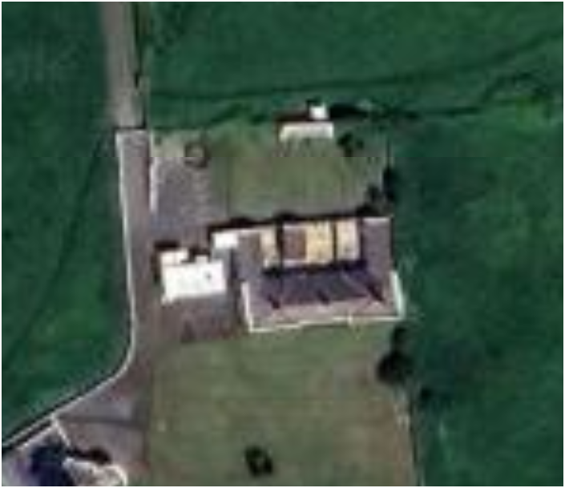
Declin 5° E
50.58° N, 1.30° W

Slide 2
