Slide 1
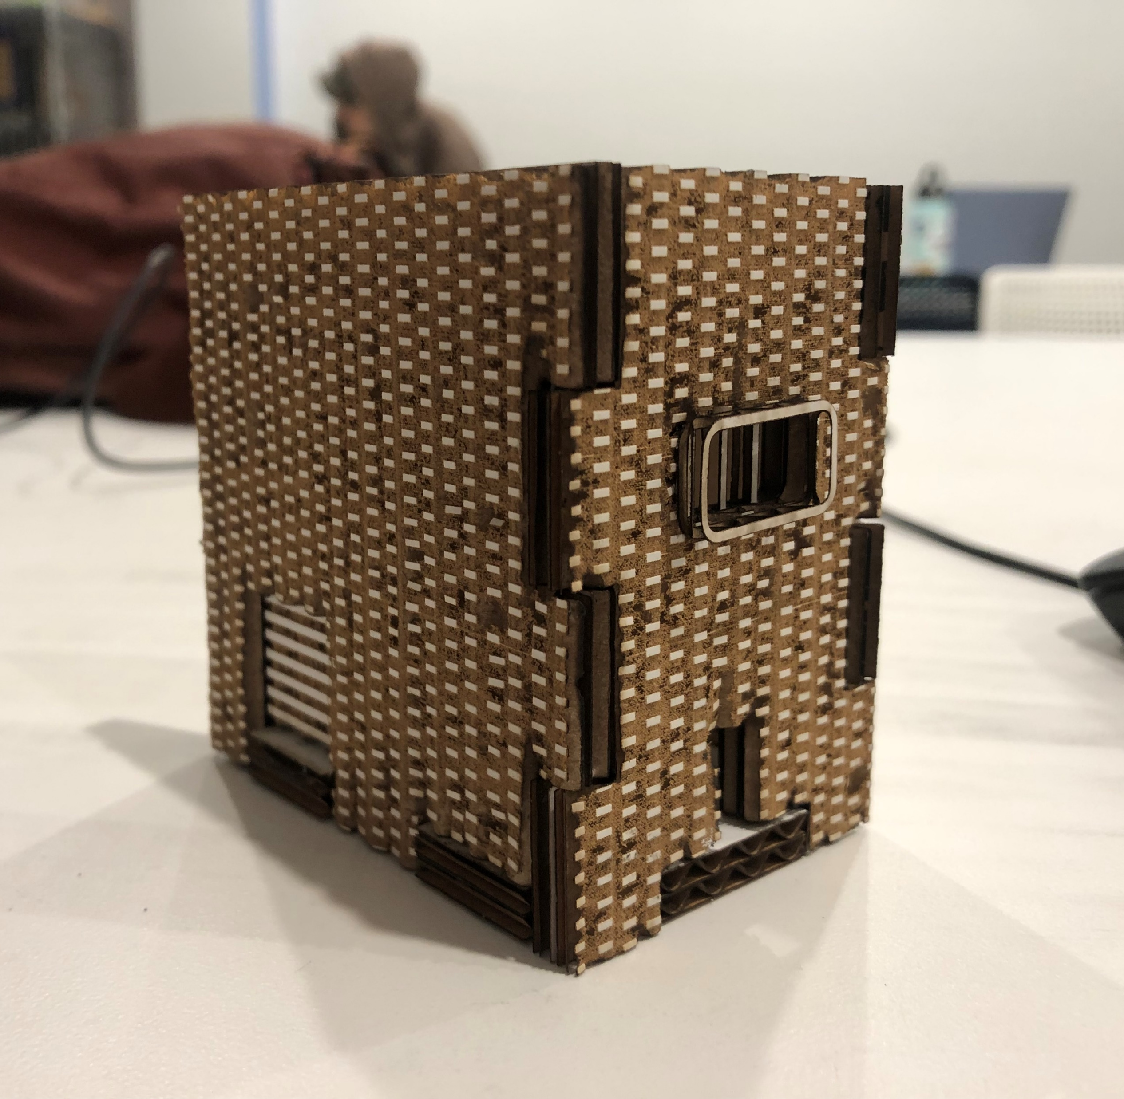
Context
“As part of a larger project looking at what design features create a neighborhood, I want to categorize urban areas into regions by how quickly a pedestrian could walk between them.”

Slide 2
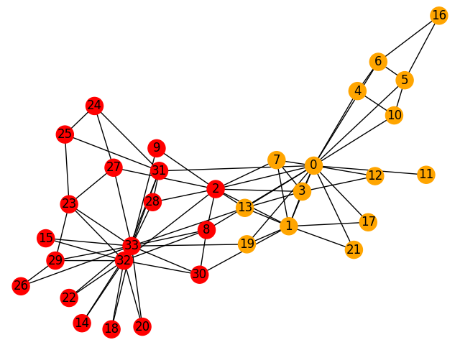
Network Graph of Addresses
597 × 636
Create list of addresses
Query OpenRouteService to find the time between each of these addresses
Convert the addresses to “nodes” and the inverse of the travel times to “edges”
Use NetworkX to create a network graph of the relationships
Color it with “community detection”?

Slide 3



