Slide 1
Working with Data
Adrian Gallard | Data Analyst

Slide 2
Overall Agenda
General workflow from data model reporting
Learn about different resources that can assist you at each stage in the process
Considerations for improved workflow practices

Slide 3
Workflow Stages
BUILD
SHOW
EXPLORE

Slide 4
Data Exploration

Slide 5
Data Exploration
Data Exploration is the practice of combing through and understanding your dataset better
It is critically important to generate visualizations throughout this stage
You can uncover the quality of the dataset you are currently working with

Slide 6
Information

Slide 7
Information
For the most basic of exploration read in your dataset and find the following:
  How much data do I have? (Rows)
  How many features do I have? (Columns)
  How is the data formatted?
  Is there data missing?
  Is there an imbalanced amount of target data?
    Do I have an abundance of A but a scarce amount of B?

Slide 8


What should I use?
Pandas is a great library for data analysis & engineering
Pandas makes great use of pythonic capabilities
Alternatives:
  Excel, R Studio
You may also consider using a web-based notebook like Jupyter Notebooks
Cell-based execution makes iterative exploration much more intuitive

Slide 9
Visualizations

Slide 10
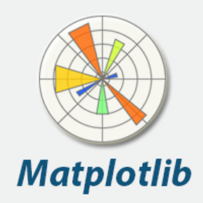
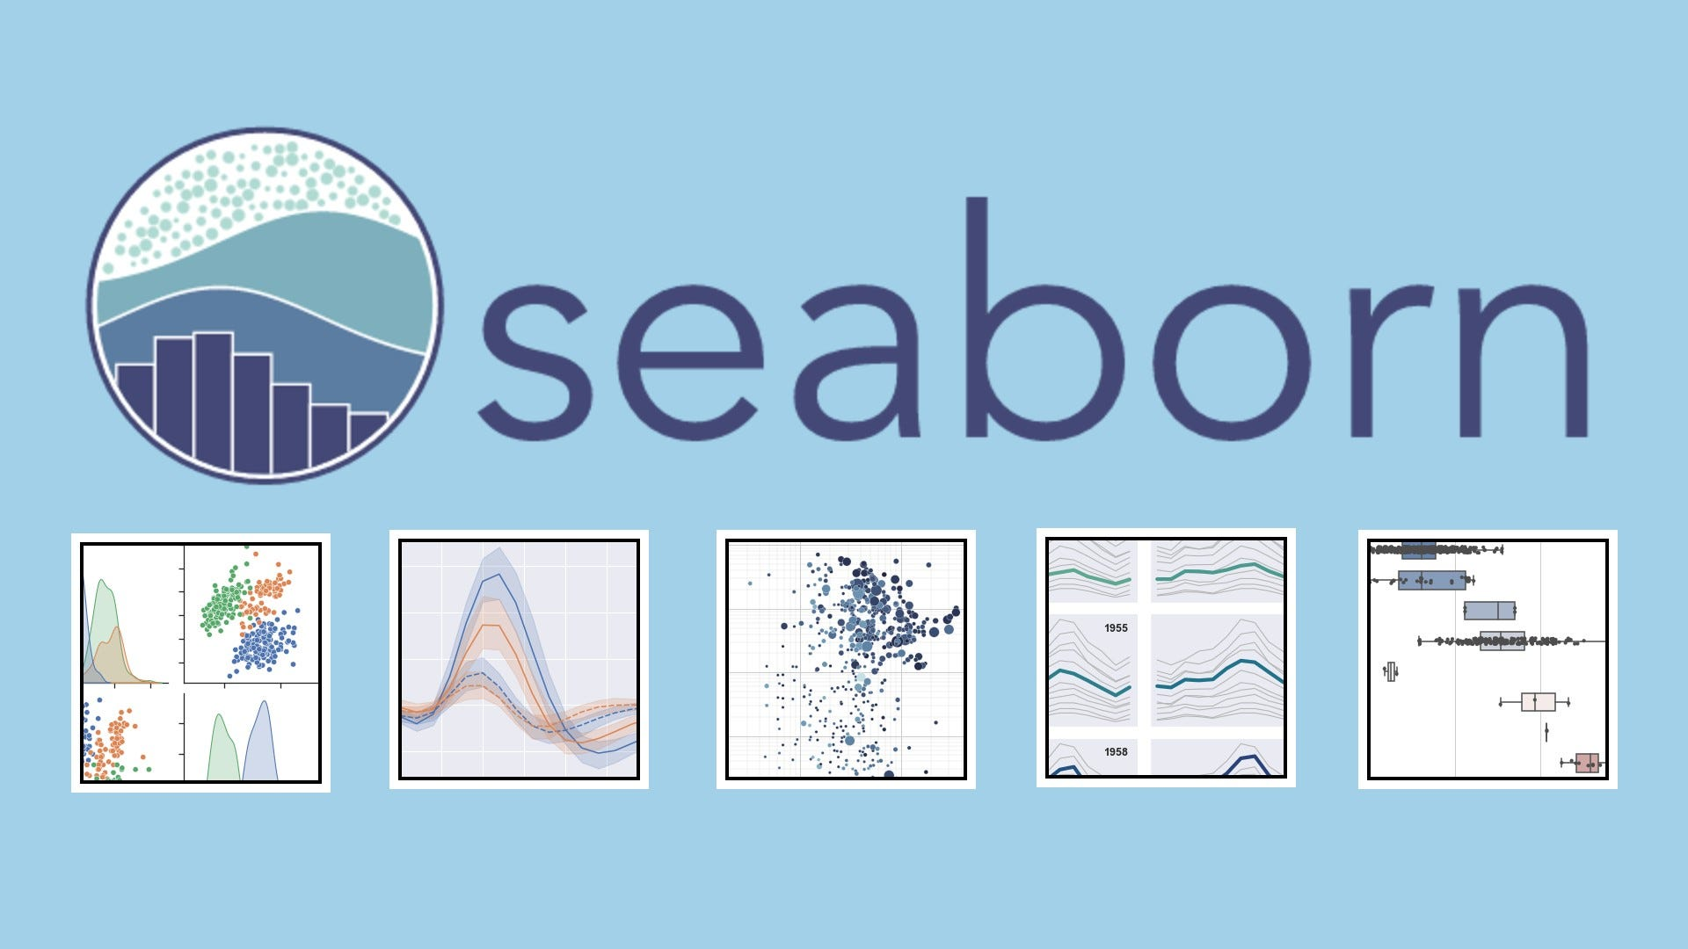

Visual Clarity
Visuals help clarify the behavior of data
Aid in communicating findings
Suggested Libraries:
  Matplotlib Seaborn Plotly
- Access to Quick Plots
- Built on Matplotlib
Interactive Plots
Great for Web-Apps
- Built into many integrated visualizations
- Basic Plots

Slide 11
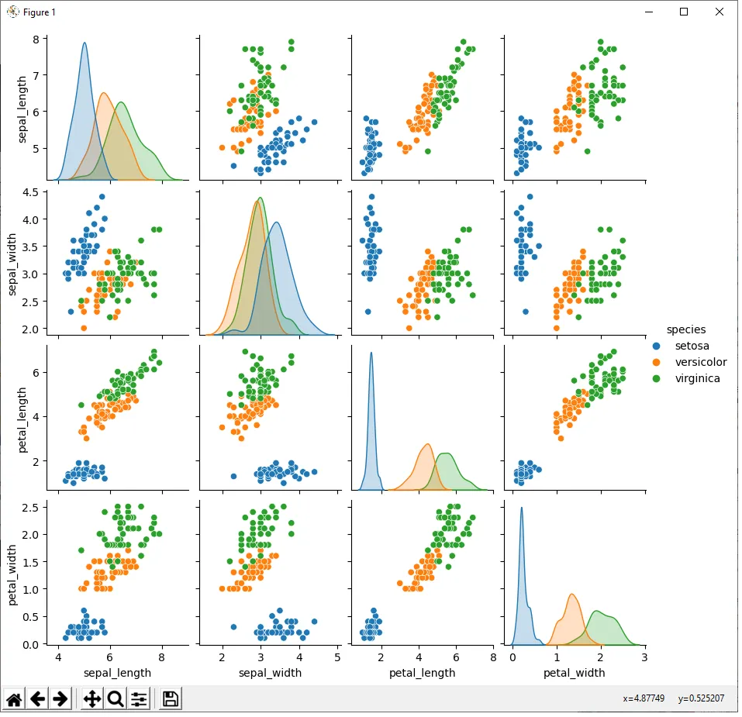
Pair-Plots
pair-plots are a quick way to see a variety of feature comparisons that can show immediate trends

Slide 12
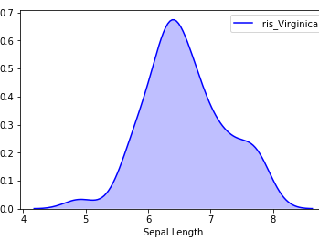
Distributions
Tell us how the data is spread out
Can show if data leans in a particular direction or if it’s normally distributed

Slide 13
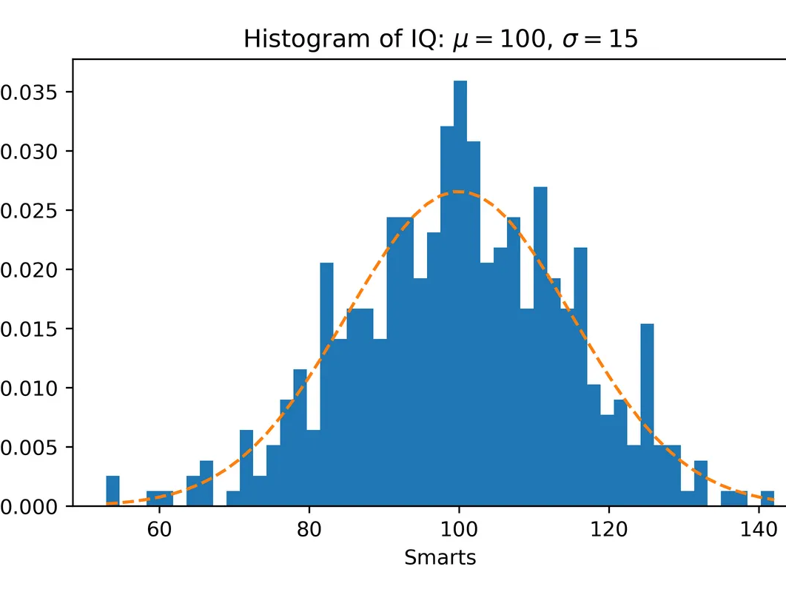
Histograms
Shows distribution with discrete numbers
A distribution can be inferred through Histograms

Slide 14
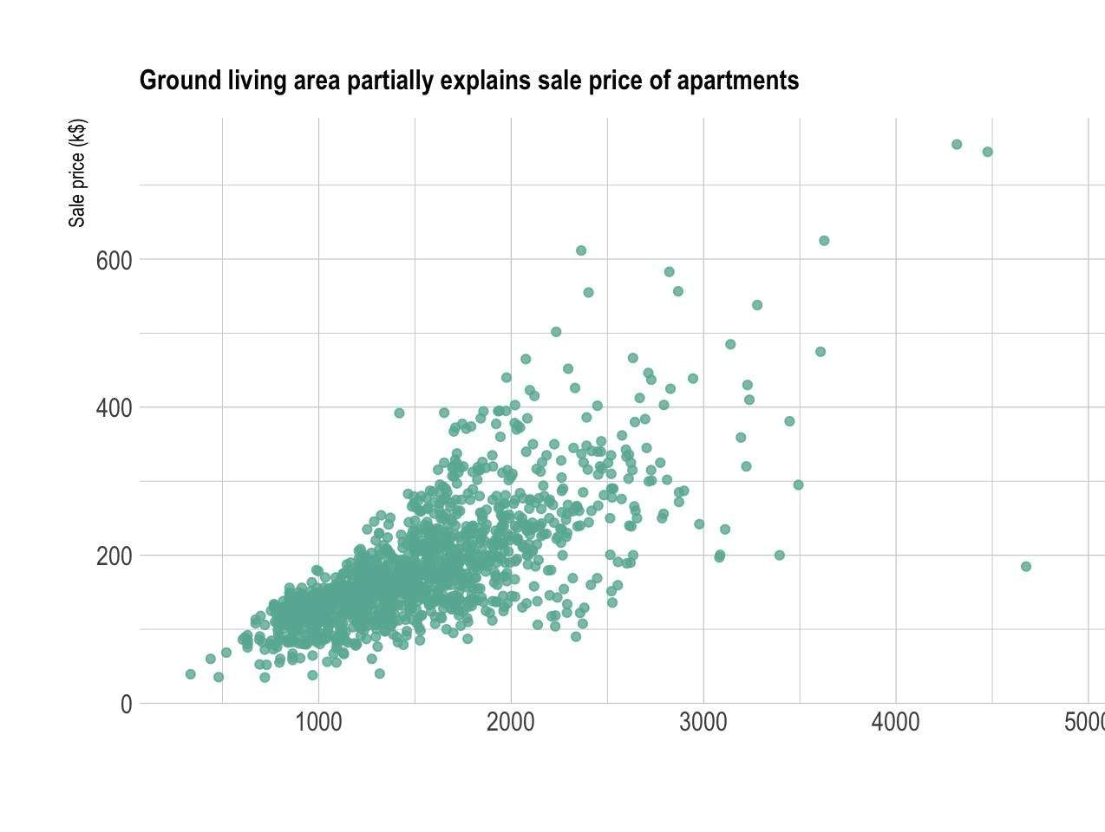
Scatterplots
Great for detecting potential relationships between features against your target label

Slide 15
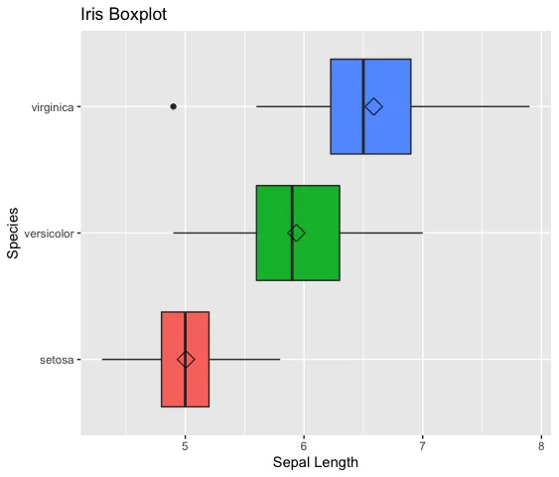
Boxplots
Boxplots are an excellent way to identify outliers within a dataset
You can use violin-plots for more detail

Slide 16
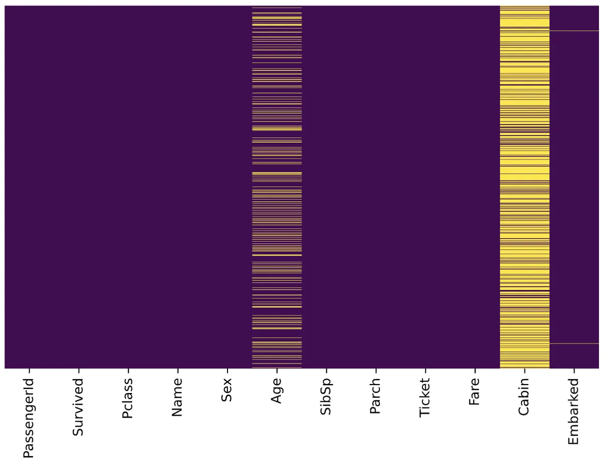
Heatmaps
Heatmaps can be used to visualize missing values and their impact on a dataset

Slide 17
Project Dependent Visualizations
Some datasets require unique applications
  Time Series
  Networks
  Natural Language
  Sound
  Images
  etc.

Slide 18
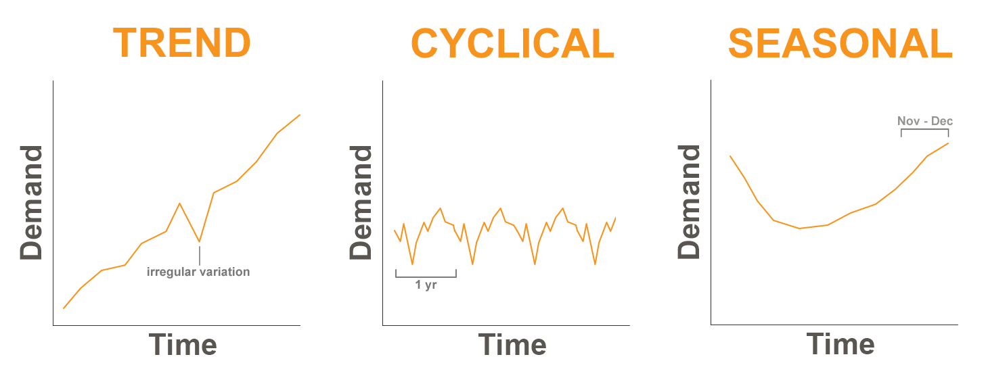
Time-Series – Trends, Cycles, Seasons

Slide 19
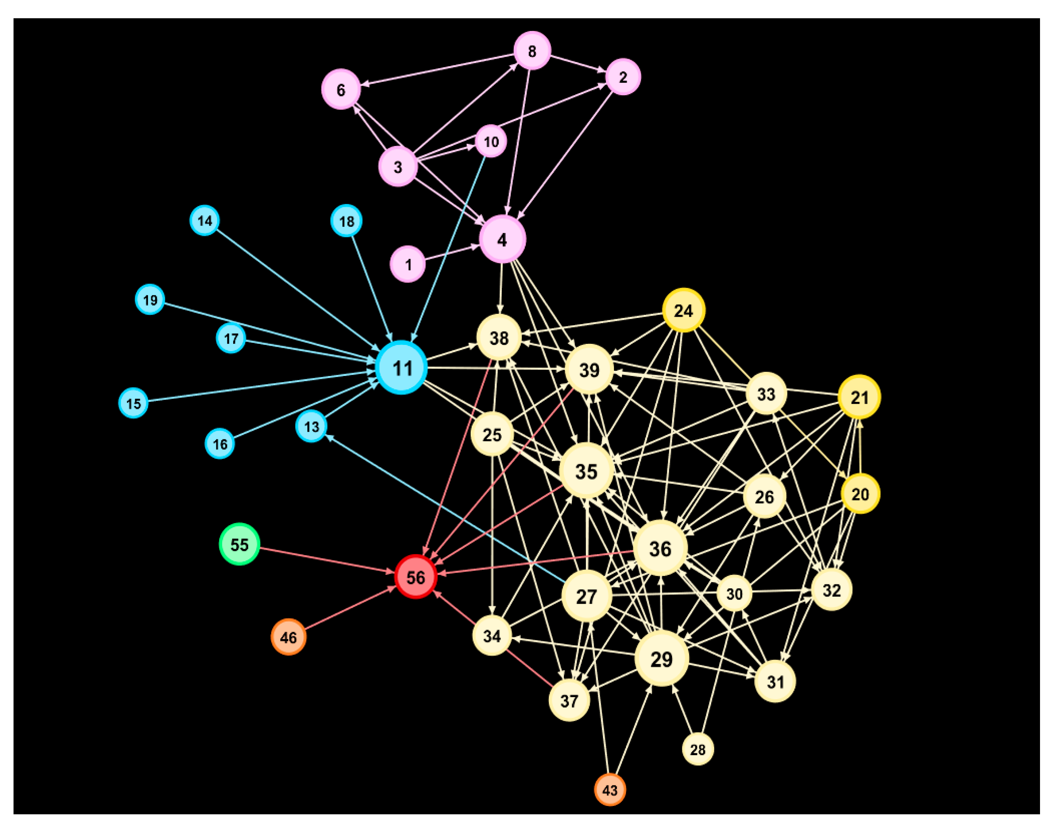
Network Analysis
What relationships exists in the data?
Do any groups emerge?
If so, how do these groups interact?
What do these findings imply?

Slide 20
Note on Data Preprocessing
Once you understand your data you may likely need to adjust some parameters for your data
Discussions on feature-engineering are beyond today’s discussion
If you have questions on how best to process your data prior to model building feel free to reach out with questions! (Contact Info at end of presentation)

Slide 21
Model Building

Slide 22
Model Building
This work is built on your previous Data Exploration efforts
Generally, you’ll want to try multiple models
You’ll also want to try optimizing models for improved performance
Visualizations still play a part in your model selection decision
Model Building can serve two general purposes
  Prediction
    Model is intended for active-use on new incoming data
  Interpretation
    Model is intended for understanding underlying patterns
    New incoming data serve to confirm past behavior or indicate a shift

Slide 23
Baselines & Optimizations

Slide 24

Basic Classifiers & Regressions
For your standard classification & regression work Scikit-Learn is a great library to work with
Built-in tools for k-folds and train-test splits
Has multiple “off-the-shelf” algorithms:
  SVM, Logistic Regression, AdaBoost, Stochastic Gradient Descent, Random Forests, etc.
Lots of Tutorials, Guides, & Example Usage

Slide 25

Transformers & LLMs
Huggingface is a great library for Transformer-based architectures and LLMs
Documentation & Guides are available
Great for Natural Language Processing (NLP)
  Text Classification, Fill-in the Blank, Text Generation, Topic Modeling, Sentiment-Analysis

Slide 26
Model Building Stages
Basic Workflow
Fine-tuning details
Utilize a base model without fine-tuning
  Metrics serve as baseline for performance
Create a fine-tuning pipeline for an “optimized model”
  Compare to your baseline
Always use visualizations to gauge performance
Save your metrics
  Save to external file (csv, txt)
  Save visualizations
Random/GridSearch
  Use Sklearn modules
  Start with a wide search via RandomSearchCV
  Narrow down your optimization via GridSearch
Optuna
  Bayesian Optimization
  Acts as “fusion” of Random & Grid Methods
  Provides built-in visualizations for optimization process

Slide 27
Model Performance & Selection

Slide 28
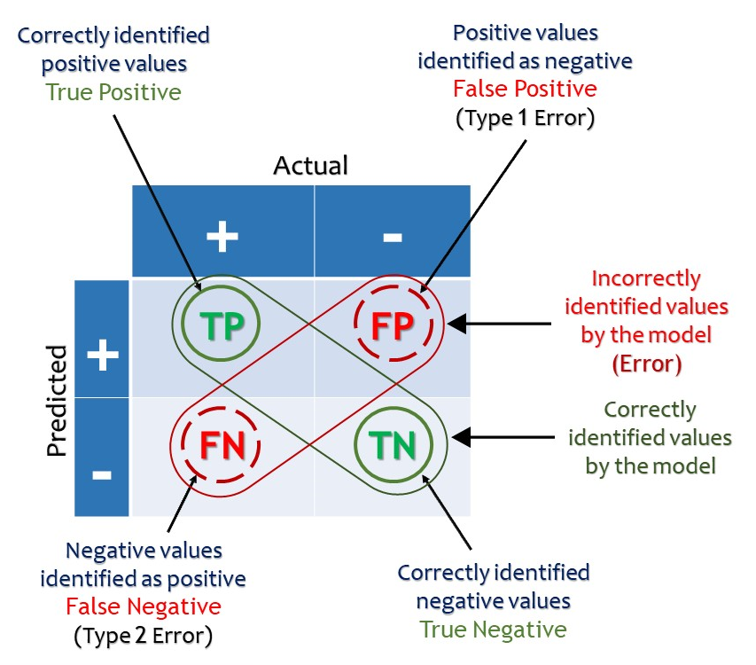
What were the Results?:
Confusion Matrix

Slide 29
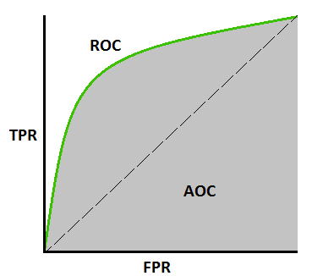
Which model fits best? :
ROC / AUC
Receiver Operating Characteristic (ROC):
  Compares True Positive & False Positive Rates to gauge how well a model fits to the data
Area Under the Curve (AUC):
  The amount of space covered by the ROC Curve which indicates how well the model fits

Slide 30
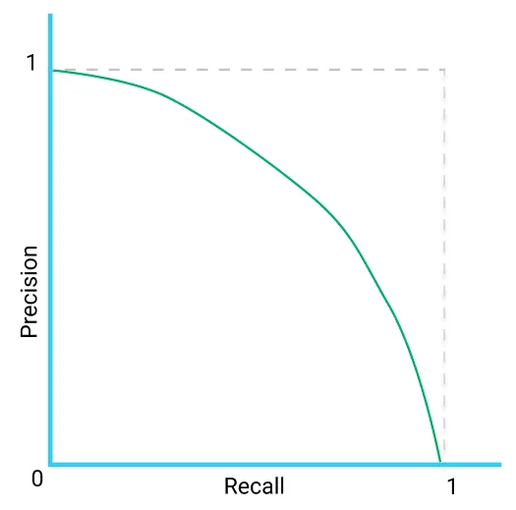
Which model fits best? :
Precision-Recall Curve
Precision-Recall Curve:
  Similar to ROC/AUC but uses Precision instead of FPR (also known as Fallout)
  Precision is number of true positives out of all positive predictions (TP/P)
  Recall is the number of true positives out of all true positives and false negatives (TP/TP + FN)

Slide 31
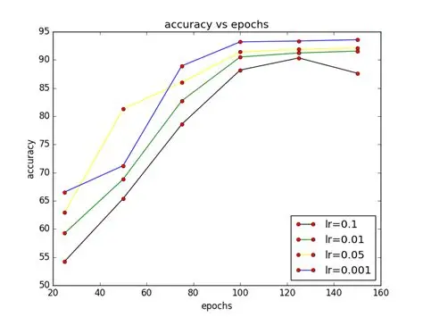
How did the model learn?
When appropriate, we should visualize our model learning process as well as key target metrics

Slide 32
Show Your Work

Slide 33
Showing your work
Having a good model is great but not the final step
You need to ensure you understand the decision-making process behind your model
You’ll also need to focus on communicating your findings
The delivery of the report may be dependent on your organization

Slide 34
Visualizing Your Model

Slide 35
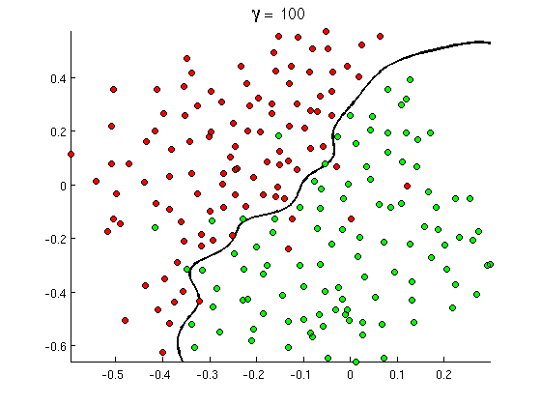
How does the model decide labels?
You can visualize the decision boundaries for a given model
If you have lots of features you can use Principal Component Analysis (PCA) to create a 2D representation of the data

Slide 36
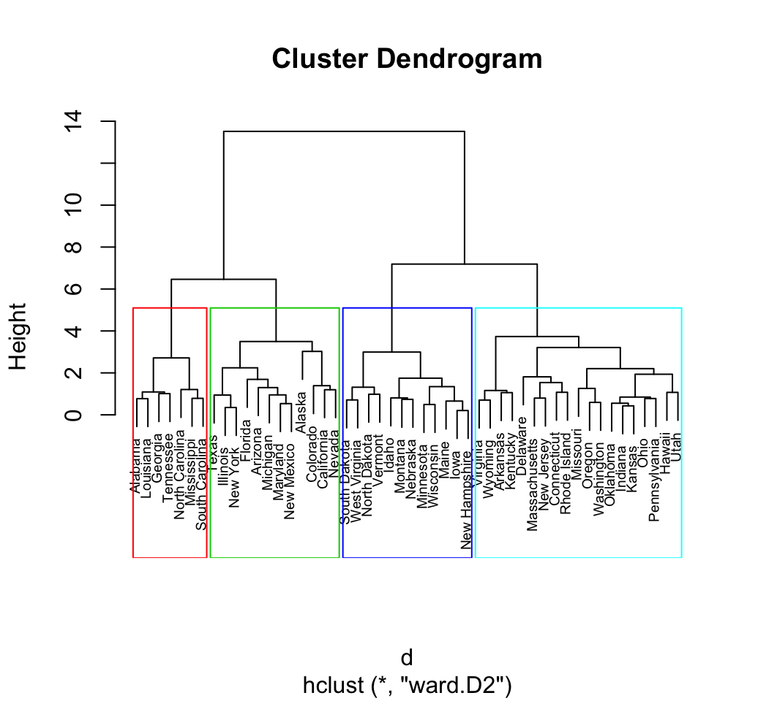
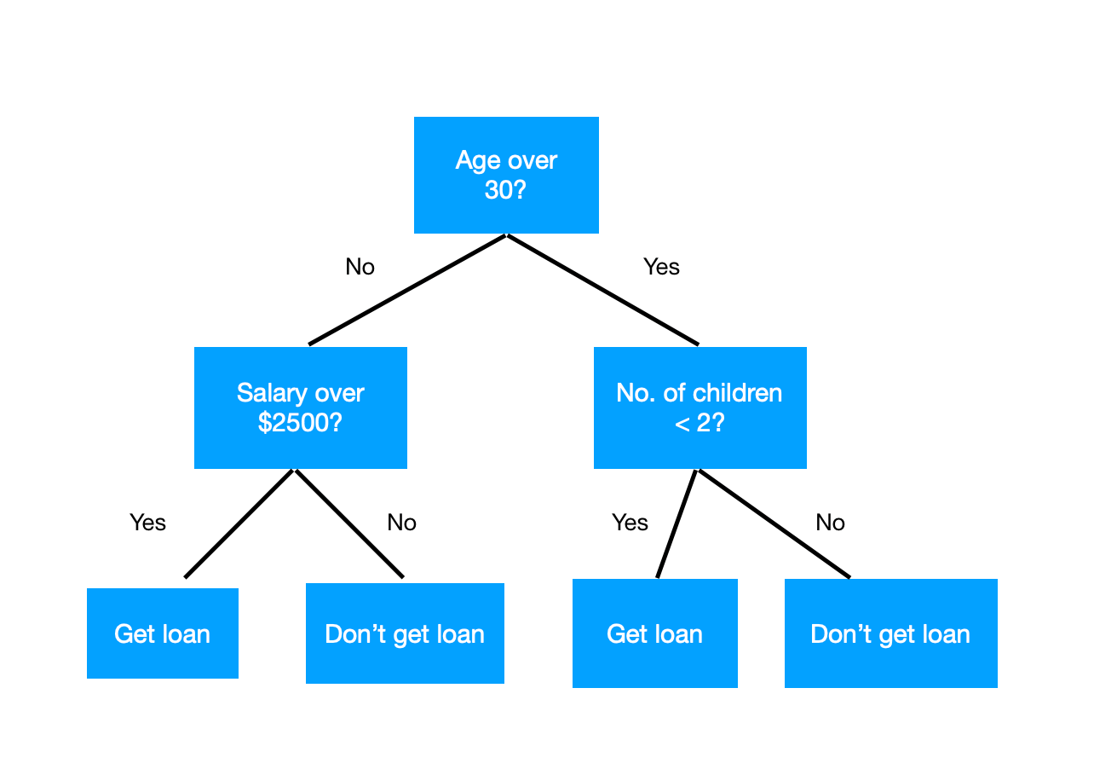
What does the model tell us? - Trees/Hierarchies

Slide 37
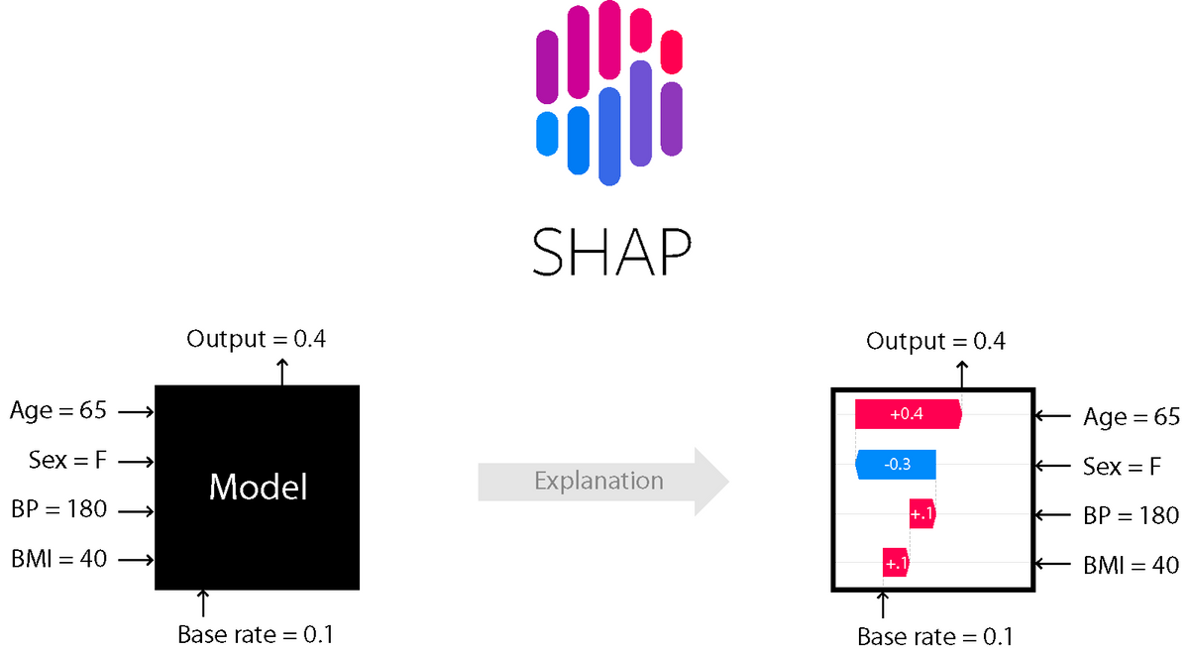
How does the model value inputs?
Shapley Additive Values are a model agnostic method for interpreting model outputs

Slide 38
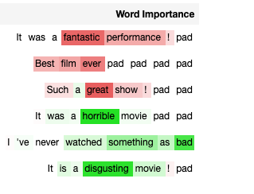
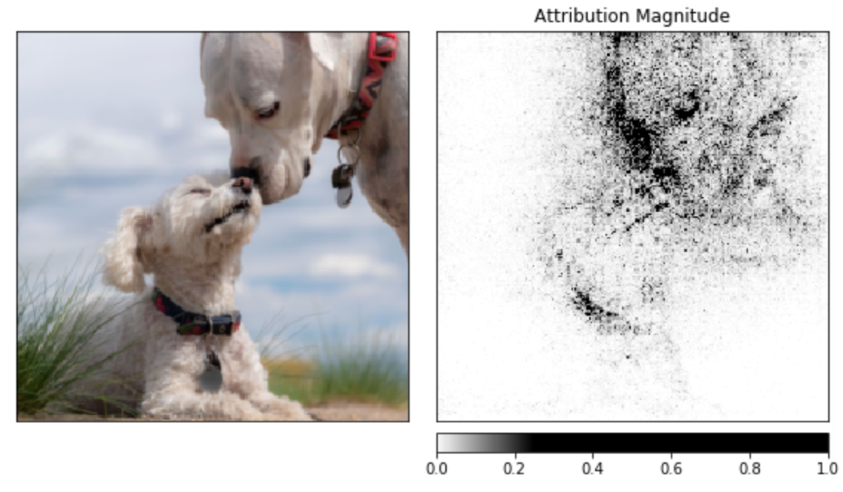
What is the model looking at?:
Image uses captum.ai for PyTorch

Slide 39
Presenting Results

Slide 40
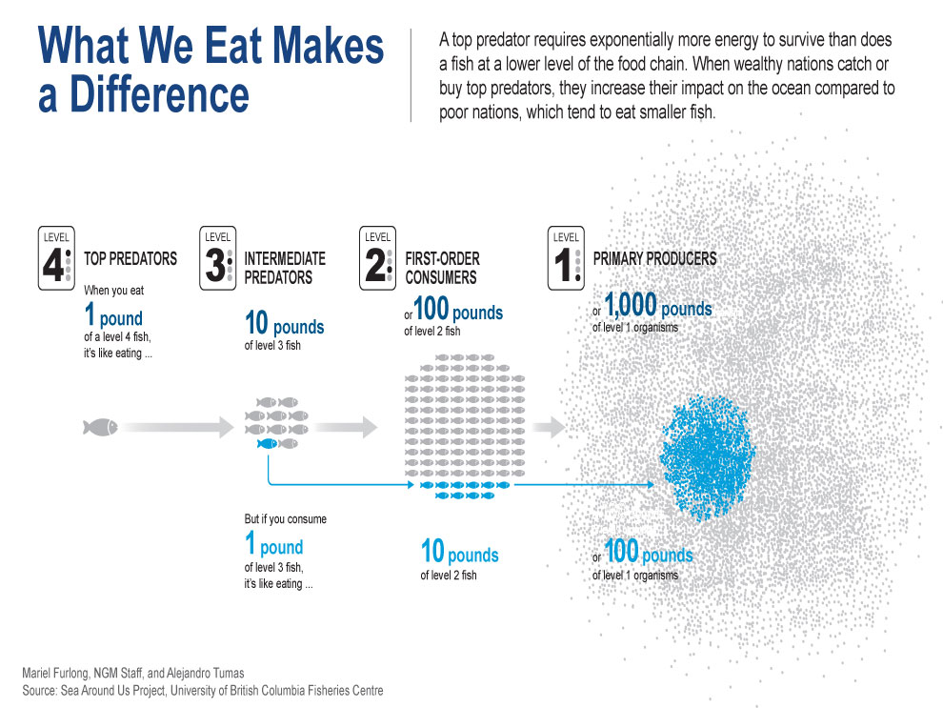
Big Picture | ”Storytelling”

Slide 41
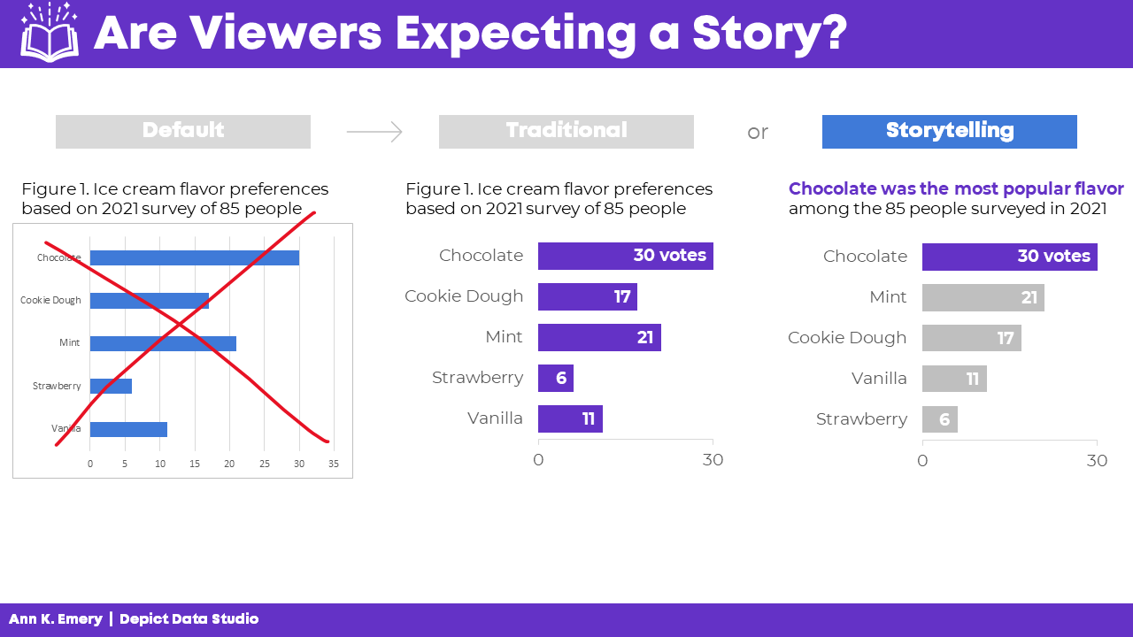
Recommended Charts/Ideas
Stick to bar-charts & line graphs
If a particular feature is important highlight it
Use a consistent theme across the board
Apply proper formatting and include labels where appropriate
Add context via footnotes

Slide 42
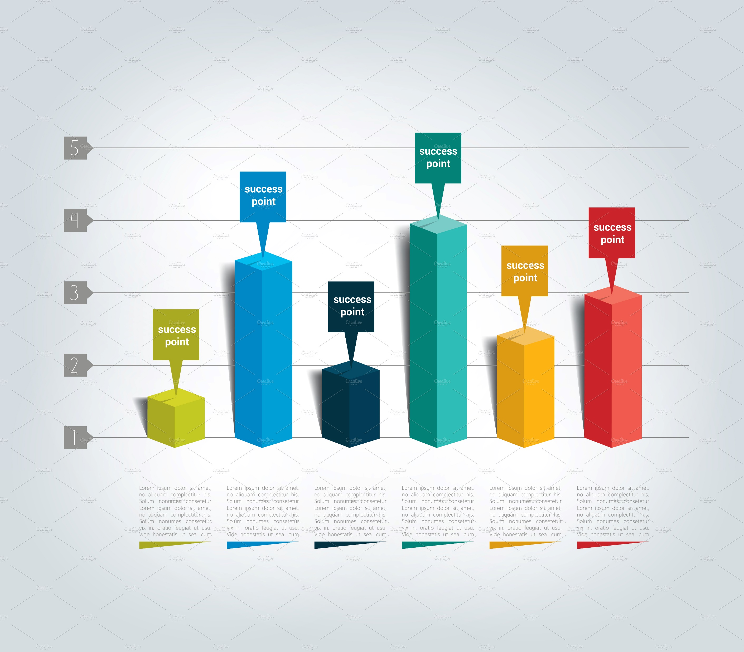
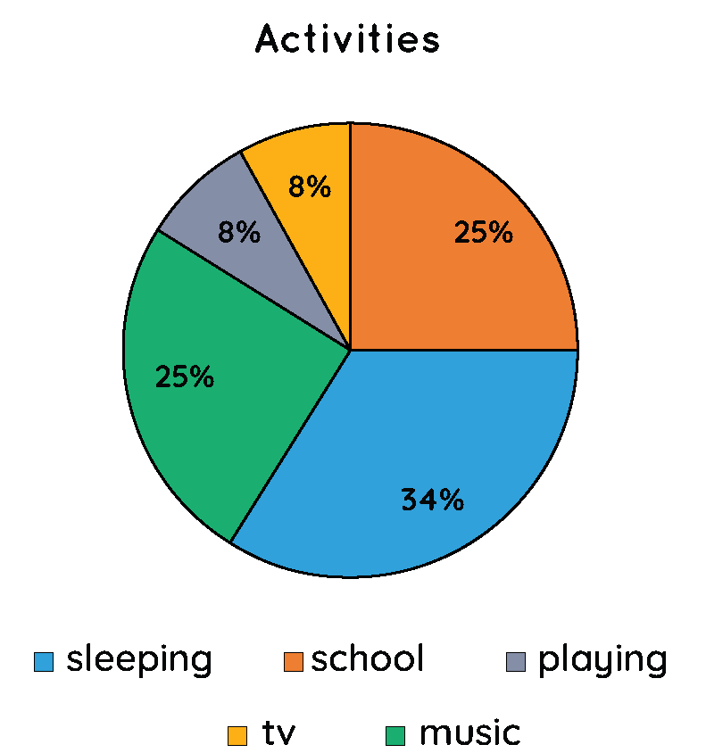
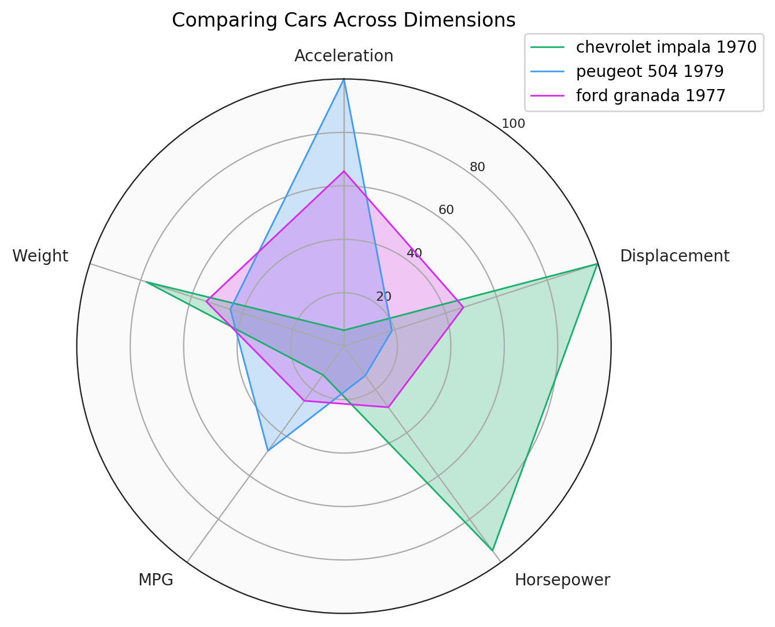
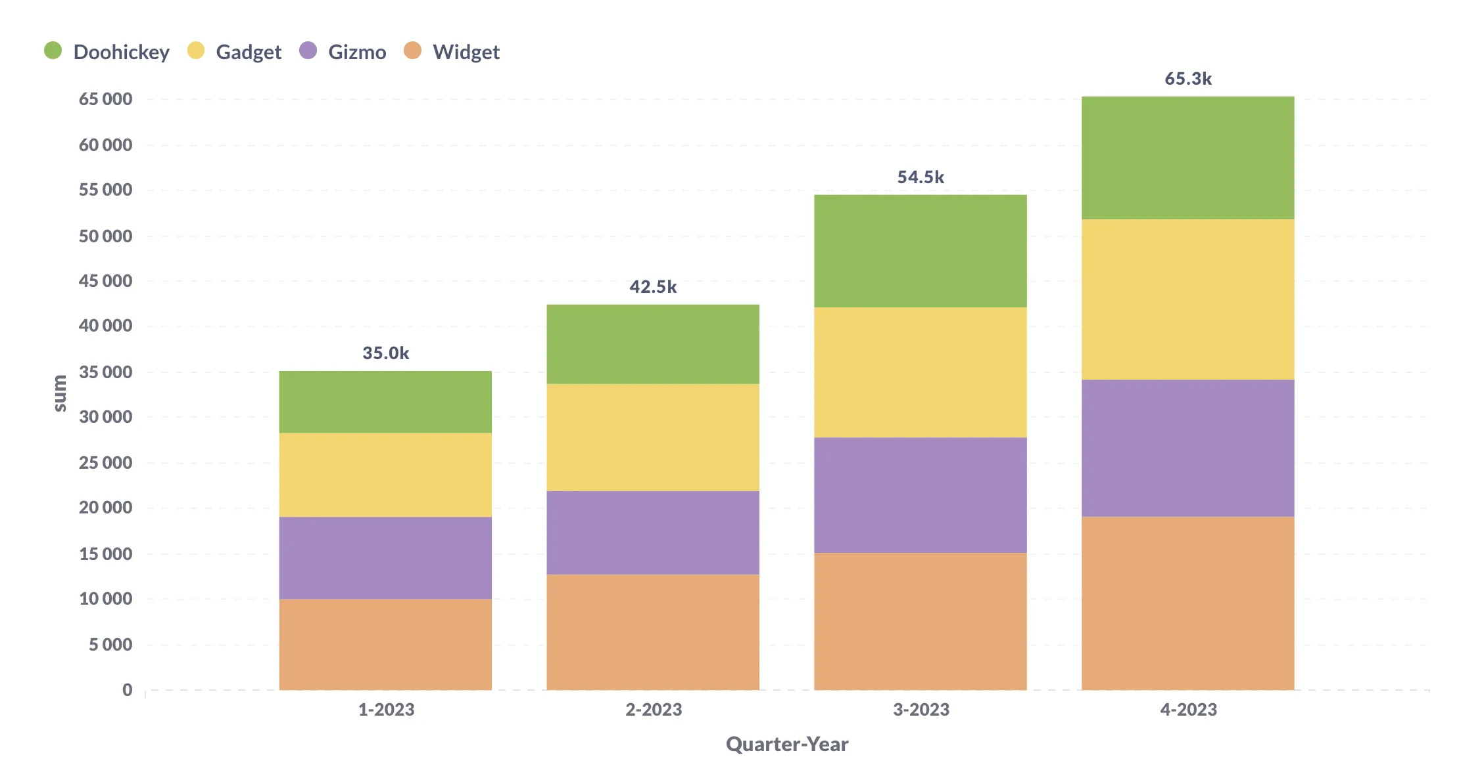
Avoid These…
There is a time and place for charts of all kinds, but some charts work better than others (generally…)
Charts that make it difficult to visually understand relationships (e.g. area charts of any kind) should be avoided unless perfectly suited to the message you’re conveying
Use color purposely and avoid oversaturating the page with noise

Slide 43
Things to Consider…
Key Performance Indicators (KPIs)
Basic Charts work Best (Lines & Bars)
Maintain consistent schemes throughout any report
Add any important discoveries as footnotes within report
Anticipate potential end user questions and investigations

Slide 44
Closing Remarks

Slide 45
Keep This In Mind
Be the expert
Focus on the end-use
Your work is a platform

Slide 46
Next Steps
Work on your workflow
Explore new ways to explore
Communicate with Clarity

Slide 47

Questions?
GitHub Repo
Adrian Gallard | Data Analyst
agallard3@gatech.com
https://github.com/ajgallard/vip

