Slide 1


PROCESSES MODELING BY ARTIFICIAL NEURAL NETWORKS
Tadej Kodelja, Igor Grešovnik i
Robert Vertnik, Miha Kovačič, Bojan Senčič, Božidar Šarler
Laboratory for Advanced Materials Systems
(Centre of Excellence for Biosensors, Instrumentation and Process Control)
Laboratory for Multyphase Processes
(University of Nova Gorica)
Štore Steel Technical Development
(Štore Steel)

Slide 2
Scope of Presentation
Code base: IGLib (Investigative Generic Library)
  Training Data
  Training the ANN
  Results and Parametric studies
  Graphical visualization
Simulation of complete process path by ANN

Slide 3
Data Standarsd
Standardized directory structures
Standardized data file formats
  Training data
  Definition data
  Computational results (trained ANN)
I/O procedures
Enables easy data exchange between software modules.
Defined interfaces with simulation and optimization software.
Extensible formats, easy to maintain backward compatibility.

Slide 4

Generating Parameters & Outputs
Input Data Generator
datadefinition.json
Node 1
Node 2
Node i
. . .
Input parameters
Input parameters
Input parameters
Physical simulator
Physical simulator
. . .
Physical simulator
Training data
trainingdata.json

Slide 5
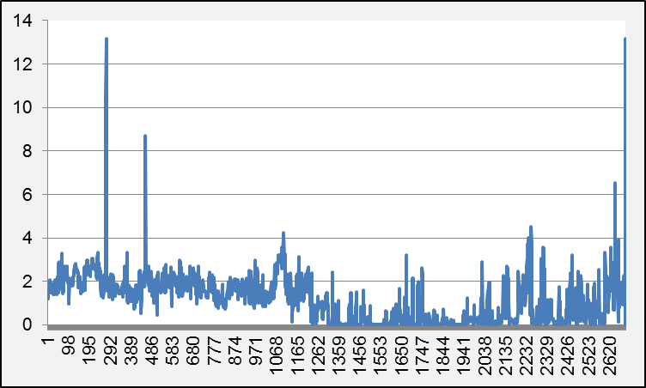
Training Data Filtering
Methods for filtering training data
  Oulayers
  Duplicated data
  Wrong data formats

Slide 6
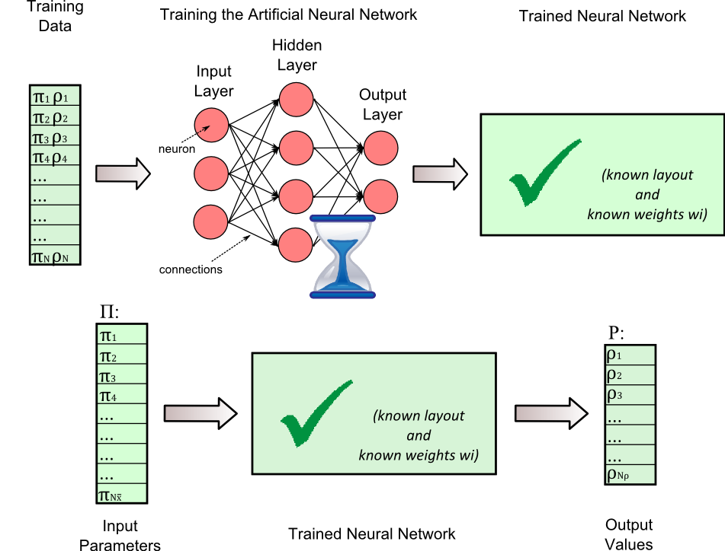
ANN Training
Implemented two open
source libraries
  Aforge
  NeuronDotNet
Customizable training
procedures

Slide 7
Parallel ANN Training
traininglimits.json
datadefinition.json
Training Parameters Generator
trainingdata.json
Node 1
Node 2
Node i
. . .
ANN Training
ANN Training
ANN Training
trainingresults.json
Training Results

Slide 8
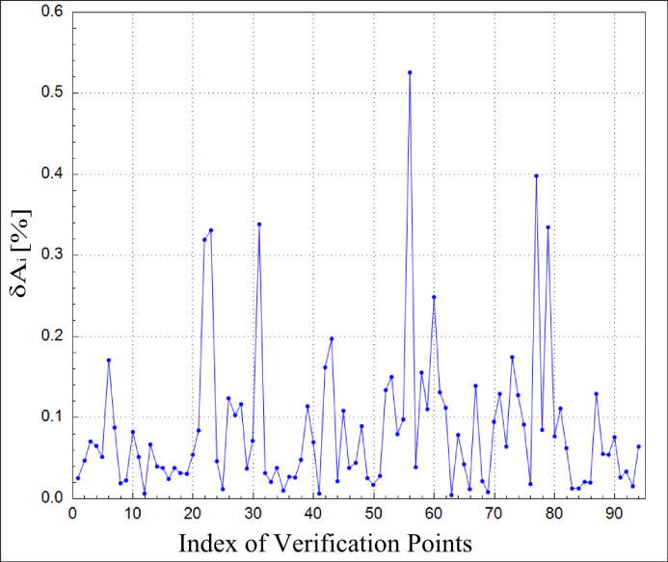
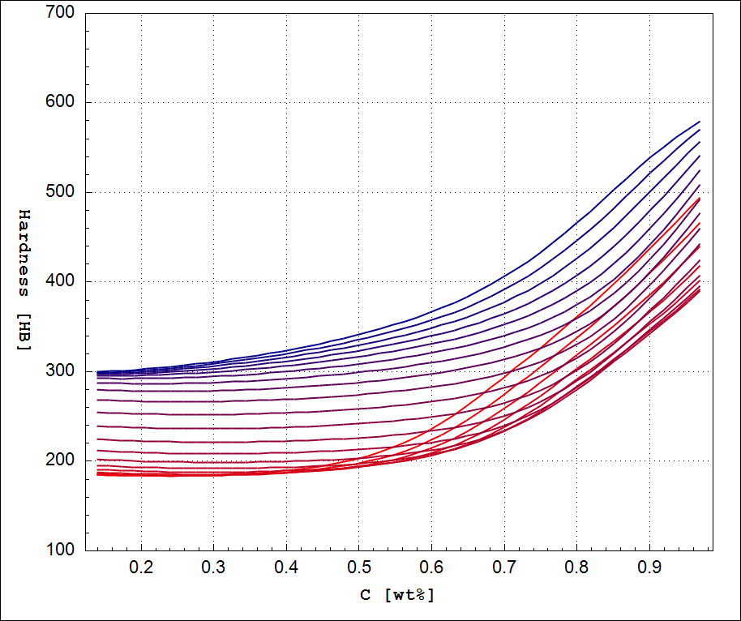
Tests and Parametric Studies
Error analysis
Analysis of response
Dealing with numerical issues

Slide 9
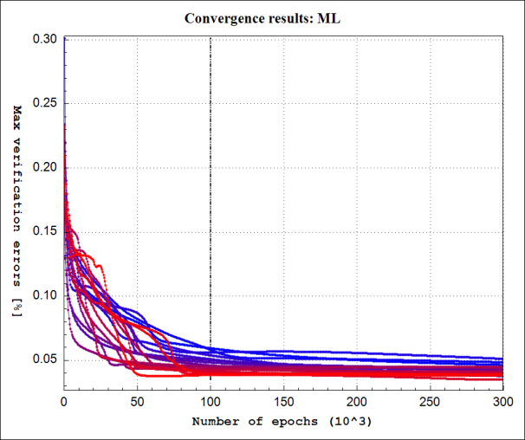
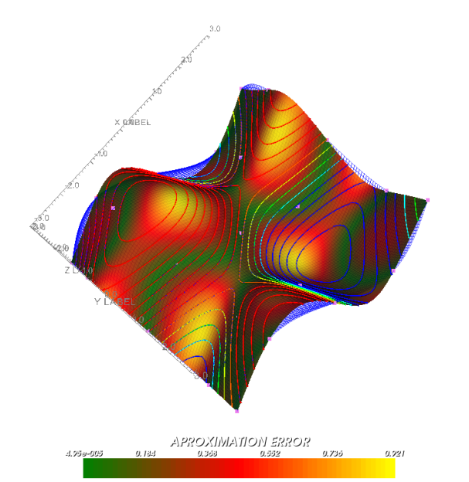
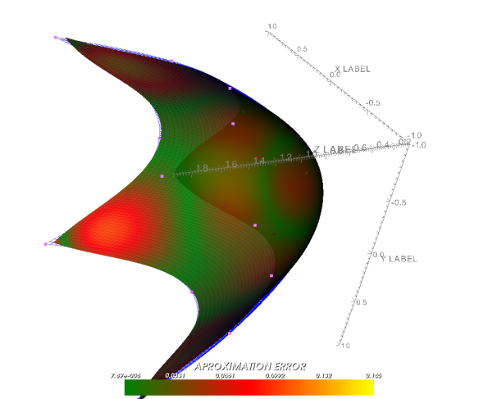
Graphical Visualization
Implemented two open source
graphical libraries
  ZedGraph
    1Dimensional
  VTK
    2,3Dimansional
    Vectors, Tensors
    Contours

Slide 10
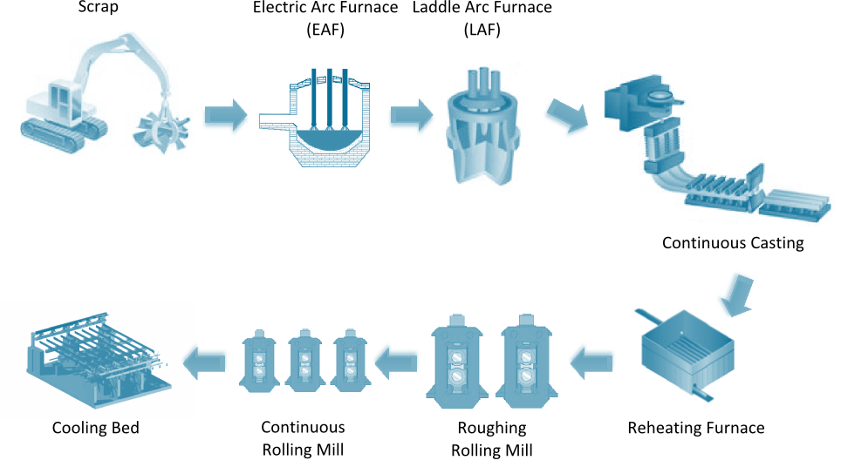
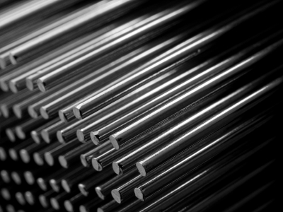
Štore Steel Process Scheme
Main Goals of Through Process Modeling Strategy
PROCESS PARAMETERS
151
MATERIAL PROPERTIES
Elongation
Tensile strength
Yield Stress
Hardness
Necking

Slide 11
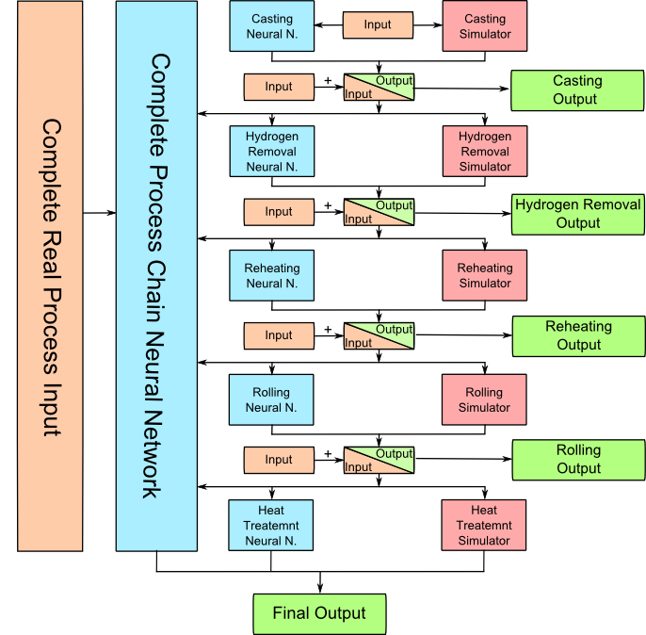
Steel Process Route Modeling Scheme
MAIN CONCEPT
Combination of Physical Modeling
and Artificial Intelligence Modeling
PROCESSES
Casting
Hydrogen Removal
Reheating
Rolling Mill
Heat Treatment

Slide 12
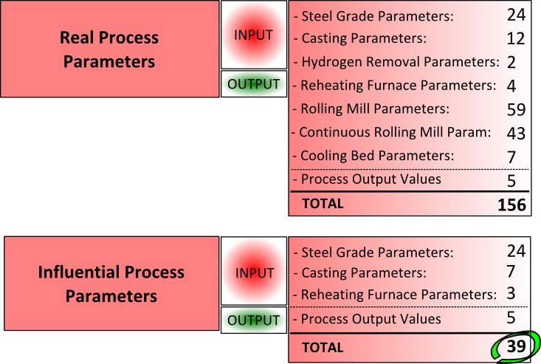
Process Parameters and Properties
PROCESS OUTPUT VALUES
A (%) – Elongation
Rm (N/mm²) – Tensile strength
Rp0,2 (N/mm²) – Yield Stress
HB – Hardness After Rolling
Z (%) – Necking
Influential parameters have been selected based on expert knowledge of technologists in Štore Steel.

Slide 13
ANN for Steel Production Chain
Separate Training data for 2 dimensions (140 mm, 180 mm)
Parameters for training (34 Input, 5 Output, 1879 training sets, 94 verification sets)
100.000 ANN training cycles
Training performed on a workstation with 12 processor cores (Xeon 5690 3.47GHz )
Training times 1 to several days
Response evaluation times in range of 1/100 s (suitable for optimization)
Results discussed with industrial experts

Slide 14
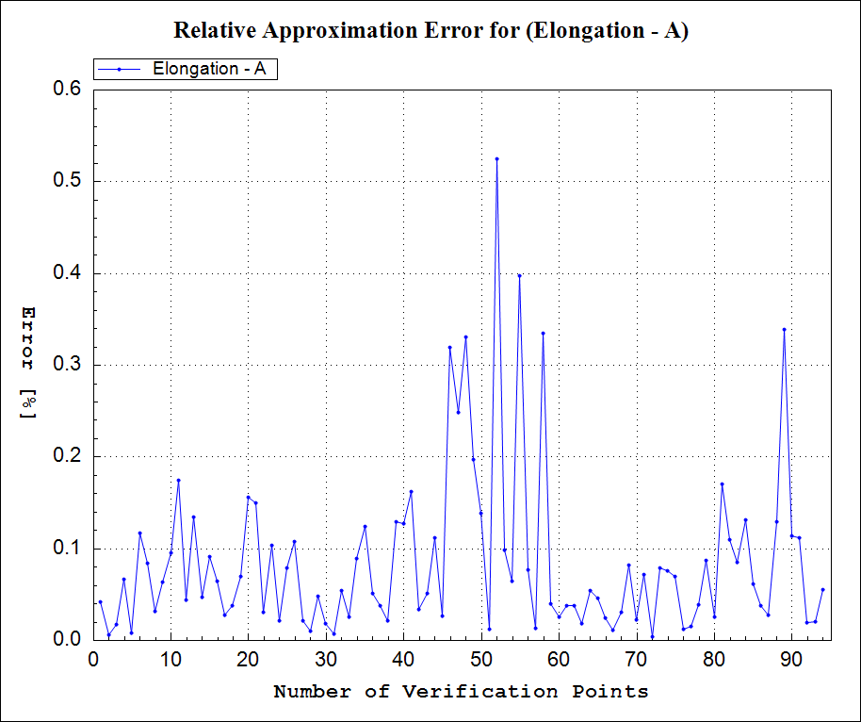
Errors in verification points
MAX. APPROXIMATION ERRORS
Elongation | 0.6 %
Tensile strength | 0.7 %
Yeld stress | 0.4 %
Hardness after rolling | 0.5 %
Necking | 3.4 %
Errors in verification points

Slide 15
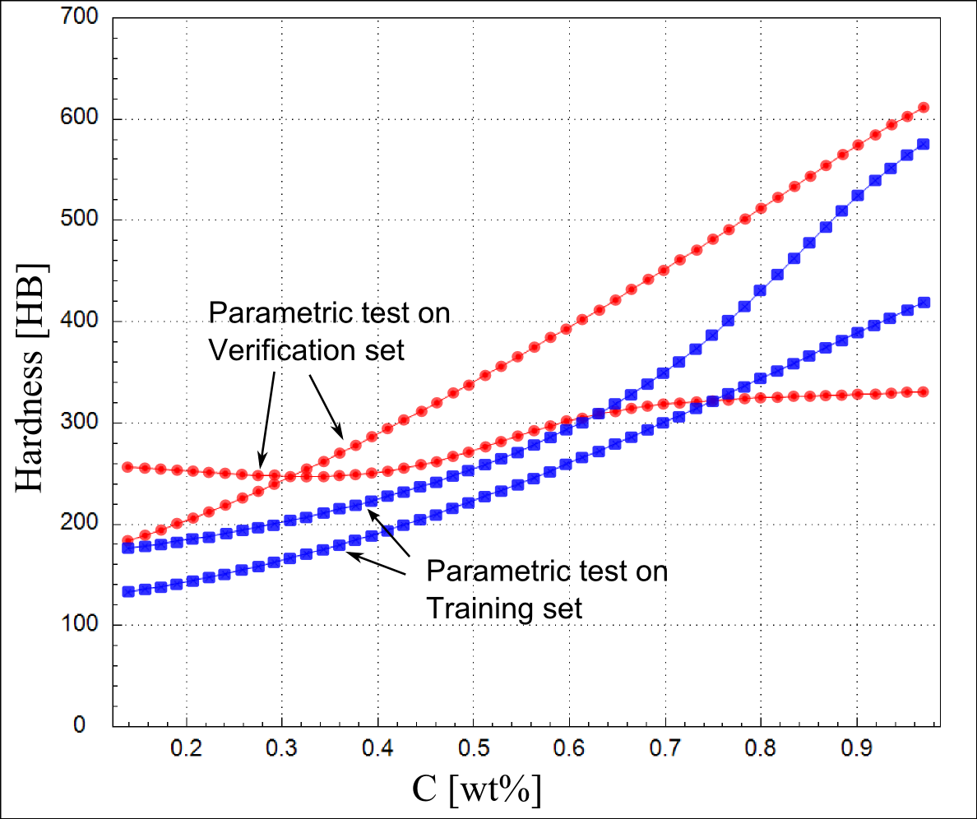
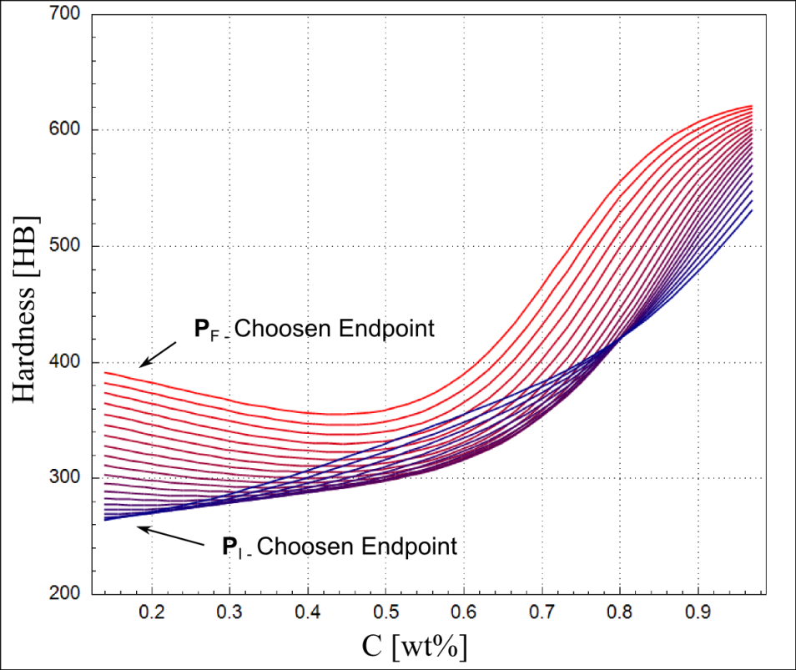
Parametric Studies
Steel hardness after rolling as a function of the carbon mass fraction
Calculated on 2 training and 2 verification sets
Calculated on 2 real sets and 18 calculated sets on the line between them

Slide 16
Conclusions and Further Work
A dedicated software framework to support ANNs
  Ability of parallel training to find suitable architecture and training parameters
Interfaces with numerical simulators for generation of training data (parallel module included).
Analysis of results (parametric studies, error estimation)
Applications
  ANN model for complete steel production process chain
  ANN model for continuous casting process
Further work:
Assessment of data quality and error estimation
Widen the range of applications

Slide 17
References
Grešovnik, I. (2012): Iglib.net - investigative generic library. Available at: http://www2.arnes.si/ ljc3m2/igor/iglib/.
Grešovnik, I.; Kodelja, T.; Vertnik, R.; Šarler, B. (2012): A software framework for optimization parameters in material production. Applied Mechanics and Materials, vol. 101, pp. 838-841.
Grešovnik, I.; Kodelja, T.; Vertnik, R.; Šarler, B. (2012): Application of artificial neural networks to improve steel production process. Bruzzone, A. G.; Hamza, M. H. 15th International Conference on Artificial Intelligence and Soft Computing. Napoli, Italy. IASTED, pp 249-255.
Grešovnik, I.; Kodelja, T.; Vertnik, R.; Senčič, B.; Kovačič, M.; Šarler, B. Application of artificial neural network in design of steel production path. Computers, Materials & Continua, 2012.

