Slide 1



TOPMOST STEEL PRODUCTION DESIGN BY USING ARTIFICIAL NEURAL NETWORK THROUGH PROCESS MODELING
Tadej Kodelja
Igor Grešovnik, Robert Vertnik, Božidar Šarler
Laboratory for Advanced Materials Systems
(Centre of Excellence for Biosensors, Instrumentation and Process Control)
Laboratory for Multiphase Processes
(University of Nova Gorica, Institute of Metals and Iechnology)

Slide 2
Scope of Presentation
Through process modeling
Process parameters
Use of artificial neural network – ANN
Error estimation and parametric tests
Conclusion and further work

Slide 3
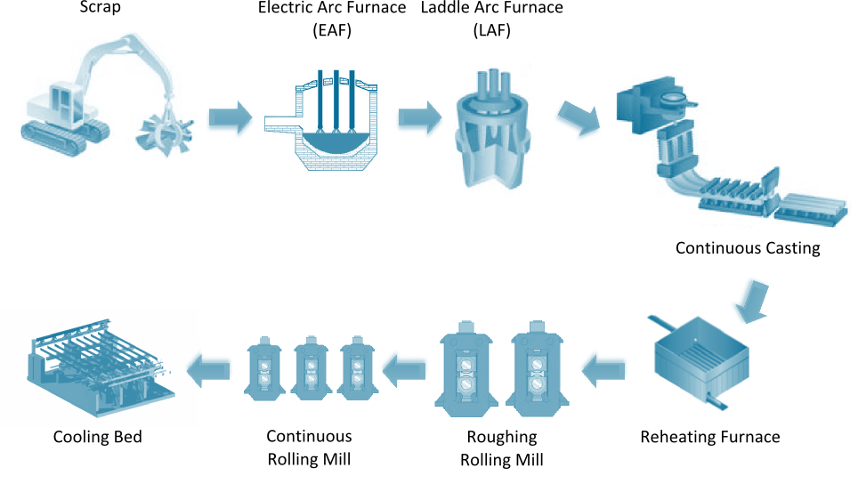
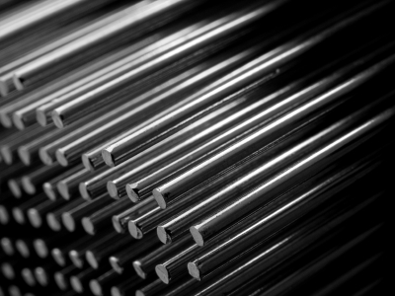
Štore Steel Process Scheme
Main Goals of Through Process Modeling
PROCESS PARAMETERS
151
MATERIAL PROPERTIES
Elongation
Tensile strength
Yield Stress
Hardness
Necking

Slide 4
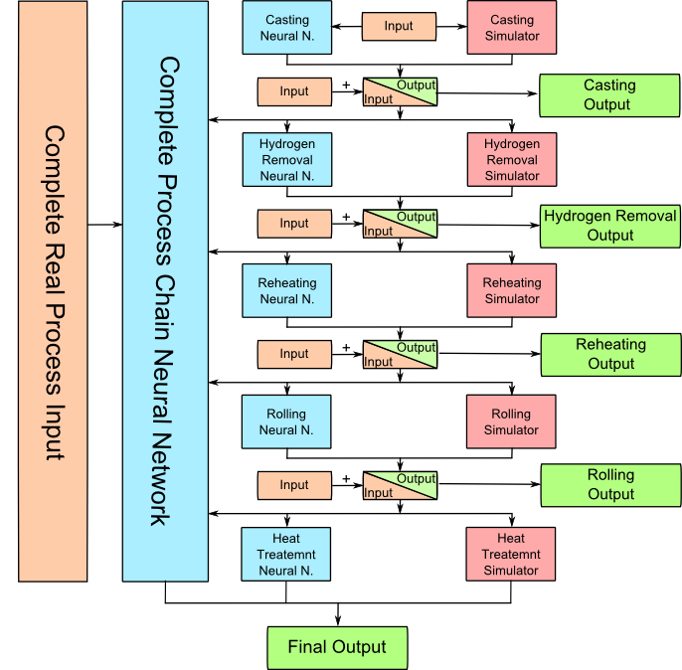
Steel Process Route Modeling Scheme
MAIN CONCEPT
Combination of physical modeling
and artificial intelligence modeling
PROCESSES
Casting
Hydrogen Removal
Reheating
Rolling Mill
Heat Treatment

Slide 5
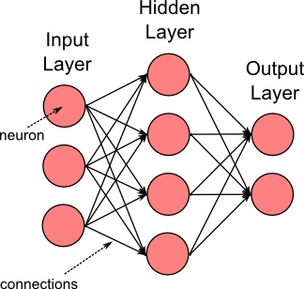
Artificial Intelligence Modeling
Artificial Neural Network - ANN
Mathematical model inspired by the structure of biological neural networks
ANN learns by example as do their biological counterparts
ANN are typically organized in layers (Input, Hidden, Output)
Implemented open source library (Aforge.net)
Feedforward Backpropagation algorithm
Supervised learning (known Inputs and outputs)
Multylayer architecture

Slide 6
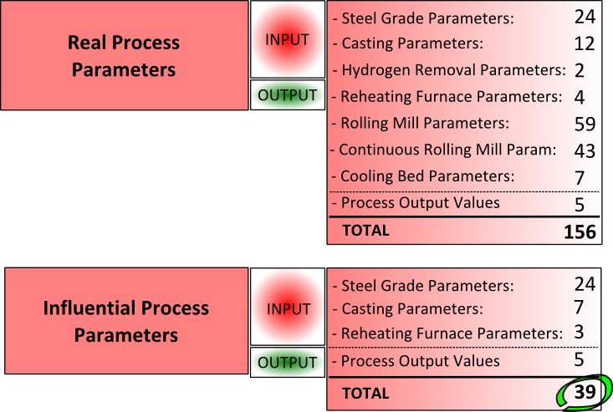
Process Parameters and Properties
PROCESS OUTPUT VALUES
A (%) – Elongation
Rm (N/mm²) – Tensile strength
Rp0,2 (N/mm²) – Yield Stress
HB – Hardness After Rolling
Z (%) – Necking
Influential parameters have been selected based on expert knowledge of technologists in Štore Steel.

Slide 7
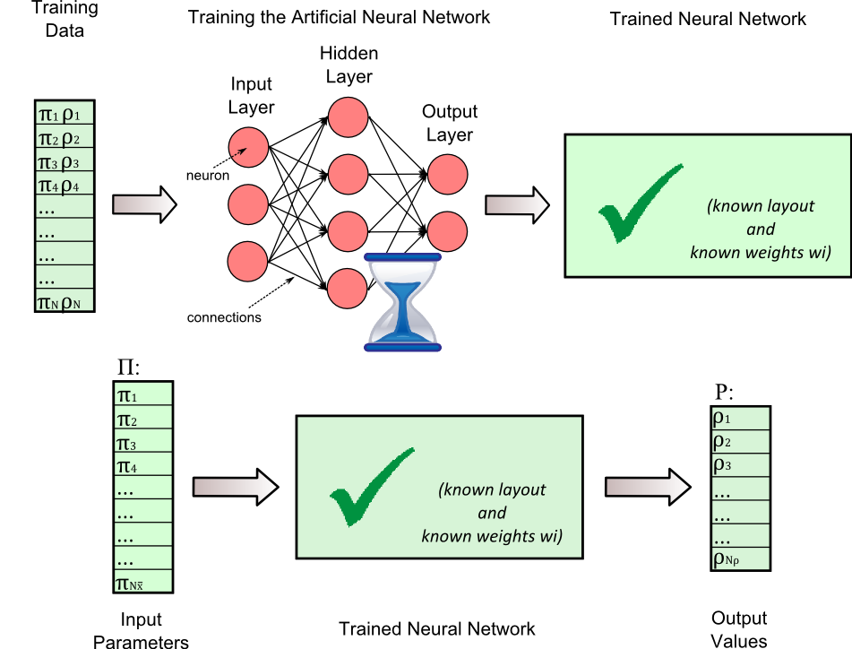
ANN for Steel Production Chain
Separate training data for 2 dimensions (140 mm, 180 mm)
Parameters for training (34 input, 5 output, 1879 training sets, 94 verification sets)
100.000 ANN training cycles
Training performed on a workstation with 12 processor cores (Xeon 5690 3.47GHz )
Training time ~ 20 hours
Response evaluation times in range of 1/100 s (suitable for optimization)

Slide 8
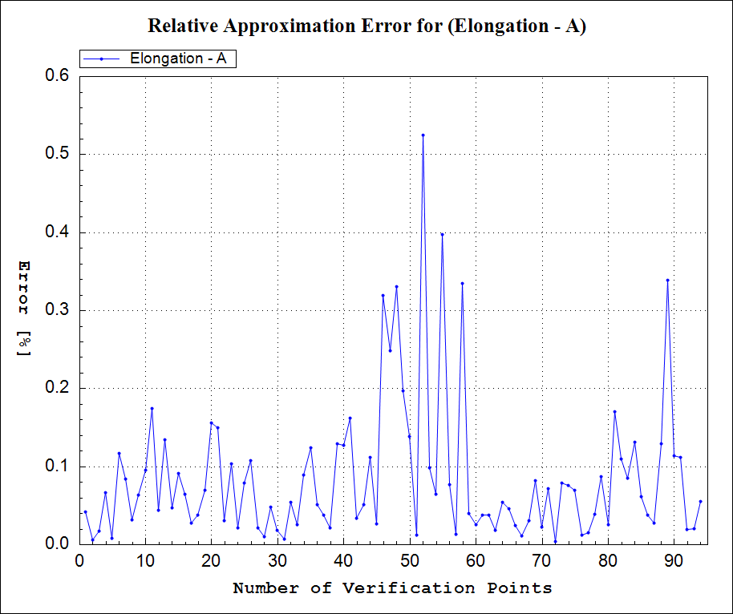
Errors in Verification Points
MAX. APPROXIMATION ERRORS
Elongation | 0.6 %
Tensile strength | 0.7 %
Yeld stress | 0.4 %
Hardness after rolling | 0.5 %
Necking | 3.4 %
Relative error in verification points for elongation

Slide 9
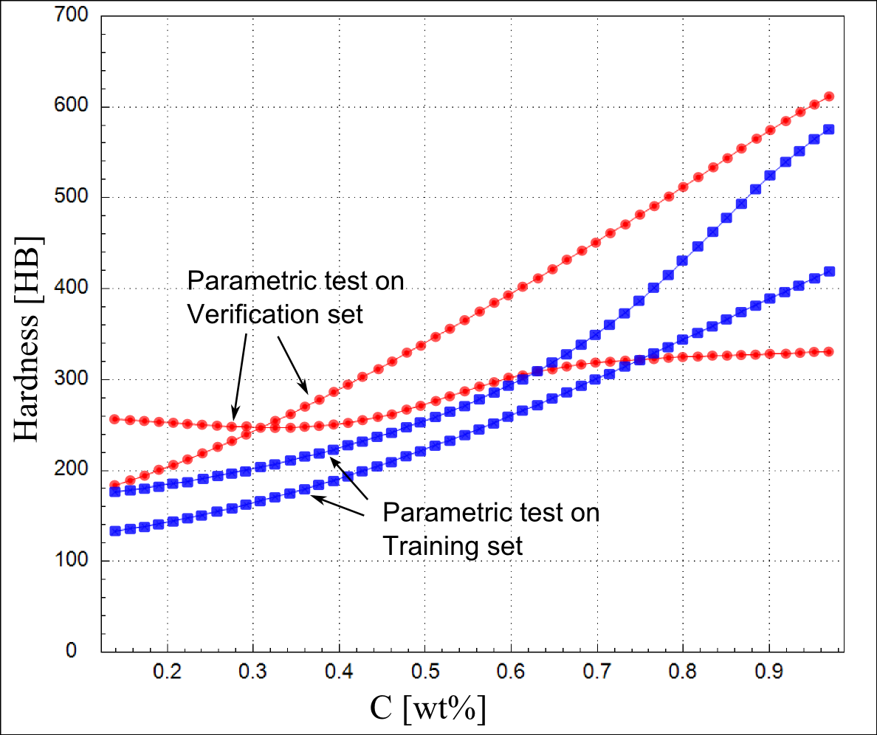
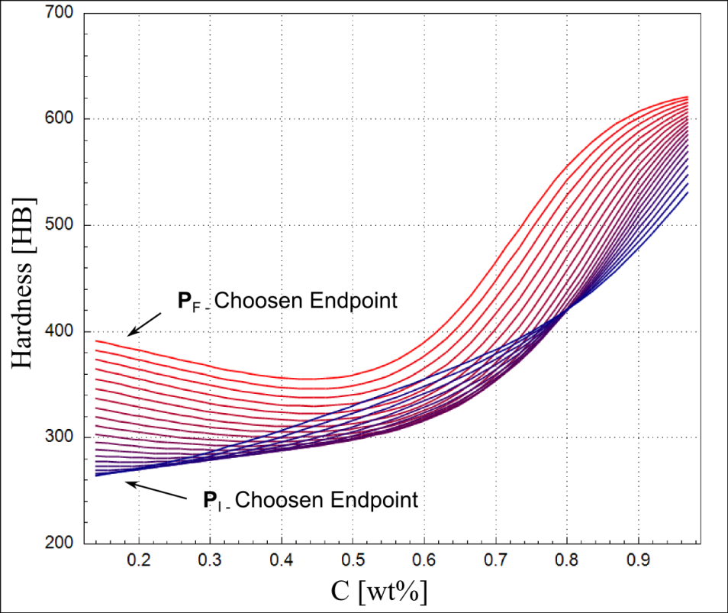
Parametric Studies
Steel hardness after rolling as a function of the carbon mass fraction
Calculated on 2 training and 2 verification sets
Calculated on 2 real sets and 18 calculated sets on the line between them

Slide 10
Conclusions
Connect process parameters with final material properties
Methodology has been successfully demonstrated
The problems lie in details such as
  Lack of sensors where data should be collected
  Lack of systematic data acquisition
  Lack of understanding the quality of ANN
Which process parameters influence on the predefined product properties?
Grešovnik, I.; Kodelja, T.; Vertnik, R.; Senčič, B.; Kovačič, M.; Šarler, B. Application of artificial neural network in design of steel production path. Computers, Materials & Continua, 2012, In press.

