Slide 1
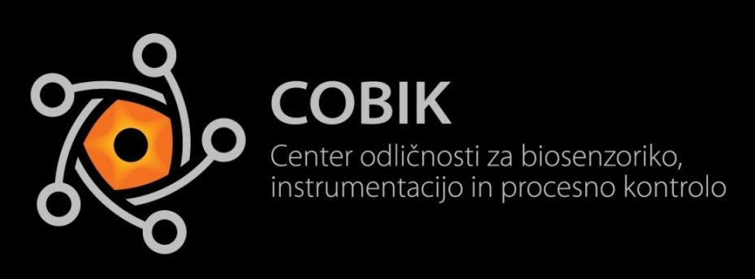

Numerical Modelling of Fullerene Production by the Electric Arc - Discharge Method CENTER ODLIČNOSTI ZA BIOSENZORIKO, INSTRUMENTACIJO IN PROCESNO KONTROLO
Katarina Mramor, Božidar Šarler
Laboratory for Advanced Matarials Systems
Center of Excellence for Biosensorics,
Instrumentation and Process Control
Ljubljana, Slovenia

