Slide 1

Notes:
This Scout clipart is my JAM
https://openclipart.org/user-detail/Scout

Slide 2

Version control systems (like Git) allow you to retain your
science karma (!) over the course of a project

Slide 3

Goals for today:
Understand what these tools are for
Create a repository (“repo”) online
Create a repo from your desktop
Push a commit
Fork a repo
Push an edit to a forked repo
Done!

Slide 4
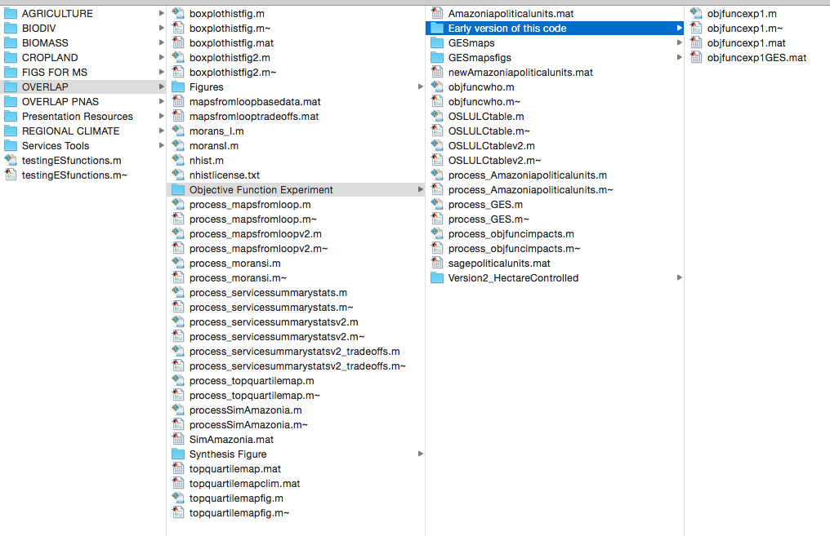
The problem that needs solving:

Slide 5
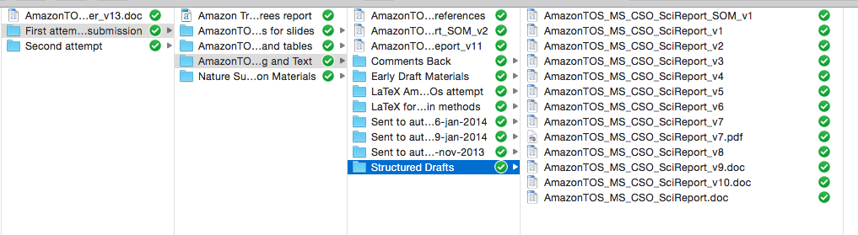


And it doesn’t apply only to code!
What is my PhD on again????
I WANT COOKIE DOUGH

Slide 6
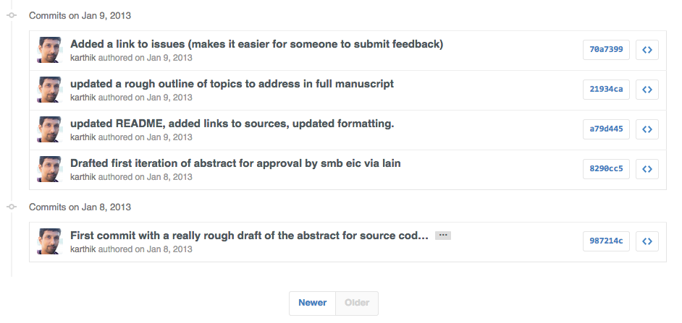
Git, a revision control system, lets you: (1) track the history of changes you’ve made (2) keeps your work reproducible (even to you!) (3) helps you keep good documentation and (4) collaborate without writing over others’ work
https://github.com/karthik/smb_git/commits/master?page=4
Notes:
Paper:
http://www.scfbm.org/content/8/1/7
Tutorials:
https://try.github.io/levels/1/challenges/1
http://www.dataschool.io/git-and-github-videos-for-beginners/
Doing this all through Rstudio
http://jonlefcheck.net/2013/11/04/a-basic-tutorial-to-version-control-using-git/

Slide 7
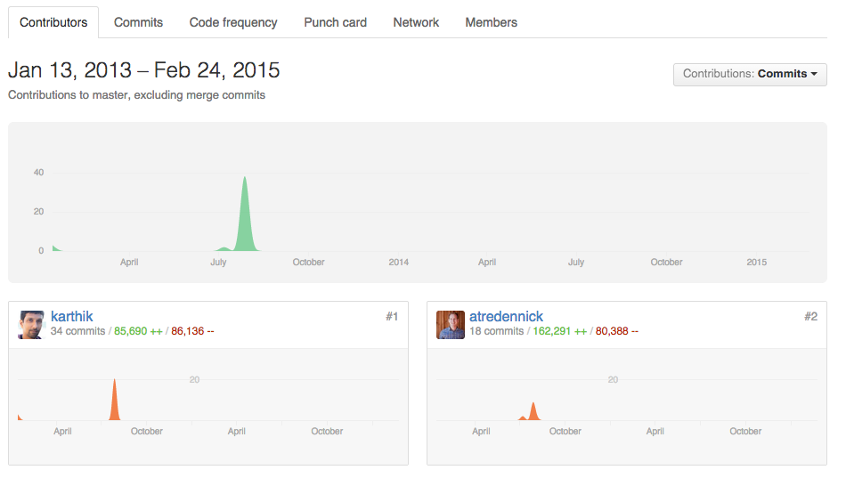
Git, a revision control system, lets you: (1) track the history of changes you’ve made (2) keeps your work reproducible (even to you!) (3) helps you keep good documentation and (4) collaborate without writing over others’ work
https://github.com/karthik/esa_data_viz/graphs/contributors
Notes:
Code can be made public
Talk about the spectrum of using this

Slide 8

Links:
https://github.com/
github.com/coconn
Notes:
Linux resources –
https://stackoverflow.com/questions/1516720/git-gui-client-for-linux
https://stackoverflow.com/questions/15398229/is-there-any-github-gui-client-for-linux-os
http://www.linux.com/learn/tutorials/796387-beginning-git-and-github-for-linux-users/
Command line resources
http://classic.scottr.org/presentations/git-in-5-minutes/

Slide 9
Some other slides that I might use as reference follow…

Slide 10
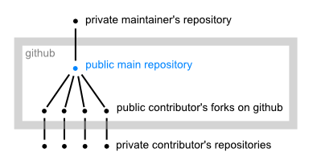
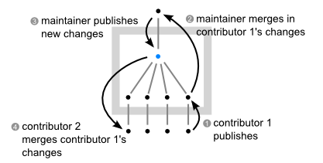
Collaborating with others
Notes:
http://www.eqqon.com/index.php/Collaborative_Github_Workflow – workflow fork-style overview
https://stackoverflow.com/questions/6286571/git-fork-is-git-clone – fork on github vs git clone
https://help.github.com/articles/using-pull-requests/ - collab models

Slide 11
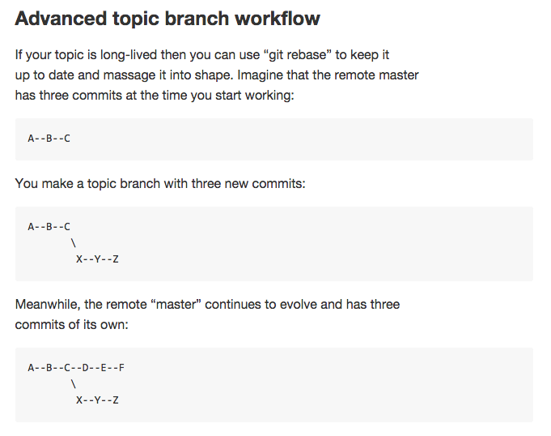
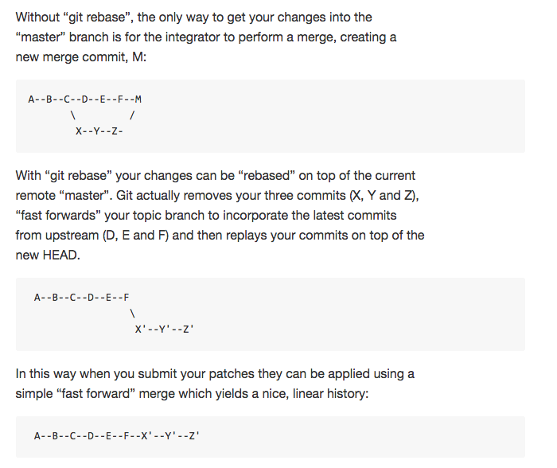
Branches
Notes:
https://github.com/dchelimsky/rspec/wiki/Topic-Branches

