Slide 2
Clustering
(Chapter 2)
My thesis
Estimation
(Chapters 3,4,5)
Testing
(Chapters 3,4)
Regression

Slide 3
Clustering
(Chapter 2)
My thesis
Estimation
(Chapters 3,4,5)
Testing
(Chapters 3,4)
Regression

Slide 4
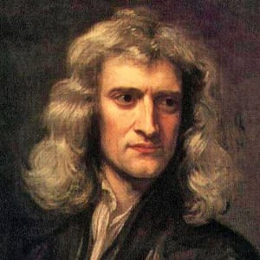
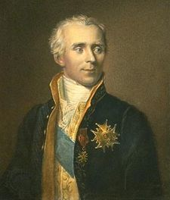

Slide 6



Super-critical regime
$$2s=d$$
$$s$$
Sub-critical regime
$$d$$

Slide 7

Super-critical regime
$$2s=d$$
$$s$$
$$4s=d$$
Sub-critical regime
$$d$$

Slide 8





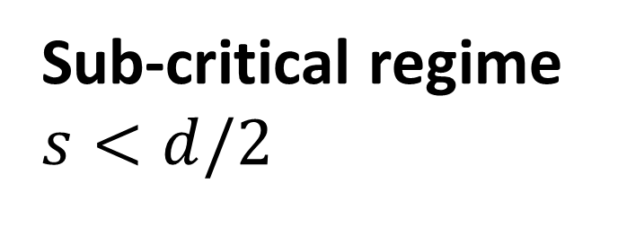
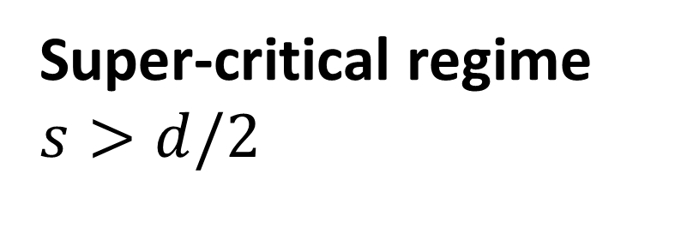

Super-critical regime $s>d/2$
Sub-critical regime $s<d/2$
$$C^{0}$$
$$C^{0}$$
$$H^{s}$$
$$H^{s}$$
$$C^{s}$$
$$C^{s}$$

Slide 9


$$f(x)$$
$$Df(x)$$

Slide 10




$$f_{0}^{(n)}$$
$$p^{(n)}$$
$$θ_{n}$$
$$r_{n}$$

Slide 11


Super-critical regime
$$2s=d$$
$$s$$
$${\hat{f}}_{LS}$$
Sub-critical regime
$$d$$

Slide 12

Super-critical regime
$$2s=d$$
$$s$$
$$4s=d$$
$${\hat{φ}}_{LS}$$
Sub-critical regime
$$d$$

Slide 13

Super-critical regime
$${\hat{f}}_{LE}$$
$$2s=d$$
$$s$$
$${\hat{f}}_{LS}$$
Sub-critical regime
$$d$$

Slide 14

$${\hat{φ}}_{LE}$$
Super-critical regime
$$2s=d$$
$$s$$
$$4s=d$$
$${\hat{φ}}_{LS}$$
Sub-critical regime
$$d$$

