Slide 1
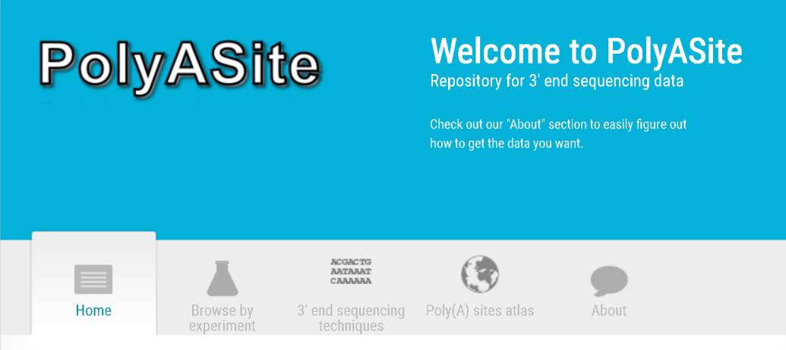
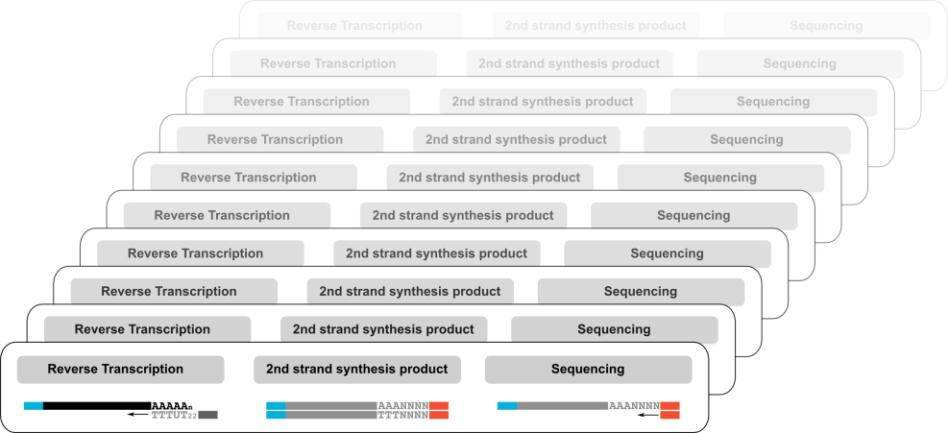
Different 3’ end sequencing libraries…
Number of poly(A) sites per species:
Mouse: 183,225 Human: 392,912
3’ end sequencing libraries
human: 78 samples (7 protocols)
mouse: 110 samples (8 protocols)
Uniform processing pipeline
protocol-specific library preprocessing
remove protocol specific artifacts

