Slide 1
Battle of World Capitals!!!
Capstone Project, Coursera-IBM Specialization
AnIbal J Guerra S,
Medellín, Colombia

Slide 2

Introduction
What factors are really needed for a city to achieve the perfect balance that makes it attractive, providing enough quality of life to consider it city as a well-developed city.
Are there any categories of venue that can be related as a sign of having a balanced development?

Slide 3
Bussiness problem
For public servers in the government (i.e. major, governors) having clarity about such factors would give them clarity about the decisions that should be made to keep the city on the road to development. Two questions seem obvious: where on that road is the city right now (what does the city “have”) and what should we “have” as a city in order to be considered as developed city in the future.
I would use the Foursquare data related to all of the venues that the capitals of the world have right now, and see if through data science I get to stratify (or cluster) those cities to see if there are specific venues that are characteristic of the cities development in each class.
Hypothesis: It is possible to discriminate groups of cities according to the amount of certain types of venues in them. If so, is it possible to find out which venues are characteristics of well-developed cities.

Slide 4
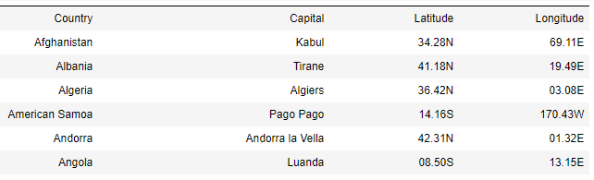
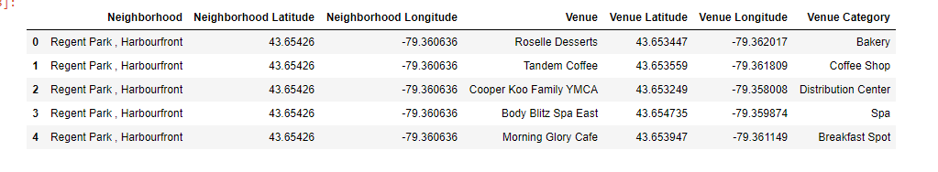

Data source
More than 200 capitals of the world and along with their geo-localization data.
Up to 100 venues per city as returned by a foursquare request.

Slide 5
MEthodology
Web scrape from website page for a list of capitals of the world along with their geo-localization data.
Explore and pre-process geo localization data.
Use Foursquare API to find the venues corresponding to each capital.
Clean encode and normalize venues data.
Apply k-means clustering, find the optimal k value and visualize data using Folium maps
Analyze each cluster to find if any matches the criteria of well-developed cities.

Slide 6
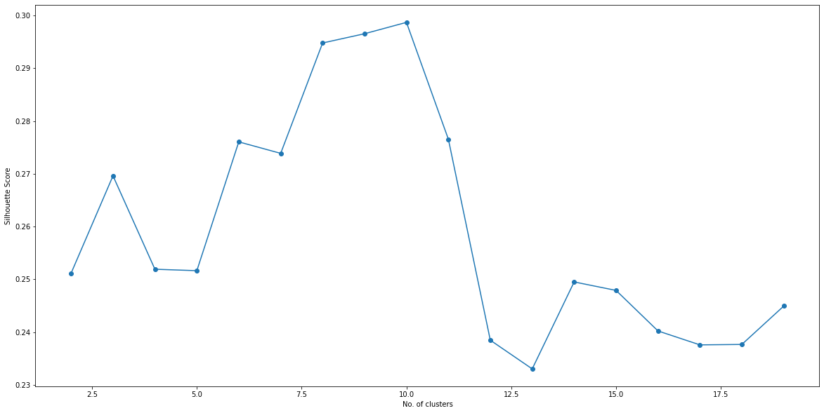
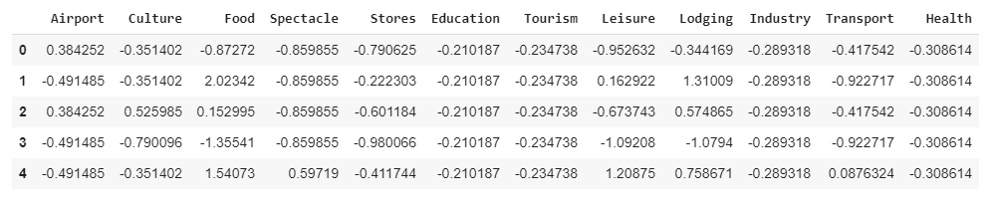
Machine-learning clustering
With selected and normalized input columns:
Apply K-means clustering algorithm
Iterate using different k to optimize the k value through the silhouette score metric
Plot the map with the optimal cluster value.
Example of final input data
Plot of the silhouette score for different k

Slide 7
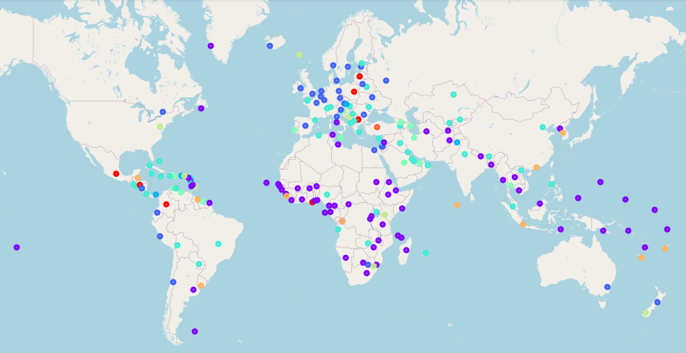
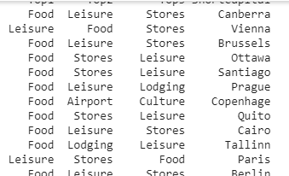
results
With k=8, this was the resulting clustering :
Cluster number 2 matched the concept of well-developed cities.
That cluster was dominated in more than 90% by food, leisure, and stores venues.

Slide 8
conclusions
I have built a model to cluster world cities according to the most common venues in them.
It seems that, according to the Foursquare dataset, those venue categories are characteristics of a well-developed economies.
There is space for improvement in the model, using more data and normalizing input data respect to population size.
Nowadays, the commerce and service venues have become an important part of a city development, and according to the results presented here their growth could be related to the definition of a healthy economy.

