Slide 1

College Fight! (WIP)
By: Samip Niraula, Abraham Halim

Slide 2
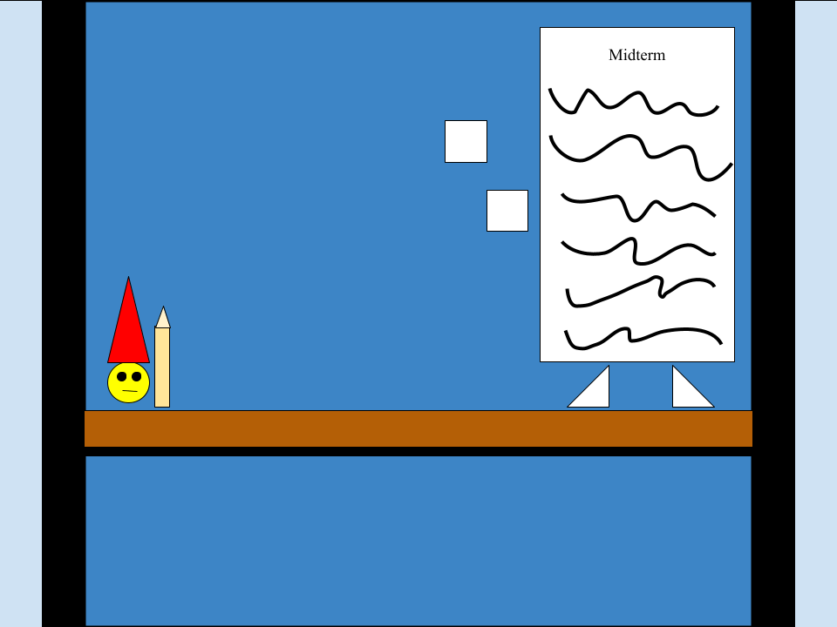

Scene 1

Slide 3
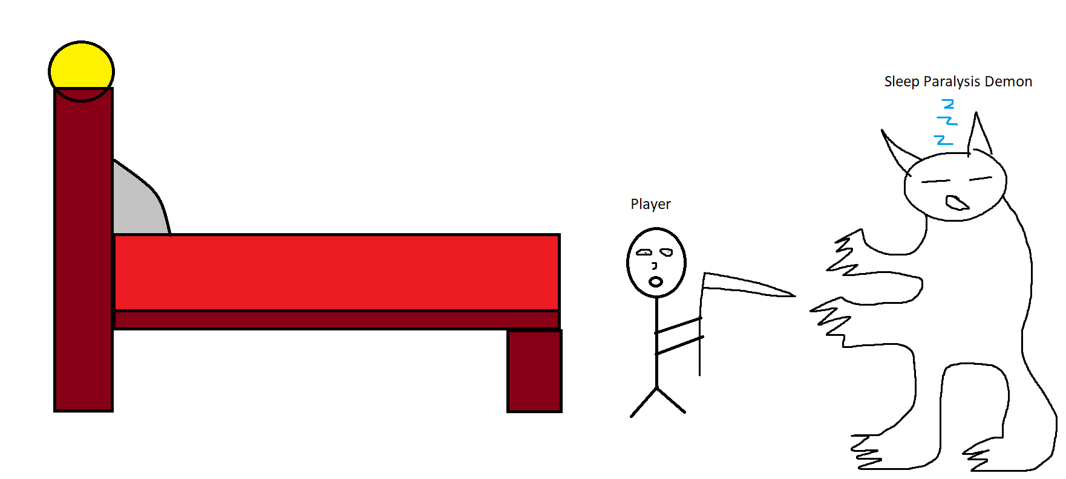
Scene 2

Slide 4
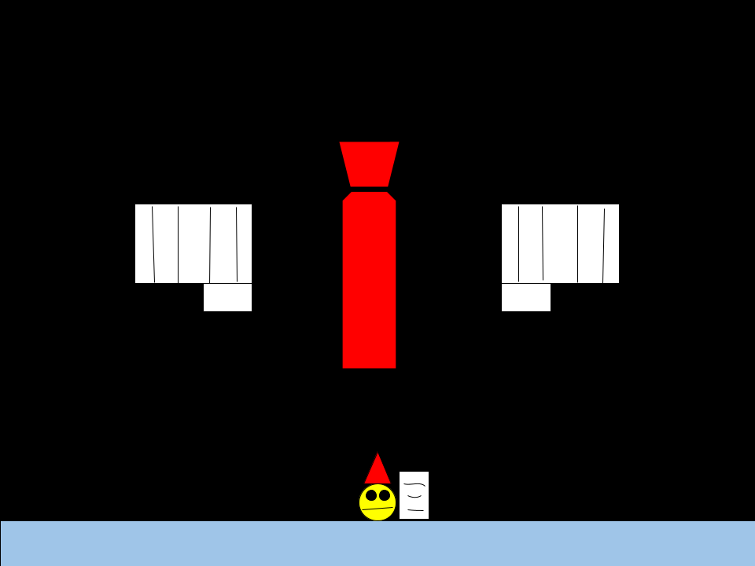
Scene 3
Have you had any job experience?
What are your worst qualities?
Why should we hire you?

Slide 5
TAKE THE FIGHT TO COLLEGE!
Annihilate your college enemies in our game.
Sabram
Studios

Slide 6
Credits
Scenes were done in ms paint and or google drawings
Audio was recorded on obs, by Abe smacking spoons against his mug and scribbling on a notebook

