Slide 1
Crash!

Slide 2
Data & Background
FARS Accident Fatality Data (2015)
3 different CSVs
Accident Data
Vehicle Data
Person Data
Referenced manuals to understand the data
GES General Estimate Sampling
Notes:
How we found the data (FARS)
Took us awhile to find a large enough dataset
Ended up combining 3 CSVs
What information is in each doc
Accident data -- what columns, information, etc.
Vehicle - what columns, information, etc
Person - what columns, information, etc.

Slide 3
Core Message
Identifying factors contributing to fatal accidents
Questions
Does time factor into fatal accidents?
Day of week, month, time of day
Do personal factors affect fatal accidents?
Alcohol, age, distracted, etc.
Does location impact the number of fatalities?
City, state, region
Does weather impact the number of fatalities?
Notes:
What were the general questions that we started with?
Once we found a good enough dataset how did they change?
How did these lead to our hypthesises

Slide 4
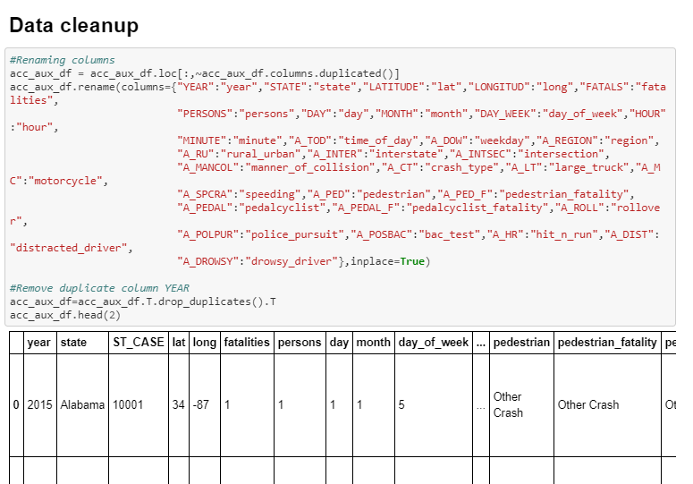
Data Cleanup

Slide 5
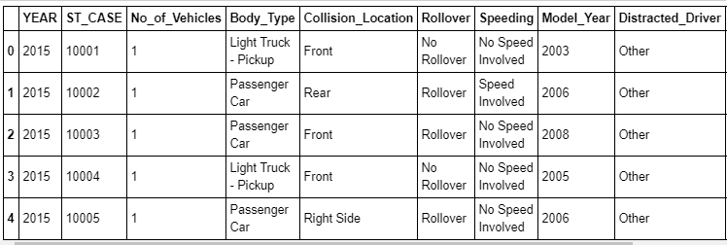
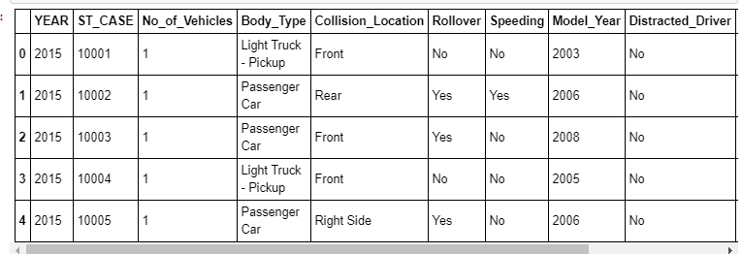
Data Cleanup

Slide 6
Additional Sources Used
Citipy
Finding city name based on lat and long using citipy library.
Geocoding API
Finding latitude and longitude based on citi name using Geocoding API.

Slide 7
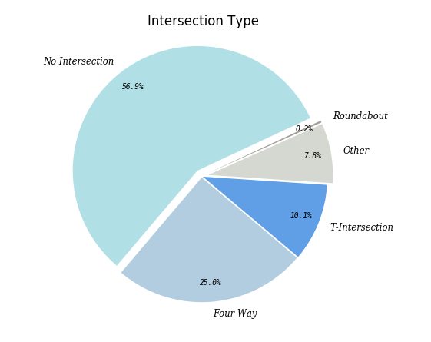
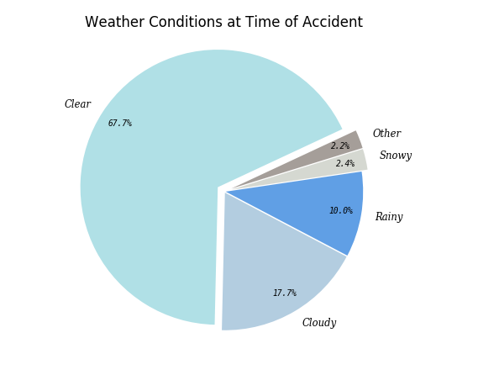
Weather and Intersections

Slide 8
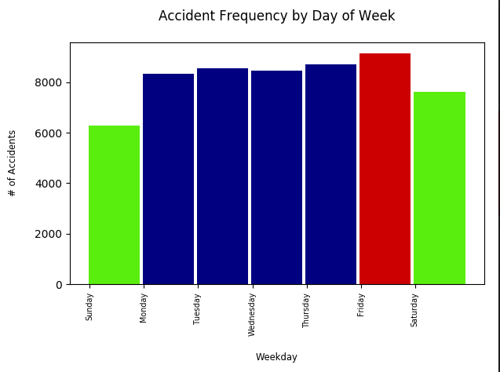
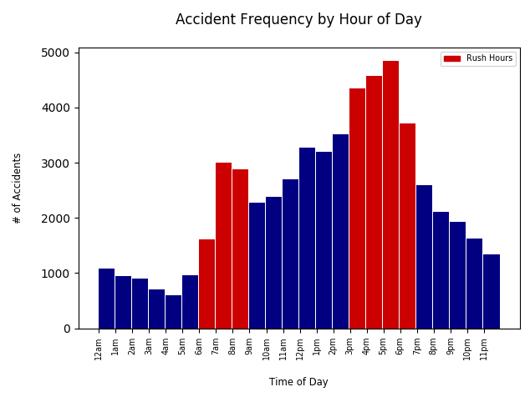
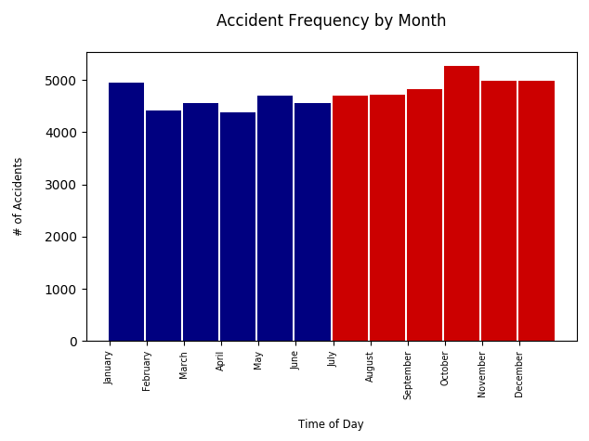
Time Anaysis

Slide 9
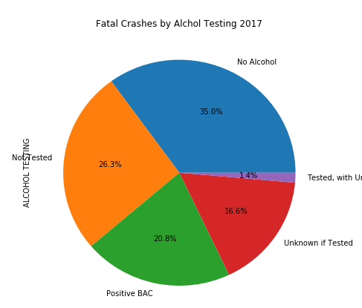
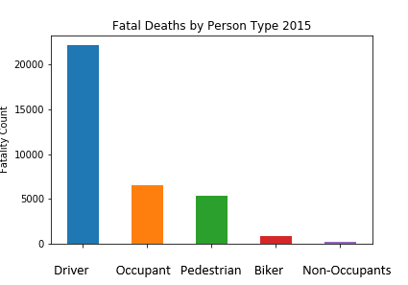
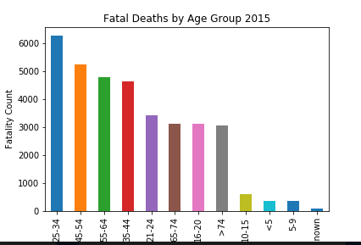
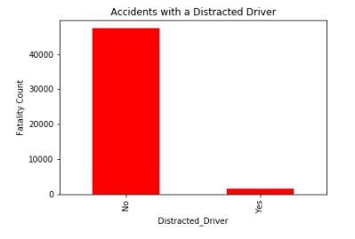
Personal Factors

Slide 10
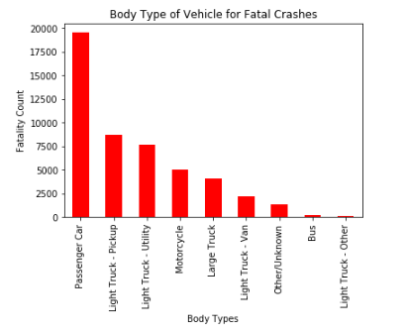
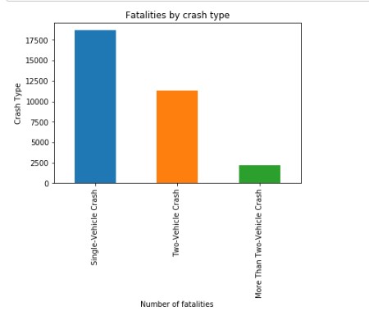
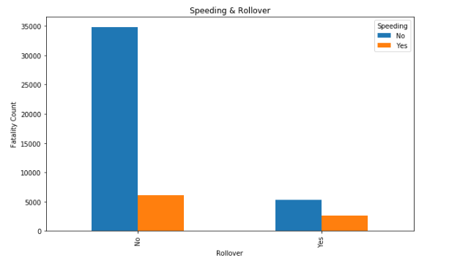
Speeding, Rollover, Vehicle Type, Crash Type

Slide 11
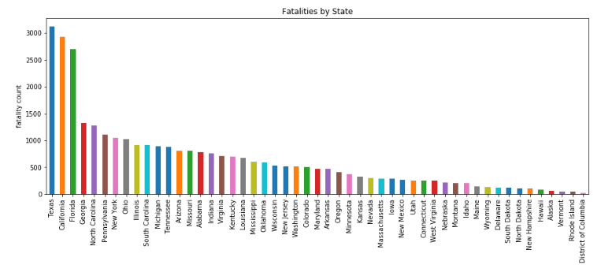
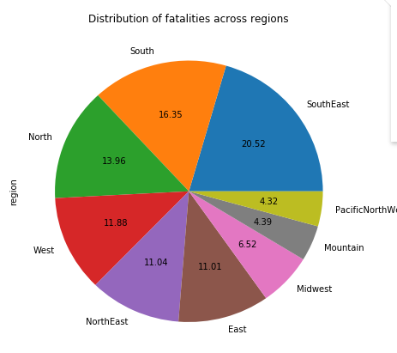
Location

Slide 12
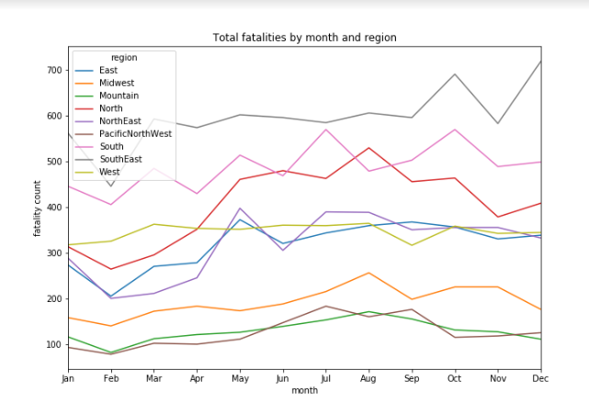

Slide 13
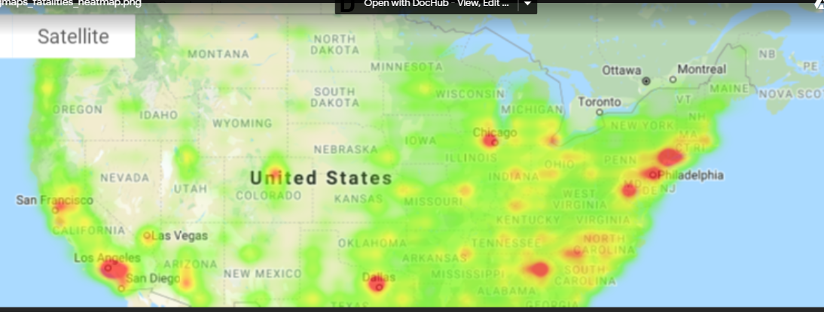

Slide 14
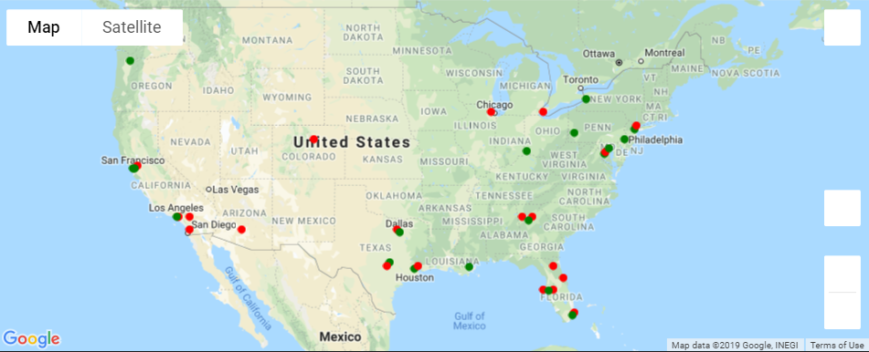
Red = FARS data
Green = 2018 Survey Data

Slide 15
Conclusion
Assumption: More accidents would occur in the winter months in the northern part of the country Finding: Least no. of accidents occured in the months of Jan, Feb, Mar
Assumption: More accidents would occur when driver is drunk Finding: Alcohol was not the most contributing factor
Assumption: There would be more accidents on the weekend Finding: Also most accidents occur during rush hours.
Notes:
Discussion
Discuss your findings. Did you find what you expected to find? If not, why not? What inferences or general conclusions can you draw from your analysis?

Slide 16
Conclusion (Cont…)
Assumption: More fatal crashes occur in highly populated areas Finding: Indeed
Our analysis is consistent with multiple surveys for fatality accidents

Slide 17
Challenges
Finding a large enough data set that would allow us to do enough analysis
Tried to reach out to MN Dot & Hwy Safety Information Systems
Data needed a lot of cleaning
Columns had confusing name
Venn Diagram
Collaborating to code/project work
Notes:
Post Mortem
Discuss any difficulties that arose, and how you dealt with them
Discuss any additional questions that came up, but which you didn't have time to answer: What would you research next, if you had two more weeks?

Slide 18
Questions?

