Slide 1
2015 Capstone Project – Youthful Cities
Created by: Andrew Howard
CKME136

Slide 2
Data Set
Youthful Cities
55 Cities
21 Features
Visualizations

Slide 3
Problems/issues
Missing Data Points
Multi-page Excel Worksheet
2014 Data used
100 Features normalized to 21 features

Slide 4
Question and plan
Feature Selection
Linear Regression and 5 fold cross validation
RMSE
Hierarchical Clustering

Slide 5
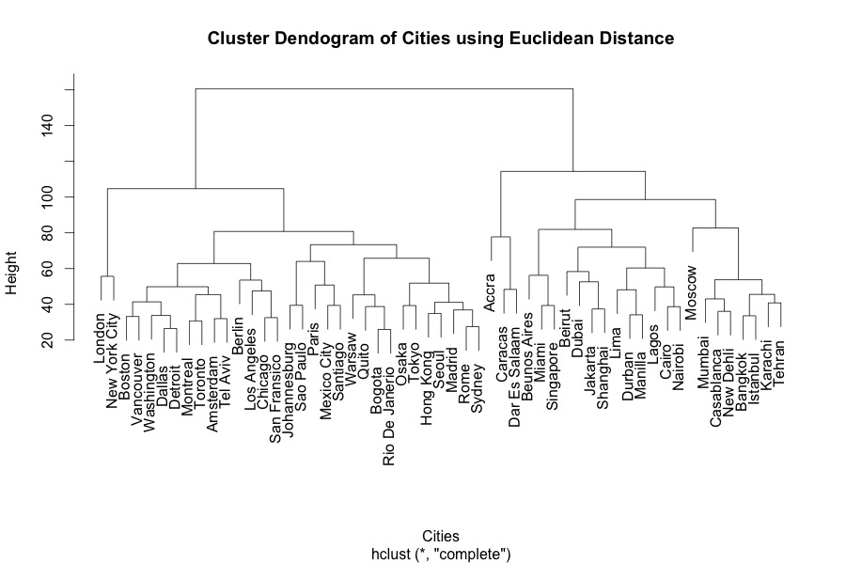
Hierarchical Clusters

Slide 6
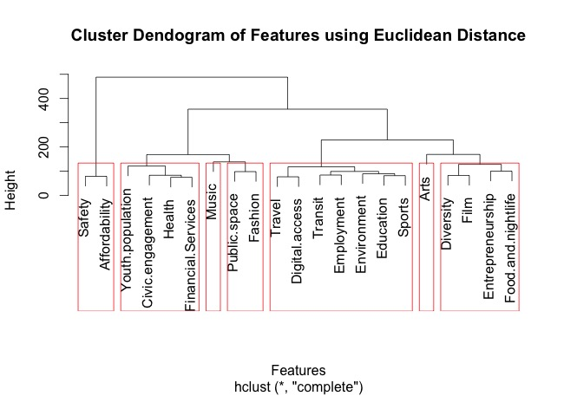

Slide 7
Experiments
1 Random Feature from 7 Cluster Cut Off of Dendogram
3 Stepwise Linear Regression models
Calculated the RMSE
Separated the models into 5 folds
Calculated the mean RMSE for each fold.
Visualized the models

Slide 8
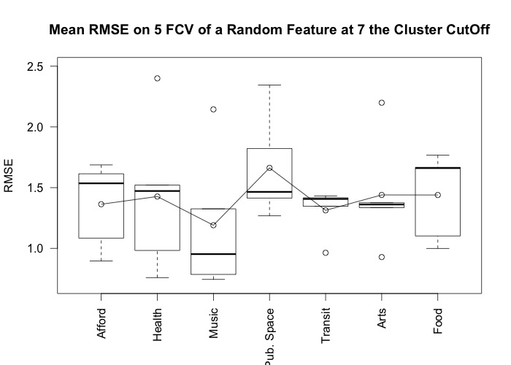

Slide 9
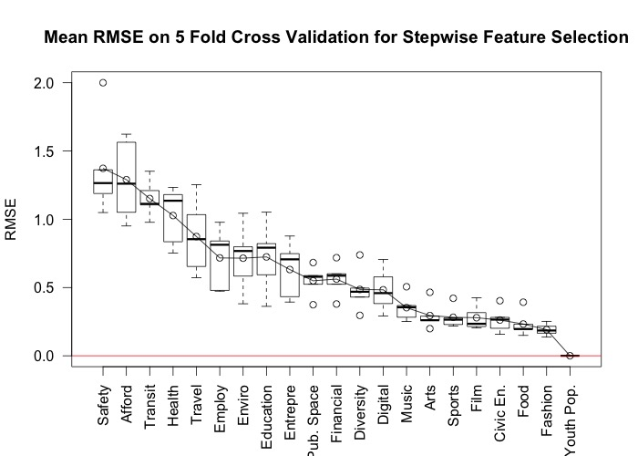

Slide 10
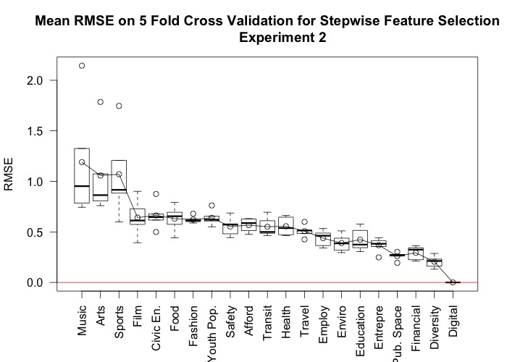

Slide 11
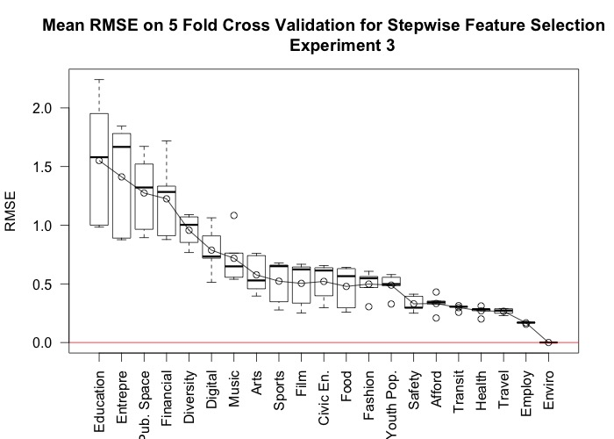

Slide 12
Conclusions
Downward trajectory
Removing only 1 feature jumps RMSE
RMSE stays consistent for another 5 features.
Optimal number would be around 15.

Slide 13
Where to go from here?
Explore the city cluster dendogram
Run further models to better select features
Explore the full 100 features

