Slide 1
Basic Sound Detection for Enemy AI
James Schmidt and Aji Suprana
4/18/2017

Slide 2
Basic Sound Detection for Enemy AI
Purpose
Issues With Sound Modeling
Basic Implementation
Demo

Slide 3


Why have sound detecting AI?

Slide 4
Why have sound detecting AI?
Smarter AI
Gives the appearance of intelligence
Makes interactions feel more realistic
Adds depth to your AI
Player Immersion
World feels more alive
Player can use sound to their advantage
Because stealth mechanic dude!

Slide 5
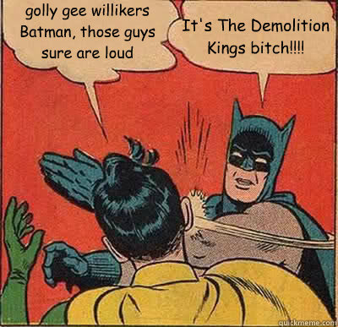
Don’t delay, start today…
Golly gee willikers Batman, sound detection is awesome! Lets start…
We haven’t even discussed the implementation issues yet!

Slide 6
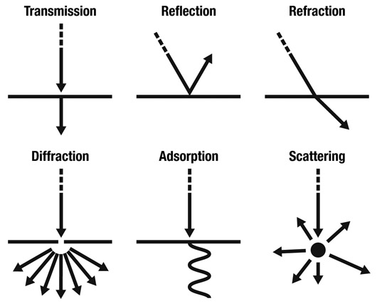
3 main issues with realistic sound modeling
Ray Casting Sound
Sound Reflection
Sound Diffraction

Slide 7
Ray casting sound is redundant to do!
Why do more work?
Infinite directions!
There’s an easier way!
Use pathfinding

Slide 8
Sound reflection has too much overhead!
Using Reflection
Cast multiple rays
Find normal and compute incident angle
Cast secondary rays, if it hits then add to list
Find the smallest path from the list
Using Pathfinding
Easier to compute!
Always gives the smallest path upfront

Slide 9
Utilize the basic property of diffraction!
Using Diffraction:
Sound wraps around edges, making the edge the center of a secondary source
Doors can be treated just like edges!
Catch:
Secondary sources emit a lower intensity
Using Pathfinding
Mimics diffraction without the need for creating multiple secondary sources!

Slide 10

Basic implementation for sound detection
Create an object with a sound emitter
Upon emitting a sound: check if a listener is inside the max distance circle
If there is, then pathfind to the listener
If the total path distance <= max distance, then tell the listener that the sound can be heard and send it the created path
If the listener identifies the sound, then reverse the created path
Then have the listener start walking the path to where the they assume the source to be

Slide 11
How it looks
DEMO

Slide 12

Wrap it up!

Slide 13
Wrap it up!
Sound Detection for Enemy AI
Makes your AI feel more realistic and your world feel more alive
Remedy the Issues
Don’t overwork the problem, say no to ray casting
Reflection can be useful but requires too much
Utilize pathfinding to mimic sound diffraction
Go With a Basic Implementation
If intensity is required then implement an attenuation function

Slide 14
Questions/Comments

Slide 15
Edge cases to consider
Smarter AI
Use

Slide 16
Changing the highlight color
←This is a bullet point
To change the highlight color of the title or bullets
Select the lines
Click the bullet drop down in the Home tab
Select “Bullets and Numbering”
Click the Color drop down and choose a color
It’s better to go into the Master slide and change the color there if it’s for all slides in the presentation
View->Slide Master

Slide 17
Don’t let the audience read ahead
Add polish with a Fade for each point
To add a Fade animation
Put the cursor anywhere in the text
Go to the Animations tab
Click Fade
To reorder animations
Go to Animations tab and select Animation Pane
Drag and drop to reorder
Use the drop down to change when it happens

Slide 18
“Home->New Slide” drop down has choices
There are many New Slide drop down versions
Section (optional footer)
Indented Content (optional footer)
Content (optional footer)
Split Content (optional footer)
Blank page (optional footer)
Note: You can always hide the footer
Click on a blank part of the background
Right click and choose “Format Background”
Check the “Hide Background” checkbox

Slide 19
Checklist for editing slides
Is the formatting of the slides consistent?
Is the text large enough to read?
Is each slide aesthetically pleasing?
Is there too much stuff on each slide?
Is there anything annoying that should be removed?
Is there enough interesting stuff?
Are the slides adding value?

Slide 20


Get rid of noise, decoration, and chart junk
The title should explain the point of the slide
Candidate Applications
The number of candidates dropped
over the last six years
Candidate Applications Per Year
500
456
400
385
300
Applications
200
155
100
94
1985
1990
1995
2000
2005
1985
1993
1998
2008
23

Slide 21
Make your PowerPoints better
Use less ink
No chart junk
No gifs
No crowding
No walls of text
No decoration/background
Use one highlight color
Sentences as titles – So What?
Allow your slides to breathe
Fewer bullets or no bullets
Text appears as you talk about it
Interesting and relevant images
Aesthetically balance your slides
Consistency between all slides

Slide 22
Make your Delivery better
Figure out your key message
Practice, practice, practice
Adapt to your audience
Empathize with the audience
Give a performance
Involve the audience
Show up early and test
Extinguish idiosyncrasies
Use repetition to make it stick
Be a storyteller
Vary your pacing and pitch
Show your excitement
End strong – stick the landing
Tell them what to remember

