Slide 1
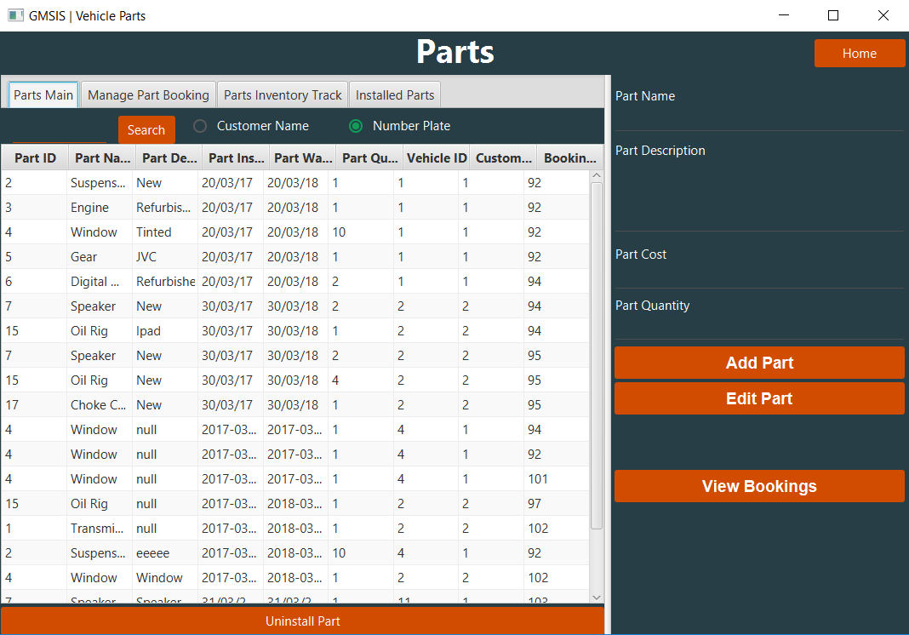
Radio button search functionality
Tab navigation bar:
Parts main: views installed parts,
Manage parts booking: adds existing parts to vehicle
Parts inventory track monitors part additions and withdrawals
Installed parts shows how much of each part on a vehicle
Home
button
Add/Edit Panel – linking to parts inventory table
Installed part table displaying all relevant information
View bookings button meeting requirement 9
Uninstall button for installed parts

Slide 2
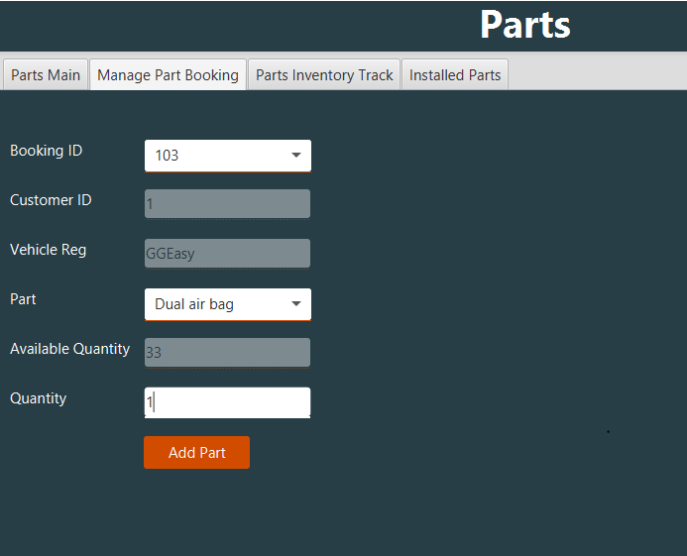
Dropdown list
Un-editable fields filled out after selecting booking ID
Part Dropdown list
Submit Installed Part button

Slide 3
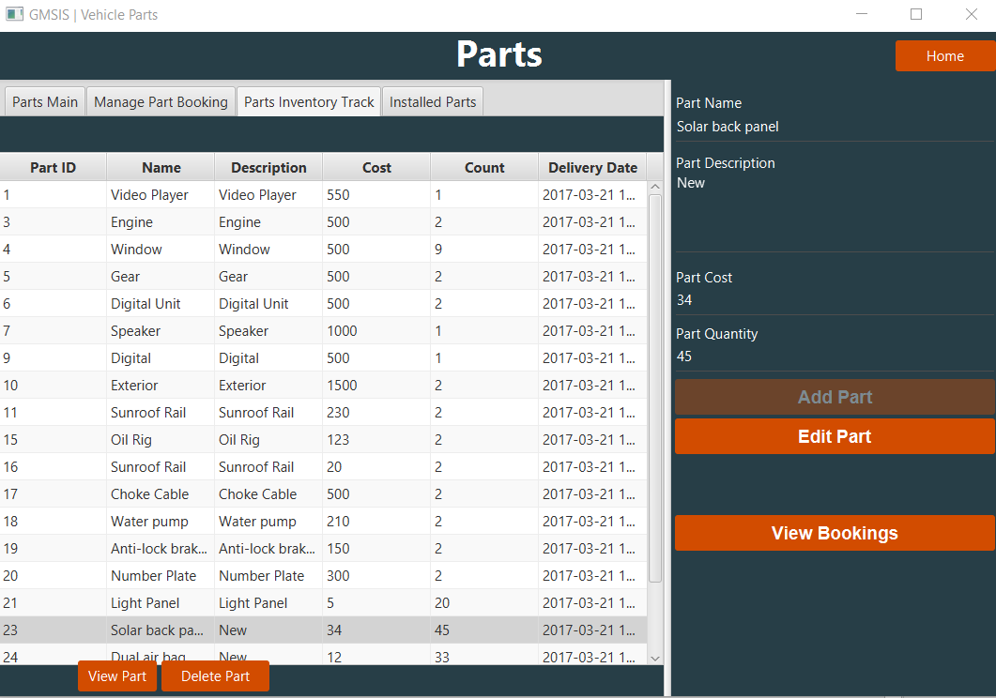
View part button: displays selected part information on click
Delete part button: Deletes part from Part Inventory table

Slide 4
