Slide 1
CUS1166 – Software Engineering Technology Presentation
Flask-Mail
Alan Jiang
April 10th, 2019

Slide 2

Overview
Notes:
Provide any information need to orient the audience what topic you are about to present.

Slide 3
Purpose/Goal of Technology
One of the most basic functions in a web application is the ability to send emails to your users.
The Flask-Mail extension provides a simple interface to set up SMTP with your Flask application and to send messages from your views and scripts.
Notes:
Motivate. what problem does this technology tries to solve; What is its purpose

Slide 4
Use Cases/Examples/ Applications
Take user input from a form and send via email
Send files as attachments
Send email notifications to site owner
Send registration confirmation or password reset links
Generate and send database query results, html blocks, etc
Notes:
Identify possible use cases, examples, problems someone could consider using this technology.

Slide 5
Background – Key Concepts
Simple Mail Transfer Protocol (SMTP)
Transmission Control Protocol (TCP)
Secure Sockets Layer (SSL)
Notes:
Introduce any background, key concepts and terminology needed for the audience to understand the technology your are presenting.

Slide 6
Getting Started Tutorial
Installation
pip install Flask-Mail
Or, if cloning my repository:
git clone https://github.com/ajiang13/Flask-mail_demo.git
pip install -r requirements.txt
Notes:
Present a getting tutorial; this should cover the basic activities for someone to start using the technology and solving a basic problem using this technology (This might need more that one slides)

Slide 7
Getting Started Tutorial (cont.)
2. Configuration
Before continuing, you should consider creating environment variables to store your email address and password, to avoid hard-coding your login credentials. See link in Resources slide for guide.
Alternatively, you can set your login credentials in a config file (and add to .gitignore).
Notes:
Present a getting tutorial; this should cover the basic activities for someone to start using the technology and solving a basic problem using this technology (This might need more that one slides)

Slide 8
Getting Started Tutorial (cont.)
2. Configuration (cont.)
We’ll be using these settings for Gmail:
MAIL_SERVER='smtp.gmail.com'
MAIL_PORT=465
MAIL_USE_TLS=False
MAIL_USE_SSL=True
MAIL_USERNAME='example@gmail.com'
MAIL_PASSWORD='your password'
In app.py line 43:
"<path you're uploading from>"
Change this to the path for the folder you want to upload from
Notes:
Present a getting tutorial; this should cover the basic activities for someone to start using the technology and solving a basic problem using this technology (This might need more that one slides)

Slide 9
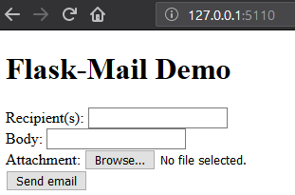
Non-Trivial Application
Compose email based on user input and send. Supports attachments.
Try it:
python app.py
In any browser, navigate to http://127.0.0.1:5110/
Fill out the form and attach file if desired.
Click Send email (and wait a few seconds).
Notes:
Demonstrate a non-trivial use case/application of the technology that you coded/prepared. This should be a custom example you coded yourself. Possibly this can be an example demonstrating how you could use this technology in your team’s project. You might need more that one slide for this section.

Slide 10
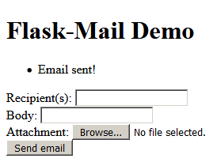
Non-Trivial Application (cont.)
If successful, you should be redirected to the same page and the flashed message should appear: Email sent!
Check your outbox/inbox. It can take a minute or two to appear.
Notes:
Present a getting tutorial; this should cover the basic activities for someone to start using the technology and solving a basic problem using this technology (This might need more that one slides)

Slide 11
Resources
Documentation:
https://pythonhosted.org/Flask-Mail/
Useful links:
Set environment variable for email address/password
https://www.twilio.com/blog/2017/01/how-to-set-environment-variables.html
Another tutorial
https://pythonprogramming.net/flask-email-tutorial/
Notes:
Resources for further reading. Provide a list of resources to help your classmates to learn more about this technolgy.

Slide 12
Q&A
Feel free to ask any questions!
Notes:
Open the floor for your classmates and the instructor to ask question about your presentaiton.

Slide 13
Thank you!!!

