Slide 1
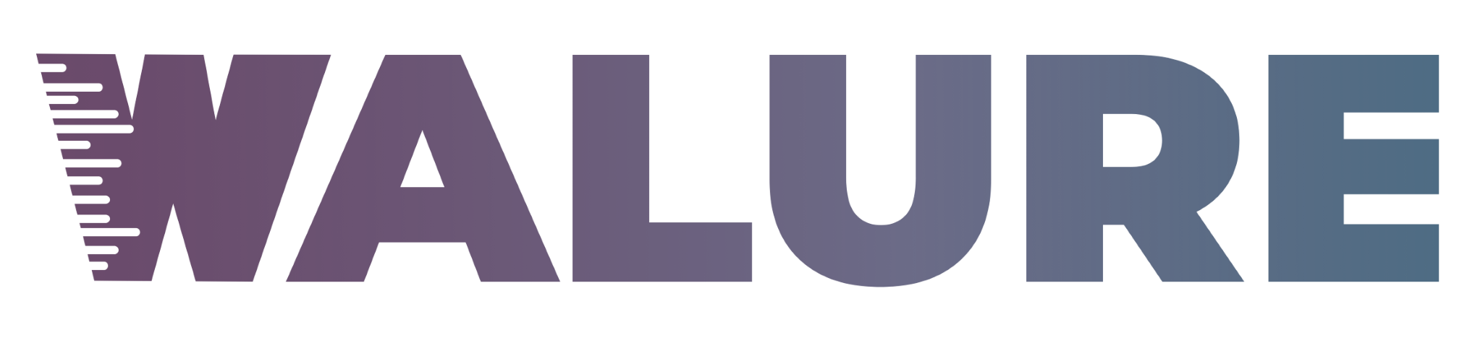
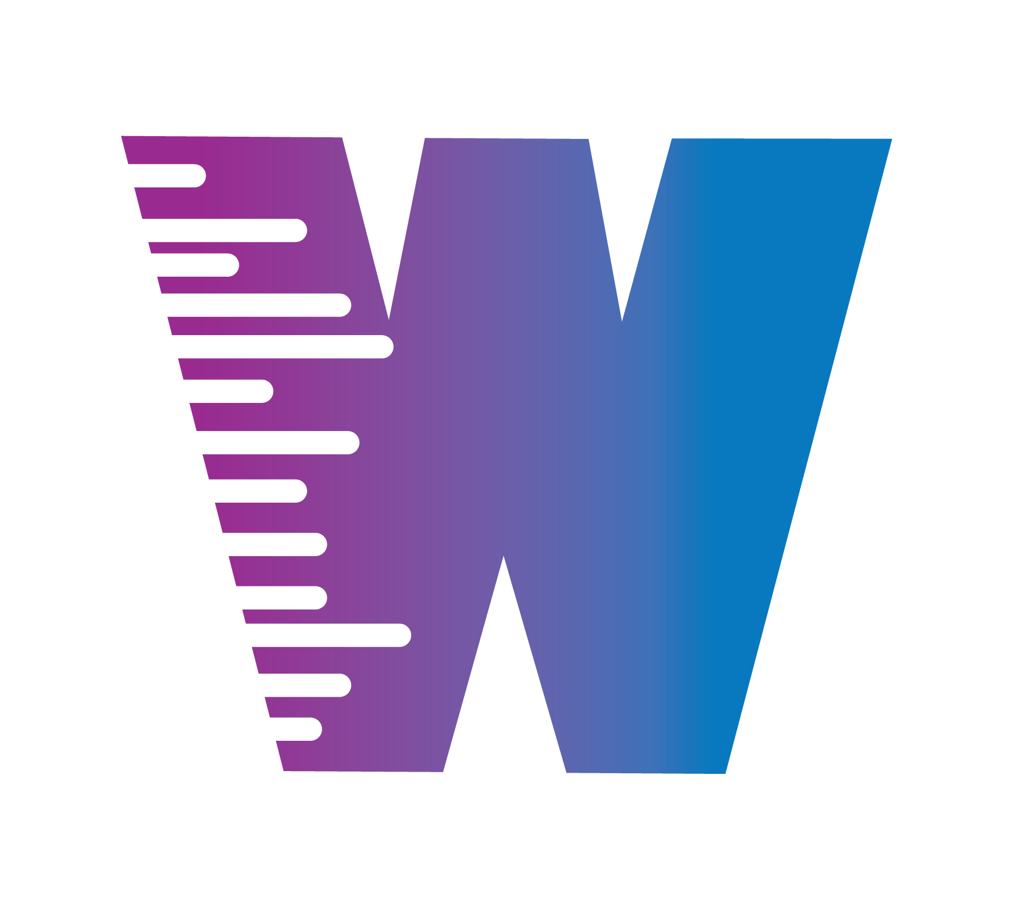
End-to-End DevOps Pipeline on Azure using GitOps
Terraform • GitHub Actions • DockerHub/ACR • AKS • ArgoCD • Prometheus • Grafana
at WALURE ACADEMY
by: AJIBADE APATA

Slide 2
Project Objective
Build and deploy a .NET application using DevOps best practices
Automate infrastructure provisioning
Implement CI/CD with GitOps
Add monitoring and observability
This follows a real world cloud-native workflow and production-ready DevOps architecture

Slide 3
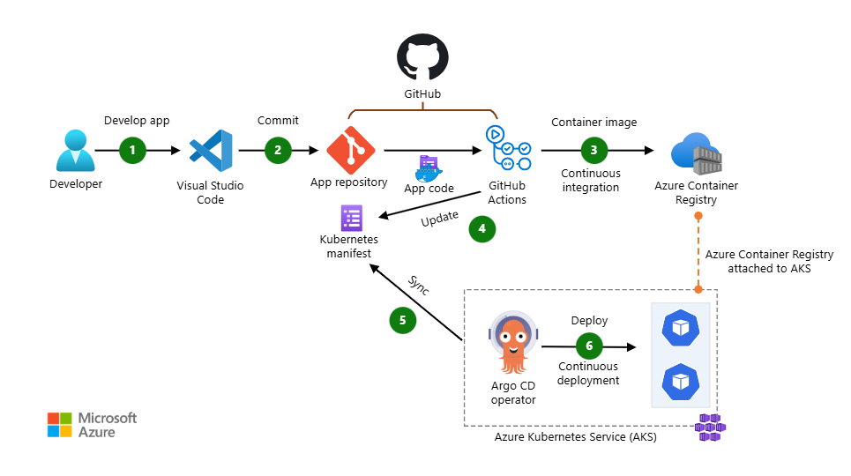
Project Architecture

Slide 4
ARCHITECTURE DIAGRAM (END-TO-END)
Developer
(Git Push to GitHub)
Azure Container Registry
(ACR)/DockerHub
Stores Docker Images
GitHub Repo
.NET Source Code
Dockerfile
Kubernetes Manifests
Terraform IaC
Azure Kubernetes Service (AKS)
Argo CD (GitOps CD)
Watches GitHub Manifests
Syncs Desired State
Self-healing
GitHub Actions (CI)
Build .NET App
Build Docker Image
Push Image to ACR
AjibadeApi (.NET App Pods)
Image pulled from ACR
Health + Metrics endpoints
Prometheus → Grafana
Metrics Collection
Dashboards & Monitoring

Slide 5
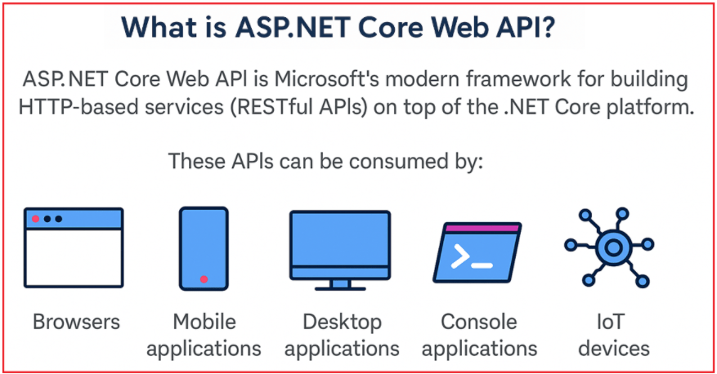
Application Layer (.NET API)
ASP.NET Core Web API
Dockerized application
/health endpoints for Kubernetes probes, /metrics endpoints for Prometheus
Notes:
A ASP.NET Core Web API (Web Application Programming Interface) is a bridge that enables different software applications to communicate with each other over the internet. It enables developers to create lightweight, scalable, and secure APIs that multiple types of clients can consume. Instead of directly connecting databases or systems.
Today, businesses can’t rely solely on a website because users access data from multiple devices, including smartphones, tablets, smart TVs, IoT devices, and even voice assistants. To support this multi-device ecosystem, you need a central way of exposing your business data and services. That’s where ASP.NET Core Web API comes in: it acts as a single interface between your business data and all the clients. Reasons We Need It:
Multi-Device Access: One API can serve browsers, mobile apps, and IoT devices simultaneously.
Separation of Concerns: Business logic lives in the API, while clients only consume the data.
Scalability: APIs can handle thousands/millions of requests if built on a high-performance framework like ASP.NET Core.
In simple terms, ASP.NET Core Web API is needed because it allows businesses to expose their data and services securely to all kinds of devices in a fast, modern, and scalable way.
P.S - A Web API is like a waiter in a restaurant; it takes your order (request), passes it to the kitchen (server), and brings back the food (response).

Slide 6
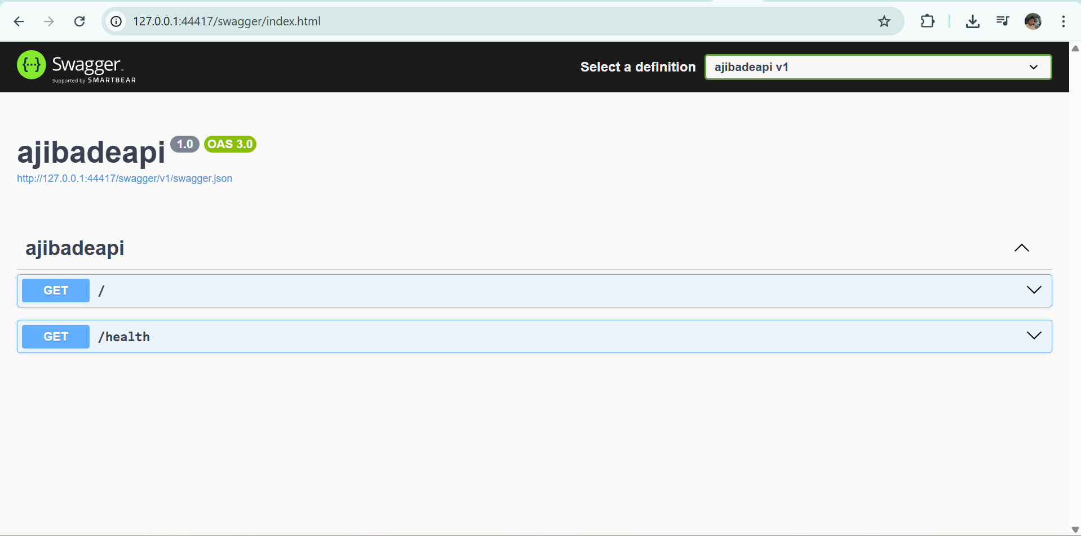


Slide 7
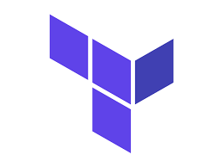
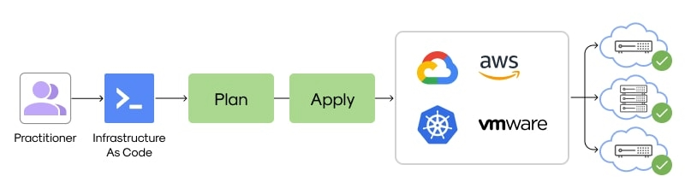
Infrastructure as Code (Terraform)
Creates Azure Resource Group
Provision Azure Kubernetes Service (AKS)
Creates Azure Container Registry (ACR)
Assigns permission for AKS to pull images from ACR
It has a repeatable infrastructure, version-controlled with no manual cloud setup
Notes:
Infrastructure as Code (IaC) tools allow you to manage infrastructure with configuration files rather than through a graphical user interface. IaC allows you to build, change, and manage your infrastructure in a safe, consistent, and repeatable way by defining resource configurations that you can version, reuse, and share.
Terraform is an open-source Infrastructure as Code (IaC) tool by HashiCorp that allows for safe, efficient, and consistent provisioning of cloud, on-premises, and SaaS resources using declarative configuration files. It automates the entire lifecycle—creation, management, and destruction—of infrastructure components (servers, networking, databases) across multiple platforms.
Using Terraform has several advantages over manually managing your infrastructure:
Terraform can manage infrastructure on multiple cloud platforms.
The human-readable configuration language helps you write infrastructure code quickly.
Terraform's state allows you to track resource changes throughout your deployments.
You can commit your configurations to version control to safely collaborate on infrastructure.
To deploy infrastructure with Terraform:
Scope - Identify the infrastructure for your project.
Author - Write the configuration for your infrastructure.
Initialize - Install the plugins Terraform needs to manage the infrastructure.
Plan - Preview the changes Terraform will make to match your configuration.
Apply - Make the plannsed changes.

Slide 8
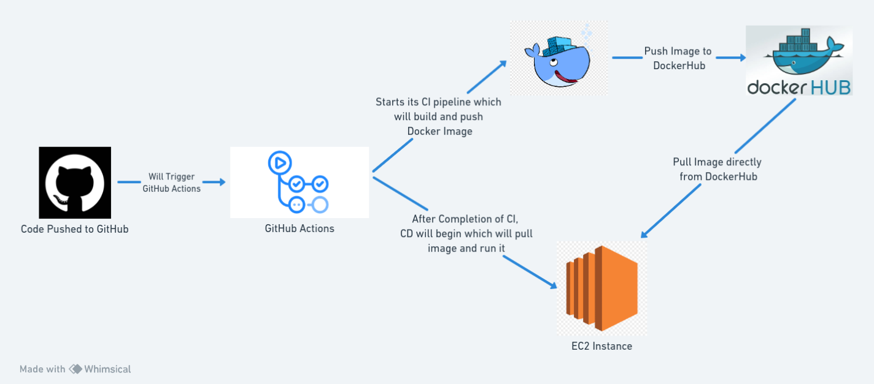
CI: GitHub Actions
Triggered on push to main
Build .NET application
Build Docker image
Push image to Azure Container Registry (ACR)
Every code change produces a new container image automatically
Notes:
GitHub Actions is a continuous integration (CI) and continuous delivery (CD) platform that allows you to automate your software development workflows directly within your GitHub repository. It provides a built-in, event-driven automation tool that is deeply integrated with the GitHub platform.

Slide 9
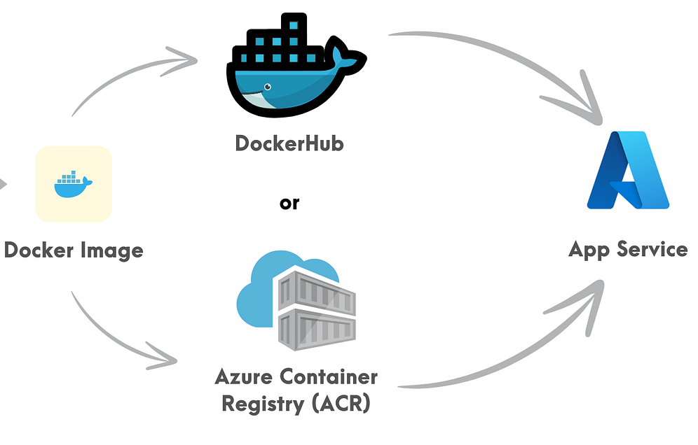
Azure Container Registry (ACR) / DockerHub
Stores Docker images securely
Acts as the source of AKS deployments
Notes:
Azure Container Registry (ACR) and Docker Hub are both container registries used to store, manage, and distribute container images. The key difference is that Docker Hub is a public-facing registry and central library, while ACR is a private, fully managed service that integrates deeply with the Microsoft Azure ecosystem.
Docker Hub acts as the central repository where Kubernetes pulls the container images needed to deploy and manage applications.

Slide 10
CD: GitOps with ArgoCD
Git as single source of truth. It’s declarative, versioned & immutable, pulled automatically and continuously reconciled
Watches GitHub Repository
Automated sync to AKS
Self-healing deployments
Notes:
How the Workflow Operates
The interaction between Docker Hub and Kubernetes is typically part of a larger, automated workflow:
Image Creation: Developers use Docker to define application requirements in a Dockerfile and build an image locally.
Image Storage (Push): The resulting Docker image, which bundles the application and all its dependencies, is pushed (uploaded) to a repository on Docker Hub. Repositories can be public or private.
Deployment Definition: A Kubernetes manifest file (usually YAML format) is created. This file specifies which container image to use (e.g., myusername/my-app:latest) and other deployment parameters, such as the desired number of replicas, scaling rules, and networking information.
Orchestration (Pull): When a user or system applies the Kubernetes manifest to a cluster using a command like kubectl apply -f filename.yaml, the Kubernetes control plane schedules the application's pods onto worker nodes. The nodes then automatically pull the specified image from Docker Hub (or another configured registry) to start the containers.
Runtime Management: Once the images are pulled and containers are running, Kubernetes takes over management tasks such as:
Scaling: Ensuring the correct number of container instances (pods) are running based on demand.
Self-healing: Automatically restarting containers that fail or go down.
Load Balancing: Distributing incoming traffic among healthy running containers.

Slide 11
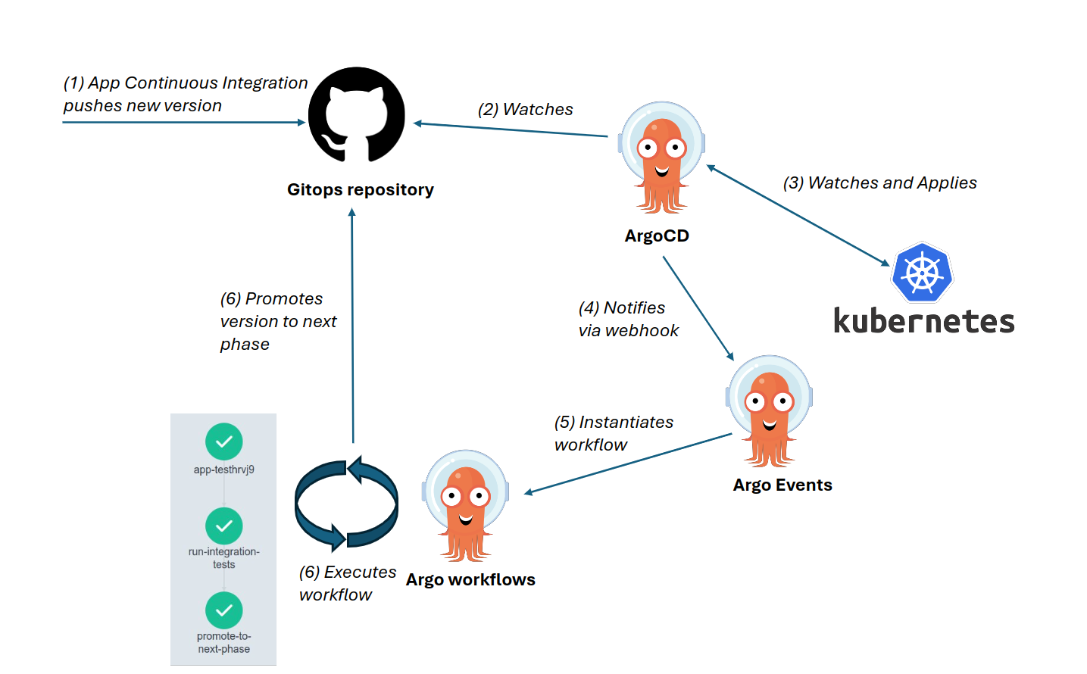
ArgoCD Workflow
Notes:
Argo CD is an open-source, declarative Continuous Delivery (CD) tool for Kubernetes that implements the principles of GitOps. It automates the deployment and lifecycle management of applications by using a Git repository as the single source of truth for the desired application state.
Kubernetes itself is the orchestration system that automates the deployment, scaling, and management of those images as containers across a cluster. Once the images are pulled and containers are running, Kubernetes takes over management tasks such as:
Scaling: Ensuring the correct number of container instances (pods) are running based on demand.
Self-healing: Automatically restarting containers that fail or go down.
Load Balancing: Distributing incoming traffic among healthy running containers.

Slide 12
Observability
Prometheus:
Scrapes application & cluster metrics
Collects CPU, Memory metrics
Grafana:
Visualize metrics
Dashboard for
Application performance
Pod & node resource usage

Slide 13
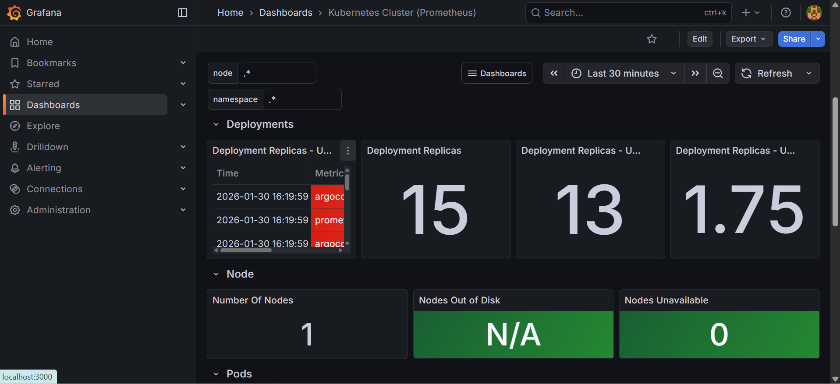
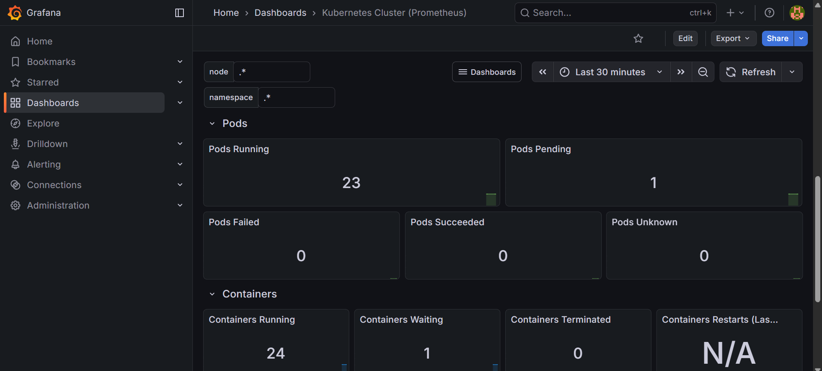

Slide 14
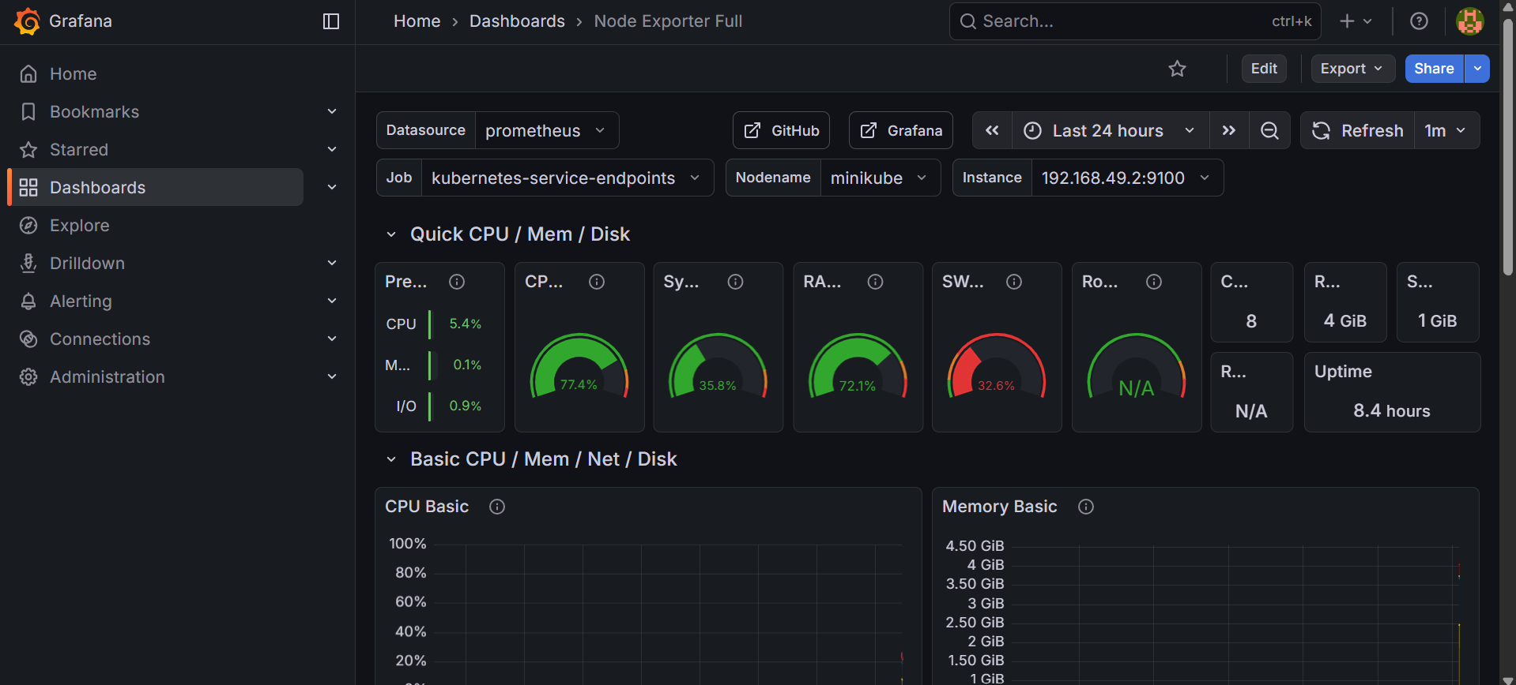
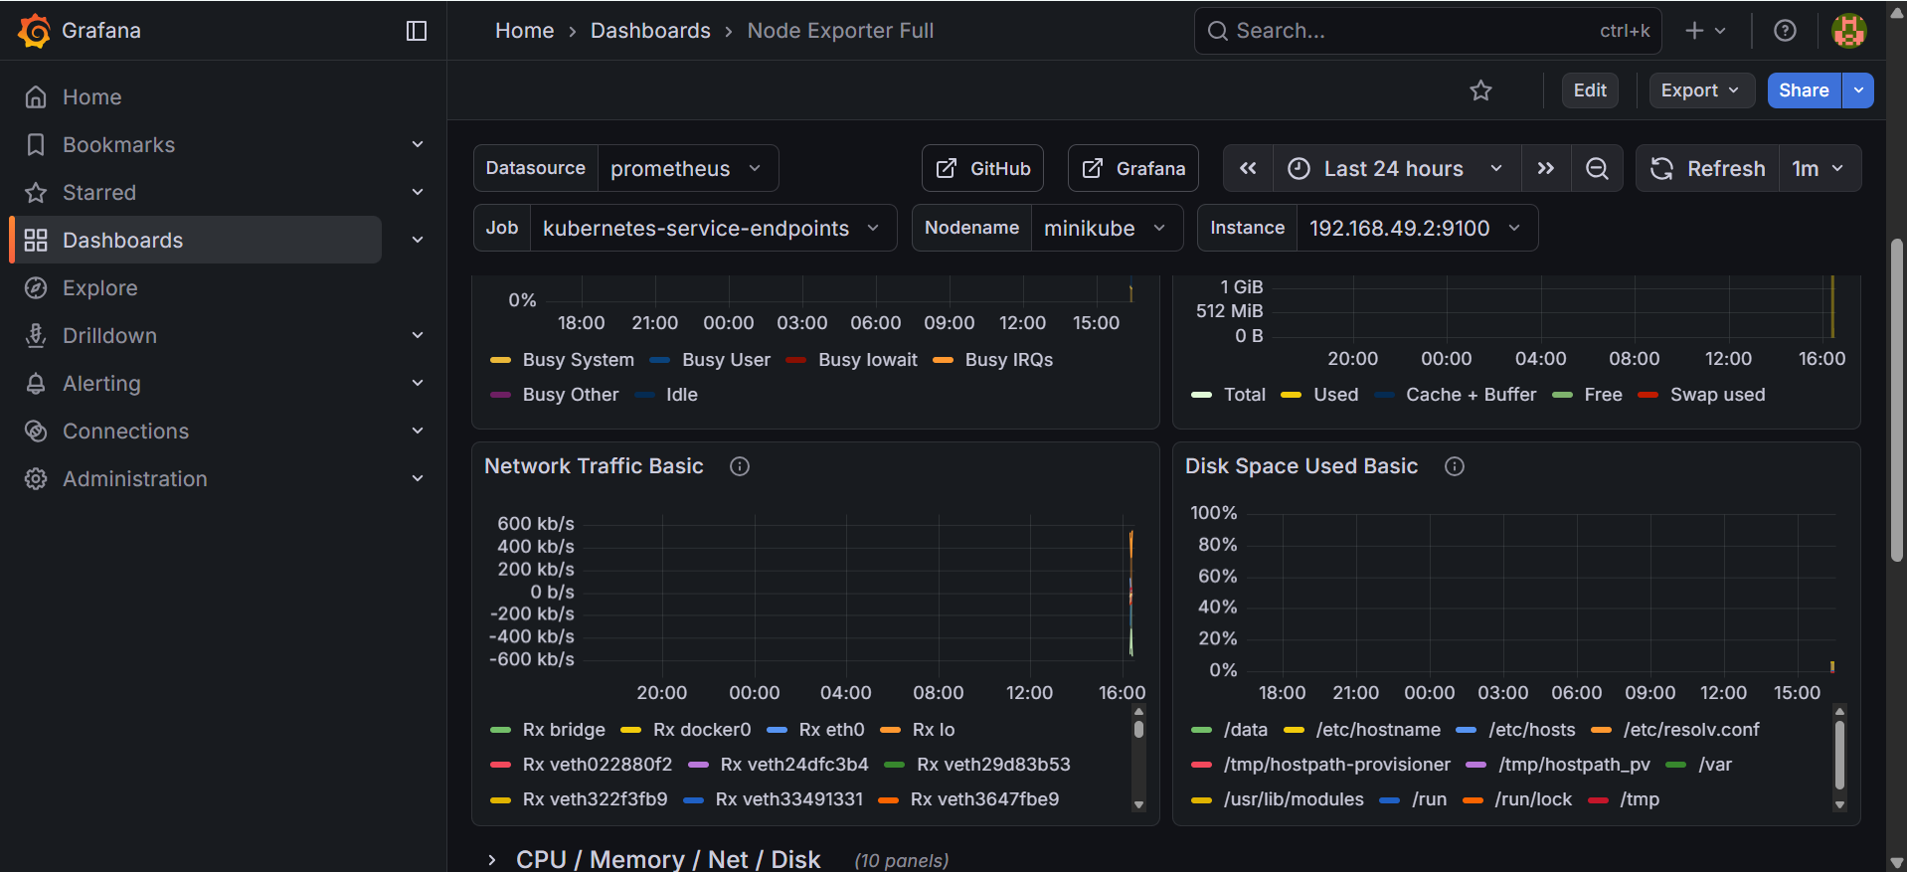

Slide 15
Conclusion
Project Outcome:
Fully automated DevOps pipeline
Production-ready deployment
Observable and scalable system
Key takeaway:
“Modern DevOps focuses on automation, reliability, and visibility”

Slide 16
THANKS FOR LISTENING

