Slide 1

SUPER MARKET SALES ANALYSIS
Submitted by
SAHIL

Slide 2
INTRODUCTION
Data set used is a supermarket sales data collected from Kaggle.
Supermarket data analysis involves examining sales patterns, revenue trends, and product performance. This can help identify top-selling products, high-demand periods, and seasonal variations.

Slide 3
OBJECTIVE OF THE STUDY
1) To visualize how explanatory variable i.e., Branch, Customer type, Gender, Product line and Payment type affect to study variable sales.
2) To check Main and Interaction effect of explanatory Variable on sales.
3) Fitting appropriate Time Series Model and analyzing study variable sales.

Slide 4
Contents
Sales Performance Analysis
Average Profit Analysis
Sentiment Analysis
Quantity of products sold in each city /branch
Top selling product

Slide 5
Data preparation
#changing the data types of date column
update supermarket_sales.supermarket_sales set _date = str_to_date(_date,"%m/%d/%Y");
#adding a new colunm as sentiment fro rating purpose
alter table supermarket_sales add column sentiment varchar(25) ;select count(sentiment) from supermarket_sales where sentiment is null ;

Slide 6
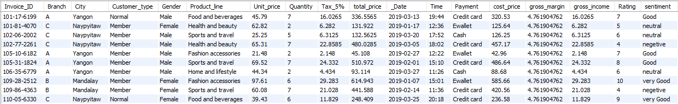
start transaction;
savepoint sentiment_insertion;update supermarket_sales set rating = round(rating);
update supermarket_sales set sentiment= case when rating between 0 and 4 then "negetive" when rating between 4 and 6 then "neutral"
when rating between 6 and 8 then "Good"
when rating between 8 and 11 then "very Good" end ;

Slide 7
Sales performance
All products in the supermarket exhibit a rising trend from the first month to the third month.
In the third month, the Food and Beverages category records the highest profit of 2673.564.

Slide 8
Average profit

Slide 9
Quantity of products sold in each city /branch

Slide 10
TOP SELLING PRODUCT
Top selling product is Electronic accessories.

Slide 11

customer spends more
Query
select invoice_id,city,customer_type,gender,product_line,total_price from supermarket_sales where total_price = (select max(total_price) from supermarket_sales);

Slide 12
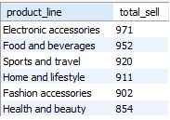
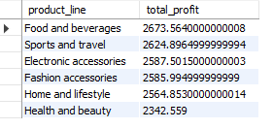
1. as we can see here top selling product is 'Electronic accessories’ But top profitable product is 'Food and beverages'

Slide 13
Sentiment

Slide 14
THANK YOU

