Slide 1

Concurrent Execution of Transactions

Slide 2

Concurrent Execution of Transaction
I/O activity can be done in parallel with CPU activity in a computer . Overlap I/O activity and CPU activity reduces the amount of time disks and processors are idle and increase system throughput (the average number of transactions completed in a given time).

Slide 3
There may be a mix of transactions running on a system . short transactions and long transactions.
Interleaved execution of a short transactions with a long transactions usually allows the short transactions to complete quickly.
In Serial execution, a short transaction could get stuck behind a long transaction leading to unpredictable delays in response time, or average time taken to complete a transaction.

Slide 4

Reduces the unpredictable delays in running transactions.
Reduces the average response time, the average time for a transaction to be completed after it has been submitted.

Slide 5
Serializability
A given set of concurrent transactions is said to be serializable if and only if it produces the same results as that of the serial execution of the same transactions.
It assumes that all accesses to the database are done using read and write operations.

Slide 6
Examples of Schedules
Schedule with
Interleaving Execution
Serial Schedule
T1 | T2
R(A)
W(A)
 | R(B)
 | W(B)
 | Commit
R(C)
W(C)
Commit
T1 | T2
R(A)
W(A)
R(C)
W(C)
Commit
 | R(B)
 | W(B)
 | Commit

Slide 7
Anomalies due to interleaved execution
Write-Read (WR) conflict
Read-Write (RW) conflict
Write -Write (WW) conflict
Two actions on the same data object conflict if at least one of them is a write.

Slide 8
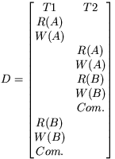
Reading Uncommitted Data (WR Conflicts)
A transaction T2 could read a database object A that has been modified by another transaction T1, which has not yet committed. Such a read is called a dirty read.
Eg: interest calculation on bank transaction

Slide 9
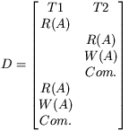
Unrepeatable Reads (RW Conflicts)
A transaction T2 could change the value of an object A that has been read by a transaction T1 , while T1 is still in progress.
If T1 tries to read the value of A again, it will get a different result. This situation couldn’t arise in a serial execution on 2 transactions: this is called an Unrepeatable Reads.

Slide 10
Let's take a real life example. Let's say two people Ben and Kathi went to Ticketmaster and wanted to order season tickets to see the match. There's only one season ticket left. Ben signs on to Ticketmaster first and finds one left, but it's $600! Ben has to think about it for a while. Kathi signs on and finds one ticket left, orders it instantly because she has $600 to spend. Kathi logs off. Finally Ben agrees to buy a ticket...... but to his surprise there is no more tickets!!

Slide 11
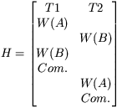
Overwriting Uncommitted Data (WW Conflicts)
A transaction T2 could overwrite the value of an object A, which has already been modified by a transaction T1, while T1 is still in progress. There is no read in this schedule. The writes are called blind writes.
We have a lost update. Any attempts to make this schedule serial would give off two different results (Either T1's version of A and B is shown, or T2's version of A and B is shown.), and would not be the same as the above schedule. This schedule would not be serializable.
Eg : salary of 2 peoples.

Slide 12
Schedules involving aborted transactions
Actions of aborted transactions will be undone.
Serializable schedule over a set S of transactions is a schedule whose effect on any consistent database instance is guaranteed to be identical to that of some complete serial schedule over the set of committed transactions in S.

Slide 13
An unrecoverable schedule
T2 has read a value for A that should never have been there (aborted).
If T2 had not yet committed, we could deal with the situation by cascading the abort of T1 and also aborting T2.
But T2 has already committed and so we cannot undo its actions.
This is a unrecoverable schedule.
T1
T2
R(A)
W(A)
R(A)
W(A)
R(B)
W(B)
commit
abort

Slide 14
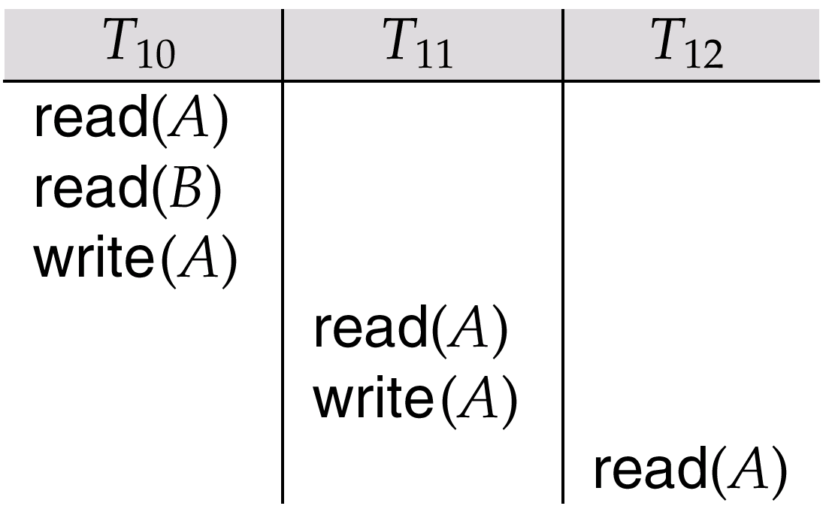
Cascading rollback – a single transaction failure leads to a series of transaction rollbacks. Consider the following schedule where none of the transactions has yet committed
If T₁₀ fails, T₁₁ and T₁₂ must also be rolled back.
This lead to the undoing of a significant amount of work.

Slide 15
In a recoverable schedule, transactions commit only after all transactions whose changes they read commit.
If transactions read only the changes of committed transactions, not only is the schedule recoverable, but also aborting a transaction can be accomplished without cascading the abort to other transactions.
Such a schedule is called avoid cascading aborts

Slide 16
Lock-Based Concurrency Control
A DBMS must be able to ensures that
  (1) Only serializable, recoverable schedules are allowed
  (2) Actions of committed transactions are not lost while undoing aborted transactions.
  Locking protocol : Is a Set of rules to be followed by each transaction to ensure that, even though actions of several transactions might be interleaved, the net effect is identical to executing all transactions in some serial order.

Slide 17
LOCK
A lock is a small bookkeeping object associated with a DB object/ mechanism used to control access to database objects.
  Shared lock: several transactions can have shared locks on the same DB object.
  Exclusive lock: only one transaction can have an exclusive lock on a DB object.

Slide 18
Strict two phase locking (Strict 2PL)
Rule #1: If a transaction T wants to read (modify) an object, it requests a shared lock. Denote as S(o).
Rule #2: If a transaction T wants to write an object, it requests an exclusive lock. Denote as X(o).
Rule #3: When a transaction is completed or aborted, it releases all held locks.

Slide 19
Example #1 of Strict 2PL
T1 | T2
X(A) | Suspend
R(A)
W(A)
X(B)
R(B)
W(B)
Commit // Release locks
 | X(A)
 | R(A)
 | W(A)
 | R(B)
 | W(B)
 | Commit
T1
X(A)
R(A)
W(A)
X(B)
R(B)
W(B)
Commit
T2
X(A)
R(A)
W(A)
X(B)
R(B)
W(B)
Commit

Slide 20
Serializability
conflict equivalent - 2 schedules are said to be conflict equivalent if they involve the (same set of actions) of the same transactions and they order every pair of conflicting actions of 2 committed transactions in the same way.
Conflict serializable – a schedule is in Conflict serializable if it is conflict equivalent to some serial schedule.

Slide 21
Variant of strict 2PL, called basic two-phase locking (basic 2PL)
Relaxes the 3rd rule of strict 2PL to allow transactions to release locks before the end, i.e., before the commit or abort action
3rd rule of 2PL
  A transaction cannot request additional locks once it releases any lock
  Every transaction has a
Growing phase – in which it acquires a locks
Shrinking phase – in which it releases locks

Slide 22
A schedule is said to be strict if a value written by a transaction T is not read or overwritten by other transactions until T either aborts or commits.
Strict schedules are
  Recoverable
  Do not require cascading aborts
  Aborted transactions can be undone by restoring the original values of modified objects

