Slide 1
Two eBPF Systems,
One Kubernetes Node
Running OpenTelemetry OBI and Cilium together
Anton Jimenez · KubeCon + CloudNativeCon NA 2026
Notes:
Timing: 1 minute
Open with the operator question: We already run Cilium. Can we add zero-code application telemetry without changing network behavior? Set the promise: attachment order, signal boundaries, and measured operational cost.

Slide 2
Agenda
01
Coexistence problem
04
Live demo
02
Attachment order
05
Benchmark
03
Signal ownership
06
Production rollout
ONE REQUEST · TWO TELEMETRY VIEWS · ONE OPERATOR MODEL
Notes:
Timing: 1 minute
Preview the six sections. Keep the appendix available for configuration and troubleshooting questions.

Slide 3
The coexistence problem
Notes:
Timing: 30 seconds
Section transition: The coexistence problem.

Slide 4
The change request sounds simple
“We already run Cilium.
Can we add zero-code tracing?”
Cilium
networking + policy
OBI
application telemetry
The production question is broader
Will packets still take the same path?
Will both systems see the evidence they need?
What new CPU, memory, and telemetry cost appears?
Notes:
Timing: 2 minutes
Frame the talk as an operational change review, not an eBPF primer. Both agents can run as DaemonSets while still producing incomplete evidence or an unsafe attachment order.

Slide 5
OBI and Cilium share the veth TC hooks
Most hooks stay separate. OBI's TCP context propagation creates the overlap.
OBI application hooks
Cilium datapath hooks
uprobes, kprobes, socket filters
XDP, cgroup, socket hooks
Application process
Host-side veth
Network
Shared BPF_PROG_TYPE_SCHED_CLS attach points
TC ingress
OBI propagation
+
Cilium datapath
TC egress
OBI propagation
+
Cilium datapath
With context_propagation set to headers, OBI does not attach the TCP propagation TC programs.
Notes:
Timing: 3 minutes
Purpose:
Narrow the coexistence discussion to the one attachment surface that both systems can use on the same node.
Talk track:
1. Start with the two top boxes. OBI primarily observes application behavior through uprobes, kprobes, and socket filters. Cilium uses several datapath hooks, including XDP, cgroup, socket hooks, and traffic control. Those separate hook types do not compete with each other.
2. Follow the packet path through the host-side veth. This interface is where the two systems can meet.
3. When OBI enables TCP context propagation with context_propagation set to tcp or all, OBI attaches SCHED_CLS programs to TC ingress and egress. Cilium also uses SCHED_CLS programs on those paths for its datapath.
4. The dark area shows the complete coexistence problem: two programs, two directions, one host-side veth. The next slides explain direction and ordering.
Important precision:
OBI does not require this shared TC surface for every deployment. Setting context_propagation to headers disables TCP-level propagation and the related TC programs. Application metrics and local spans can still exist. Zero-code trace continuity across TLS cannot use OBI's TCP packet path in that mode.
Operator takeaway:
Operator checks should focus on the host-side veth ingress and egress chains, the active OBI propagation mode, and the actual attachment backend.
Transition:
Now that the shared surface is clear, the next slide explains why pod direction appears reversed at the host-side veth.
Sources:
- https://opentelemetry.io/docs/zero-code/obi/cilium-compatibility/
- https://opentelemetry.io/docs/zero-code/obi/configure/metrics-traces-attributes/
- https://docs.cilium.io/en/stable/reference-guides/bpf/progtypes/

Slide 6
Pod and host-veth direction are opposite
Direction is named from the interface where the packet is observed.
Packet leaves the pod
Packet enters the pod
pod namespace
host namespace
host namespace
pod namespace
Pod
Host-side veth
Host-side veth
Pod
Pod view: egress
TC hook: ingress
TC hook: egress
Pod view: ingress
A pod-to-pod request crosses source host-veth ingress, then destination host-veth egress.
Notes:
Timing: 3 minutes
Purpose:
Prevent the common mistake of reading traffic-control direction from the pod or application perspective.
Talk track:
1. A veth pair acts like a virtual wire. One end appears as eth0 inside the pod network namespace. The host-facing end usually has an lxc-style interface name in a Cilium veth datapath.
2. Read the left half first. When the pod sends a packet, the application calls that pod egress. The packet crosses the pair and arrives at the host-facing veth, so the host interface runs its TC ingress hook.
3. Read the right half next. When the node sends a packet toward the pod, it leaves the host-facing veth through TC egress. The application receives that packet as pod ingress.
4. Apply the rule twice for pod-to-pod traffic. A request crosses source host-veth ingress and destination host-veth egress. The response reverses those directions.
Important precision:
Ingress and egress are interface-relative terms. Application direction, TC hook direction, Cilium observation point, and Hubble traffic direction describe related events from different perspectives. Compare the interface name and observation point before concluding that two records disagree.
Cross-node case:
The same source and destination veth rule still applies. The packet also crosses a physical or overlay interface between the nodes, which adds more observation points without changing the veth perspective.
Operator takeaway:
For a client request, expect the source pod's host-facing veth to observe TC ingress and the destination pod's host-facing veth to observe TC egress. Use this mapping when comparing OBI spans with tc inspection and Hubble flows.
Transition:
The direction is now clear. The next slide explains why program order inside each TC chain affects OBI visibility.
Sources:
- https://docs.cilium.io/en/stable/reference-guides/bpf/progtypes/
- https://docs.cilium.io/en/stable/network/ebpf/intro/

Slide 7
TC is an ordered chain, not an exclusive lock
1
observe + propagate
2
route + enforce
3
forward or stop
OBI should see the request before Cilium can redirect, translate, or drop it.
ORDER IS CORRECTNESS
Notes:
Timing: 2 minutes
A classifier can change packet state or return a terminal result. This is why order affects visibility and trace continuity, not only overhead.
Sources:
- https://opentelemetry.io/docs/zero-code/obi/cilium-compatibility/

Slide 8
Attachment order
Notes:
Timing: 30 seconds
Section transition: Attachment order.

Slide 9
TCX gives each agent a stable position
Preferred when the running kernel and both agents confirm support.
OBI
link.Head()
Cilium
link.Tail()
HEAD
TAIL
Ordered multi-attachment without explicit qdisc filter management
Runtime probing matters more than the kernel version string
A supported attach API does not prove arbitrary programs are compatible
Notes:
Timing: 3 minutes
TCX entered upstream Linux in 6.6, but distributions can backport features. OBI v0.13.0 requests head and Cilium v1.20.2 requests tail. Confirm the live attach mode from Cilium status and OBI startup logs.
Sources:
- https://github.com/open-telemetry/opentelemetry-ebpf-instrumentation/blob/v0.13.0/pkg/internal/ebpf/tcmanager/tcxmanager.go
- https://github.com/cilium/cilium/blob/v1.20.2/pkg/datapath/loader/tcx.go
- https://github.com/torvalds/linux/blob/v6.6/kernel/bpf/tcx.c

Slide 10
Legacy TC needs a priority contract
Lower numeric priority runs first.
priority 1
OBI
priority 2+
Cilium
Safe order
Both at priority 1: OBI refuses startup
For OBI v0.13.0, the forced legacy backend value is tc.
Notes:
Timing: 3 minutes
The legacy path uses Netlink-managed clsact filters. OBI uses priority 1 and validates a startup snapshot. It rejects Cilium TCX mixed with forced legacy TC, and rejects a Cilium legacy program at priority 1. Use a fresh cluster for every priority experiment.
Sources:
- https://github.com/open-telemetry/opentelemetry-ebpf-instrumentation/blob/v0.13.0/pkg/internal/ebpf/tcmanager/netlinkmanager.go
- https://github.com/open-telemetry/opentelemetry-ebpf-instrumentation/blob/v0.13.0/pkg/ebpf/tcmanager/cilium_support.go
- https://github.com/cilium/cilium/issues/36172

Slide 11
Configuration names can drift faster than behavior
Compatibility page
Pinned source and chart
OBI legacy backend
netlink
tc
Cilium TC priority
bpf.tc.priority
bpf-filter-priority
PIN VERSIONS · RENDER CONFIG · READ BACK LIVE STATE
Notes:
Timing: 2 minutes
Show the operational impact of small naming differences. For the pinned OBI v0.13.0 source, tc selects the Netlink backend. For Cilium v1.20.2, the option is bpf-filter-priority and the chart can pass it through extraConfig.
Sources:
- https://github.com/open-telemetry/opentelemetry-ebpf-instrumentation/blob/v0.13.0/pkg/config/tcbackend.go
- https://github.com/cilium/cilium/blob/v1.20.2/pkg/option/config.go

Slide 12
Signal ownership
Notes:
Timing: 30 seconds
Section transition: Signal ownership.

Slide 13
Split signal ownership on purpose
OBI answers application questions
Hubble answers network and policy questions
route, latency, status
source and destination identity
client and server spans
verdict, drop reason, TCP state
trace continuity across services
DNS, flows, optional Envoy L7
Correlate by time · workload · direction · port · route · verdict
Notes:
Timing: 3 minutes
Default Hubble gives L3/L4 and security evidence. OBI gives request semantics. Correlation is usually operational, using a bounded time window and workload dimensions. Hubble HTTP metrics require L7 visibility and an Envoy redirect. Optional httpV2 exemplars can carry trace IDs.
Sources:
- https://docs.cilium.io/en/stable/observability/hubble/
- https://docs.cilium.io/en/stable/observability/visibility/
- https://docs.cilium.io/en/stable/observability/metrics/
- https://opentelemetry.io/docs/zero-code/obi/

Slide 14
Live demo: one request, two views
github.com/ajimenez1503/cilium-obi-demo
Notes:
Timing: 30 seconds
Introduce the runnable demo repository before showing the environment. The repository contains the kind setup, pinned Cilium and OBI values, Grafana dashboards, verification scripts, recordings, benchmark evidence, and the latest presentation deck.
Sources:
- https://github.com/ajimenez1503/cilium-obi-demo

Slide 15
Application and network telemetry share Grafana
kind · 2 workers · Cilium v1.20.2 · Hubble
traffic
generator
edge-nginx
recommendations-v2
recommendations-v1
OBI DaemonSet
spans + RED metrics
Grafana LGTM
Tempo + Prometheus
Cilium + Hubble
Prometheus metrics
OpenTelemetry Collector
scrape + OTLP export
Hubble Relay + UI
flow records + verdicts
Notes:
Timing: 2 minutes
Purpose:
Show that Grafana receives telemetry from both eBPF systems while Hubble Relay remains available for individual flow records.
Talk track:
1. Follow the solid line across the top. The traffic generator calls edge-nginx, which calls recommendations-v2 and then recommendations-v1.
2. Follow the magenta path. OBI observes the applications and sends spans plus RED metrics directly to Grafana LGTM. Tempo stores the traces and Prometheus-compatible storage serves the metrics.
3. Follow the lower blue path. An OpenTelemetry Collector scrapes the Cilium agent Prometheus endpoint on port 9962 and the Hubble metrics endpoint on port 9965. The Collector sends those metrics to the same LGTM instance over OTLP/HTTP on port 4318.
4. Follow the blue path on the right. Hubble flow records and verdicts remain available through Hubble Relay, the CLI, and Hubble UI.
Important precision:
Grafana receives aggregated Cilium and Hubble Prometheus metrics, not the raw Hubble flow stream. Relay and Hubble UI provide per-flow evidence. The two views complement each other: Grafana shows rates, drops, resource use, and pipeline health over time, while Hubble shows the identities and verdict for a specific network exchange.
Operator takeaway:
Use one Grafana dashboard to compare OBI request behavior with Cilium and Hubble network metrics. Open Hubble UI when the aggregate metric points to a particular flow or policy decision.
Transition:
The next step proves that both systems attached correctly before using either telemetry view.
Sources:
- https://github.com/open-telemetry/opentelemetry-ebpf-instrumentation/tree/main/examples/nginx
- https://docs.cilium.io/en/stable/installation/kind/
- https://docs.cilium.io/en/stable/observability/metrics/

Slide 16
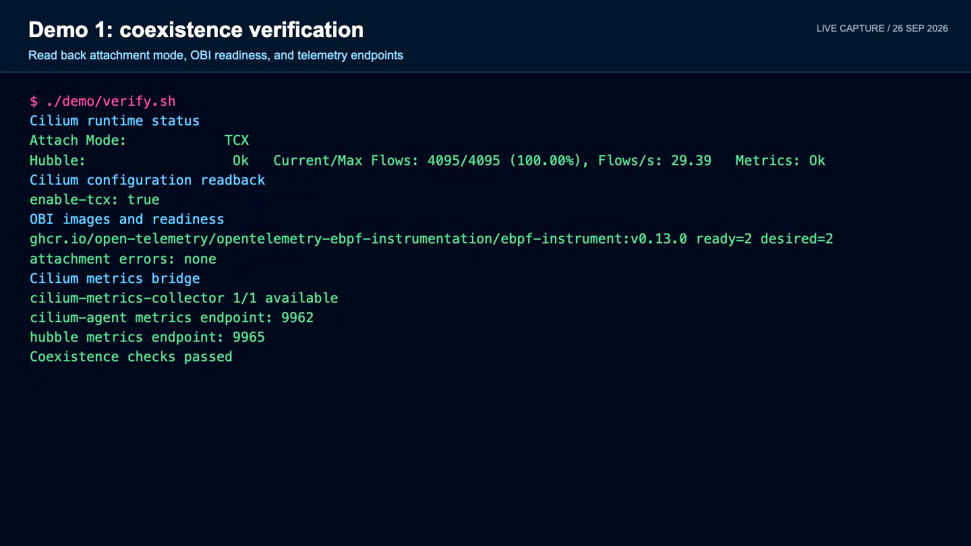
Demo 1: prove coexistence before showing traces
Notes:
Timing: 2 minutes
Click the video to play. This is a fresh run of demo/verify.sh against the local kind cluster. Pause on four checks: Cilium reports TCX, the cilium-config readback says enable-tcx=true, OBI v0.13.0 is ready on both workers, and the startup logs contain no attachment, capability, tracefs, or context-propagation errors. The point is that a Running DaemonSet is not enough. Verify the actual attachment decision before trusting either telemetry stream.
Sources:
- https://opentelemetry.io/docs/zero-code/obi/cilium-compatibility/

Slide 17
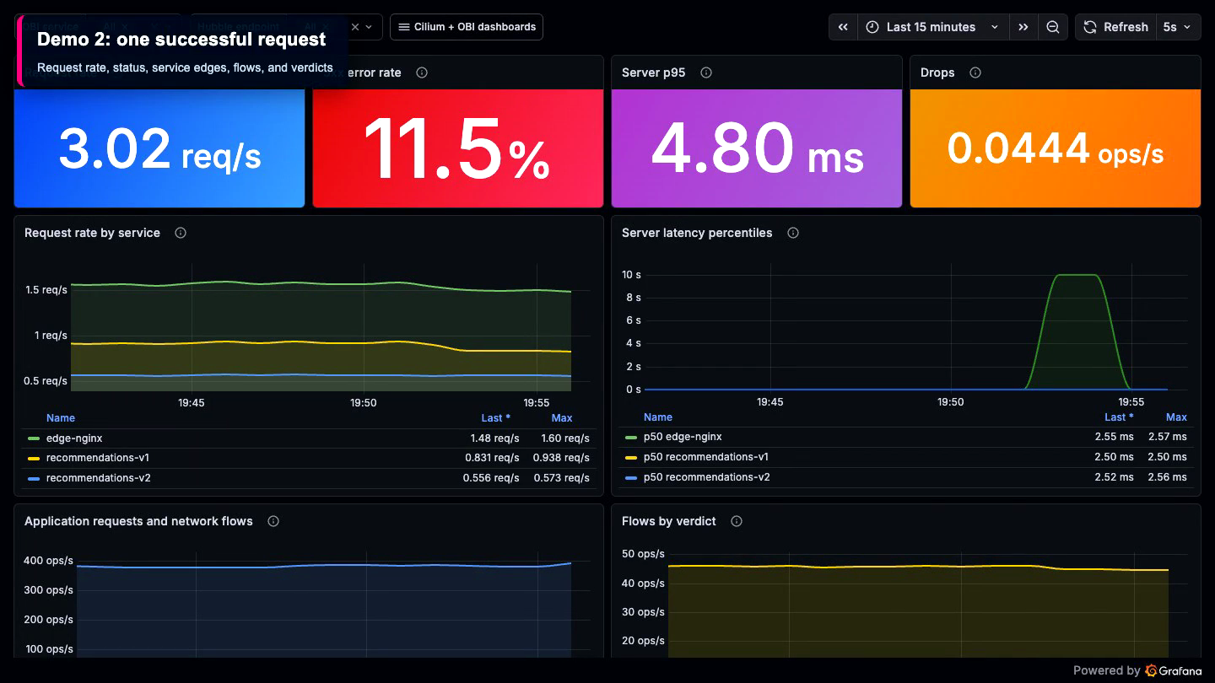
Demo 2: compare the same successful request
Notes:
Timing: 3 minutes
Click the video to play. The recording starts in the consolidated Grafana dashboard, where OBI request metrics sit beside Cilium and Hubble Prometheus metrics. It then opens Hubble UI for the same workload and request window. In Grafana, explain application rate, errors, and latency together with network flow rate and drops. In Hubble, follow edge-nginx to recommendations-v2 and recommendations-v2 to recommendations-v1, then call out workload identity, direction, ports, and the FORWARDED verdict. These are correlated views, not identical event streams. Match them by time window, namespace, source and destination workload, direction, and port. Raw Hubble flows remain in Relay and Hubble UI; Grafana contains their aggregated metrics.
Sources:
- https://docs.cilium.io/en/stable/observability/hubble/
- https://opentelemetry.io/docs/zero-code/obi/

Slide 18
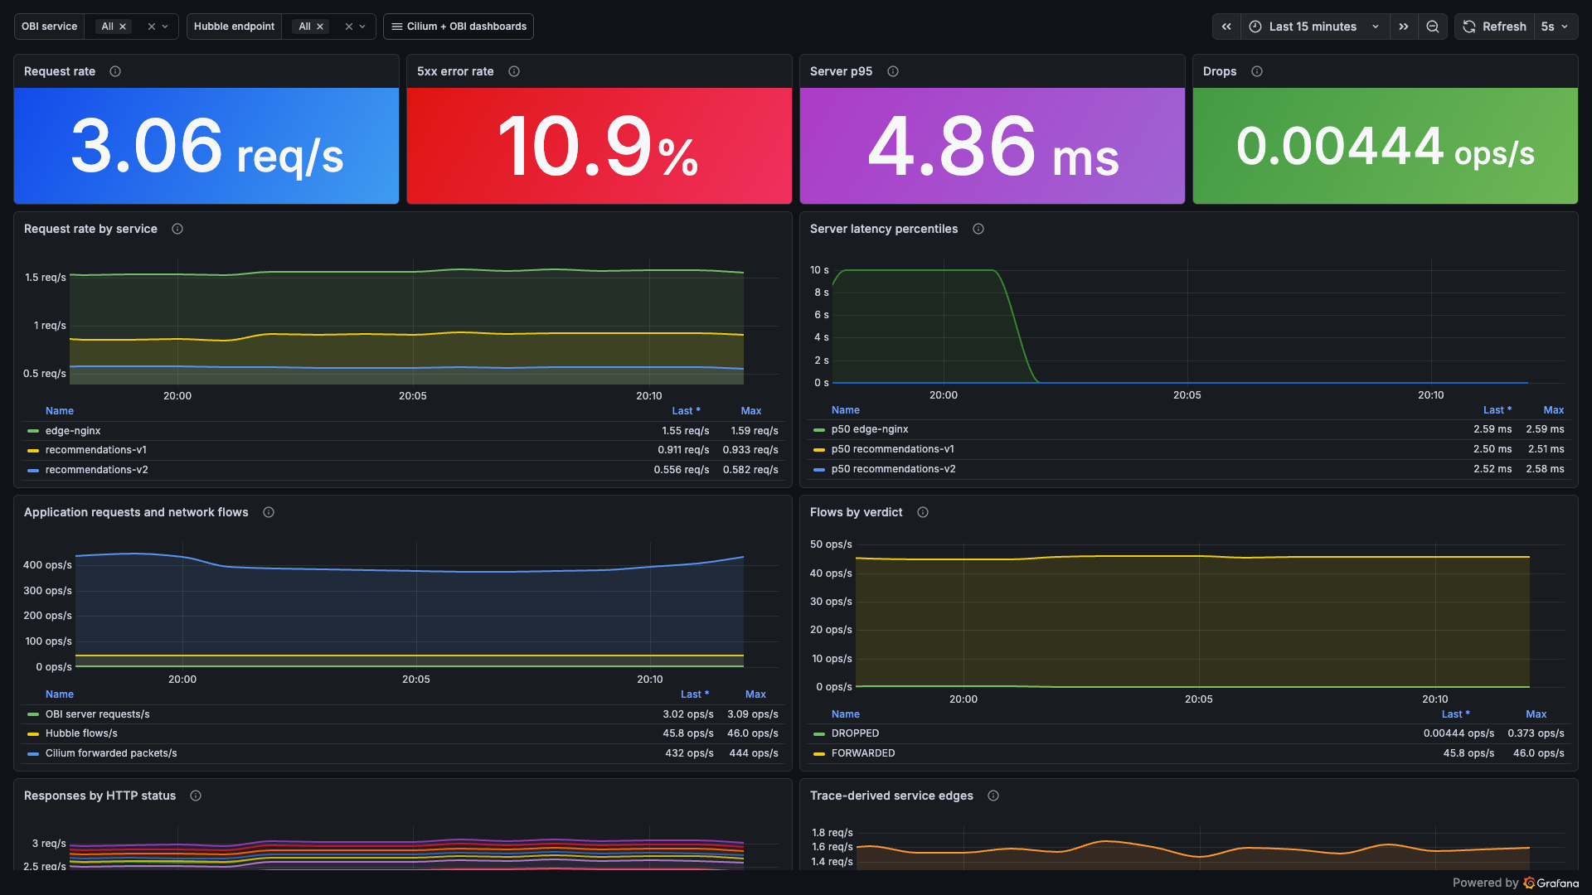
Application and network metrics in one view
Notes:
Timing: 2 minutes
Fresh capture from the running local kind cluster on 26 September 2026. Start at the top: OBI reports request rate, 5xx rate, and server p95. Then move to the lower panels: the same time window contains OBI server requests, Hubble flows, Cilium forwarded packets, and flow verdicts. The dashboard aligns the signals by time and workload. It does not claim a one-to-one event match. Treat these values as live demo evidence, not benchmark results.

Slide 19
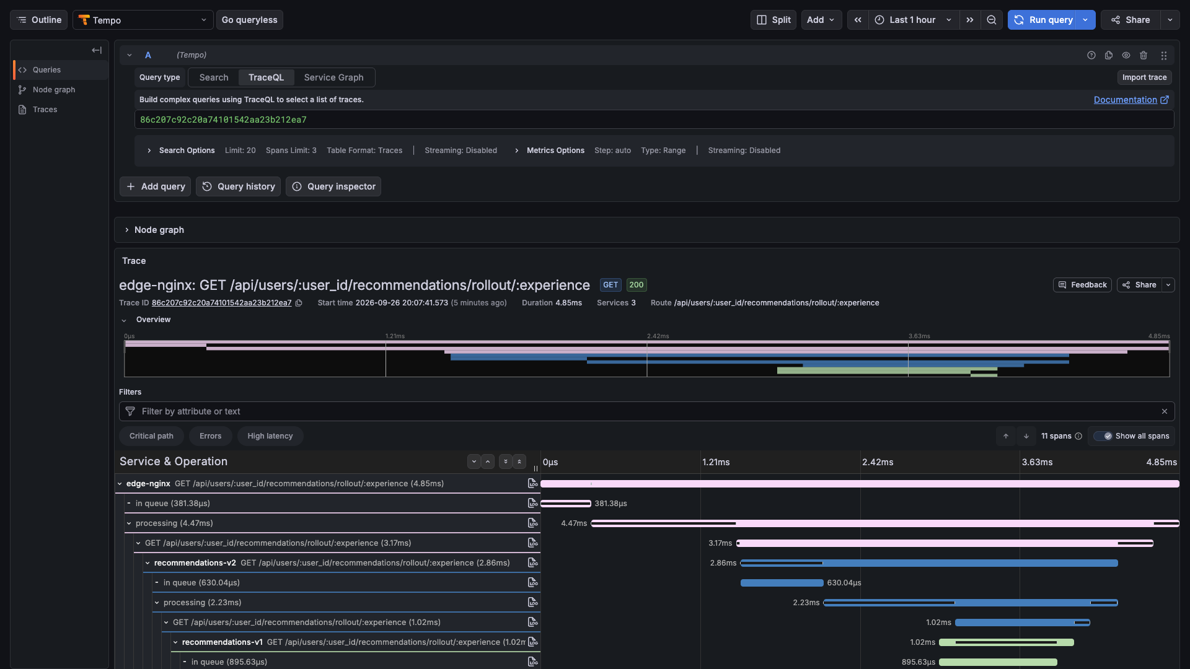
OBI reconstructs the three-service request
Notes:
Timing: 2 minutes
Fresh Tempo capture from the running local kind cluster on 26 September 2026. The trace begins at edge-nginx, continues to recommendations-v2, and reaches recommendations-v1. Point out the normalized route, HTTP 200 result, three participating services, and the nested client and server spans. OBI generated this request path without application code changes. Compare it with Demo 2's Hubble view: Tempo explains request semantics and latency, while Hubble explains workload identity, direction, ports, and verdicts.

Slide 20
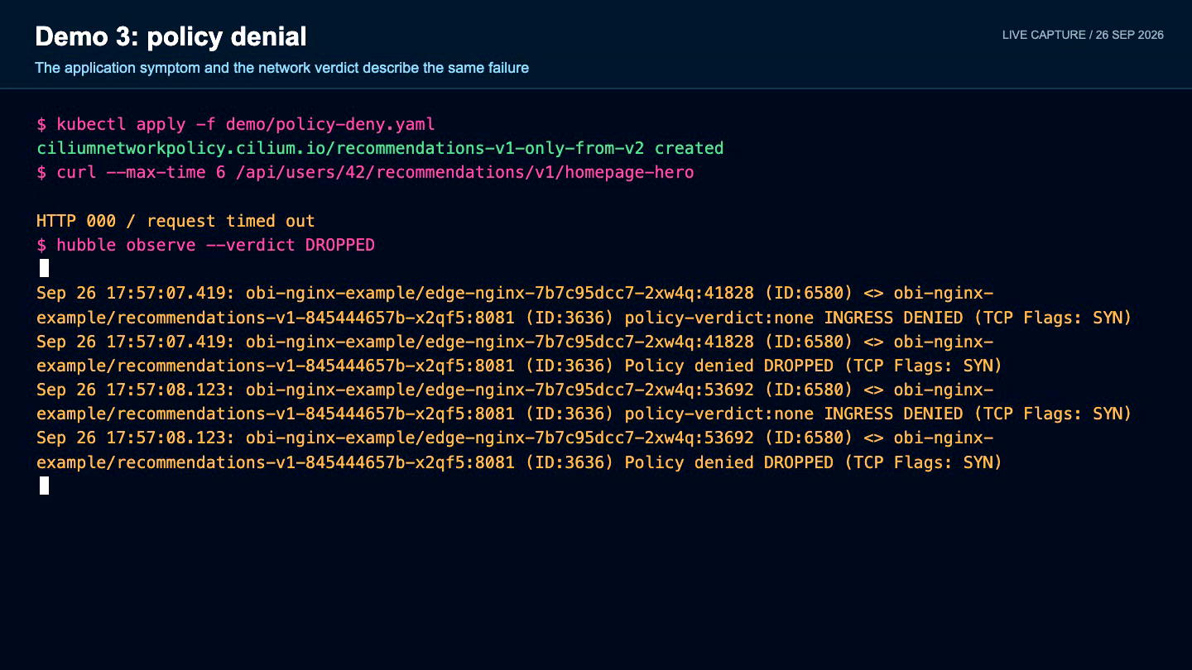
Demo 3: make a policy denial visible twice
Notes:
Timing: 3 minutes
Click the video to play. The recording applies demo/policy-deny.yaml, issues the same application request, and receives HTTP 000 because the call times out. It then shows Hubble reporting Policy denied and DROPPED for edge-nginx to recommendations-v1:8081, followed by the Grafana view for the same time window. Explain the two contracts: Hubble proves the network enforcement decision and identifies the blocked workloads; OBI shows the application symptom at the caller, such as a timeout or upstream error. A missing destination server span is expected because the request never reached that process. The recording removes the policy and verifies HTTP 200 recovery before it ends.
Sources:
- https://docs.cilium.io/en/stable/security/policy/
- https://docs.cilium.io/en/stable/observability/hubble/

Slide 21
Give network telemetry one default owner
Default combined design
OBI
application signals
Hubble
network + policy
OBI network metrics
socket_filter only
Enable the third stream only for a question Hubble cannot answer, or when duplication is the experiment.
AVOID DUPLICATE TC FLOW COLLECTION
Notes:
Timing: 2 minutes
OBI also has network observability features. In a Cilium cluster, the OBI documentation recommends socket_filter. Keep Hubble as the default network signal and OBI as the application signal to avoid duplicate volume and competing interpretations.
Sources:
- https://opentelemetry.io/docs/zero-code/obi/network/config/

Slide 22
Measure the combined system
Notes:
Timing: 30 seconds
Section transition: Measure the combined system.

Slide 23
Measured B and D within the six-condition plan
A
B
C
D
E
F
Cilium
baseline
+ Hubble
L3/L4
+ OBI metrics
no propagation
+ OBI traces
TCX propagation
+ Hubble L7
Envoy redirect
Legacy TC
fresh cluster
Same cluster, route, request count, concurrency, placement, and backend
40-request warm-up, then five samples of 200 requests at concurrency 20
B versus D: throughput 19.77 to 19.73 req/s (-0.2%), p95 1,018 to 1,020 ms (+2 ms)
0 / 2,000 failures. OBI median: 0.013 cores and 253 MiB across two pods.
7,210 spans delivered. Hubble lost events: 36 baseline, 1,083 combined.
Notes:
Timing: 3 minutes
This slide contains the corrected local rehearsal result captured on 26 September 2026.
Method:
- Same three-node kind cluster and the same application route for both conditions.
- Condition B kept Cilium and Hubble running while the OBI DaemonSet was temporarily unscheduled.
- Condition D restored OBI v0.13.0 with TCX context propagation.
- Background demo traffic was paused. Each condition received a 40-request warm-up followed by five samples of 200 requests at concurrency 20.
- ApacheBench measured throughput, failures, and percentiles through kubectl port-forward. Kubelet summary statistics provided pod CPU and working-set memory. Direct port 9965 counters from every Cilium agent provided Hubble lost-event deltas.
Measured result:
- Baseline throughput median: 19.77 req/s, range 19.70 to 19.79. Combined median: 19.73 req/s, range 19.71 to 19.76.
- Baseline p95 median: 1,018 ms, range 1,015 to 1,036. Combined median: 1,020 ms, range 1,018 to 1,023.
- Failed requests: zero across 1,000 baseline and 1,000 combined requests.
- OBI median CPU: 0.0128 cores. OBI median working set: 253.2 MiB total across two DaemonSet pods.
- The Collector accepted and exported 7,210 spans during the combined run. Accepted and exported counts matched.
- Hubble lost-event delta was 36 in the baseline and 1,083 in the combined run. The request path stayed healthy, but the telemetry-completeness gate did not pass. Investigate Hubble buffer and consumer capacity, then repeat the test before drawing a production conclusion.
Boundary:
These are local kind and kubectl port-forward rehearsal results. They are useful for the talk and for finding failure modes. They are not production capacity numbers. Conditions A, C, E, and F remain unmeasured in this run.
Sources:
- /Users/antonjim/Documents/Playground/cilium-obi-demo/evidence/benchmark-2026-09-26/results.json
- https://docs.cilium.io/en/latest/operations/performance/benchmark/
- https://opentelemetry.io/docs/zero-code/obi/configure/tune-performance/

Slide 24
Four budgets decide whether coexistence works
01
CPU
node, app, Cilium, Hubble, OBI, Collector
02
Memory
RSS plus BPF program and map memory
03
Loss
Hubble lost events, refused and dropped telemetry
04
Volume
spans, metric points, flows, active series
Traffic health and telemetry completeness are separate acceptance gates.
Notes:
Timing: 2 minutes
Measure client throughput, errors, p50, p95, and p99 alongside resources and telemetry integrity. A healthy request path does not prove trace completeness. A green telemetry pipeline does not prove the datapath cost is acceptable.
Sources:
- https://opentelemetry.io/docs/collector/internal-telemetry/
- https://docs.cilium.io/en/stable/observability/metrics/

Slide 25
Production rollout
Notes:
Timing: 30 seconds
Section transition: Production rollout.

Slide 26
Roll out through evidence gates
1
2
3
4
5
Inventory
Render
Canary
Exercise
Promote
kernel · BTF · versions · datapath
capabilities · mounts · priorities
small node pool · fast disable path
same-node · cross-node · service · deny
bounded comparison · traffic + telemetry
Promote only when packet behavior, request coverage, loss counters, and resource budgets all pass.
Notes:
Timing: 2 minutes
The production field guide begins with an inventory and ends with a bounded before-and-after comparison. Keep Cilium on the veth datapath until OBI compatibility with netkit is separately validated.

Slide 27
Three rules for running both
01
Prefer TCX
Verify the live attach mode on every node pool.
02
Make legacy order explicit
OBI priority 1, Cilium above 1, fresh cluster for tests.
03
Correlate complementary signals
OBI owns application evidence. Hubble owns network and policy evidence.
Notes:
Timing: 1 minute
Close by restating the operational contract. Safe coexistence means verified order, preserved traffic, complete enough telemetry, and measured cost.

Slide 28
Appendix
Notes:
Timing: Optional
Section transition: Appendix.

Slide 29
Appendix: pinned TCX configuration
OBI v0.13.0
Cilium v1.20.2
contextPropagation:
enabled: true
config:
data:
ebpf:
context_propagation: all
traffic_control_backend: tcx
bpf:
enableTCX: true
datapathMode: veth
hubble:
enabled: true
relay:
enabled: true
ui:
enabled: true
Notes:
Timing: Appendix
These fragments match demo/obi-values.yaml and demo/cilium-values.yaml in the workspace. Render the charts before the live session.

Slide 30
Appendix: legacy-safe and legacy-unsafe variants
Safe
Unsafe
OBI:
traffic_control_backend: tc
Cilium:
enableTCX: false
extraConfig:
bpf-filter-priority: "2"
OBI:
traffic_control_backend: tc
Cilium:
enableTCX: false
bpf-filter-priority: 1
Do not change legacy priority live on an existing production cluster.
Notes:
Timing: Appendix
Use demo/cilium-values-legacy-safe.yaml, demo/cilium-values-legacy-unsafe.yaml, and demo/obi-values-legacy.yaml. Build each variant on a fresh cluster because stale filters can break connectivity.
Sources:
- https://github.com/cilium/cilium/issues/36172

Slide 31
Appendix: live verification commands
# Cilium state
kubectl -n kube-system exec ds/cilium -c cilium-agent -- \
cilium-dbg status --verbose
kubectl -n kube-system get cm cilium-config -o \
jsonpath='{.data.enable-tcx}'
# OBI startup decision
kubectl -n obi-nginx-example logs \
ds/obi-opentelemetry-ebpf-instrumentation --all-pods=true
# Flow proof
hubble observe --namespace obi-nginx-example --follow
Notes:
Timing: Appendix
Run these read-only checks before the talk. Save clean output for the backup recording.

Slide 32
Fast failure diagnosis
OBI refuses startup
mixed TCX and legacy, or both priority 1
Propagation disabled
tracefs mount missing on affected kernels
Traffic healthy, traces missing
coverage, loss, exporter, or queue problem
Hubble lost events rise
event volume or consumer capacity problem
Series count accelerates
route or workload label cardinality
Notes:
Timing: Appendix
Use this slide to handle operational questions without turning the main talk into a troubleshooting checklist. Detailed failure modes are in research.md.

Slide 33
Questions?
Demo, dashboards, benchmark, and slides
github.com/ajimenez1503/cilium-obi-demo
Notes:
Timing: 5 minutes
Keep the demo repository visible during questions so attendees can find the setup, dashboards, benchmark evidence, and latest deck.
Sources:
- https://github.com/ajimenez1503/cilium-obi-demo

Slide 34
Notes:
Timing: End
Finish on the required Cisco closing slide.

