Slide 1
Bootstrap

Slide 2
What is Bootstrap?
Bootstrap is a free front-end framework for faster and easier web development.
Bootstrap includes HTML and CSS based design templates for forms, buttons, tables, navigation, modals, image carousels and many other, as well as optional JavaScript plugins.
Bootstrap also gives you the ability to easily create responsive designs.

Slide 3
Advantages of Bootstrap
Easy to use
Responsive features
Mobile-first approach
Browser compatibility

Slide 4
History of bootstrap
Bootstrap was developed by MARK OTTO & JACOB THORNTON at twitter and released as an open source product in August 2011 on GitHub.
Bootstrap originally named Twitter Blueprint.
In June 2014 Bootstrap was the No.1 project on Github!
Previous Bootstrap Version
Version | Release date
Bootstrap 2 | January 31 2012
Bootstrap 3 | August 19 2013
Bootstrap 4 | October 29 2014
Bootstrap 5 | May 5 2021

Slide 5

What is Responsive Web Design?
Responsive web design is about creating web sites which automatically adjust themselves to look good on all devices, from small phones to large desktops.

Slide 6
Responsive Containers
Extra small (xs) →Portrait phones
Small (sm) →Landscape phones
Medium (md) →Tablets
Large (lg) →Laptops
Extra large (xl) →Laptops and Desktops
Extra extra large (xxl)→Laptops and Desktops

Slide 7


Containers:
.container fixed width container
.container-fluid full width container

Slide 8
Example-1:
Container
<div class="container"> <h1>My First Bootstrap Page</h1> <p>This part is inside a .container class.</p> <p>The .container class provides a responsive fixed width container.</p> </div>
Container-fluid
<div class="container-fluid"> <h1>My First Bootstrap Page</h1> <p>This part is inside a .container class.</p> <p>The .container class provides a responsive fixed width container.</p> </div>

Slide 9
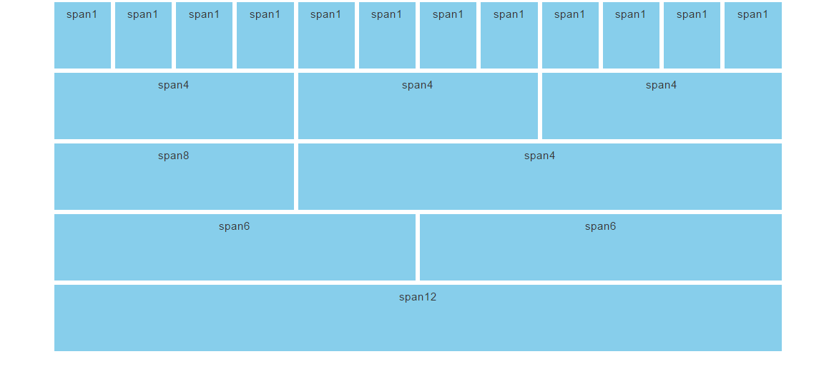
Bootstrap Grids

Slide 10
Example-2
<div class="container">
<div class="row">
<div class="col">col</div>
<div class="col">col</div>
<div class="col">col</div>
<div class="col">col</div>
</div>
<div class="row">
<div class="col-8">col-8</div>
<div class="col-4">col-4</div>
</div>
</div>

Slide 11
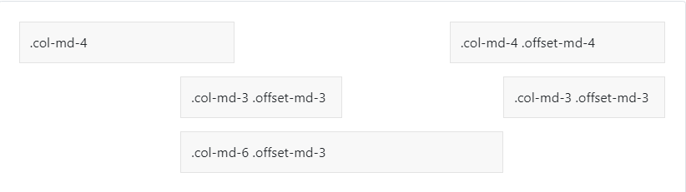
Offset:
Move columns to the right using .offset-md-* classes.
For example, .offset-md-4 moves .col-md-4

Slide 12
Example:
<div class="container">
<div class="row">
<div class="col-md-4">.col-md-4</div>
<div class="col-md-4 offset-md-4">.col-md-4 .offset-md-4</div>
</div>
<div class="row">
<div class="col-md-3 offset-md-3">.col-md-3 .offset-md-3</div>
<div class="col-md-3 offset-md-3">.col-md-3 .offset-md-3</div>
</div>
<div class="row">
<div class="col-md-6 offset-md-3">.col-md-6 .offset-md-3</div>
</div>
</div>

Slide 13
Margin & Padding
m-margin.
p- padding.
t- margin-top or padding-top.
b- margin-bottom or padding-bottom.
s- margin-left or padding-left.
e- margin-right or padding-right.
x- both left & right.
y- top & bottom.
0- eliminate the margin or padding by set.
The values for margin & padding starts from 1 to 5.
auto – for classes that set the margin & padding auto.

Slide 14
Example:
<div class="container">
<div class="row">
<div class="col-md-4">.col-md-4</div>
<div class="col-md-4 ms-auto">.col-md-4 .ms-auto</div>
</div>
<div class="row">
<div class="col-md-3 ms-md-auto">.col-md-3 .ms-md-auto</div>
<div class="col-md-3 ms-md-auto">.col-md-3 .ms-md-auto</div>
</div>
<div class="row">
<div class="col-auto me-auto">.col-auto .me-auto</div>
<div class="col-auto">.col-auto</div>
</div>
</div>

Slide 15
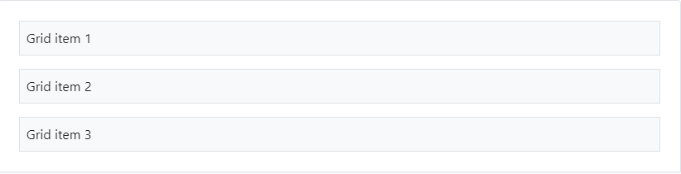
Gap
When using display: grid, you can make use of gap utilities on the parent grid container.

Slide 16
Example:
<div class="d-grid gap-3">
<div class="p-2 bg-light border">Grid item 1</div>
<div class="p-2 bg-light border">Grid item 2</div> <div class="p-2 bg-light border">Grid item 3</div>
</div>

Slide 17
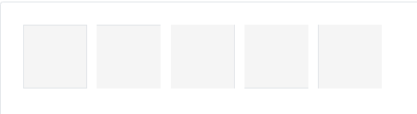
Border:
Use border utilities to quickly style the border and border-radius of an element. Great for images, buttons, or any other element.

Slide 18
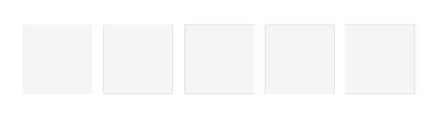
Example:
<span class="border"></span>
<span class="border-top"></span>
<span class="border-end"></span>
<span class="border-bottom"></span>
<span class="border-start"></span>
Subtractive:
<span class="border-0"></span>
<span class="border-top-0"></span>
<span class="border-end-0"></span>
<span class="border-bottom-0"></span>
<span class="border-start-0"></span>

Slide 19
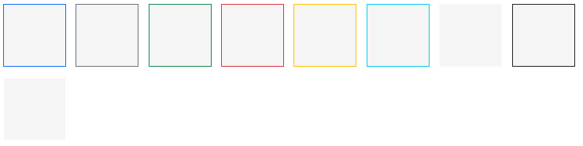
Border color:
<span class="border border-primary"></span>
<span class="border border-secondary"></span>
<span class="border border-success"></span>
<span class="border border-danger"></span>
<span class="border border-warning"></span>
<span class="border border-info"></span>
<span class="border border-light"></span>
<span class="border border-dark"></span>
<span class="border border-white"></span>

Slide 20

Border-width
<span class="border border-1"></span>
<span class="border border-2"></span>
<span class="border border-3"></span>
<span class="border border-4"></span>
<span class="border border-5"></span>

Slide 21

Border-radius
<img src="..." class="rounded" alt="...">
<img src="..." class="rounded-top" alt="...">
<img src="..." class="rounded-end" alt="...">
<img src="..." class="rounded-bottom" alt="...">
<img src="..." class="rounded-start" alt="...">
<img src="..." class="rounded-circle" alt="...">
<img src="..." class="rounded-pill" alt="...">

Slide 22

Sizes:
<img src="..." class="rounded-0" alt="...">
<img src="..." class="rounded-1" alt="...">
<img src="..." class="rounded-2" alt="...">
<img src="..." class="rounded-3" alt="...">

Slide 23
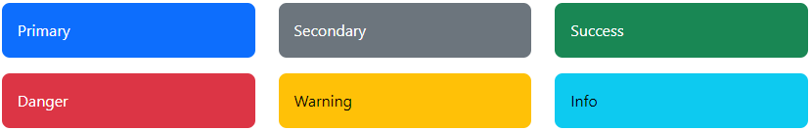
Text colors

Slide 24
<p class="text-primary">.text-primary</p>
<p class="text-primary-emphasis">.text-primary-emphasis</p>
<p class="text-secondary">.text-secondary</p>
<p class="text-secondary-emphasis">.text-secondary-emphasis</p>
<p class="text-success">.text-success</p>
<p class="text-success-emphasis">.text-success-emphasis</p>
<p class="text-danger">.text-danger</p>
<p class="text-danger-emphasis">.text-danger-emphasis</p>
<p class="text-warning bg-dark">.text-warning</p>
<p class="text-warning-emphasis">.text-warning-emphasis</p>
<p class="text-info bg-dark">.text-info</p>
<p class="text-info-emphasis">.text-info-emphasis</p>

Slide 25
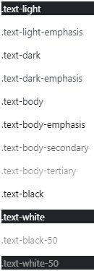
<p class="text-light bg-dark">.text-light</p>
<p class="text-light-emphasis">.text-light-emphasis</p>
<p class="text-dark bg-white">.text-dark</p>
<p class="text-dark-emphasis">.text-dark-emphasis</p>
<p class="text-body">.text-body</p>
<p class="text-body-emphasis">.text-body-emphasis</p>
<p class="text-body-secondary">.text-body-secondary</p>
<p class="text-body-tertiary">.text-body-tertiary</p>
<p class="text-black bg-white">.text-black</p>
<p class="text-white bg-dark">.text-white</p>
<p class="text-black-50 bg-white">.text-black-50</p>
<p class="text-white-50 bg-dark">.text-white-50</p>

Slide 26
Background color
<div class="p-3 mb-2 bg-primary text-white">.bg-primary</div>
<div class="p-3 mb-2 bg-secondary text-white">.bg-secondary</div>
<div class="p-3 mb-2 bg-success text-white">.bg-success</div>
<div class="p-3 mb-2 bg-danger text-white">.bg-danger</div>
<div class="p-3 mb-2 bg-warning text-dark">.bg-warning</div>
<div class="p-3 mb-2 bg-info text-dark">.bg-info</div>
<div class="p-3 mb-2 bg-light text-dark">.bg-light</div>
<div class="p-3 mb-2 bg-dark text-white">.bg-dark</div>
<div class="p-3 mb-2 bg-body text-dark">.bg-body</div>
<div class="p-3 mb-2 bg-white text-dark">.bg-white</div>
<div class="p-3 mb-2 bg-transparent text-dark">.bg-transparent</div>

Slide 27
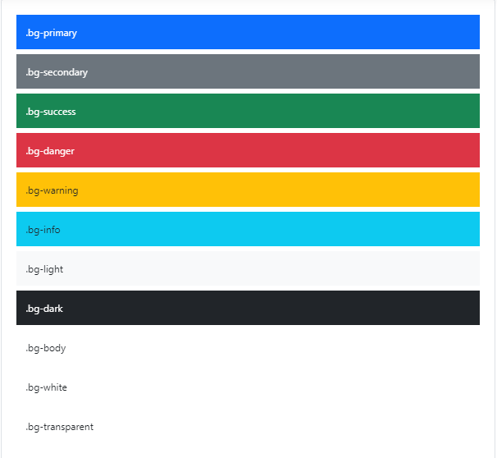

Slide 28
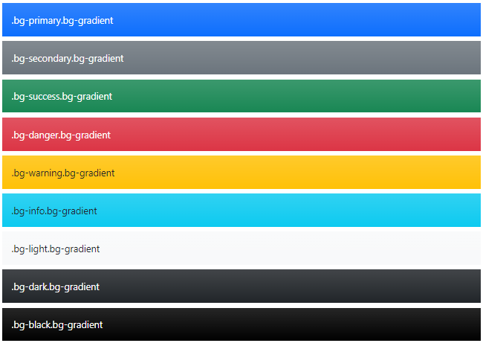
Background gradient
By adding a .bg-gradient class, a linear gradient is added as background

Slide 29
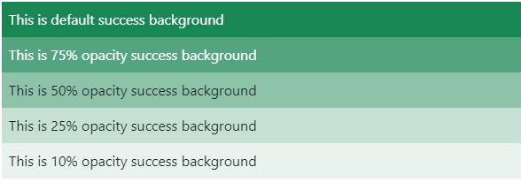
Opacity:
<div class="bg-success p-2 text-white">This is default success </div>
<div class="bg-success p-2 text-white bg-opacity-75">75% opacity </div>
<div class="bg-success p-2 text-dark bg-opacity-50">50% opacity </div>
<div class="bg-success p-2 text-dark bg-opacity-25">25% opacity </div>
<div class="bg-success p-2 text-dark bg-opacity-10">10% opacity </div>

Slide 30
Display:
none
inline
inline-block
block
grid
inline-grid
table
table-cell
table-row
flex
inline-flex

Slide 31


Example:
<div class="d-inline p-2 text-bg-primary">d-inline</div>
<div class="d-inline p-2 text-bg-dark">d-inline</div>
Example:
<span class="d-block p-2 text-bg-primary">d-block</span>
<span class="d-block p-2 text-bg-dark">d-block</span>

Slide 32
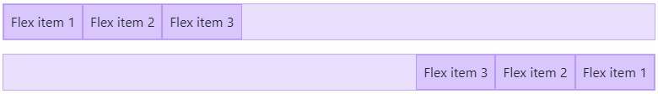
Flex-Direction:
Use .flex-row to set a horizontal direction (the browser default), or .flex-row-reverse to start the horizontal direction from the opposite side.

Slide 33
Example:
<div class="d-flex flex-row mb-3">
<div class="p-2">Flex item 1</div>
<div class="p-2">Flex item 2</div>
<div class="p-2">Flex item 3</div>
</div>
<div class="d-flex flex-row-reverse">
<div class="p-2">Flex item 1</div>
<div class="p-2">Flex item 2</div>
<div class="p-2">Flex item 3</div>
</div>

Slide 34
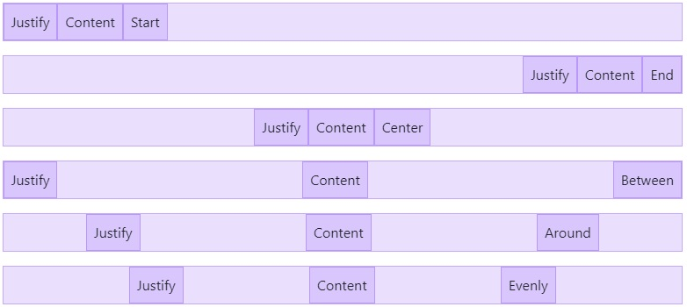
Justify content:
Use justify-content utilities on flexbox containers to change the alignment of flex items on the main axis (the x-axis to start, y-axis if flex-direction: column). Choose from start (browser default), end, center, between, around, or evenly.

Slide 35
Example:
<div class="d-flex justify-content-start">...</div>
<div class="d-flex justify-content-end">...</div>
<div class="d-flex justify-content-center">...</div>
<div class="d-flex justify-content-between">...</div>
<div class="d-flex justify-content-around">...</div>
<div class="d-flex justify-content-evenly">...</div>

Slide 36
Align items
Use align-items utilities on flexbox containers to change the alignment of flex items on the cross axis (the y-axis to start, x-axis if flex-direction: column). Choose from start, end, center, baseline, or stretch (browser default).
<div class="align-self-start">Aligned flex item</div>
<div class="align-self-end">Aligned flex item</div>
<div class="align-self-center">Aligned flex item</div>
<div class="align-self-baseline">Aligned flex item</div>
<div class="align-self-stretch">Aligned flex item</div>

Slide 37
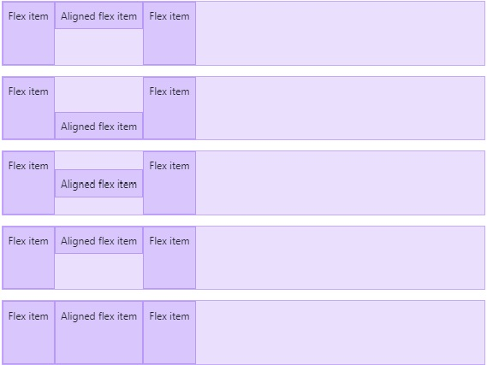

Slide 38
Grow and shrink
The .flex-grow-1 elements uses all available space it can, while allowing the remaining two flex items their necessary space.
<div class="d-flex">
<div class="p-2 flex-grow-1">Flex item</div>
<div class="p-2">Flex item</div>
<div class="p-2">Third flex item</div>
</div>

Slide 39
The second flex item with .flex-shrink-1 is forced to wrap its contents to a new line, “shrinking” to allow more space for the previous flex item with .w-100
Example:
<div class="d-flex">
<div class="p-2 w-100">Flex item</div>
<div class="p-2 flex-shrink-1">Flex item</div>
</div>

Slide 40
Order:
We only provide options for making an item first or last, as well as a reset to use the DOM order. As order takes any integer value from 0 to 5, add custom CSS for any additional values needed.
<div class="d-flex flex-nowrap">
<div class="order-3 p-2">First flex item</div>
<div class="order-2 p-2">Second flex item</div>
<div class="order-1 p-2">Third flex item</div>
</div>

Slide 41
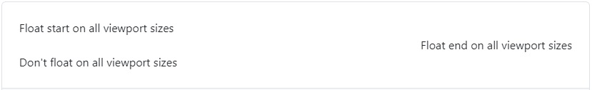
Float:
These utility classes float an element to the left or right, or disable floating.
<div class="float-start">Float start </div><br>
<div class="float-end">Float end </div><br>
<div class="float-none">Don't float on all viewport </div>

Slide 42
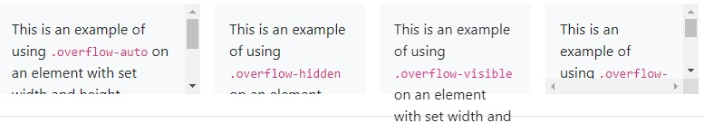
Overflow:
<div class="overflow-auto">...</div>
<div class="overflow-hidden">...</div>
<div class="overflow-visible">...</div>
<div class="overflow-scroll">...</div>

Slide 43
Position:
<div class="position-static">...</div>
<div class="position-relative">...</div>
<div class="position-absolute">...</div>
<div class="position-fixed">...</div>
<div class="position-sticky">...</div>

Slide 44
Arrange elements:
Arrange elements easily with the edge positioning utilities. The format is {property}-{position}.
Where property is one of:
top - for the vertical top position
start - for the horizontal left position (in LTR)
bottom - for the vertical bottom position
end - for the horizontal right position (in LTR)
Where position is one of:
0 - for 0 edge position
50 - for 50% edge position
100 - for 100% edge position

Slide 45
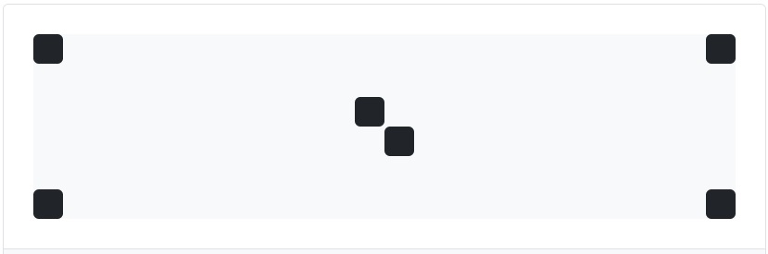
Example:
<div class="position-relative">
<div class="position-absolute top-0 start-0"></div>
<div class="position-absolute top-0 end-0"></div>
<div class="position-absolute top-50 start-50"></div>
<div class="position-absolute bottom-50 end-50"></div>
<div class="position-absolute bottom-0 start-0"></div>
<div class="position-absolute bottom-0 end-0"></div>
</div>

Slide 46
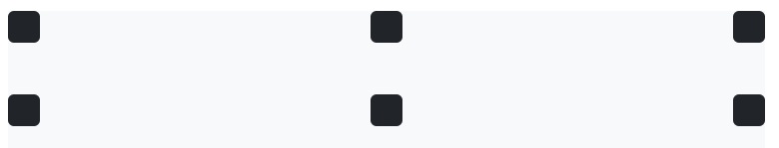
Center elements:
<div class="position-relative">
<div class="position-absolute top-0 start-0 translate-middle"></div>
<div class="position-absolute top-0 start-50 translate-middle"></div>
<div class="position-absolute top-0 start-100 translate-middle"></div>
</div>
<div class="position-relative">
<div class="position-absolute top-0 start-0"></div>
<div class="position-absolute top-0 start-50 translate-middle-x"></div>
<div class="position-absolute top-0 end-0"></div>
<div class="position-absolute top-50 start-0 translate-middle-y"></div>
<div class="position-absolute top-50 start-50 translate-middle"></div>
<div class="position-absolute top-50 end-0 translate-middle-y"></div>
</div>

Slide 47
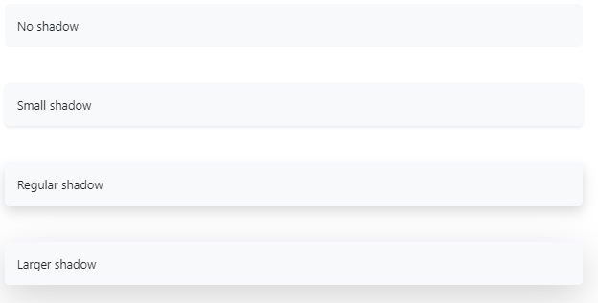
Shadows:
<div class="shadow-none p-3 mb-5 bg-body-tertiary rounded">No shadow</div>
<div class="shadow-sm p-3 mb-5 bg-body-tertiary rounded">Small shadow</div>
<div class="shadow p-3 mb-5 bg-body-tertiary rounded">Regular shadow</div>
<div class="shadow-lg p-3 mb-5 bg-body-tertiary rounded">Larger shadow</div>

Slide 48
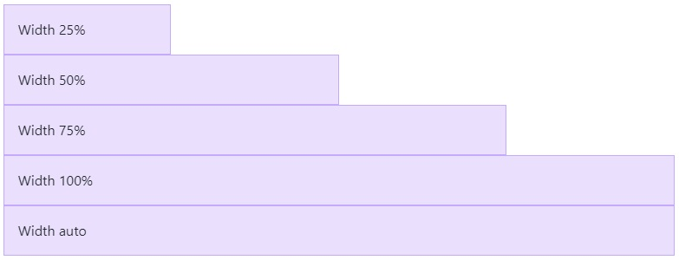
Sizing(Width):
<div class="w-25 p-3">Width 25%</div>
<div class="w-50 p-3">Width 50%</div>
<div class="w-75 p-3">Width 75%</div>
<div class="w-100 p-3">Width 100%</div>
<div class="w-auto p-3">Width auto</div>

Slide 49
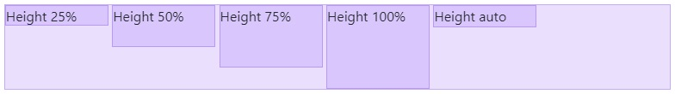
Sizing(Height):
<div style="height: 100px;">
<div class="h-25 d-inline-block" style="width: 120px;">Height 25%</div>
<div class="h-50 d-inline-block" style="width: 120px;">Height 50%</div>
<div class="h-75 d-inline-block" style="width: 120px;">Height 75%</div>
<div class="h-100 d-inline-block" style="width: 120px;">Height 100%</div>
<div class="h-auto d-inline-block" style="width: 120px;">Height auto</div>
</div>

Slide 50
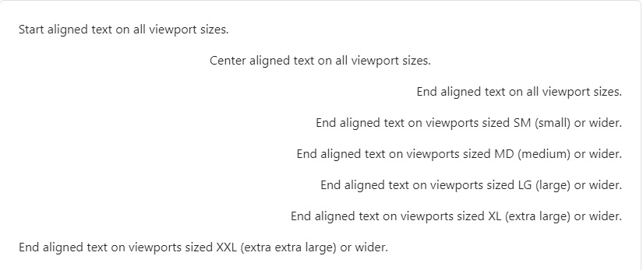
Text alignment
<p class="text-start">Start aligned text on all viewport sizes.</p>
<p class="text-center">Center aligned text on all viewport sizes.</p>
<p class="text-end">End aligned text on all viewport sizes.</p>
<p class="text-sm-end">End aligned text on viewports sized SM (small) or wider.</p>
<p class="text-md-end">End aligned text on viewports sized MD (medium) or wider.</p>
<p class="text-lg-end">End aligned text on viewports sized LG (large) or wider.</p>
<p class="text-xl-end">End aligned text on viewports sized XL (extra large) or wider.</p>
<p class="text-xxl-end">End aligned text on viewports sized XXL (extra extra large) or wider.</p>

Slide 51

Text wrapping and overflow
Wrap text with a .text-wrap class.
Example1:
<div class="badge bg-primary text-wrap" style="width:6rem;">
This text should wrap.
</div>
Wrap text with a .text-wrap class.
Example1:
<div class="text-nowrap bg-body-secondary border" style="width: 8rem;">
This text should overflow the parent.
</div>

Slide 52
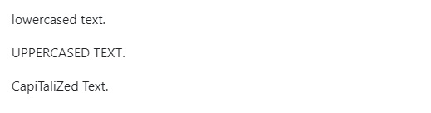
Text transform:
Transform text in components with text capitalization classes.
Example:
<p class="text-lowercase">Lowercased text.</p>
<p class="text-uppercase">Uppercased text.</p>
<p class="text-capitalize">CapiTaliZed text.</p>

Slide 53
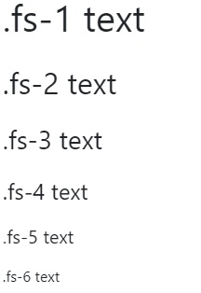
Font size:
<p class="fs-1">.fs-1 text</p>
<p class="fs-2">.fs-2 text</p>
<p class="fs-3">.fs-3 text</p>
<p class="fs-4">.fs-4 text</p>
<p class="fs-5">.fs-5 text</p>
<p class="fs-6">.fs-6 text</p>

Slide 54
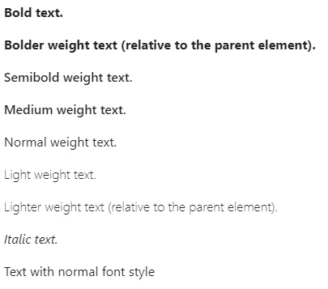
Font weight and italics
Quickly change the font-weight or font-style of text with these utilities. font-style utilities are abbreviated as .fst-* and font-weight utilities are abbreviated as .fw-*.
Example:
<p class="fw-bold">Bold text.</p>
<p class="fw-bolder">Bolder weight text
(relative to the parent element).</p>
<p class="fw-semibold">Semibold weight text.</p>
<p class="fw-medium">Medium weight text.</p>
<p class="fw-normal">Normal weight text.</p>
<p class="fw-light">Light weight text.</p>
<p class="fw-lighter">Lighter weight text
(relative to the parent element).</p>
<p class="fst-italic">Italic text.</p>
<p class="fst-normal">Text with normal font style</p>

Slide 55
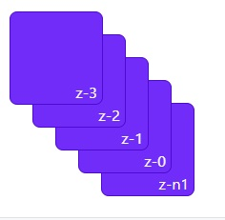
Z-index:
<div class="z-3 position-absolute p-5 rounded-3"><span>z-3</span></div>
<div class="z-2 position-absolute p-5 rounded-3"><span>z-2</span></div>
<div class="z-1 position-absolute p-5 rounded-3"><span>z-1</span></div>
<div class="z-0 position-absolute p-5 rounded-3"><span>z-0</span></div>
<div class="z-n1 position-absolute p-5 rounded-3"><span>z-n1</span></div>

