Slide 1
Music Genre Recognition
Under the supervision of Prof. Guoliang Xue
CSE 575: Statistical Machine Learning
Computing, Informatics, and Decision Systems Engineering
Arizona State University
Presented By Group 12:
Abantika Basak (1217117655)
Abhilasha Mandal (1217160477)
Ajinkya Dande (1217613956)
Omkar Muglikar (1217158150)
Rounak Sengupta (1215043206)

Slide 2
Outline
Background
Music Information Retrieval
Need for Automatic music genre classification
Overall flow of the proposed systems
Dataset used
Classifiers
Neural Networks: CNN, CNN-LSTM, BBNN
SVM
Logistic Regression
Contributions and Results
Comparison with existing work and Future scope

Slide 3
Music Information Retrieval
Extracting meaningful information from songs
Applications
Copyright Monitoring
Music transcript
Music management
Find performer/artist
Track separation
Digital Music platform
Identify song mood
Music recommendation system
Identify songs from audio (Shazam, Spotify)

Slide 4
Current Practices
Current practices rely on song file metadata and user input/feedback
Unscalable, tedious, highly subjective
More than 75000 albums released every year in USA alone
Therefore, an automatic technique for genre classification is required

Slide 5
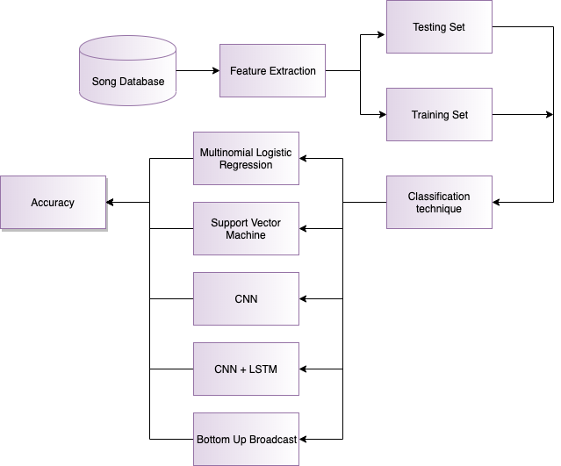
Proposed Architecture

Slide 6
Application

Slide 7
Song Dataset
GTZAN Dataset
1000 Audio files in .au format
16 bit, 22050 Hz, 30 secs each
{Blues, Classical, Country, Disco, Hip-Hop, Jazz, Metal, Pop, Reggae, Rock}

Slide 8
Generation of Mel Spectrograms
The mel-spectrogram images are generated for every audio file
Normalised the pixel values
Fed these images to the CNN
Image of a song is given in next slide

Slide 9
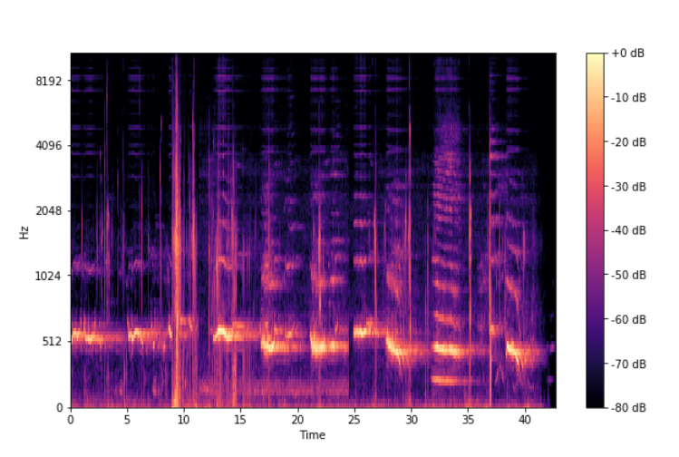
Mel spectrogram

Slide 10
ML models used and the test accuracies achieved
CNN-LSTM - 48%
SVM - 60 %
CNN - 76 %
Bottom up broadcast - 88%
Multinomial Logistic regression - 89 %
A few other RNN models were tried but were inaccurate.

Slide 11
Convolutional Neural Network
Deep Learning Algorithm
A basic question : Why ConvNets over Multi Layer Perceptron ?
Answer -
In MLP, total number of parameters - very high, ConvNets allow parameter sharing, weight sharing
Preprocessing in ConvNets - much lower than in MLP
CNNs capture local connectivity
Spatial information is lost in MLP

Slide 12
Convolutional Neural Network
Role of ConvNet - reduction of sizes of images such that they are easier to process, without losing important features
3 types of layers :
Convolution Layer
Pooling Layer
Fully Connected Layer

Slide 13
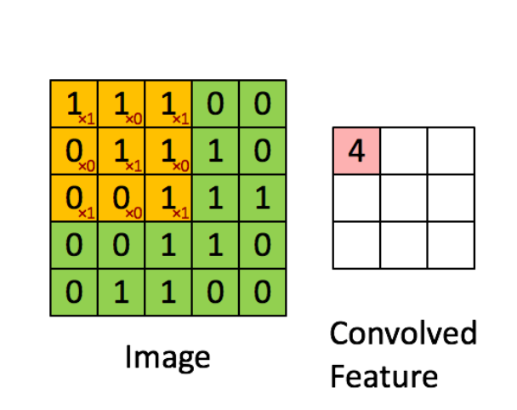
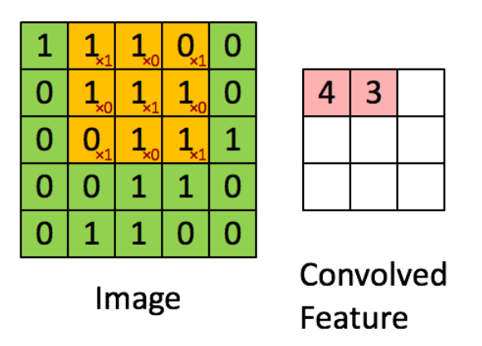
Convolution Layer
Further continues

Slide 14
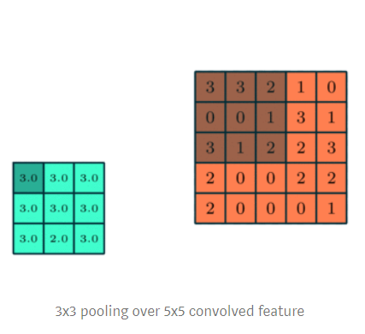
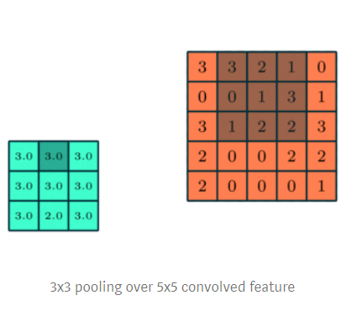
Pooling Layer (Max Pooling, Average Pooling)
Further continues
Fig : Max Pooling

Slide 15
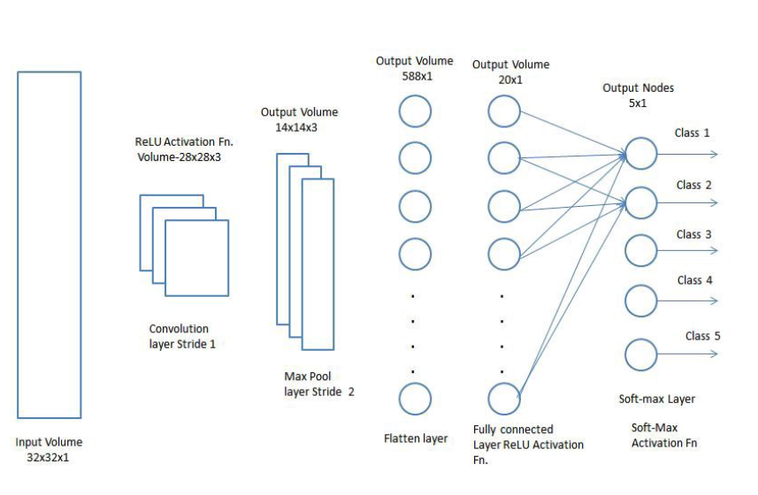
Fully Connected Layer ( as in MLP)
Fig : Basic Architecture of CNN

Slide 16
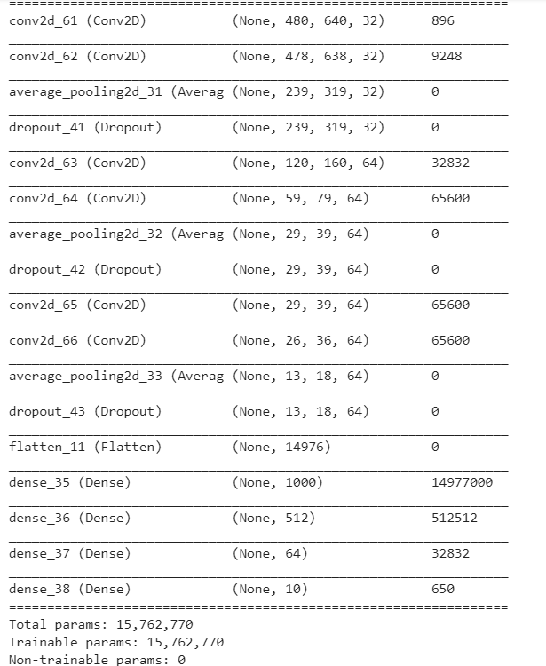
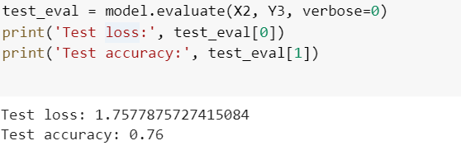
Trained for 100 epochs
Training set - 900 images
Validation Set - 100 images
Categorical Cross Entropy used as loss function

Slide 17
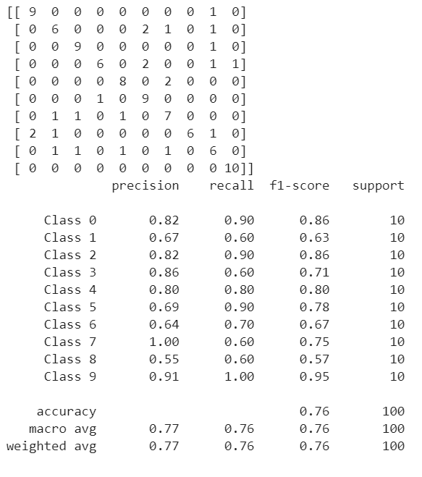
Confusion Matrix

Slide 18
Convolutional Recurrent Neural Network
Stands for Convolutional Neural Network - Long Short Term Memory
Deep Learning Algorithm
Why use both CNN and RNN?
CNN - makes sense - each spectrogram is an image
RNN - excel in understanding sequential data ( Here, we use CNN-LSTM as LSTM captures long-term dependencies )

Slide 19
CNN-LSTM Architecture (next slide)

Slide 20
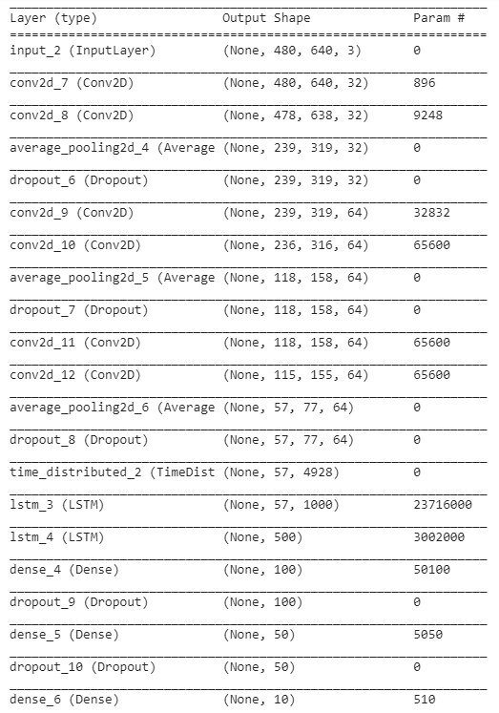

Slide 21
Trained for 200 epochs
Training set - 900 images
Validation Set - 100 images
Categorical Cross Entropy used as loss function
Test Accuracy : 48 %

Slide 22
Bottom-up Broadcast Neural network
Input is an image of mel-spectrogram (288 X 432 X 3)
It is an architecture of CNN
Trained for 100 epochs (training set 900 samples, validation set 100 samples)
Consists of 3 inception blocks
Categorical cross entropy used as loss function

Slide 23
Intuition behind this architecture -
[4] low-level features tend to be more contributed for improving the genre classification performance (Choi et al., 2017). Therefore, how to construct an appropriate CNN structure to maximally abstract high-level information and preserve the lower-level features simultaneously
[4] sound events are accumulated by frequency over time domain which causes the individual genre has different performance sensitivity to different time scales and levels of features. Therefore, it is necessary to design a specific CNN structure which can comprehensively handle multi-scale of audio features

Slide 24
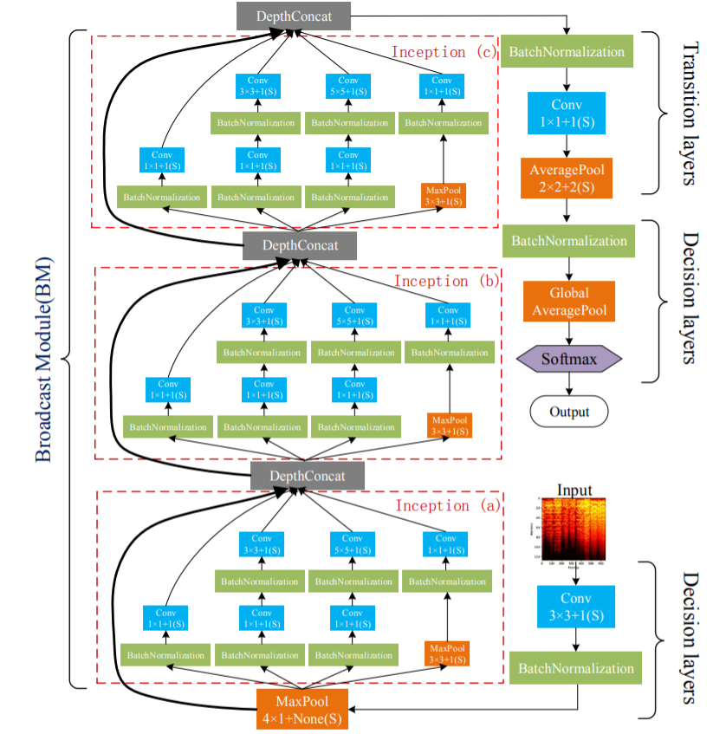

Slide 25
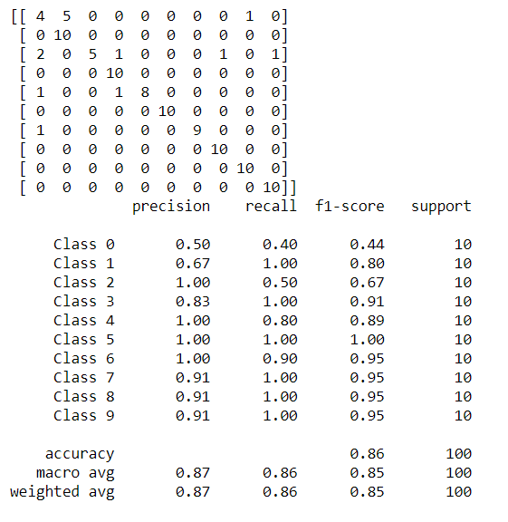
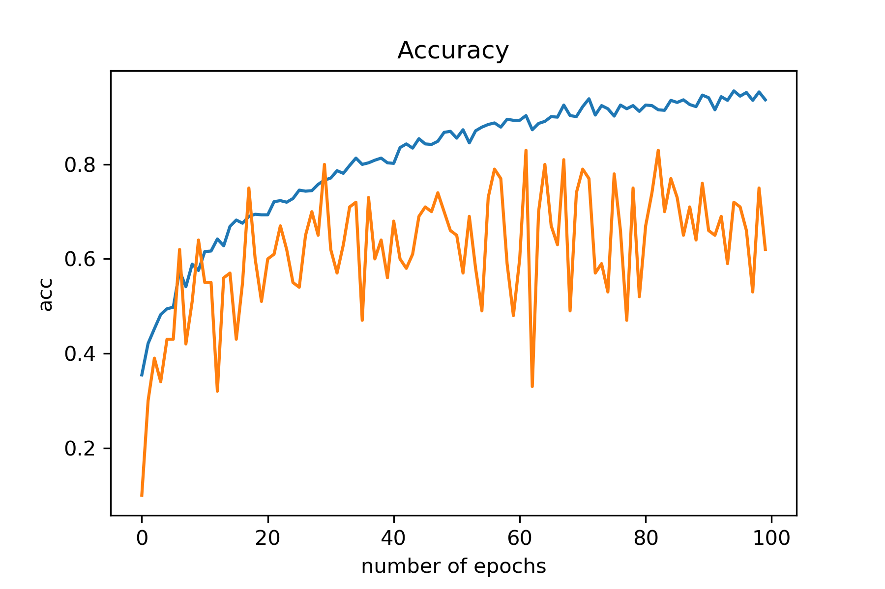
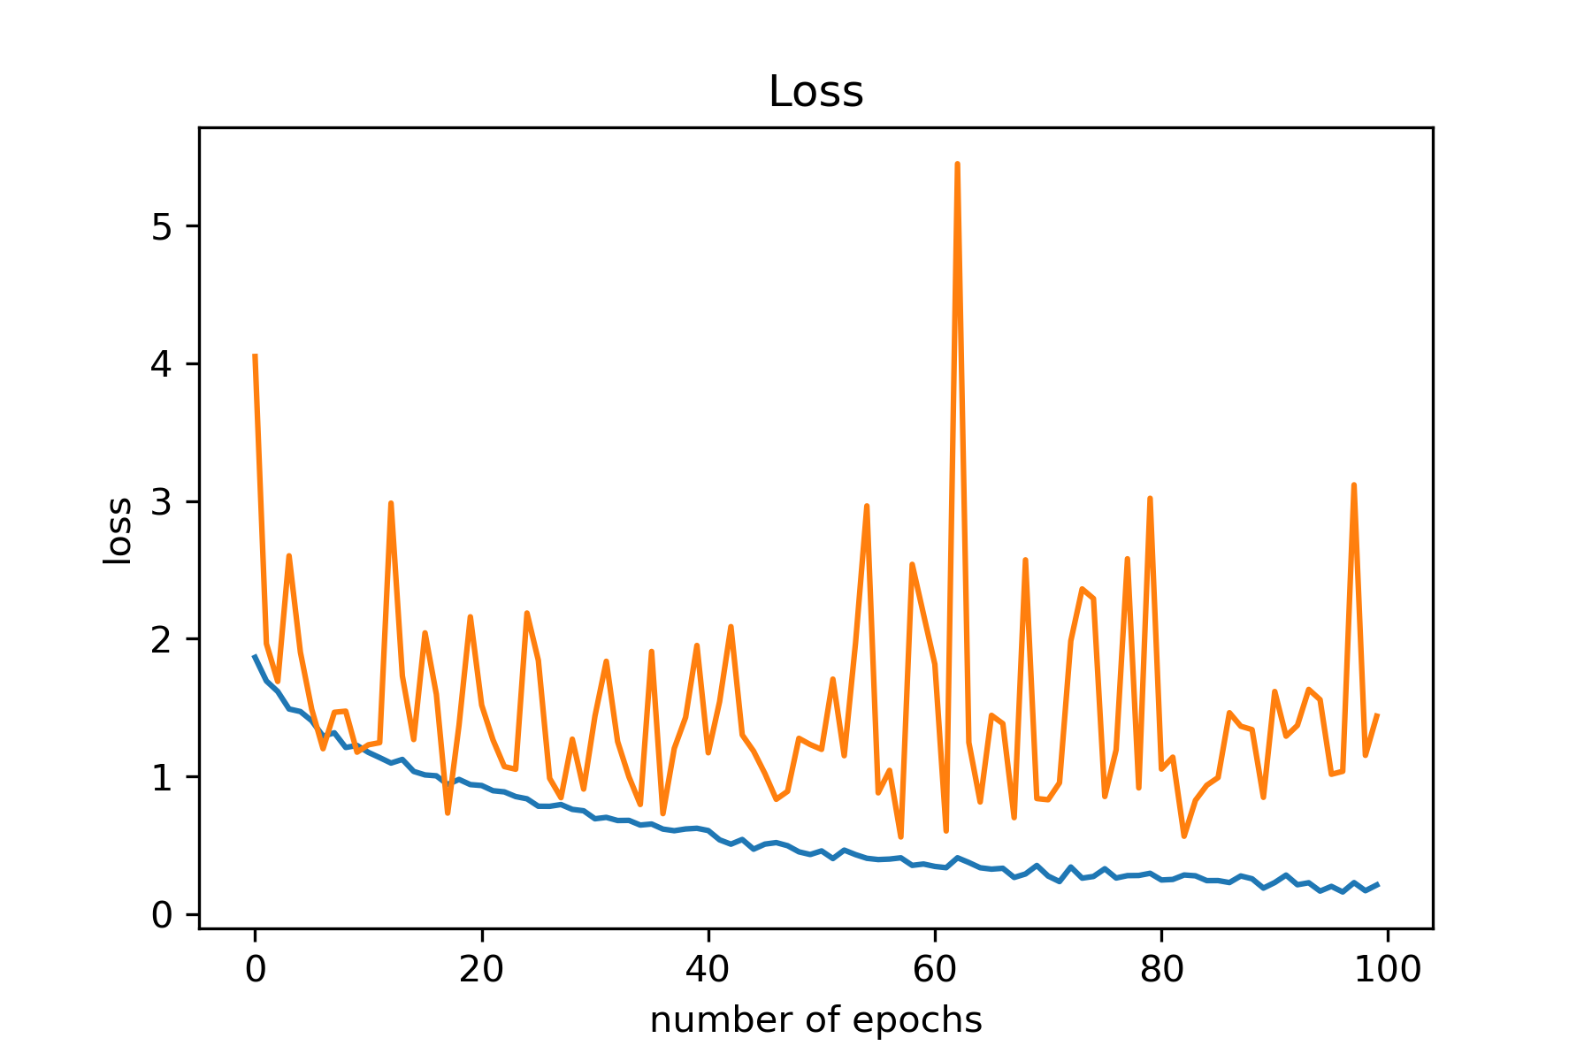

Slide 26
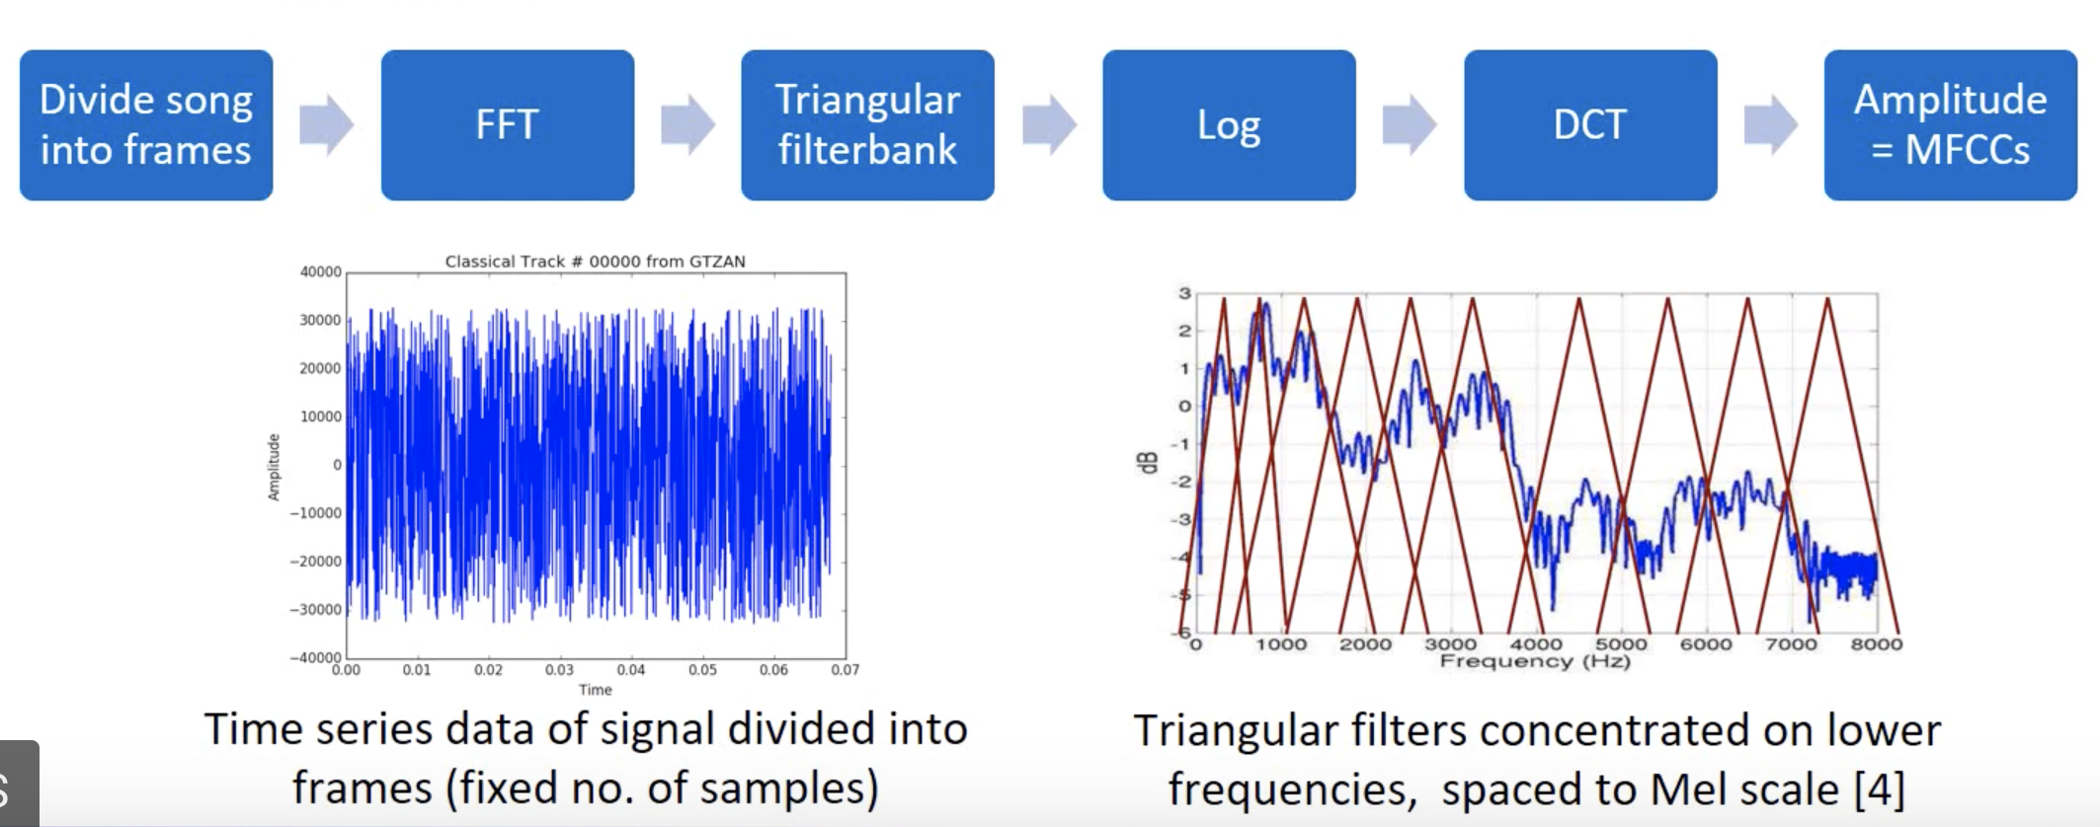
Feature Extraction
Mel Frequency Cepstrum Coefficients(MFCCs)
Widely used feature for speech/sound recognition as timbral feature
Takes into consideration human perception of frequencies
Some frequencies are ‘more important’ to human ears

Slide 27
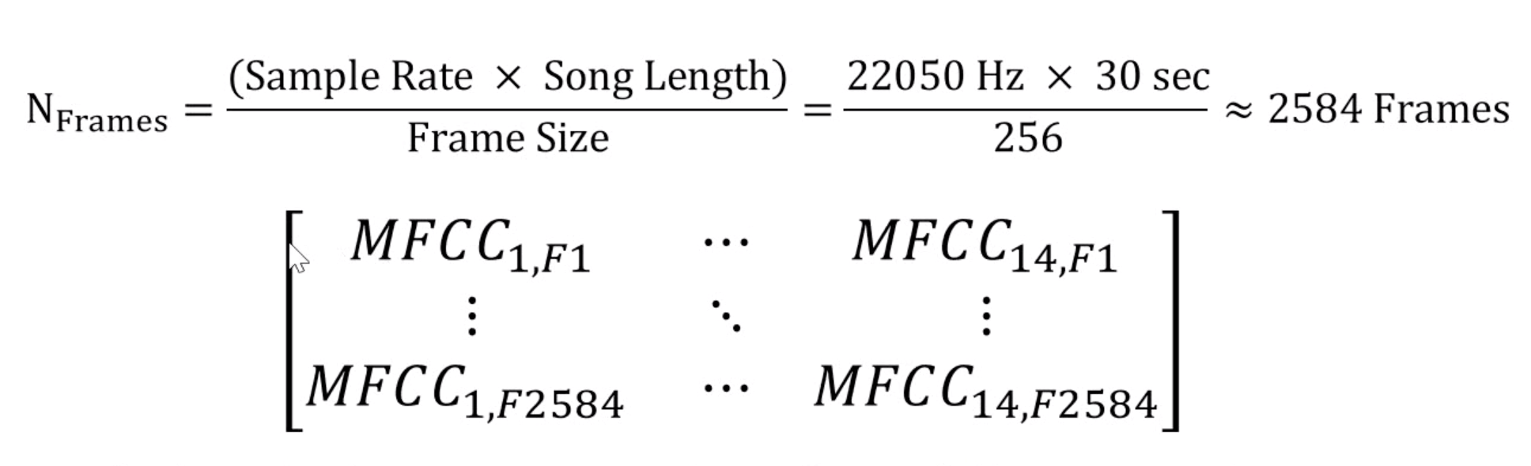
Feature Extraction
After MFCC Extraction, each song can be visualized as an array of size N_{Frames} X N_{MFCC}
For the GTZAN Dataset, each frame is configured as 256 samples
We further take mean vector and covariance of this MFCC matrix to create our final feature vectors

Slide 28
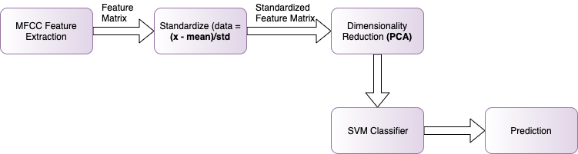
Support Vector Machine
Steps -
MFCC Feature Extraction
Standardize the Feature Matrix
Apply Dimensionality Reduction
Train SVM based on the output of feature extracted and reduced matrix
Based on the training, predict the results for the test data.

Slide 29
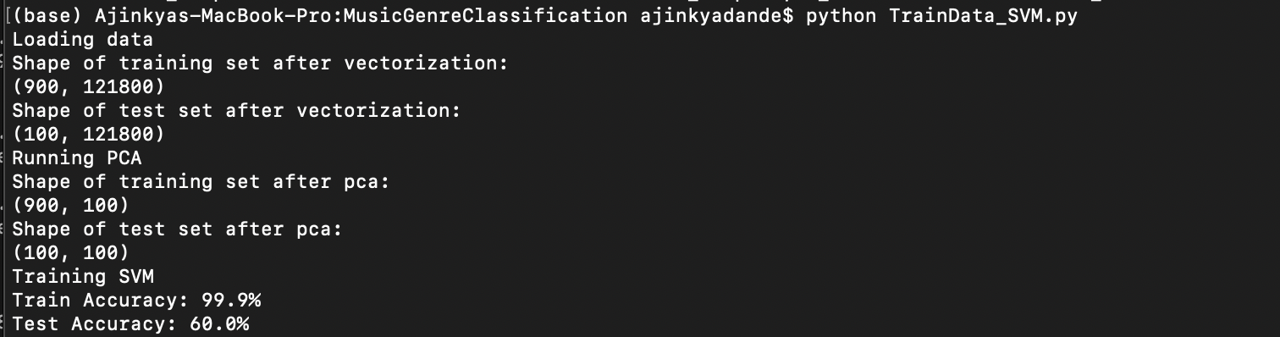
Result of SVM

Slide 30
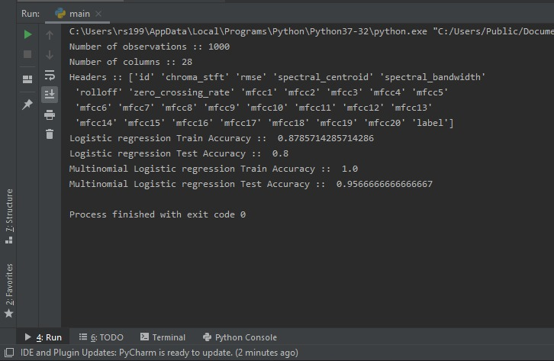
Multinomial Logistic Regression
We have followed the same procedure as SVM
Accuracy - 96%

Slide 31
Lesson learned
Data preprocessing - how to generate spectrograms and use CNN to their advantage.
Comparison of different models based on accuracy
Logistic regression - best accuracy
BBNN - second best
CNN - third best
Therefore, we may safely conclude that complex models don’t always work.

Slide 32
Contributions
Abantika - CNN, CNN-LSTM
Abhilasha - SimpleRNN
Ajinkya - SVM
Omkar - Bottom up Broadcast Neural Network
Rounak - Multinomial Logistic regression
Github link: https://github.com/omkar1729/Music-genre-Recognition---SML

Slide 33
References
[1] G. Tzanetakis and P. Cook. Musical genre classication of audio signals. IEEE Transactions on Speech and Audio Processing, 10(5):293{302, July 2002.
[2] Hareesh Bahuleyan. Music Genre Classication using Machine Learning Techniques. arXiv e-prints, page arXiv:1804.01149, Apr 2018.
[3] Archit Rathore and Margaux Dorido. Music Genre Classication. Indian Institute of Technology, Kanpur, Department of Computer Science and Engineering, 2010.
[4] Caifeng Liu et al. “Bottom-up Broadcast Neural Network For Music Genre Classification”. In:CoRR abs/1901.08928 (2019). arXiv: 1901.08928.url :http://arxiv.org/abs/1901.08928.

