Slide 1
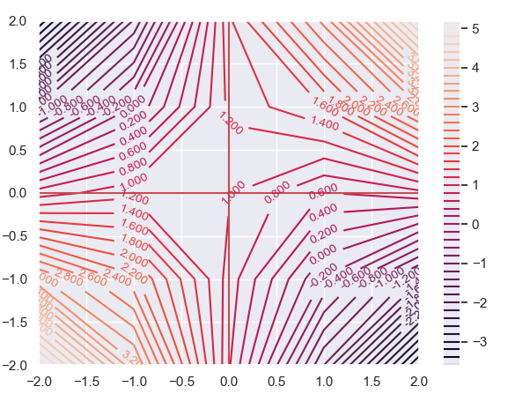


Contour Plot of Estimated ATE using MALTS
(True ATE = 1)
${(γ}_{T}$)
Sensitivity Parameter
for Treatment Choice
Sensitivity Parameter for Outcome
${(γ}_{Y}$)

