Slide 1
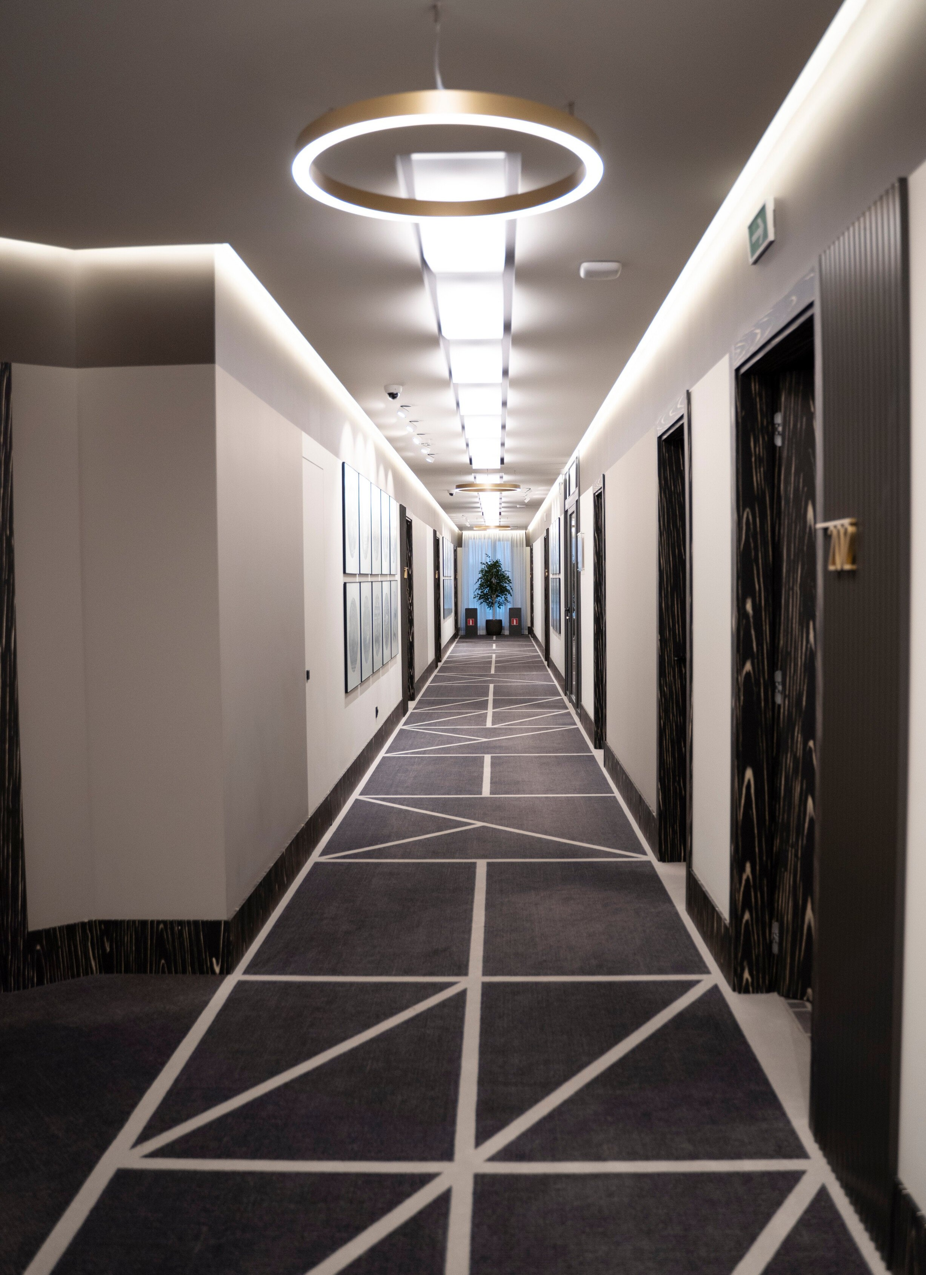
An Overview of our Hotel Reservation System

Slide 2
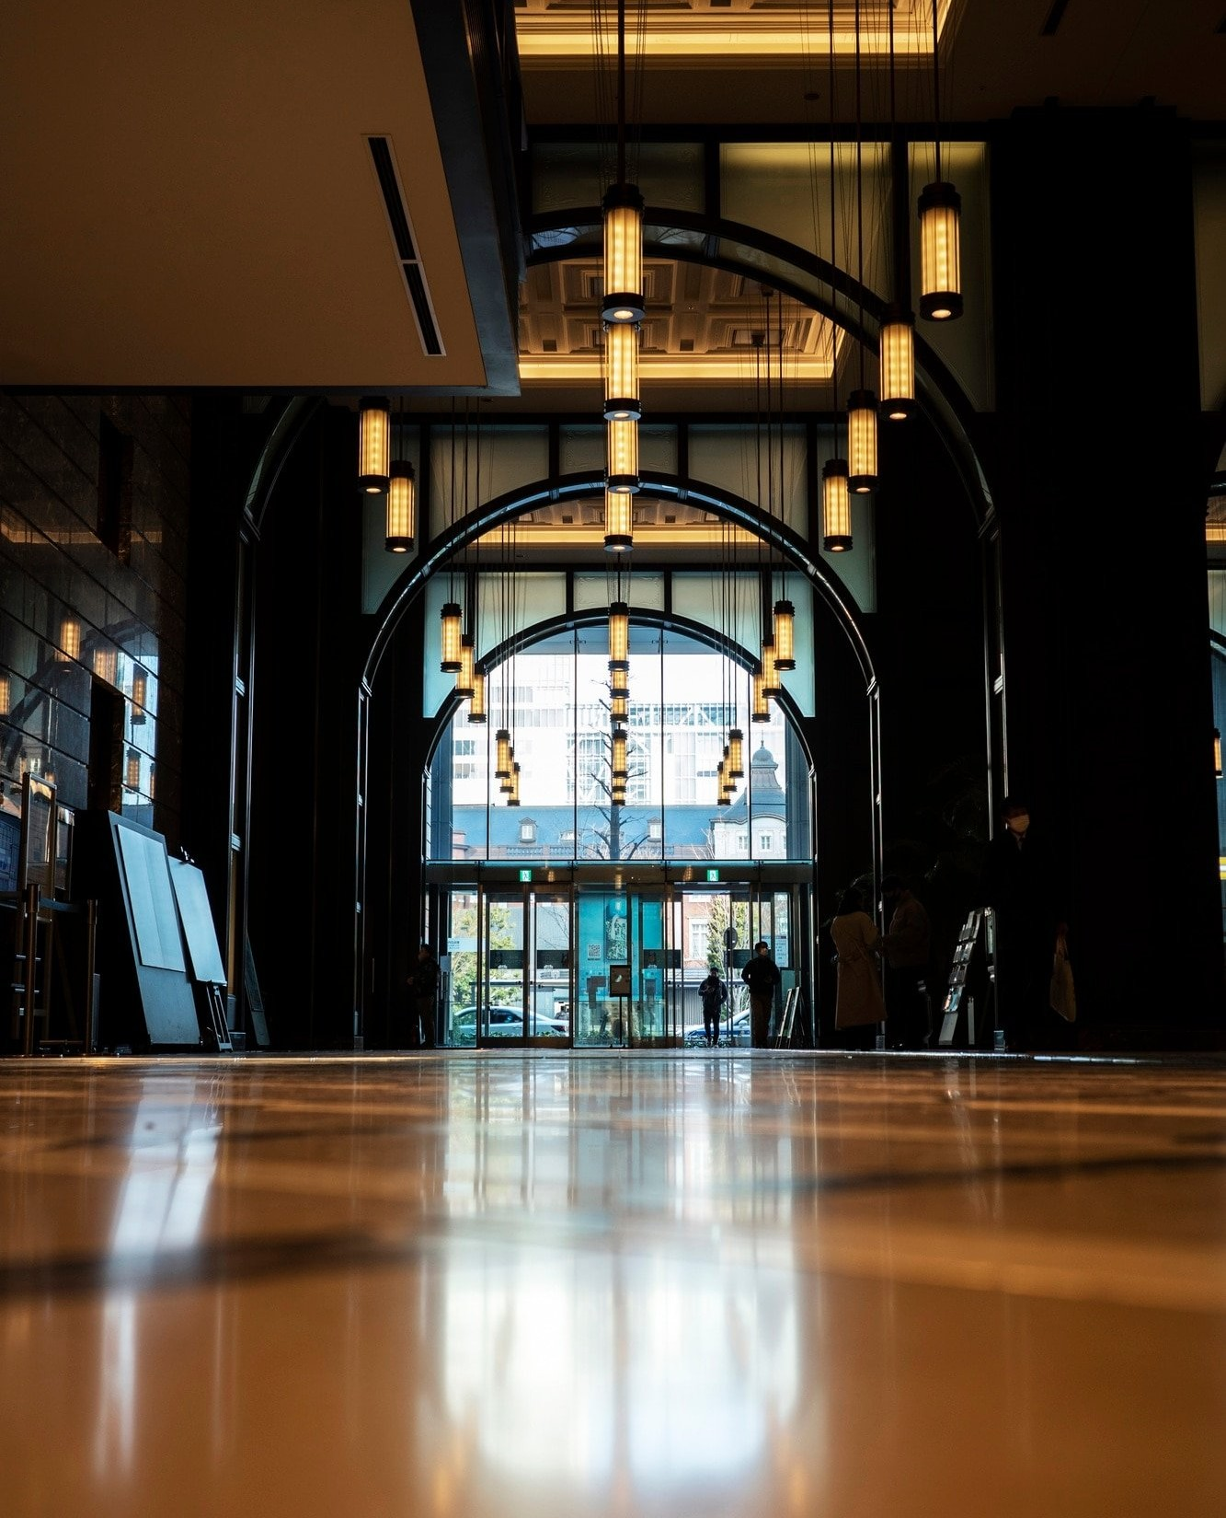
Introduction
Hotel Reservations Through a User- Friendly Web Application.
This presentation will outline how our user-friendly web application simpliﬁes hotel reservations for our customers.

Slide 3

Web Application Overview
Our new reservation system several beneﬁts by offering a
offers user-
friendly interface and a host of convenient features.
Key features include: Intuitive user interface Room availability Advanced search ﬁlters
Secure payment processing Personalized user accounts

Slide 4
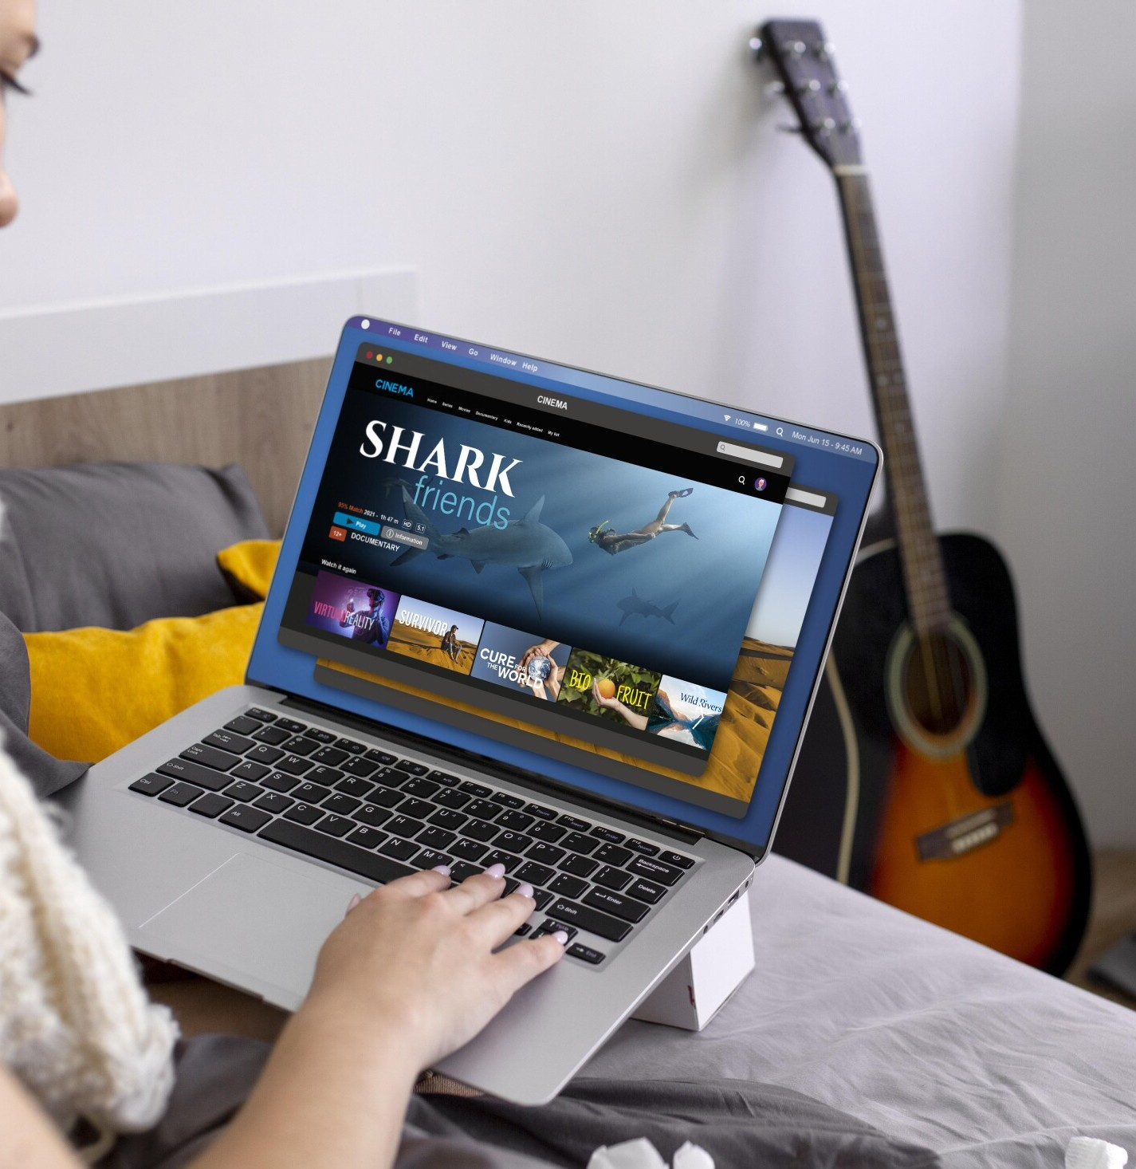
How the System Works
Users start by visiting the homepage.
They input their booking details and preferences.
The application fetches data to
display a list of available hotels.
Users can view search results in both list and map views.
Upon selecting a hotel, they can explore room options and prices.
Users proceed to the checkout process,
where they conﬁrm their reservation
A booking conﬁrmation is sent to their email

Slide 5

Technologies To be Used
Frontend: React Js, Bootstrap Backend: Java (Spring Boot) Database: MySQL
Payment Gateway: Paypal

Slide 6
Key Modules
User Registration and Authentication: Allow users to create accounts for
easier bookings.Secure login through email or social media.
Search and Filters: Users can reﬁne searches based on dates, location, and preferences. Real-time availability check.
Hotel Listings and Details: List hotels with images, descriptions, and ratings.Provide comprehensive hotel details.
Room Selection and Booking: Users can select from various room types and prices. Seamless booking process with email conﬁrmation.
User Proﬁles and Preferences: Users manage proﬁles, view booking history, and set preferences.
Payment Processing: Secure online transactions .

Slide 7
Thank You!

