Slide 1

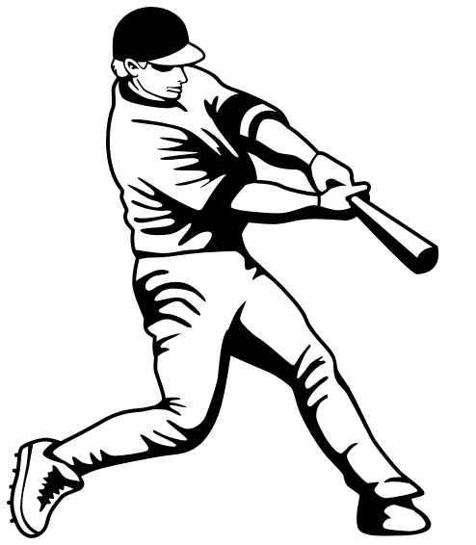

Beat the Streak – ECE 699 – Learning from Data
George Gatling
Ajinkya Shivdikar
Notes:
Our learning from data project for the class is about baseball! We are going to try to train a learning machine to “beat the streak”.
So the obvious question is…

Slide 2
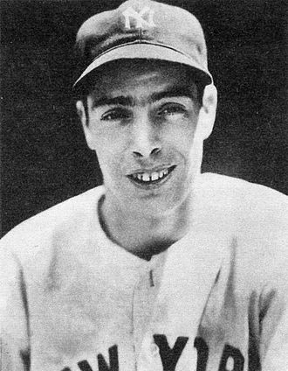
What Streak?
In 1941, Joe DiMaggio achieved a hit in 56 consecutive games
In the 77 years since, the next best streak is only 45 games in a row.
Notes:
There has been a lot of debate over the years, especially as baseball “analytics” has become popular, about how probable DiMaggio’s streak was.
Some argue that batters’ streaks are simple the streaks predicted by simple Poisson distributions.
Some argue that such a model is overly simplistic and doesn’t account for phenomena like “hot hand” where a batter on a streak is more likely to keep his streak going.
In any case it is an unbroken record that has stood for a long time.
As a point of trivia, DiMaggio married Marylyn Monroe.

Slide 3
MLB.com Beat the Streak
Introduced in 2001 and no winners in all 17 years
Your streak resets to zero.
Start
no
Did he get a hit?
In the morning, choose a batter
In the afternoon, he plays his game
yes
Win with a streak of 57
Your streak goes up by one!
Notes:
Fascination with DiMaggio’s record over the years eventually led to a fantasy baseball game: Beat the Streak.
Describe the game as shown.
Remarkably, despite millions of users on the website, in all 17 years of the BTS game, no one has won.

Slide 4
Common BTS Strategies
Random Choice | “Good” Batters
“Bad” Pitchers | “Hot Hand”
Let’s model BTS mathematically…
Notes:
BTS players post a lot of forums about their thoughts and strategies. Four in particular are quite common.
Describe the strategies.

Slide 5
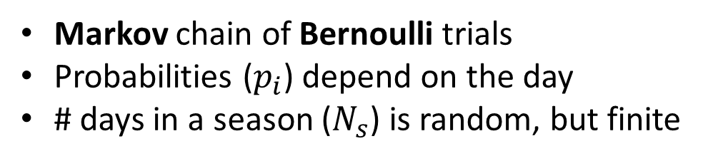

Modeling the BTS Game
Markov chain of Bernoulli trials
Probabilities ($p_{i}$) depend on the day
# days in a season ($N_{s}$) is random, but finite
_{pi}
_{pi}
_{pi}
0
1
2
56
57
_{1-pi}
_{1-pi}
₁
_{1-pi}
$$1≤i≤N_{s}$$
Notes:
The game is a series of Bernoulli trials because there are just two outcomes: the batter hits or doesn’t.
Its Markov because all you need to know is the state you are in (your current streak) to predict the future of the game.
Or, given the present, the future is independent of the past.
However, the transition probability does change every day and the number of transitions in the chain is random, so this model is still quite complex.

Slide 6
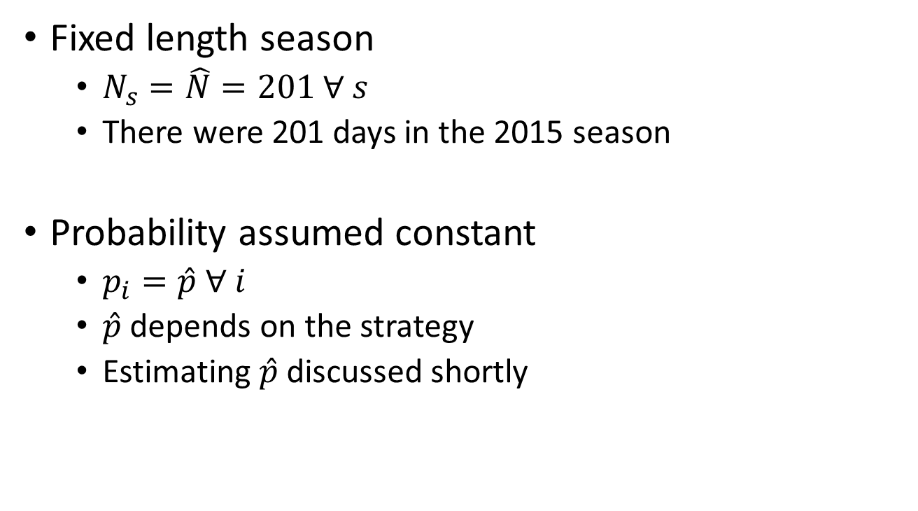
Simplifying the Model
Fixed length season
$N_{s}=\hat{N}=201 ∀ s$
There were 201 days in the 2015 season
Probability assumed constant
$p_{i}=\hat{p} ∀ i$
$\hat{p}$ depends on the strategy
Estimating $\hat{p}$ discussed shortly

Slide 7
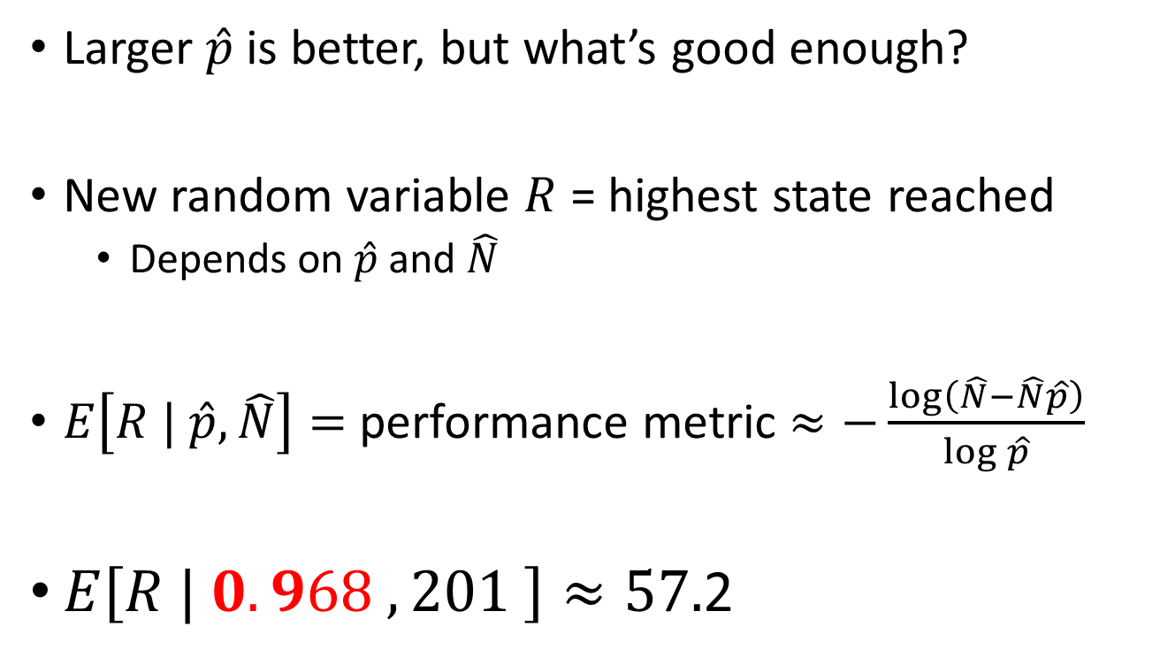
Measure of Performance
Larger $\hat{p}$is better, but what’s good enough?
New random variable $R$ = highest state reached
Depends on $\hat{p}$ and $\hat{N}$
$E\left[R | \hat{p},\hat{N}\right]=$ performance metric $≈−\frac{\log\left(\hat{N}−\hat{N}\hat{p}\right)}{\log{\hat{p}}}$
$E\left[R | 0.968 , 201 \right]≈57.$2
Notes:
R has a surprisingly small variance, often falling within 2 or 3 of its expected value.
Describe prof experiment with the coin tossing kids.

Slide 8
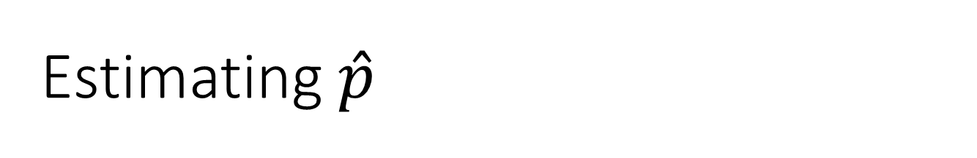
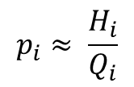
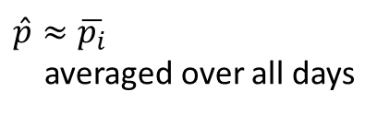
Estimating $\hat{p}$
$$p_{i}≈ \frac{H_{i}}{Q_{i}}$$
All batters on the i^{th} day
B_{i}
$\hat{p}≈\overline{p_{i}}$
averaged over all days
Batters predicted to get hits
Q_{i}
Ones that get hits
H_{i}
Our task: identify the orange region each day

Slide 9
Our Strategy
From historical player performance
“Learn” about the players
Predict games in which specific batters will get hits
Fortunately baseball fans and reporters keep detailed records of every play in every game!

Slide 10
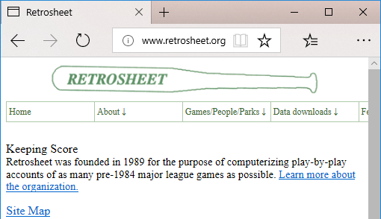
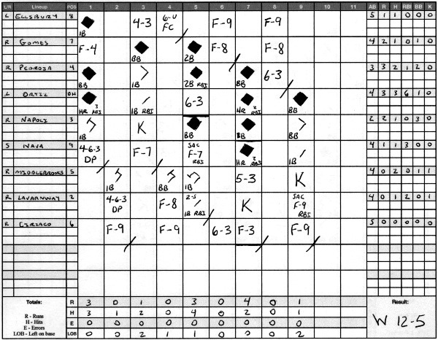
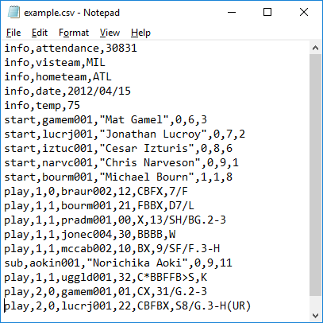
Historical Data, Scoring Games

Slide 11
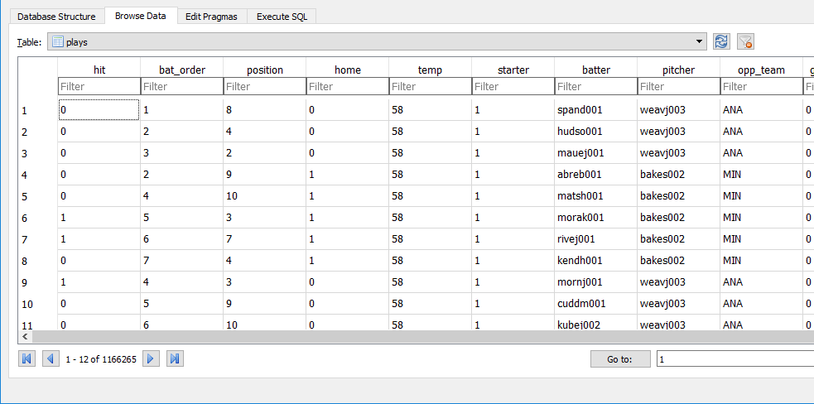
Data Mining – Plays
A record for every play in which a batter was involved.
BUT BTS is based on batters performance in whole games, not plays

Slide 12
Data Mining – Games
Derived from plays table
A record for every batter, game pair
Date
Batter
Starting pitcher he faces
Opposing team
Batter is starter?
Batter is playing at home?
Temperature that day
Size of crowd watching the game
Much more could be included…
Outcome: whether he got at least one hit
This is our dataset for learning, verification, and testing

Slide 13
Data Partitioning
We used retrosheet.org data from 2010-2016
2010-2014
Derive player statistics
Train learning machines
2015
Tune parameters of learning machine
Choose features
2016
Used only once, final test to predict performance

Slide 14
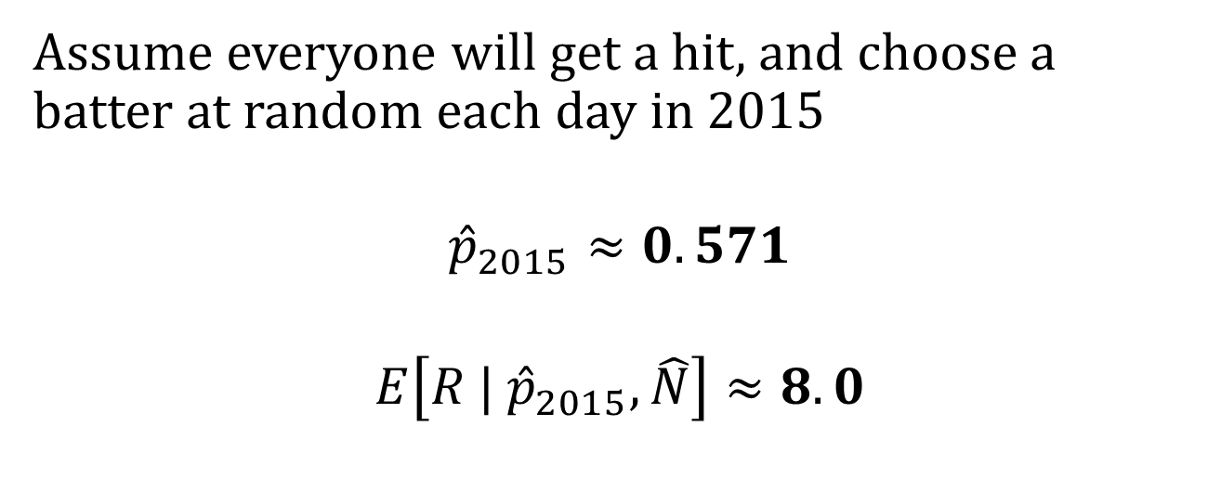
Exploring the Data – Null Rate
Assume everyone will get a hit, and choose a batter at random each day in 2015
$${\hat{p}}_{2015}≈0.571$$
$$E\left[R | {\hat{p}}_{2015}, \hat{N}\right]≈8.0$$
We seek a learning algorithm that can perform better than this!

Slide 15
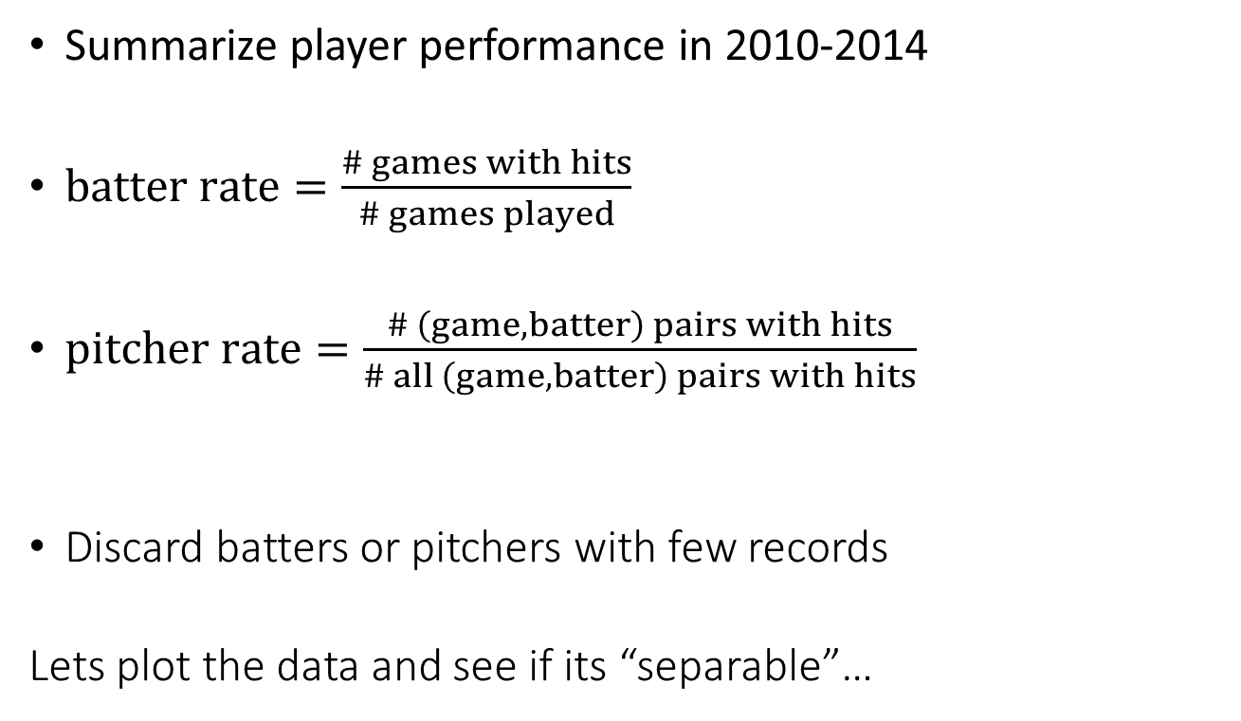
Preprocessing – Player Statistics
Summarize player performance in 2010-2014
$batter rate=\frac{\# games with hits}{\# games played}$
$pitcher rate=\frac{\# \left(game, batter\right) pairs with hits}{\# all \left(game, batter\right) pairs with hits}$
Discard batters or pitchers with few records
Lets plot the data and see if its “separable”…

Slide 16
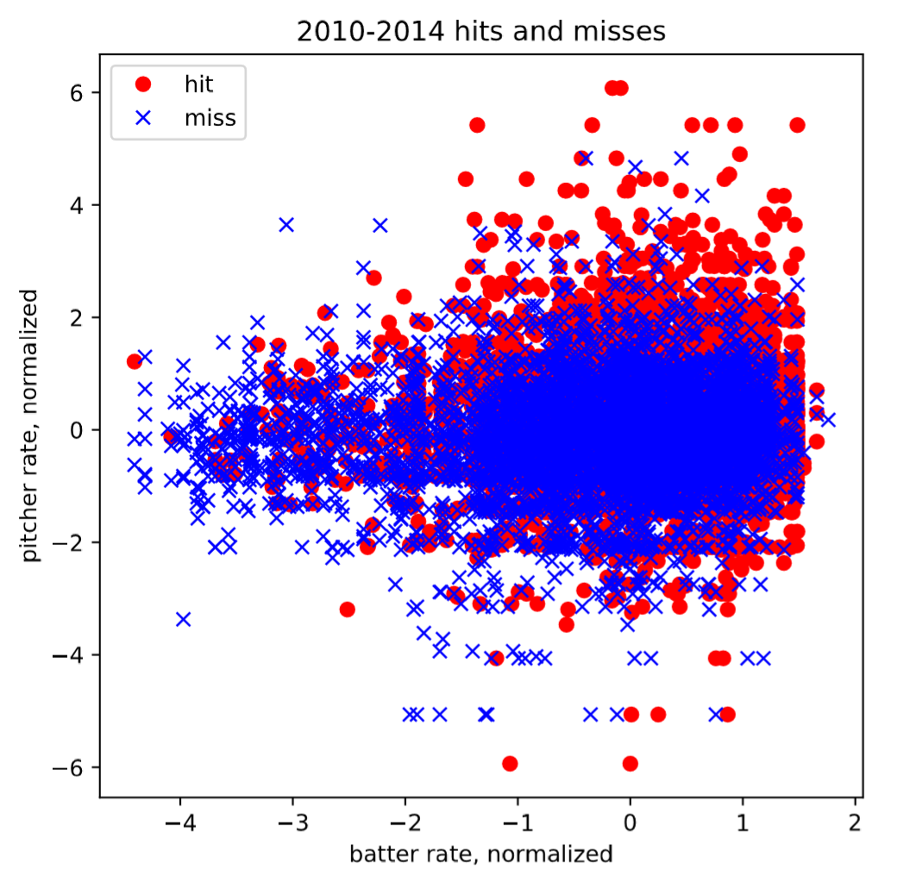
Exploring the Data – Two Features
The classes are very overlapped

Slide 17
Exploring the Data – Two Features
This region looks promising!
The classes are very overlapped
Supervised Learners Fail
Sensitive to noise
Often choose to classify everything one way
Or draw irrelevant boundaries through the data

Slide 18
Exploring the Data – Two Features
This region looks promising!
The classes are very overlapped
Supervised Learners Fail
Sensitive to noise (very different results on random subsets of training data)
Classify everything one way
Find irrelevant boundaries through the data

Slide 19
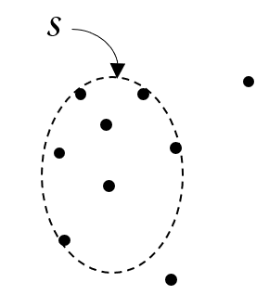
Unsupervised One-Class Learning
Bound the training samples by smallest surface
Allow some fraction of samples to be misclassified
Consider hits and misses separately
We used one-class support vector machine, RBF kernel

Slide 20
A Contrived Example

Slide 21
Supervised Learner Divides Space
misses
hits
Notes:
Hard to separate with one linear boundary

Slide 22
Unsupervised learner on misses
misses
not misses

Slide 23
Unsupervised Learner on Hits
not hits
hits

Slide 24
Combining the Two
miss = yes & hit = no
overlap
miss = no & hit = yes

Slide 25
Combining the Two
miss = yes & hit = no
overlap
miss = no & hit = yes
Overall error rate may be high, but false positive rate in the bounded region is very low. This is acceptable to play BTS.

Slide 26
Using the Classifier on New Data
miss = yes & hit = no
overlap
miss = no & hit = yes

Slide 27
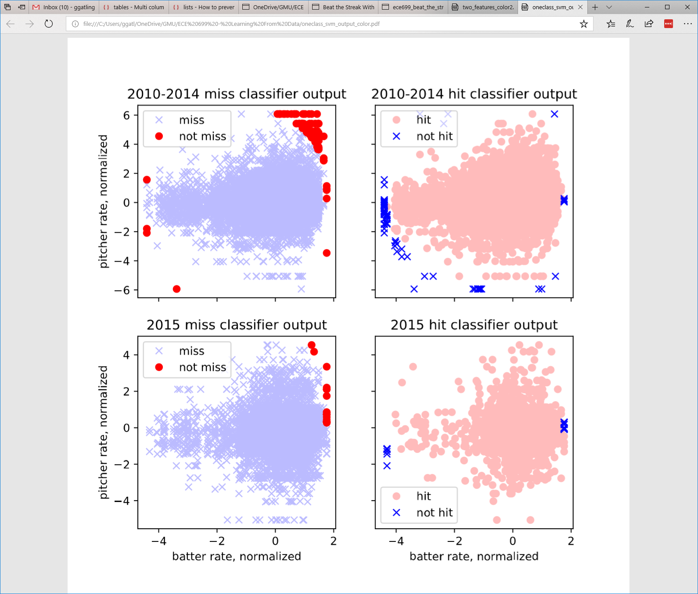
One-Class SVM with RBF Kernel

Slide 28
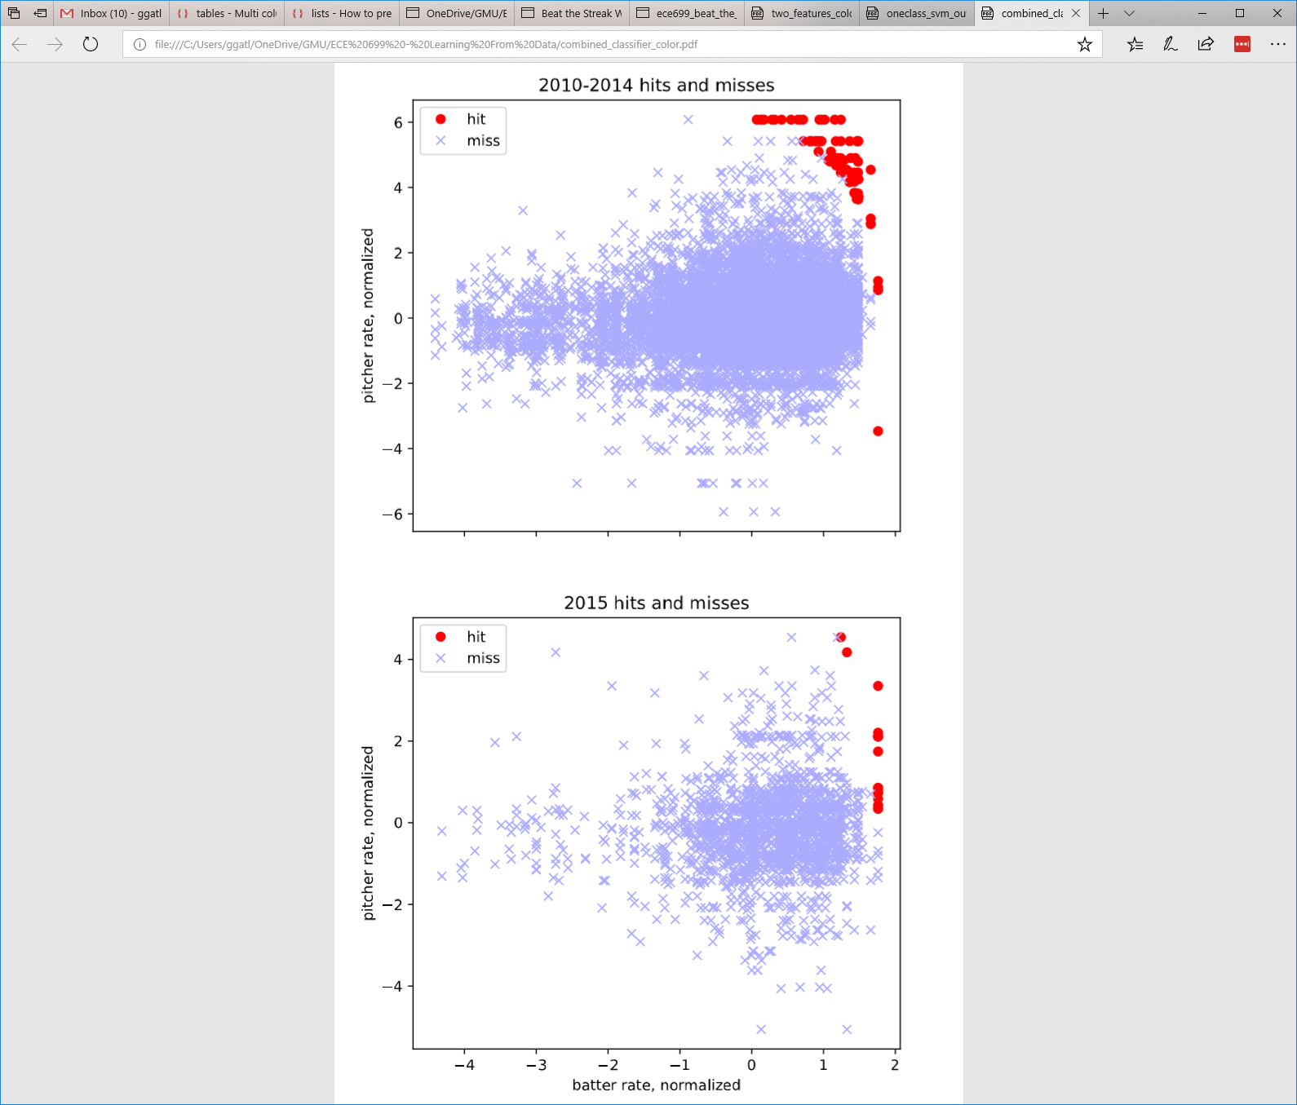
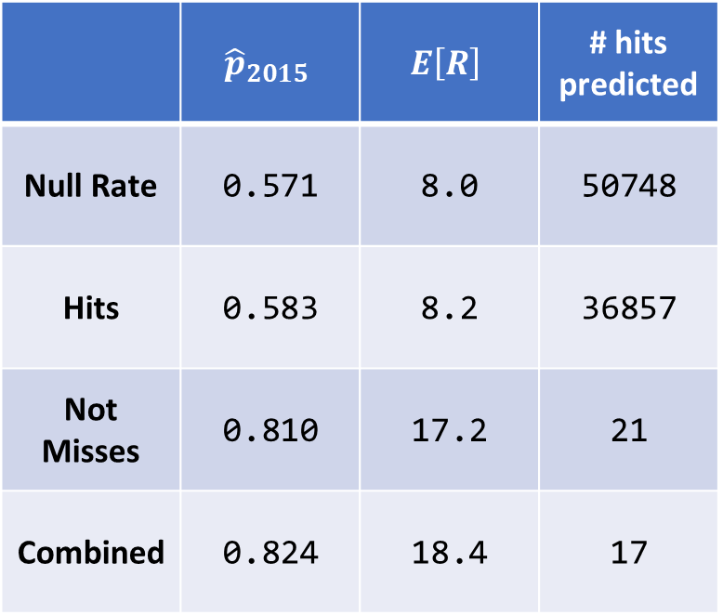
Combined Classifiers
2015 Verification Results, 2 Features
 | $${\hat{p}}_{2015}$$ | $$E\left[R\right]$$ | # hits predicted
Null Rate | 0.571 | 8.0 | 50748
Hits | 0.583 | 8.2 | 36857
Not Misses | 0.810 | 17.2 | 21
Combined | 0.824 | 18.4 | 17

Slide 29
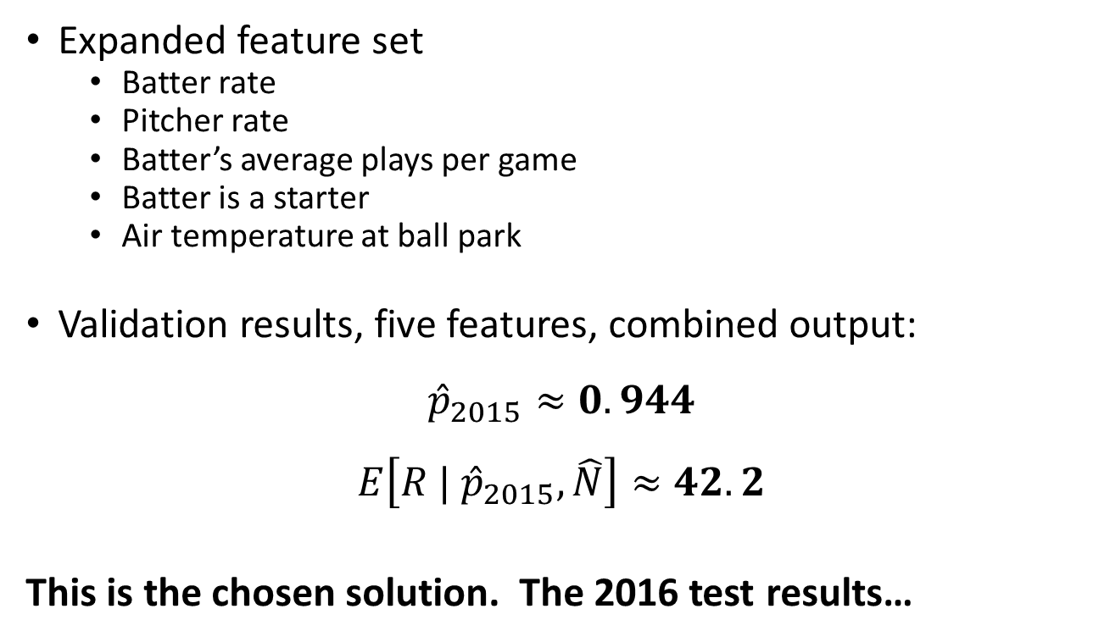
Verification with Five Features
Expanded feature set
Batter rate
Pitcher rate
Batter’s average plays per game
Batter is a starter
Air temperature at ball park
Validation results, five features, combined output:
$${\hat{p}}_{2015}≈0.944$$
$$E\left[R | {\hat{p}}_{2015}, \hat{N}\right]≈42.2$$
This is the chosen solution. The 2016 test results…

Slide 30
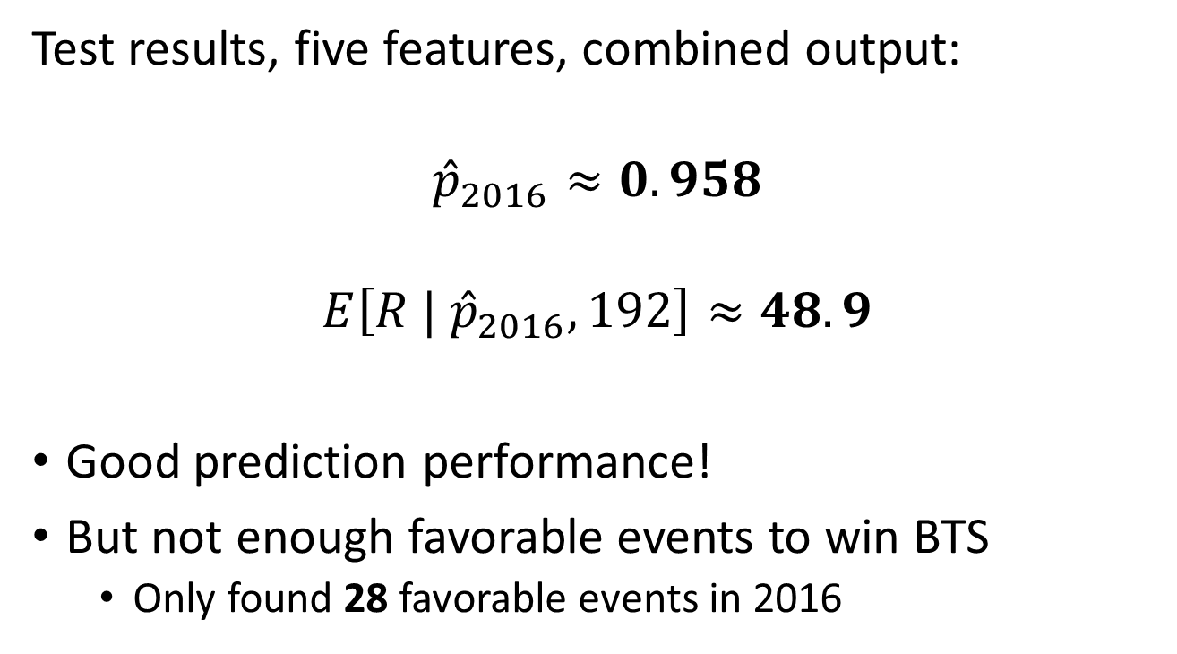
Testing The Solution – 2016
Test results, five features, combined output:
$${\hat{p}}_{2016}≈0.958$$
$$E\left[R | {\hat{p}}_{2016},192\right]≈48.9$$
Good prediction performance!
But not enough favorable events to win BTS
Only found 28 favorable events in 2016

Slide 31
Future Work
Different unsupervised classifier
Different feature set
Use regression
‘score’ each event
Choose highest score

Slide 32
Conclusion
Supervised classifiers fail
Unsupervised learners beat random guessing
Not enough favored events to win

Slide 33
Questions?

