Slide 1

AML Mini Project
Guide: Prof. Jayshree Aher
Group MM_08:
1032180007 Sumedh Kamble
1032180268 Chirantan Joshi
1032180678 Ajinkya Karnik
1032180715 Dhwanit Kapur

Slide 2
Problem Statement
Malaria Cell Classification on Human Cell using Machine Learning.
Dataset link:
https://lhncbc.nlm.nih.gov/LHC-downloads/downloads.html#project-a225

Slide 3
Objectives
Implement different Machine Learning algorithm to classify infected and uninfected cell such as :
Naïve Bayes
Logistic Regression
Random Forest
Support Vector Machine/Classifier
Ensemble model

Slide 4
Tools Used
Jupyter Notebook for classification in Python.
Google Colab
matplotlib
cv2
scikit learn
RandomForestClassifier
GaussianNB
LogisticRegression
LinearSVC, SVC

Slide 5
Dataset Description
Dataset has 27,558 images of cells.
Giemsa-stained thin blood smear slides from 150 infected and 50 healthy patients were collected and photographed at Chittagong Medical College Hospital, Bangladesh.
We have used 1200 images of cells for training and test the machine learning model.

Slide 6
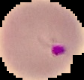
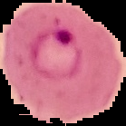
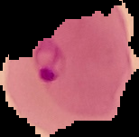



Sample Images of Dataset
Infected Cells
Uninfected Cells

Slide 7
Data Pre-processing
Pre-processing in Python
Resizing
Normalization
Standardization
Extracting sub-images

Slide 8
Data mining tasks performed
Selecting images from proper directory
Pre processing
Applying Machine Learning algorithm
Interpretation and Evaluation

Slide 9
Output of ML algorithms
Algorithm | Accuracy on Train set | Accuracy on Test set
Naïve Bayes | 65.1% | 70.4%
SVM | 92.7% | 85.8%
Logistic Regression | 100% | 75.8%
Random Forest | 100% | 87.9%
Hyper Parameter Tuning Random Forest | 88.5% | 81.7%
Ensemble | 94% | 87.9%

Slide 10
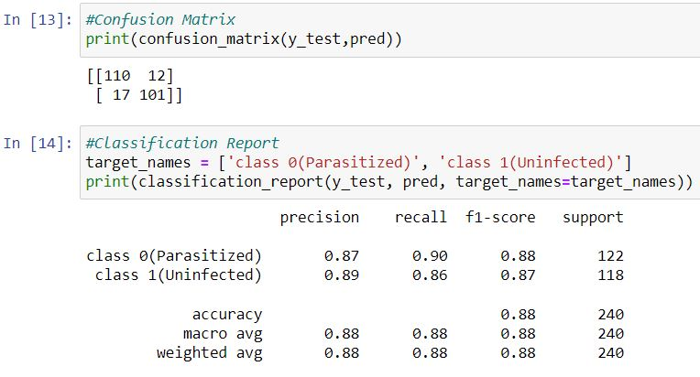
Visualization Screenshots
Random Forest

Slide 11
Visualization Screenshots
Random Forest with Hyper Parameter Tuning

Slide 12
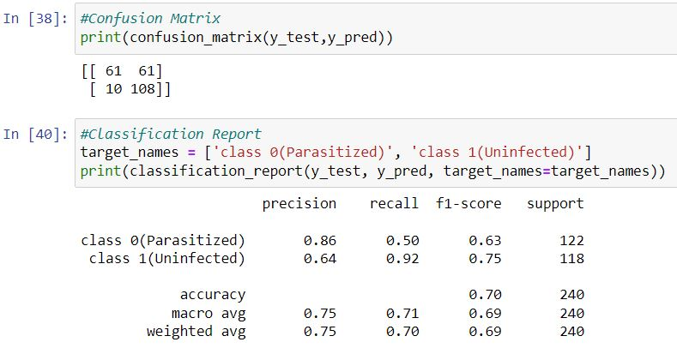
Visualization Screenshots
Naïve Bayes

Slide 13
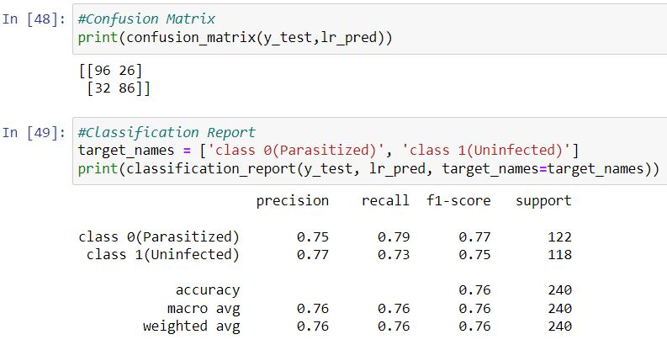
Visualization Screenshots
Logistic Regression

Slide 14
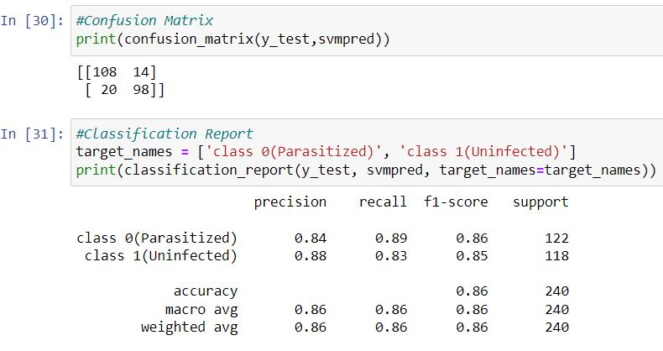
Visualization Screenshots
Support Vector Machine/Classifier

Slide 15
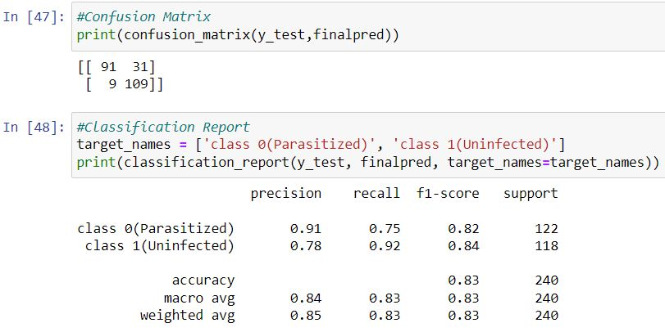
Visualization Screenshots
Ensemble Model

Slide 16
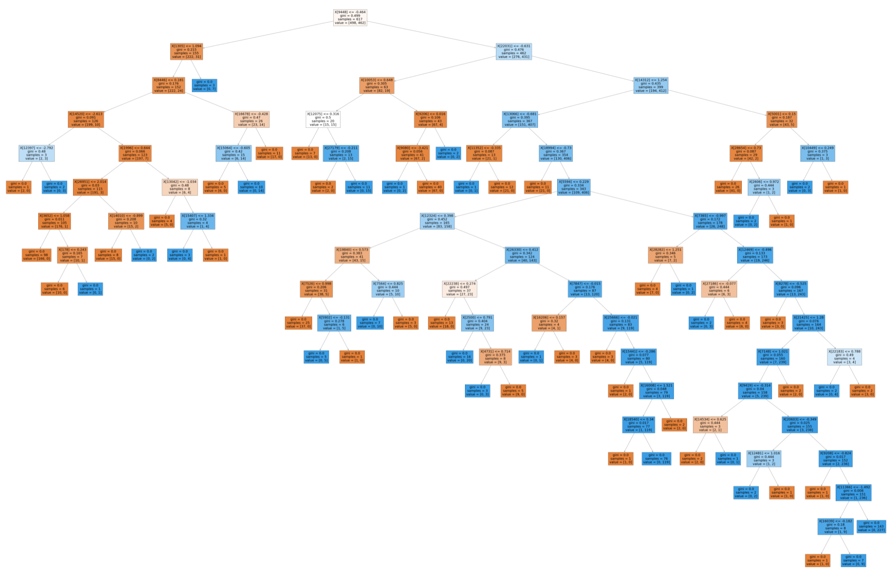
Visualization Screenshots
Random Forest
One of the Decision Tree from Random Forest

Slide 17
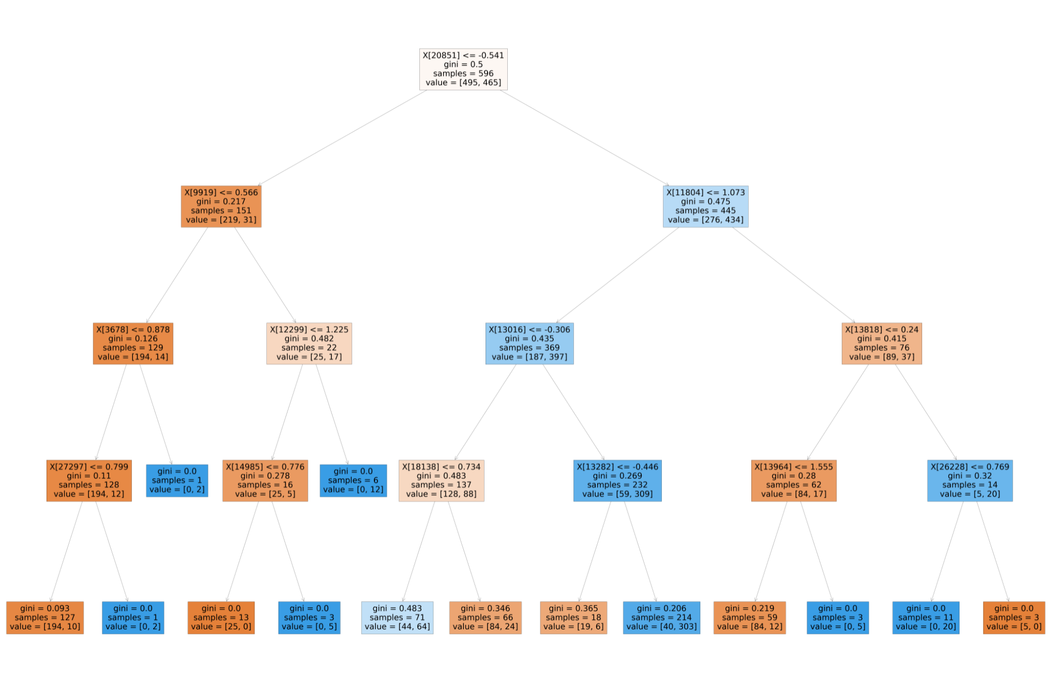
Visualization Screenshots
One of the Decision Tree from Hyper Parameter Tuning Random Forest

Slide 18
Conclusion
We have implemented 5 different machine learning algorithms
Naïve Bayes
SVM
Logistic Regression
Random Forest
Ensemble model to classify malaria cells.
Out of all those algorithm Ensemble model has achieved best accuracy on train set and test set as 94% and 87.9% respectively.

Slide 19
References
https://ceb.nlm.nih.gov/repositories/malaria-datasets/
https://www.oreilly.com/library/view/hands-on-machinelearning/9781788992282/d9d74493- e4b0-4592-9515-12188ca60ee5.xhtml
https://scikit-learn.org/stable/modules/svm.html
https://machinelearningmastery.com/logistic-regression-for-machine-learning/
https://www.analyticsvidhya.com/blog/2017/09/naive-bayes-explained/
https://scikit-learn.org/stable/modules/sgd.html
https://www.analyticsvidhya.com/blog/2018/06/comprehensive-guide-for-ensemble-models/

Slide 20
THANK YOU!

