Slide 1
FOOD AND WATER
SE C U R I T Y

Slide 2

FOOD SECURITY And INSECURITY
Food security is the condition in which all people, at all times, have physical, social and economic access to sufficient safe and nutritious food that meets their dietary needs and food preferences for an active and healthy life.
Food security also means that the people who produce our foods are able to earn a decent, living wage growing, catching, producing, processing, transporting, retailing and serving food.
Since we are talking about food security we need to know about food insecurity. So here goes the definition: food insecurity refers to a lack of access to enough good, healthy, and culturally appropriate food.

Slide 3
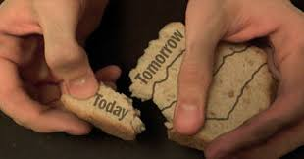
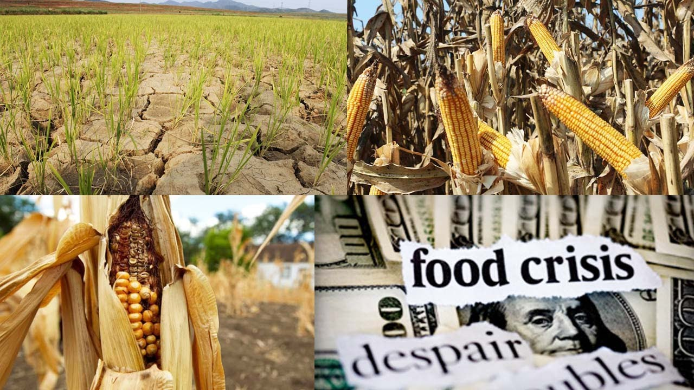
Causes of food insecurity
The most common causes of food insecurity are:
Drought and other extreme weather events.
Pests, livestock diseases and other agricultural problems.
Military conflicts.
Corruption and political instability.
Rapid population growth.
An increasing global population, in combination with climate change, poses a threat to food security as arable land becomes more scarce

Slide 4
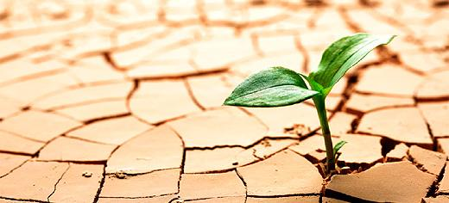
ATTAINING FOOD SECURITY
Eliminating hunger and malnutrition, and achieving wider global food security are among the most intractable problems humanity faces.
The major ways to achieve food security are:
Improve food quality
Produce higher yields
Break down the trade barriers
Share the crowded planet
Government needs to work in consultation with climatic bodies
Promote Green World

Slide 5
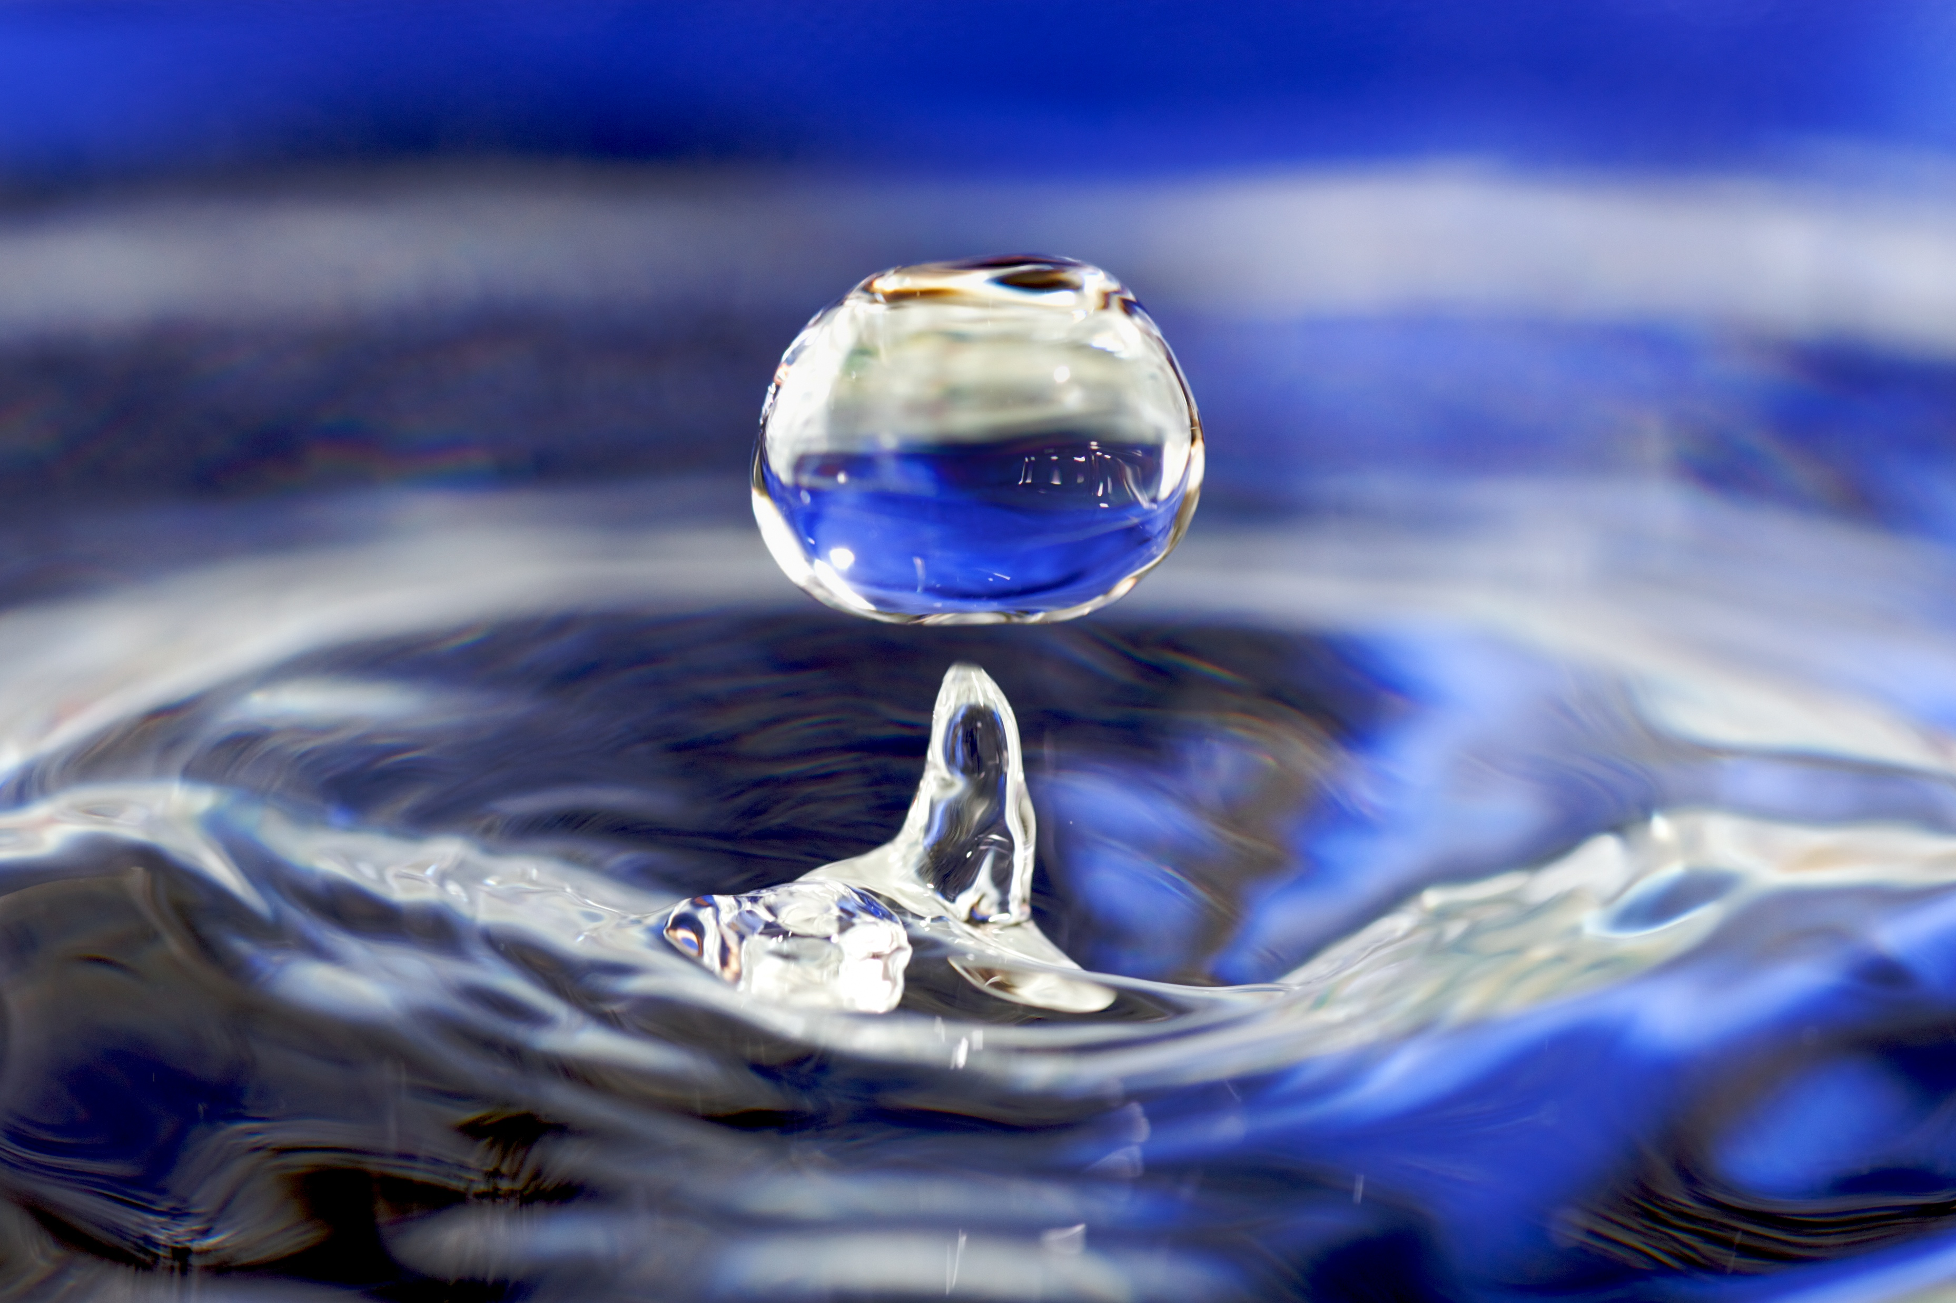
WATER SECURITY And INSECURITY
Water security can be defined as the ability to access sufficient quantities of clean water to maintain adequate standards of food and goods production, proper sanitation, and sustainable health care.
Water, in absolute terms, is not in short supply planet-wide. But, according to the United Nations water organization the total usable freshwater supply for ecosystems and humans is only about 1% of all freshwater resources.
And, water use has been growing at more than twice the rate of the population increase in the last century.

Slide 6
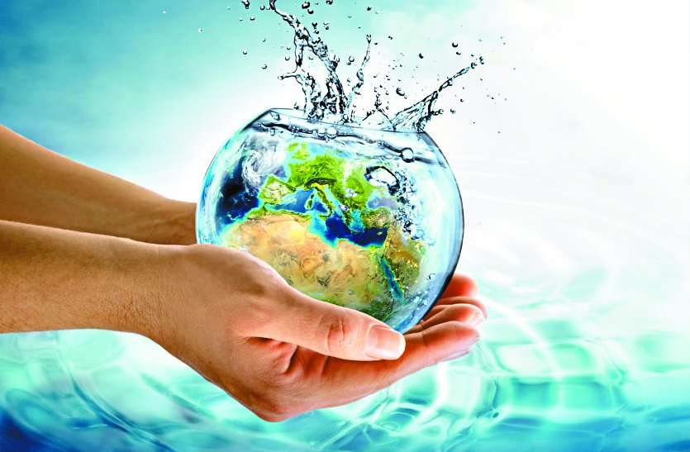
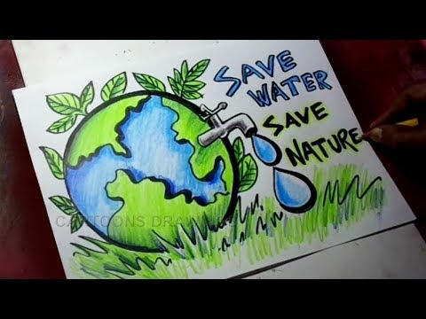
PREVENTIONS
There are basically many ways to achieve water security or save water and few of them are mentioned below :
Shut water off when ever not required
Dispose chemicals properly.
Recycle water
Install a rain barrel
Get involved in water education.

Slide 7
THANK YOU ☺
BY;
M.MUSKAAN
SECTION 2

