Slide 1
Geo_Share Mobile Application Made by:- Ajinkya Bedekar(U101116fcs177) Kenneth prabhakaran(u101116fcs275) Dhruva Agarwal(u101116fcs177) biren sharma(u101116fcs246)

Slide 2
objectives

Slide 3

Share any type of file from anywhere

Slide 4

We won’t cut you short with your file size

Slide 5
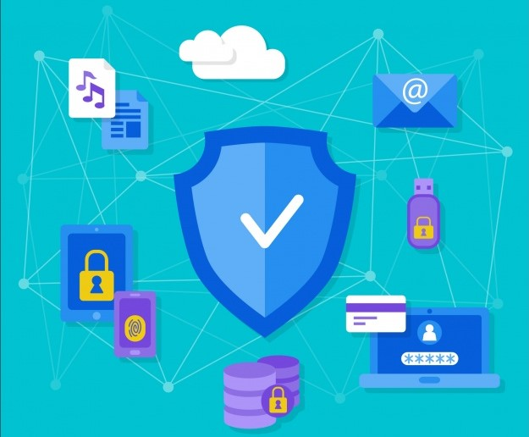
We have it secure!!! Yes, it’s safe

Slide 6
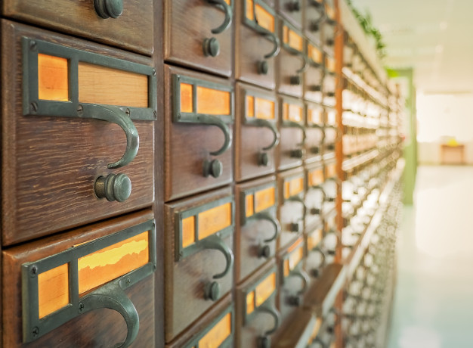
Store any number of files without hassle

Slide 7

Solely share your ideas and files to multiple clients

Slide 8
Features

Slide 9

Smart file sharing app

Slide 10

Collaborate with the clients easily and securely

Slide 11
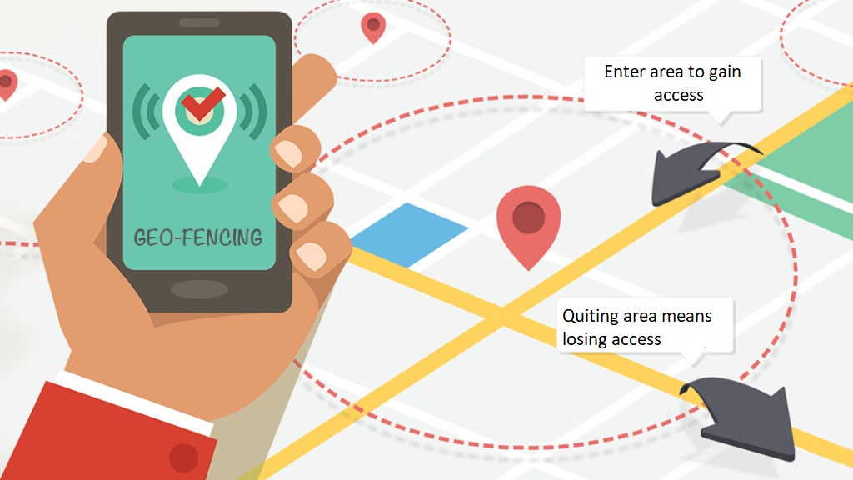
Keep your files to yourself with geo-fence

Slide 12
How To Use

Slide 13
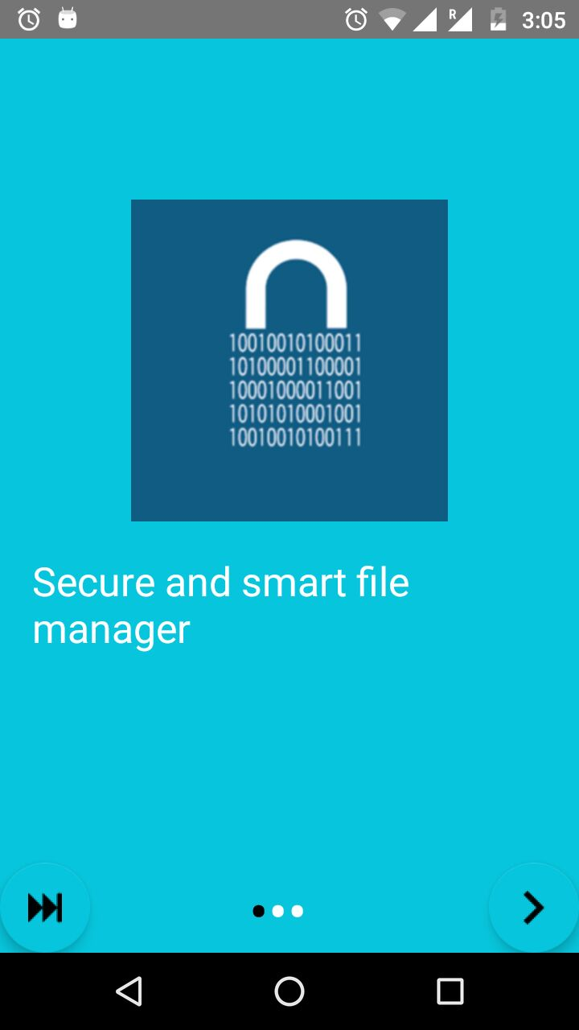
App Featured Pages
Click here to know more about our App
Click here to skip the introduction

Slide 14
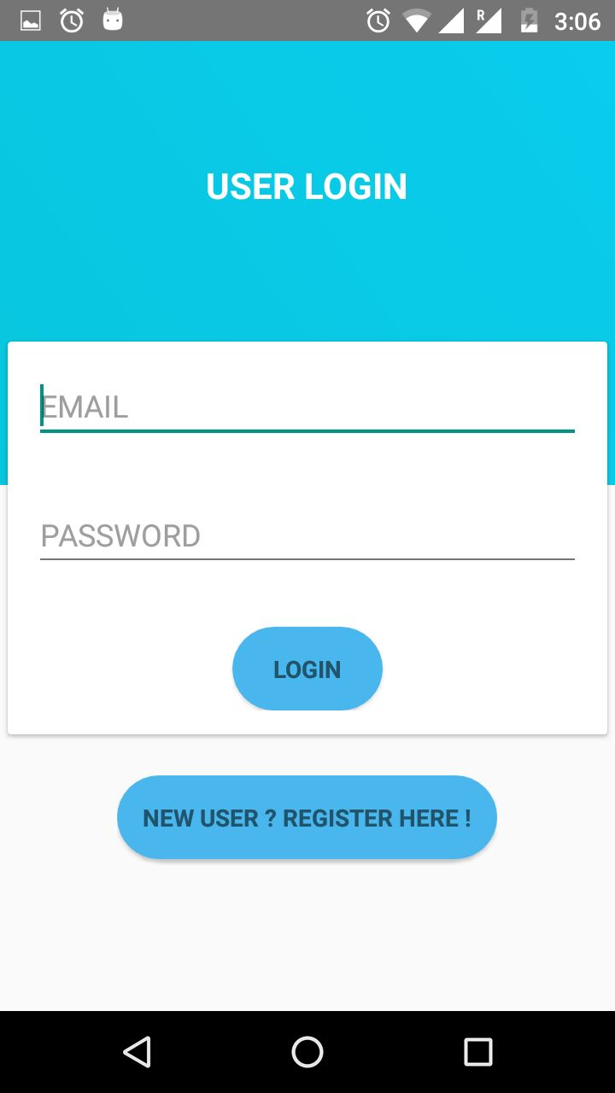
Login Page
Click the login button to go to your Dashboard
Click here to Register if you are a new User

Slide 15
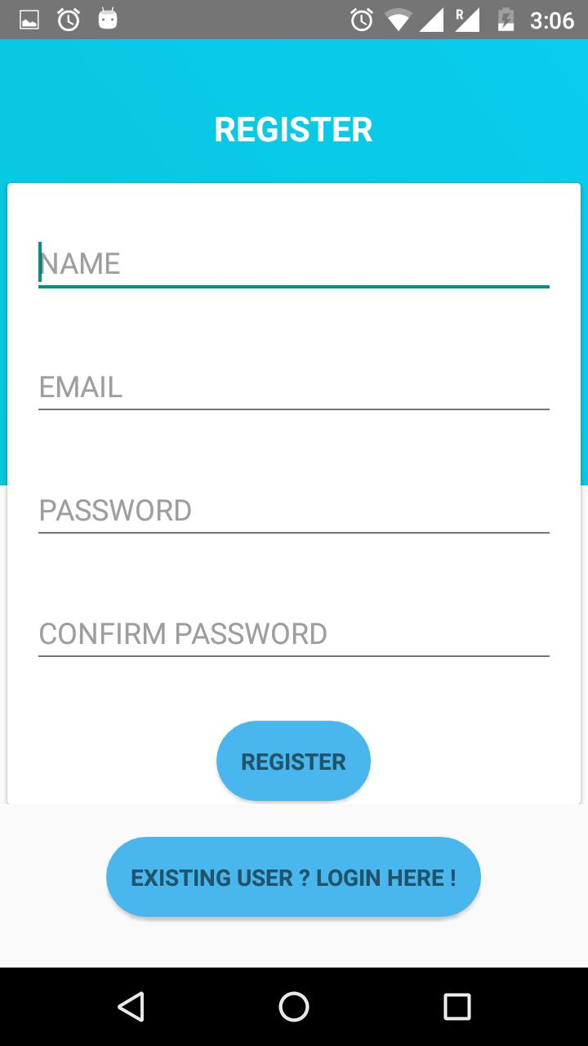
Register Page
Click here to register in the App
If you are already registered, click here

Slide 16
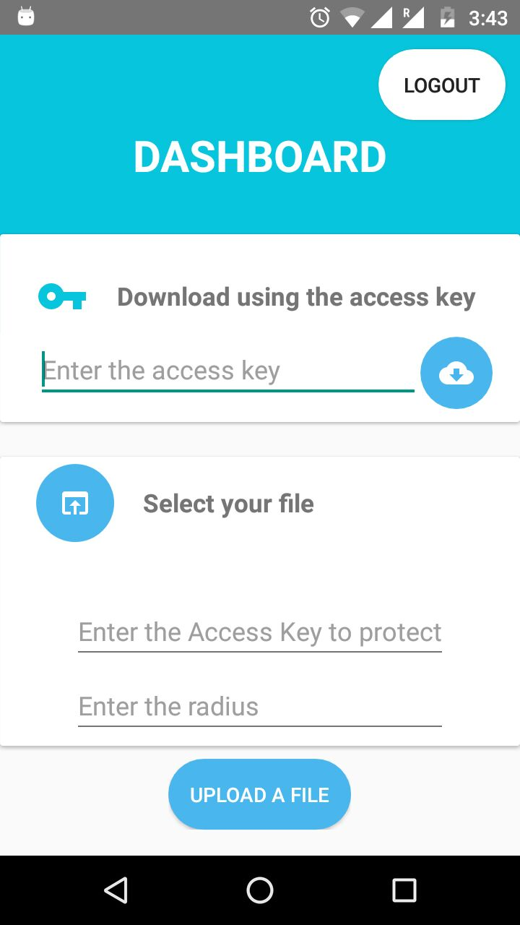
Dashboard
Enter the access key for the file you want to download
1. Click here to select a file to be uploaded
Click here to Download the file
2. Enter an access key to upload a file
3. Enter a radius for the secure region
4. Click here to finally upload the file

Slide 17
Difficulties Faced
We were unable to properly retrieve the file name/ URL from the device storage.
Capturing the location of the devices after the first time as it was returning all the null values.
Calculating the unit for radius of area as the difference in two latitude and longitudes change as we go far from the equator.
Geo-fencing was a totally new chapter for us to learn and it took a while to get used to it.
When downloading the files, in the beginning the app was crashing as there was an issue with the location function.
Downloading file into the same device creates an issue and it does not download the file.

Slide 18
Functionalities fulfilled by the project
A user can easily share any number of files of any size from anywhere, anytime to the people they desire to share.
Files of all types and any quantity can be shared using this app without any inconvenience for the user or their clients.
We achieved the safe and secure state with the help of Geo-fencing and password protection.
More than one clients can easily access the files uploaded by any one person simultaneously.

