Slide 1
Natural Language Processing Project Report
Group Number: G14
Group Members:
Ajinkya Bedekar (U101116FCS183) (D5)
Dhruva Agarwal (U101116FCS177) (D5)

Slide 2
Paper Title and Author Names
Paper Title:
MELD: A Multimodal Multi-Party Dataset for Emotion Recognition in Conversations
Authors’ Names:
Soujanya Poria
Devamanyu Hazarika
Navonil Majumder
Gautam Naik
Erik Cambria
Rada Mihalcea

Slide 3
Description of Problem
Multimodal data analysis exploits information from multiple-parallel data channels for decision making
Conversational emotion recognition system can be used to generate appropriate responses by analysing user emotions
Existing (very few) works are limited to dyadic conversation understanding
EmotionLines can be used as a resource for emotion recognition for text only
There is no multimodal multi-party conversational dataset available for emotion recognition research
Authors have extended, improved, and further developed EmotionLines dataset for the multimodal scenario

Slide 4
Our Work
The work done by our group was mainly focussed on the analysis of the dataset
The analysis was mainly of classification report, confusion matrix, and precision-recall
Types of classifications: Emotion and Sentiment
Types of modality: Text, Audio, Bimodal
Pre-trained models and pickle files are used
Python module: sklearn is used for the analysis of dataset

Slide 5
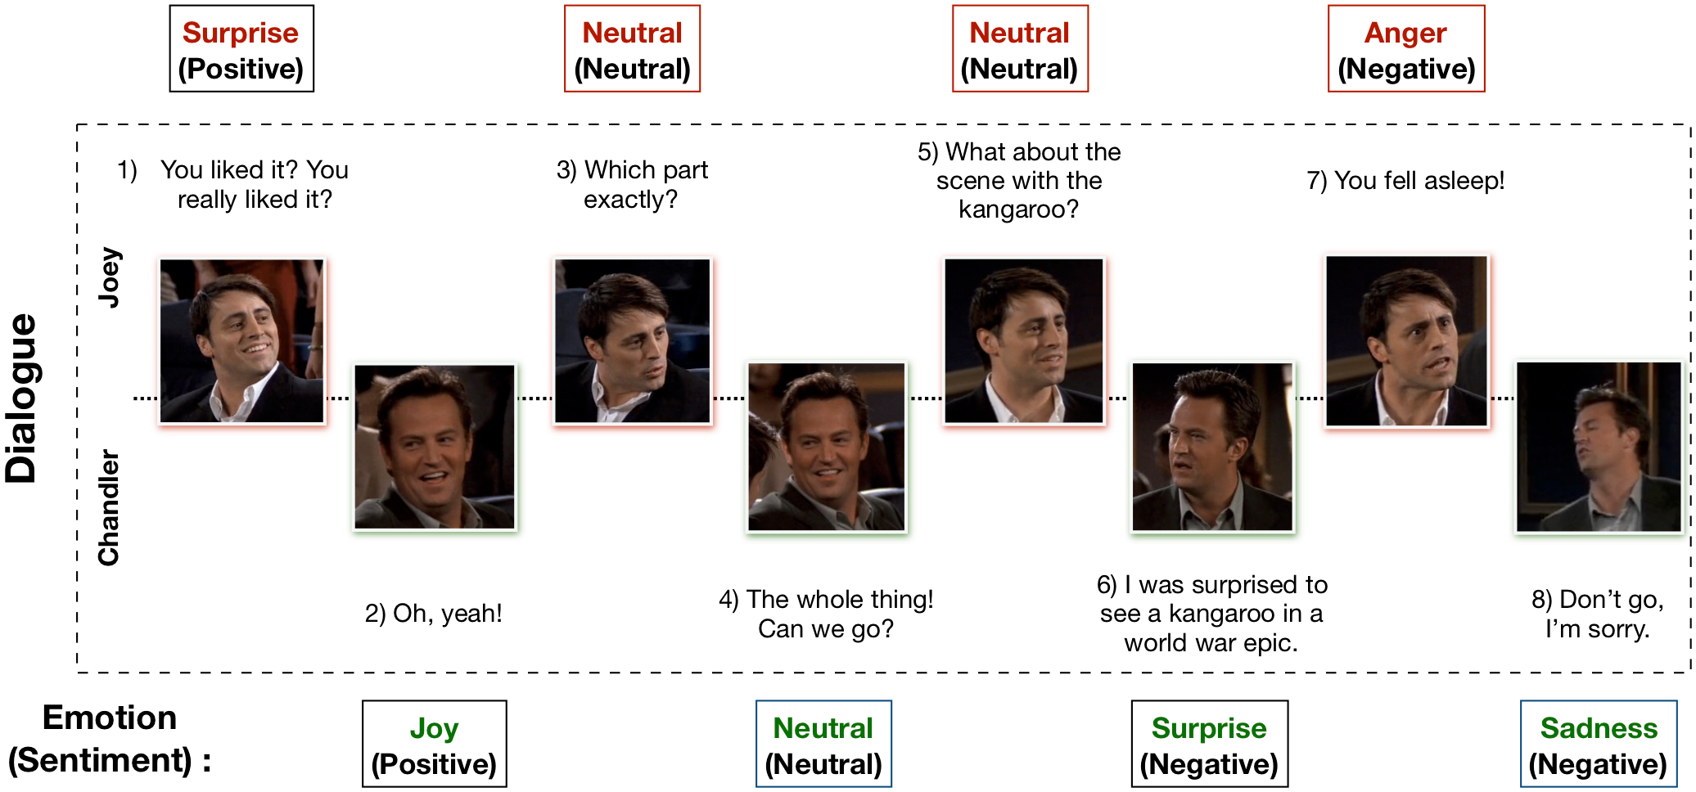
Example Dialogue

Slide 6
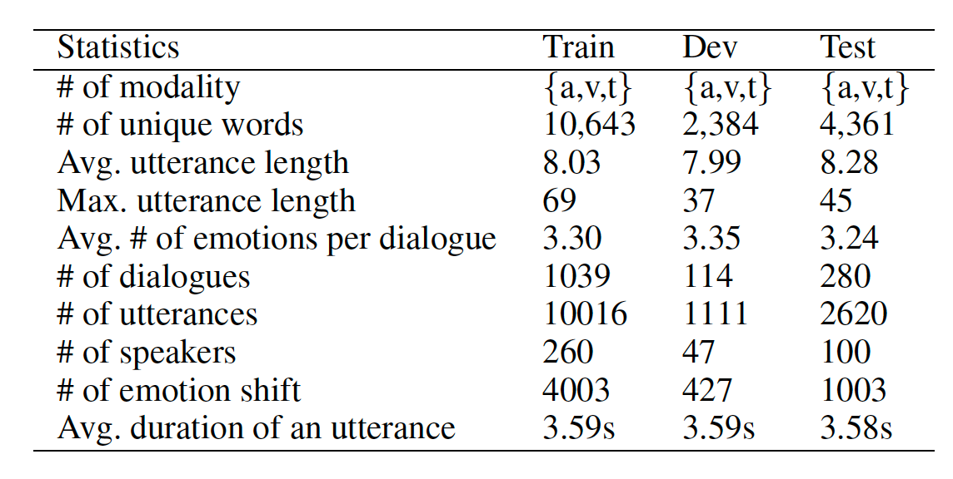
Dataset Statistics

Slide 7
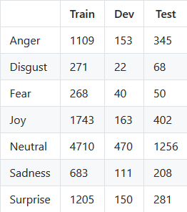
Dataset Distribution

Slide 8
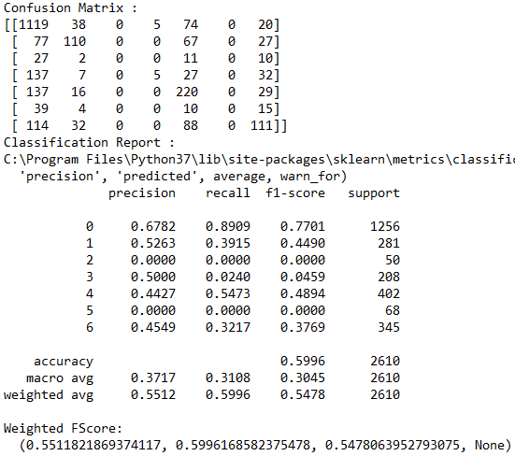
Results

Slide 9
Which group member has done what?
Ajinkya Bedekar
Developing the main code for analysis of dataset
Dhruva Agarwal
Developing the helper code to run the main file

Slide 10
Dataset used
Dataset URL:
http://web.eecs.umich.edu/~mihalcea/downloads/MELD.Raw.tar.gz
http://web.eecs.umich.edu/~mihalcea/downloads/MELD.Features.Models.tar.gz
Details of Dataset:
MELD has been created by enhancing and extending EmotionLines dataset
But it also encompasses audio and visual modality along with text
MELD has more than 1400 dialogues and 13000 utterances from Friends TV series
Each utterance in a dialogue has been labeled by seven emotions -- Anger, Disgust, Sadness, Joy, Neutral, Surprise and Fear
MELD also has sentiment (positive, negative and neutral) annotation for each utterance

Slide 11
Conclusions
Authors introduced MELD dataset
Process of building dataset and results obtained are described
MELD contains raw videos, audio segments, and transcripts for multimodal processing
Features used in experiments are also provided
MELD will be useful as training corpus for conversational emotion recognition and multimodal empathetic response generation
Based on it, future research can explore design of efficient multimodal fusion algorithms, novel ERC frameworks, as well as extraction of new features from audio, visual, and textual modalities

Slide 12
