Slide 1
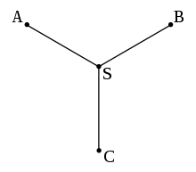
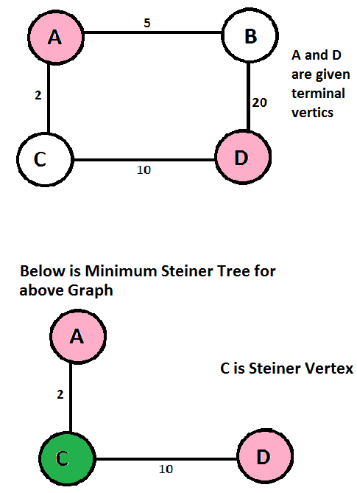
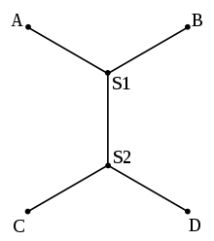
What is steiner tree? The problem of "Shortest Connectivity” The given set of vertices is called Terminal Vertices and other vertices that are used to construct Steiner tree are called Steiner vertices.
NP-Complete

Slide 2
Well-known variants of minimum steiner trees
Euclidean Steiner tree
Rectilinear Steiner tree
Steiner tree in graphs and variants
k-edge-connected Steiner network problem
k-vertex-connected Steiner network problem

