Slide 1

at
theProject
(Online Job Portal)
Avi Gupta(018) Dhruva Agarwal(177) Ronak Jain(102) Shivam Goel(115)

Slide 2
Novelty of theProject
Yes, We agree that there are other competitors in the market with the similar product but “theProject” stands out of all of them.
First let's see what are some of the biggest problems with current products then we will have a look at how the “theProject” aims at eliminating them all.
“Close to 61% of the surveyed freelancers and Interns have not been paid at least once through their career. Further, many freelancers receive payments only after 2-4 weeks of invoicing, thereby creating a gap in flow of capital,” – PayPal survey
Solution, Trust is the biggest factor affecting freelancers and intern, to tackle this we have added an agreement between project creator and project Seeker so that if any party fails to do his/her duty, he/she will blocked from the site and in severe cases he/she will be fined. And payment is secure and should be done through our website’s provided gateways of banks to remove any kind of disparities.

Slide 3
Sophistication value of theProject
theProject” is basically a Web based Application, which enables desirous individual to search for an opportunity through our application, and a desirous venture/company to hire the best resource available. This web page aims to reduce the time and hustle of Seekers and Creators .
Some of its features are :-
● Students, Freelancers, Job/Avenue seekers can register on the portal, then they will add their skills, certificates, experiences & will go through various evaluations which would all contribute to rating(or Trust coefficient), a unique feature for employer/avenue creators.
● Employers or Avenue Creators can register on the platform and then search for a candidates according to their requirements.

Slide 4
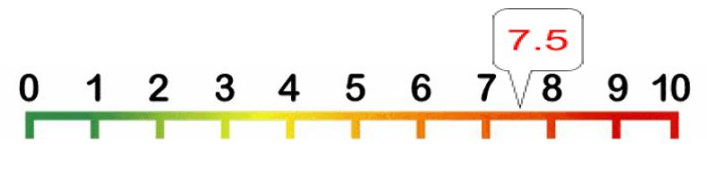
Continued…
So, this project aims to attempt a lot of things at the same time with implementation of the newest technologies, which makes it stand between intermediate and hard level of sophistication.
If we as a team had to rate it between 1 - 10 where 1 being the easiest and 10 being the hardest :-

Slide 5
Applicability of theproject
Our project is build for students, job seekers and people who have projects which they need to be worked upon by other experts.
Just like other web apps which provide such opportunities for both the parties, we also provide a platform for all to meet and help each other.
But, with all that, we also provide them with trust and surety. Thus, our product is more beneficial for the public when compared to every other present web-app.
Whenever, a student or job seeker wishes to apply for a job, they can visit the web app and the jobs posted by the job providers can be accessed from there.

Slide 6
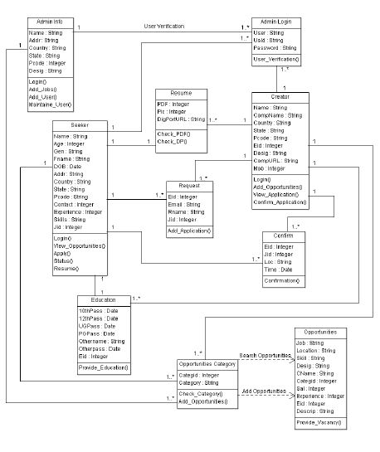
Class Diagram

Slide 7
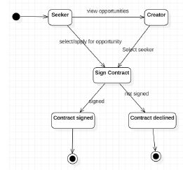
State Diagram
Contract

Slide 8
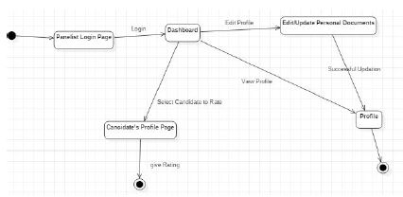
Panelist

Slide 9
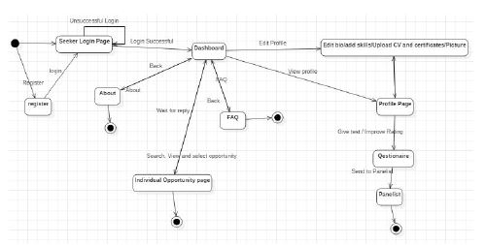
Seeker

Slide 10
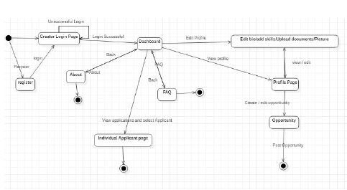
Creator

Slide 11
Tools and Technologies
MySql for Database
Jsp, CSS, Bootstrap for front-end development
Advanced Java(inclusive of spring) for back-end development
In order for the database interact with java, we used JDBC.
For the front end pages to work with java, we applied JSP to it.

Slide 12
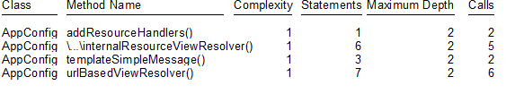
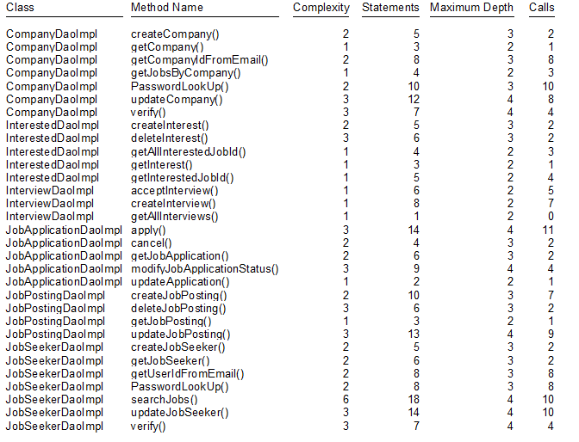
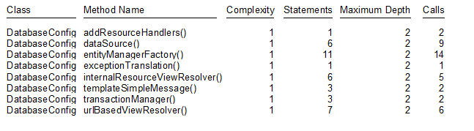
Coding Metrics and Testing of theProject
metric_app
metric_config
metric_dao

Slide 13
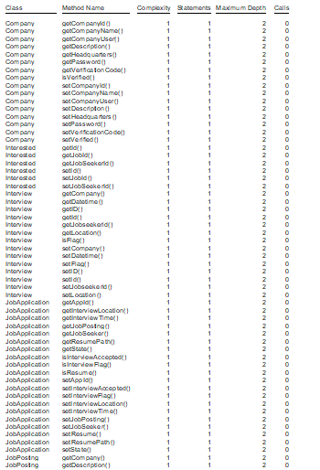

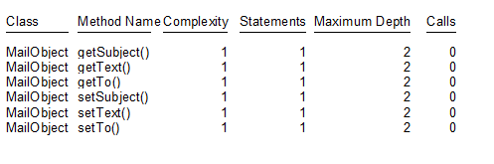
metric_mail
metric_dto
metric_entity

Slide 14
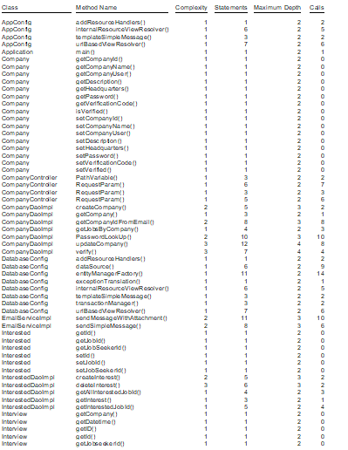
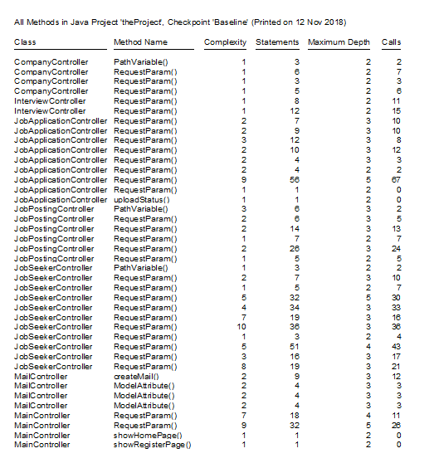
metric_sprng
metric_controller

