Slide 1
Carbon Nano TubesUsed For Targeted Drug Delivery For Cancer Therapies
By aditi singh

Slide 2
Team Members
Aditi Singh(Student 1, Student 11)
Akshaye Khanna (Student 2)
Archana Sanjay Gujar (Student 3)
Amanpreet (Student 4)
Faaiz Arzoo Shaik(Student 5)
Sri Sai Kumar(Student 6)
Kushal Muktala(Student 7)
Ajinkya Bedekar(Student 8)
Disha Chichghare(Student 9)
Gavinson Bashan (Student 10)

Slide 3
What is Carbon Nano Tubes?
Carbon nanotubes (CNTs) are allotropes of carbon with a cylindrical nanostructure. These cylindrical carbon molecules have unusual properties, which are valuable for nanotechnology, electronics, optics and other fields of materials science and technology. Carbon nanotubes (CNTs) are made by rolling up of sheet of graphene into a cylinder.
CNTs are most promising candidates in the field of nanoelectronics, especially for interconnect applications. Metallic CNTs have aroused a lot of research interest for their applicability as VLSI interconnects due to high thermal stability, high thermal conductivity, and large current carrying capability.

Slide 4
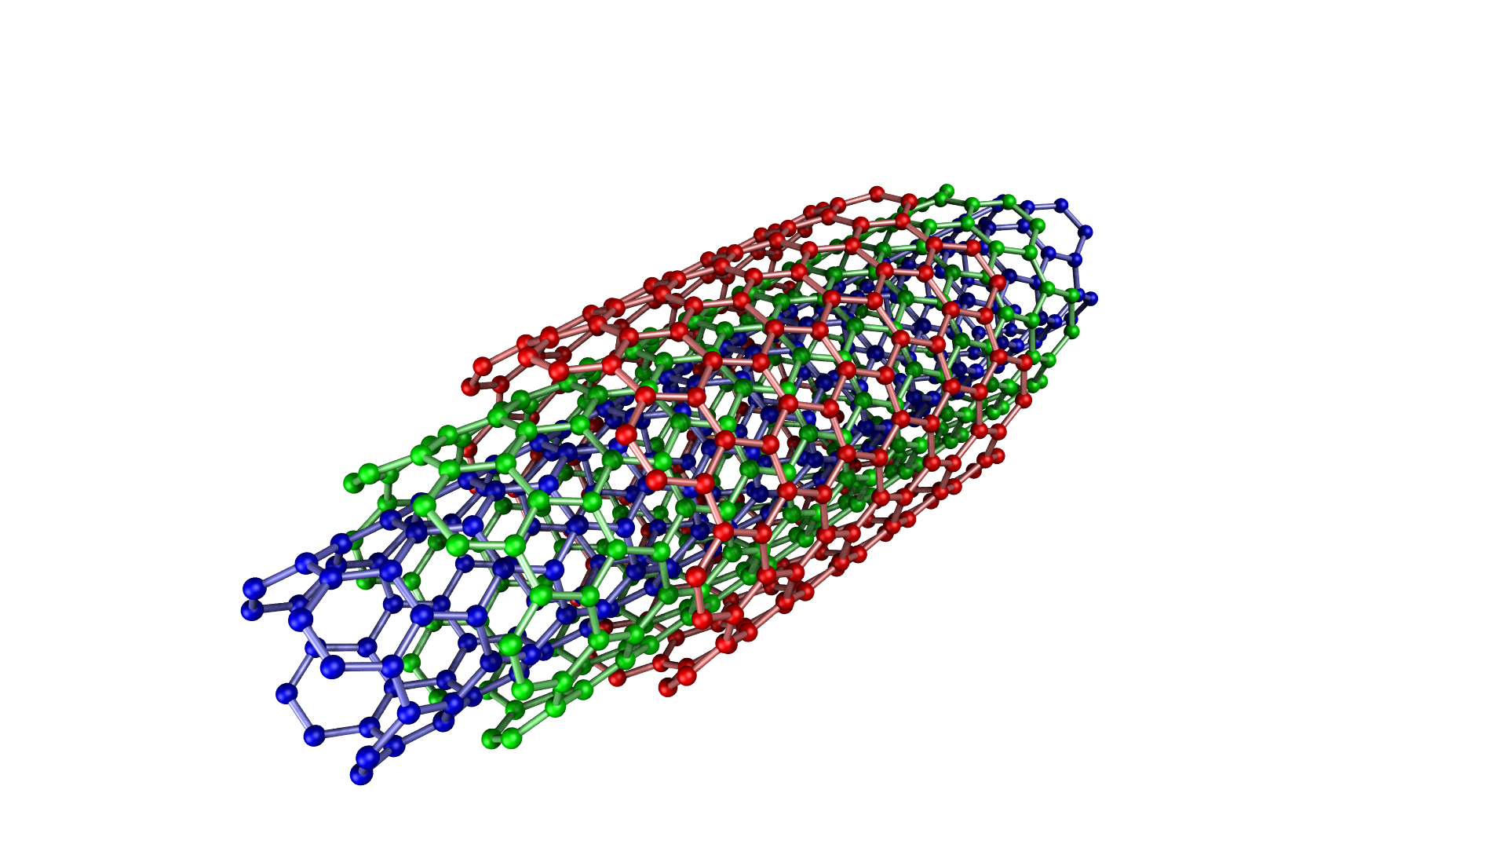
Multi Walled Carbon Nano Tube

Slide 5
How Is It Used?
As there are many applications of Carbon Nano Tubes, these are now used in Medicine field too.
Cancer, as we all know is a deadly disease, and it can be cured through therapies like chemotherapy ,radiation therapy, surgery ,etc. Typically, both cancer and healthy cells reside side by side in the body. Chemotherapy drugs are not capable of differentiating between the two and destroy both equally.
This is the reason that sometimes it is said that a cancer patient has died of chemotherapy and not cancer .
But using CNT in drug delivery systems, the death of healthy cells have gone down as compared to previous statistics.

