Slide 1
Increasing CNT demand
CNTs replacing conventional cancer therapy treatments because of more efficiency.
Hence a new market is going to open exclusively for production of CNTs.
Large career opportunities are running towards younger generation in Nanotechnology sector.

Slide 2
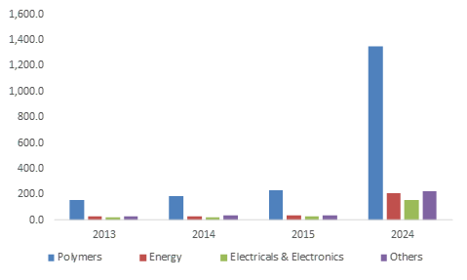
U.S. Carbon Nanotubes Market size, by application, 2013-2024 (USD Million) Sourse: https://www.gminsights.com/industry-analysis/carbon-nanotubes-market

Slide 3
Perception of employers in this field
One should have a good science background in physics, chemistry and nanotechnology area.
Should have professional skills to handle precise science instruments.
Should keep himself in pace with new market trends and latest technology in nanoparticles.
Precision and hardwork

