Slide 1
CARBON NANOTUBES-TARGETED DRUG DELIVERY
VALUE CREATION AND INTERDISCIPLINARY KNOWLEDGE EFFECTIVENESS

Slide 2
Introduction
Carbon nanotubes are very prevalent in today’s world of medical research
Carbon nanotubes are highly researched in the fields of efficient drug delivery and bio-sensing for disease treatment
Carbon nanotube technology has shown to have the potential to alter drug delivery and bio-sensing methods

Slide 3
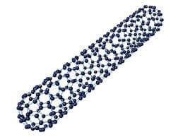
Carbon nanotube properties
CNTs have high electrical conductivity
CNTs consider to have very high tensile strength
CNTs are highly flexible-can be bent considerably without damage
CNTs are very elastic and having high thermal conductivity.

Slide 4
Interdisciplinary research for sustainable technologies
Natural resources are limited and the technologies implemented today have in many instances reached their limits, both ecologically and politically.
Thus an urgent need exists for the development of alternatives, which can be considered under the term research for sustainable technologies.

