Slide 1


Cost considerations, Management challenges.
It involves low cost research compared that for delivery of new chemical entity.
Production of nanotubes is an expensive task , so we need to consider production cost value.
Minimizing the drug usage would significantly reduce the effective cost of drug which would give financial relief to the patients.
Management is the main thing to be considered while establishing an organization.
Location of organization matters a lot because cost of labour, resources , export and import differ from location to location.

Slide 2



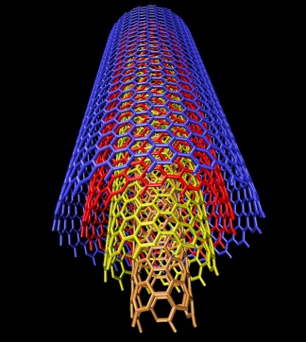
Organization Structure, System Performance needs.
Usage of carbon nanotubes for cancer therapy is one of the best innovations.
For the organization to sustain, its structure should be flexible.
The quality and the perfection should always be maintained to persist. Fame of the organization mainly depends on product quality and performance.
The role of advertisement is most important to promote our product.

