Slide 1
TECHNOLOGY, TOOLS, TECHNIQUES FOR PRODUCT MANUFACTURING PROCESSES AND TECHNOLOGY

Slide 2
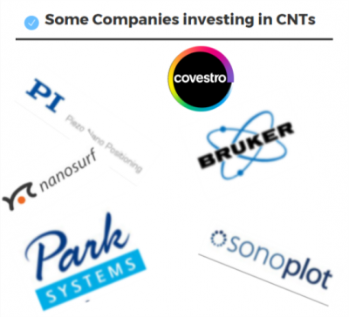

Slide 3
PROCESSES USED IN CANCER THERAPY
1. Boron Neutron Capture Therapy
2. Selective Cancer Cell Destruction
3. Tumor Targeting

Slide 4
Boron Neutron Capture Therapy
Neutron capture therapy (NCT) is a noninvasive therapeutic modality for treating locally invasive malignant tumors such as primary brain tumors and recurrent head and neck cancer. It is a two step procedure. The patient is injected with a tumor localizing drug containing a non-radioactive isotope that has a high propensity or cross section to capture slow neutrons.

Slide 5
Selective Cancer Cell Destruction
Selective cancer cell destruction can be achieved by functionalization of SWNT with a folate moiety, selective internalization of SWNTs inside cells labeled with folate receptor tumor markers, and NIR-triggered cell death, without harming receptor-free normal cells.

Slide 6
Tumor Targeting
Targeting the tumor cells by the use of Carbon Nano Tubes.

Slide 7
Some more researches made in this field like Tiny Hollow Carbon Balls, created in the lab of chemical scientist Sayan Bhattacharyya at the Indian Institute of Science Education and Research (IISER) in Calcutta, may assume a significant role in humanity's fight against cancer, if the researchers can replicate their lab feat in real conditions. These porous carbon Nano spheres - one-tenth the size of a dust particle - that the IISER scientists synthesized from abundantly available lemon grass, delivered anticancer drugs exclusively to cancerous cells in a controlled manner, making them an ideal vehicle for targeted delivery of cancer drugs. The experiments were carried out in lab-bred cancer cells and their research was published in journal 'Carbon'. It showed that the Nano carriers could be altered to spare healthy cells. The destruction of healthy cells while killing tumor cells has been the bane of modern cancer treatment. For this study, the scientists used doxorubicin, a commonly used anticancer drug.

