Slide 1
Book RECOMMENDATION SYSTEM
Presented on 12/07/2018
Presented by:- Ajinkya Patankar, akshay sovani, sharvani pratinidhi

Slide 2
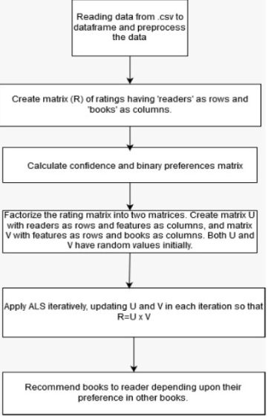
Overview
Implemented Collaborative Filtering using Matrix Factorization.
Used ALS(Alternating Least Squares) algorithm to achieve matrix Factorization
Recommended the following:
Books similar to the input books
Books a particular reader would most likely to cherish reading

Slide 3
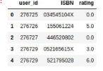
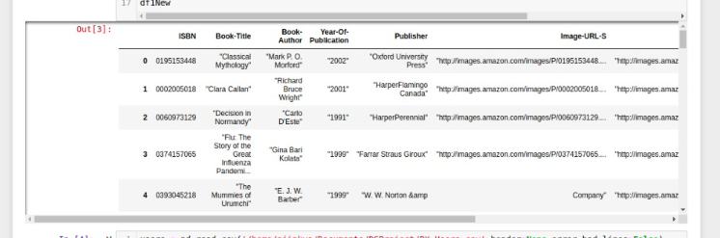
INPUT DATASET
Dataset Used:- Two files: Book-Rating.csv and Books.csv
Book-Rating.csv: Contains User-Id, ISBN Number and Rating
Books.csv: Contains ISBN Number, Book-Title, Book-Author, Year-of-Publication, Publisher

Slide 4
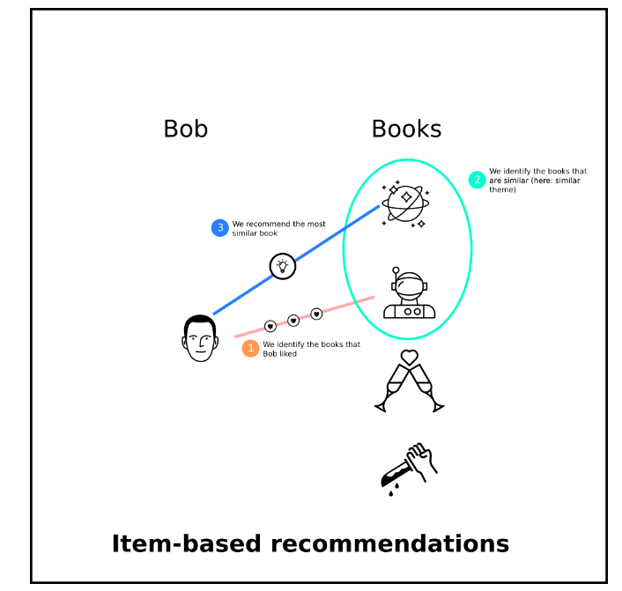
Algorithm Used – Collaborative Filtering
Underlying Principle:- If a person A has the same opinion as person B on an issue, then A is more likely to have B’s opinion on a different issue.
There are two types of recommendations :
Item based (book)
User (Book-reader) based

Slide 5
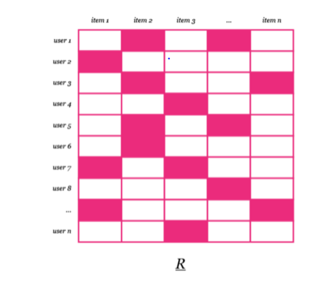
Matrix Factorization
Used the training data set matrix R (user x item) to split into two matrices of dimensions U (user x feature) and V (feature x item).
Here, items represent book readers, whereas items represent books.

Slide 6
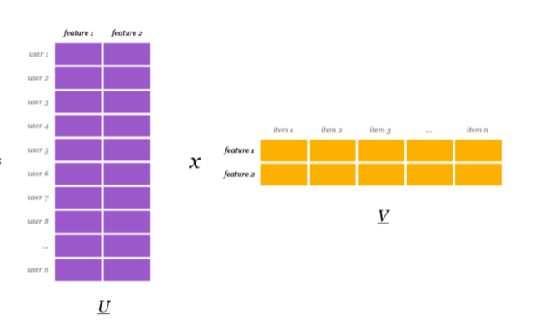
Matrix Factorization
U:
Rows : Users
Columns : Features
V:
Rows : Features
Columns : Books
R = U x V

Slide 7
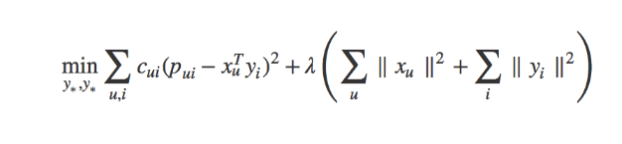
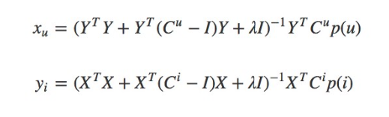
Alternating Least Square
Goal:- To minimise the difference between original training data matrix and subsequent U x V over the iterations.
To minimise the adjacent loss function
Iteratively updating the two matrices, U and V

Slide 8


Confidence and Preference Matrices
Confidence matrix is obtained by multiplying original matrix with a discrete value called alpha.
We also add 1 so we have a minimal confidence even if α x r equals zero
Preference Matrix is obtained by establishing the values as 0, if the original training matrix doesn’t have any rating value i.e. the user has not read the book and therefore has not rated the book
Whereas 1, if the book has been rated

Slide 9
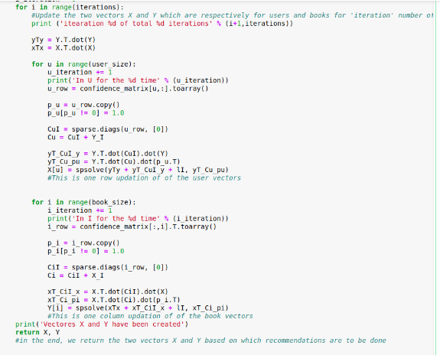
Alternating Least Square
Iterating for the specified number of times passed in the function call.
Creation of the matrices U and V.
Updation of the matrices U and V in the first iteration. The subsequent iterations use the updated U and V to update U and V again.
Finally after the function has iterated over completely, it returns the matrices U and V.

Slide 10
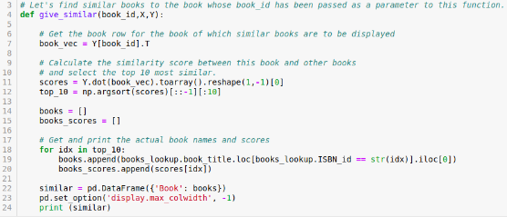

Item-item collaborative filtering
give_similar() gives the books similar to the input book.
Score is calculated by dot product of book matrix with the transpose of the ith row of book matrix.
Converting it into an array and then sorting which fetches the indices of top 10 similar books.
Later on, the original books_lookup dataframe is referred to get the book names.

Slide 11
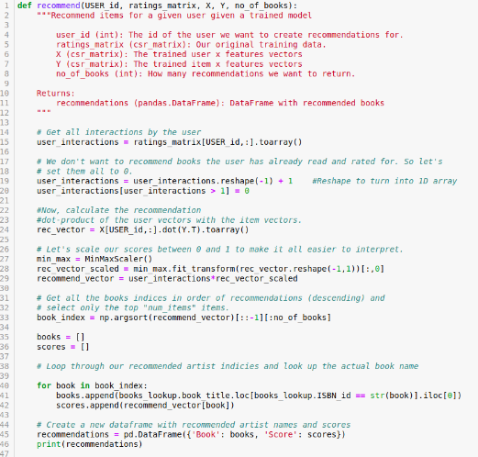

User-Item collaborative Filtering
Recommend() function, recommends the books according to the user’s interests.
Score is calculated by dot product of ith row of User Matrix with the transpose of the book matrix.
Converting it into an array and then sorting, indices of top 10 similar books are fetched.
Later on, function comes up with names of top 10 books from the original books_lookup dataframe.

Slide 12
Future scope for stage 4
Optimization of ALS function
Front-end for the two functions similar and recommend

Slide 13
REFERENCES
http://www2.informatik.uni-freiburg.de/~cziegler/BX/
https://medium.com/mediarithmics-what-is/what-are-recommendation-systems-and-how-do-they-work-91aa8bf3ec11
https://en.wikipedia.org/wiki/Collaborative_filtering

