Slide 1
VOICE AUTHENTICATION ON SMART SPEAKER
By
Ajinkya Jadhav
Advisor
Dr. Richard Matovu

Slide 2
AGENDA
Serial no. | Content
1. | Problem Statement
2. | Existing Applications
3. | Proposed Solution
4. | Project Proposal
5. | Work-Flow Diagram
6. | Scope
7. | Development Methodology
8. | Technical Requirements
9. | Project Timeline
10. | Success Criteria

Slide 3
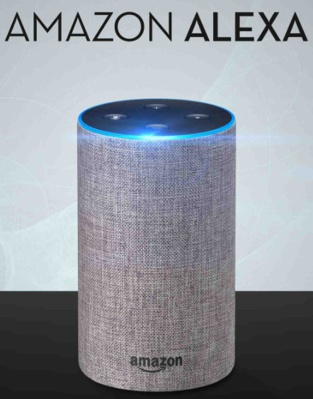

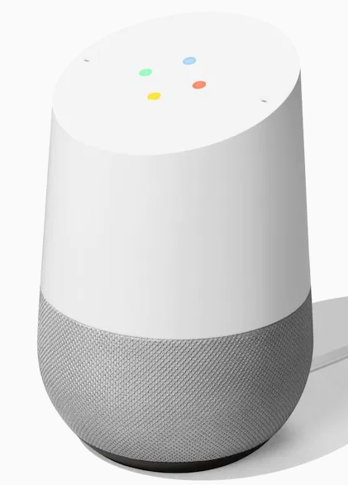
SMART SPEAKERS/ VOICE ASSISTANTS

Slide 4
SMART SPEAKERS
A voice-controlled device
- ”Alexa, what is the weather?”
- Receive answers from the device/cloud
43% of U.S. households have smart speakers
Over 90 million in the U.S
$30 billion market in 2024
Amazon Echo 70%, Google Home 31%

Slide 5
SMART SPEAKERS: WHAT THEY ARE BEING USED FOR?
Play your favorite tunes
You can control your home with ease
You'll get your questions answered
You can access news, shopping, podcasts, and more
You'll get recommendations quickly
Your smart speakers will get you organized

Slide 6
SMART SPEAKER: WHAT’S THE PROBLEM?
No user authentication to access many devices in the market.

Slide 7
PROPOSED SOLUTION
To authenticate the user to access the voice assistant system

Slide 8
01
VOICE AUTHENTICATION

Slide 9
VOICE AUTHENTICATION
It is an innovative biometric technology that allows you to use your unique voiceprint.
Voice recognition technology offers higher security than other biometric modalities, such as passwords, scanning, fingerprints, etc.
All security technologies require a person to be present and interact with the device directly (physically).

Slide 10
PROJECT PROPOSAL
To overcome the security problem of voice assistants, making this model.

Slide 11
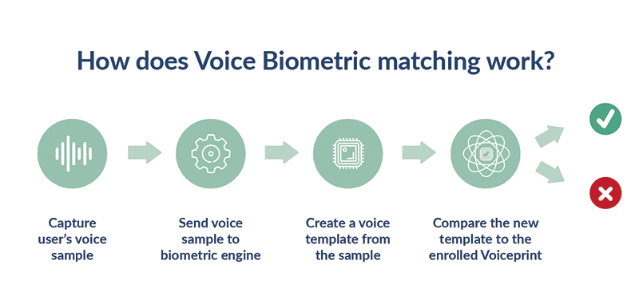
WORKFLOW OF VOICE BIOMETRIC SYSTEM

Slide 12
METHODOLOGY
The system will verify the person’s identity. To verify an enrolled person's identity, the voice biometric system captures a new speech sample, creates a template from the sample, and compares it against the enrolment template.
A strong match between templates indicates that the same person spoke both samples, thus verifying the person's identity.

Slide 13
DEVELOPMENT METHODOLOGY
Data Collection – Voice Samples of wake-up keyword of several users
Design Machine Learning Model
- Use the collected voice samples
- Extract voice features
- Time-Series Frequency
- Distinguish between user and imposters
Deploying it in Raspberry Pi
Testing

Slide 14
SCOPE
Build Machine Learning model to authenticate user
Deploy it in raspberry pi

Slide 15
TECHNICAL REQUIREMENTS
Programming Language – Python
Raspberry Pi
Machine Learning

Slide 16
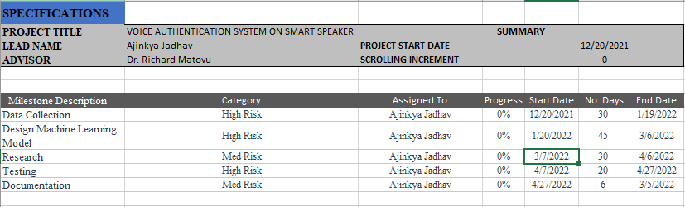
PROJECT TIMELINE

Slide 17
SUCCESS CRITERIA
Developed system successfully authenticating users
Good Accuracy from ML model
Deployed Raspberry Pi system correctly verifying the user

Slide 18
THANK YOU….

