Slide 1

MARKETING AND RETAIL ANALYTICS
Ajinkya Shakkarwar

Slide 2

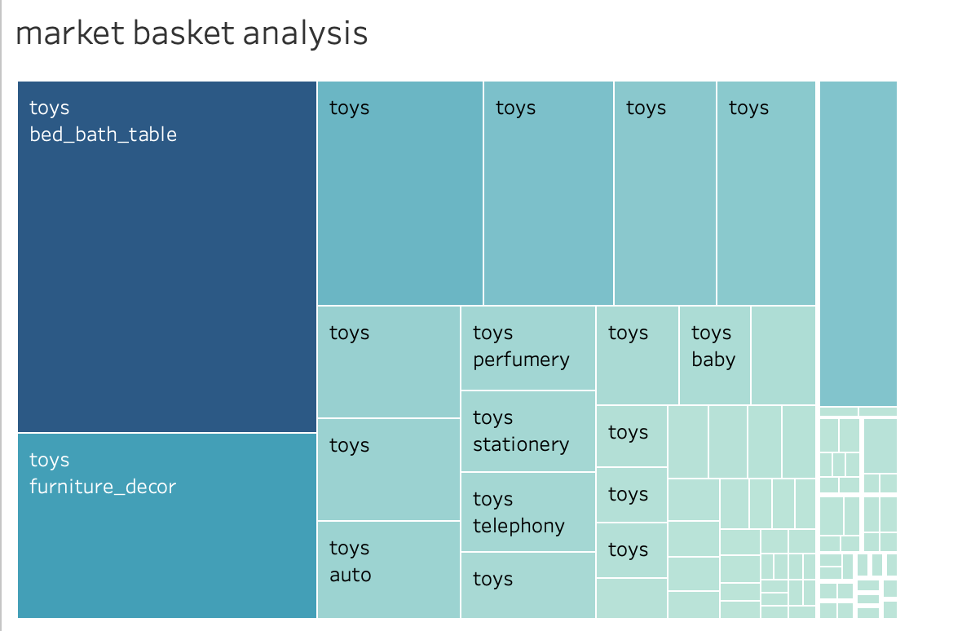
MARKET BASKET ANALYSIS
The toys category with a subcategory bed_bath_table has the most no of orders(291)

Slide 3

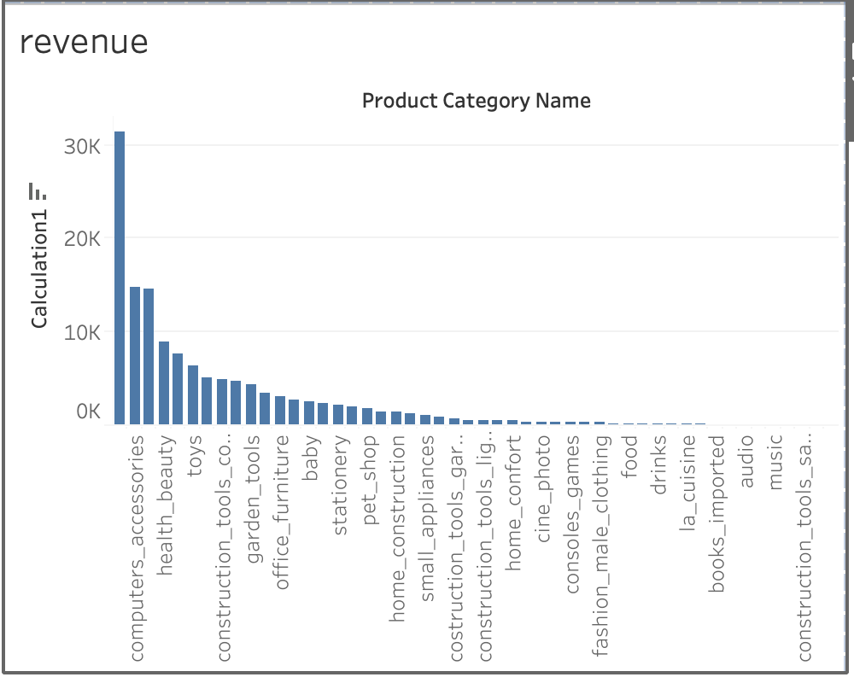
Revenue
Computer Accessories seems to have the maximum number of revenue.(31,449)
Party Supplies seems to have the least revenue.(8)

Slide 4
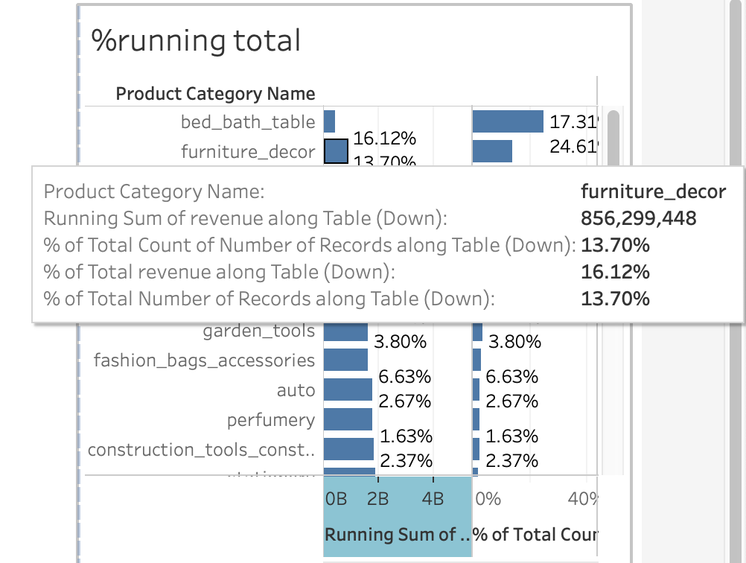
Running Total and % of Total Count

Slide 5
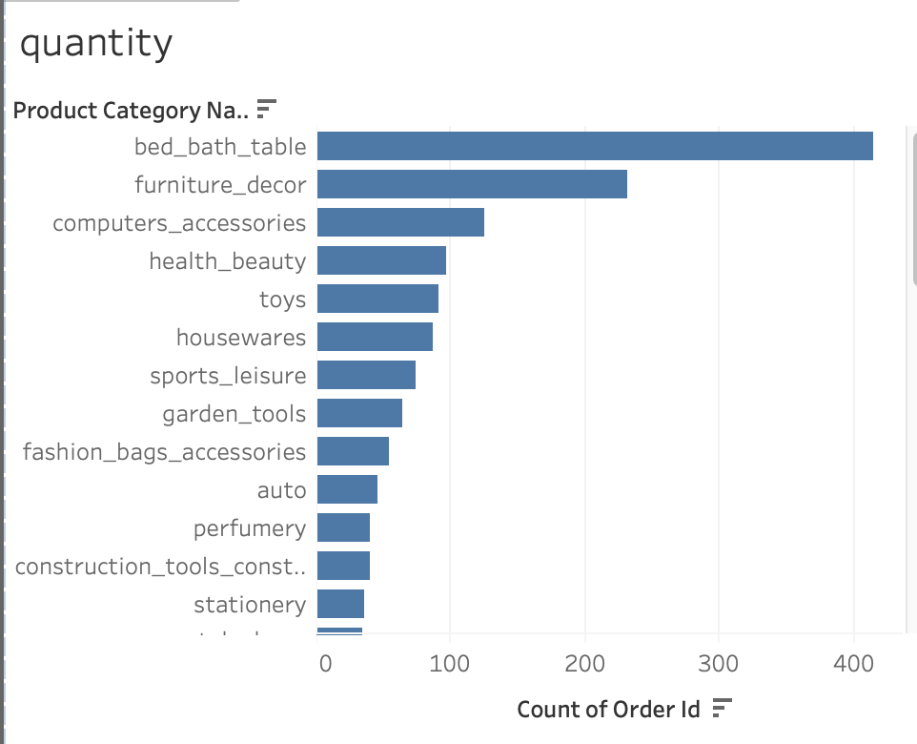
QUANTITY OF ORDERS
Bed_bath_table seems to have the greatest number of order count.(415)
Following furniture_decor and computer_accessories seems to have decent number of orders.(231 and 125 respectively)/

Slide 6
Sub-category like bed_bath_table should be taken care of.
bed_bath_table seems to have the greatest number of revenue; compute accessories should be taken care of.
Further, the category like computer accessories and health_beauty seems to have decent revenue.
CONCLUSION

Slide 7

Thank You

