Slide 1

Smart Advanced Calculator
Simplifying Calculations with Real-Time Integration.
Developed by Ajinkya S Patil(42), IT Engineering, VESIT.
Utilizing Flutter, Firebase, and API Integration.
Video_Presentation_Github
Page-1

Slide 2

Introduction: The Problem
Users often juggle multiple calculator apps. This is inefficient and lacks integration.
Multiple Apps
Inefficient
Users switch between apps for different calculations.
Switching apps is time-consuming and frustrating.
Lacks Integration
No seamless data transfer between calculators.
Page-2

Slide 3
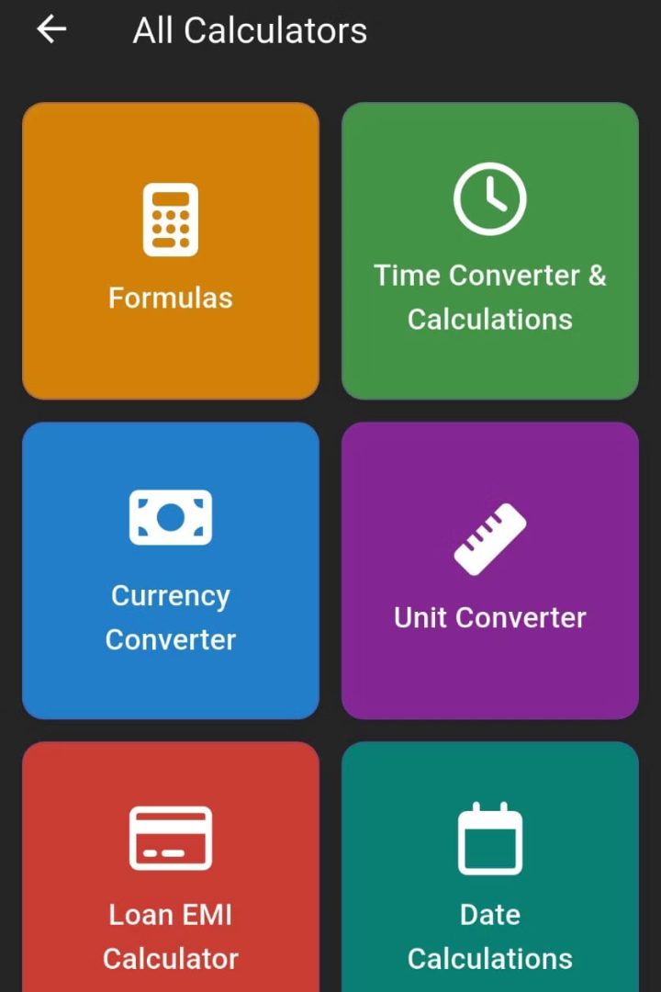
Our Solution: Smart All-in-One Calculator
This app combines all essential calculators into one.
All-In-One
Smart Interface
Combines essential calculators into a single app.
User-friendly design for easy navigation, ensuring a smooth and intuitive user experience.
Real-Time
Seamless calculations with real-time integration, providing instant results and updates.
Page-3

Slide 4





Key Features: All-in-One
Basic arithmetic, scientific, unit converter, financial, and health calculators are available in one app.
Arithmetic
Scientific
Unit Converter
Financial
Page-4

Slide 5
Tech Stack: Flutter & Firebase
Flutter is used for cross-platform development and Firebase for data, authentication, and analytics.
Flutter
Firebase
Cross-platform (iOS & Android)
Real-time data
Fast performance
Authentication
Analytics
Page-5

Slide 6
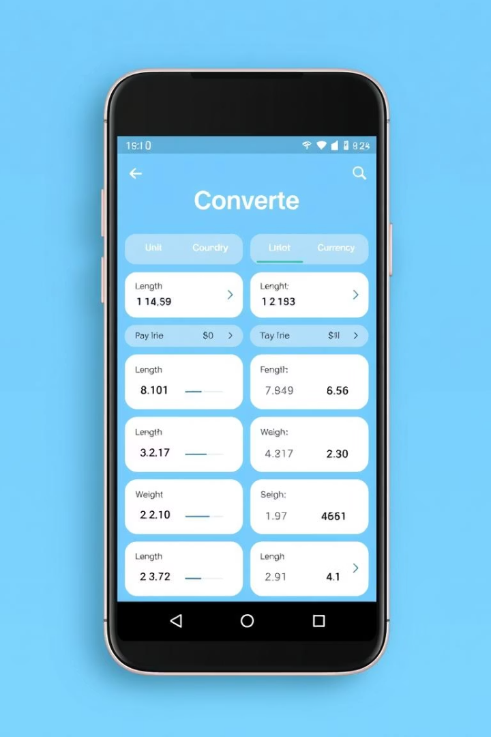



Feature Spotlight: Unit Converter
Supports 150+ units. Includes real-time currency conversion and offline mode.
Real-Time
Currency updates every 15 mins via API.
Offline Mode
Basic conversions available offline.
Custom Units
Users can add and save custom conversions.

Slide 7
Monetization & Future Plans
Ads
1
Display non-intrusive ads.
Premium
2
Offer ad-free version.
Subscription
3
Advanced features, and priority support.
The app will initially use ads to generate revenue. A premium version will remove ads. A subscription model unlocks advanced calculators. This includes financial and health tools.
Page-7

Slide 8




Feature Spotlight: Smart Calculator
This feature includes calculators for loan EMI, currency conversion, date and time calculations, and unit conversions for mass, temperature, length, data, area, and volume.
1
Loan EMI
2
Currency Converter
3
Date Time Calculation
4
Units (mass, temp, length...)
Page-8

Slide 9

Conclusion: The Smart Choice
Solves a common problem with an elegant solution. Leverages cutting-edge technologies.
Elegant Solution
Optimal Performance
The app provides a unified interface for all essential calculators, eliminating the need to switch between multiple apps.
Built with Flutter, the app offers fast performance and a smooth user experience on both iOS and Android platforms.
Simplifies Calculations
Real-time data integration and an intuitive design make complex calculations simple and efficient.

