Slide 1
ANALYSIS OF MARKETING STRATEGY OF THE PORTUGUESE BANK
- Done by
Ajin Rufus

Slide 2
Aim
To perform analysis of various attributes that may contribute to the subscription of term deposit at the Portuguese bank.

Slide 3
Contents
Distribution of Age
Age
Job Types
Marital Status
Level of Education
Credit availability
Average yearly balance
Housing loan
Loan
Communication Types
Last Day contacted in the month
Last Month contacted in the Year
Duration of call
Days since Last Contact
Outcomes of Previous Marketing Strategies
Subscription
Correlation
Conclusion

Slide 4
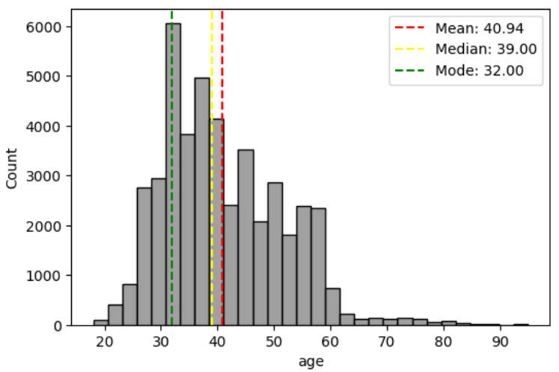
Age
Distribution is right skewed
Middle-aged adults are contacted more.
They are more likely to invest in term deposits.

Slide 5
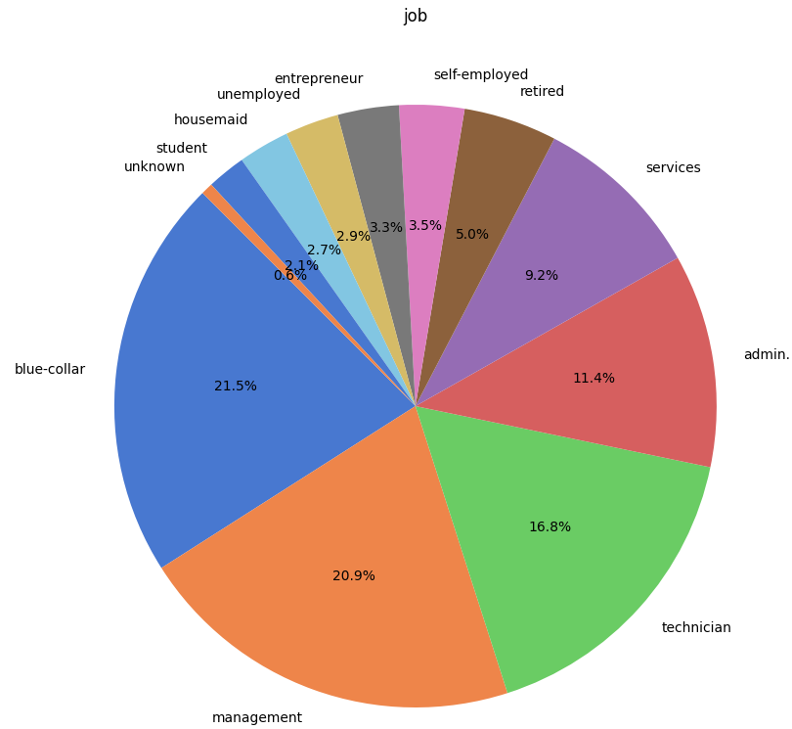
Job Types
More privileged people in good jobs like people in management jobs, blue-collar jobs, among others are contacted more
They are more likely to invest in term deposits.

Slide 6
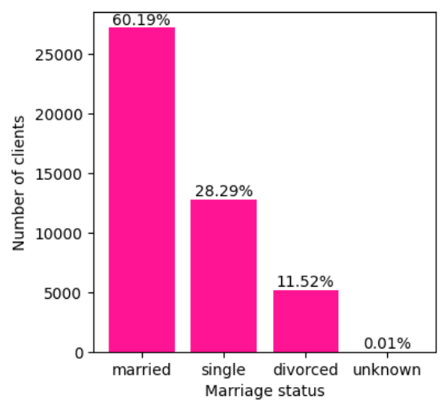
Marital Status
60.19% of targeted calls were made to married clients.
This targeting makes sense because married people often have a higher tendency to save.
Therefore, they are more likely to invest in term deposits.

Slide 7
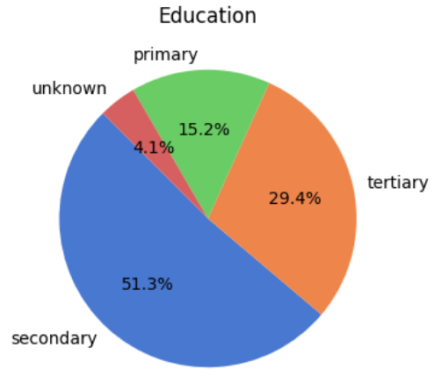
Level of Education
More than half the people contacted tend to have a secondary level education.

Slide 8
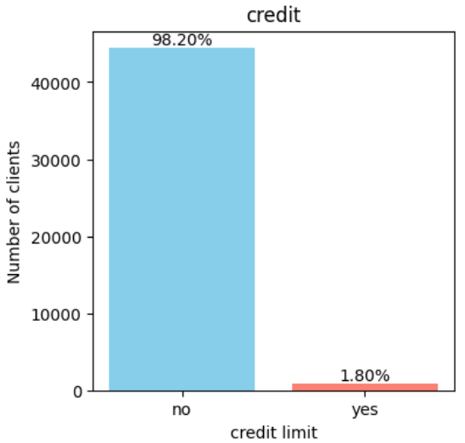
Credit Availability
Only about 2% of clients have failed to meet their credit obligations.
These 2% right now are less likely to do more investment.
Therefore, remaining 98% can be contacted for consideration.

Slide 9
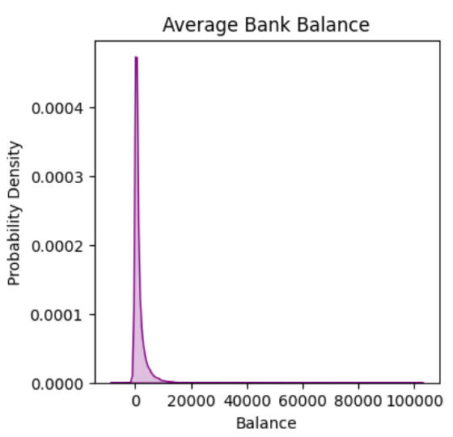
Average Yearly Balance
Heavily left skewed distribution, with the tail on the positive side.
Indicated most clients are from middle-income groups.
Targeting middle-income groups is effective because they tend to save more, unlike high-income groups who often focus on investing.

Slide 10
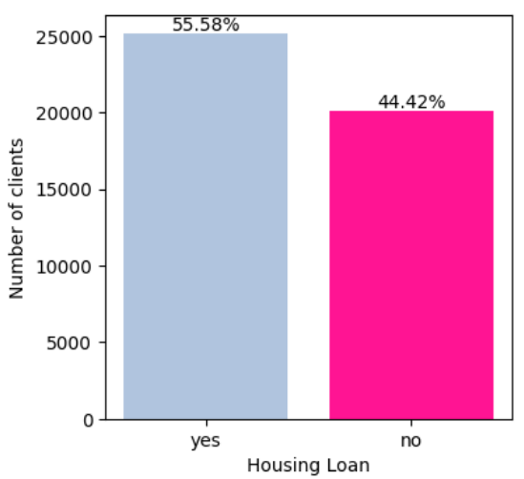
Housing Loan
55.58% of clients have taken up a housing loan.
Clients with housing loans are less likely to make term deposits right now.
But equal focus is given to both with clients having housing loans preferred slightly.
Focus can be on clients without housing loans for higher potential subscriptions.

Slide 11
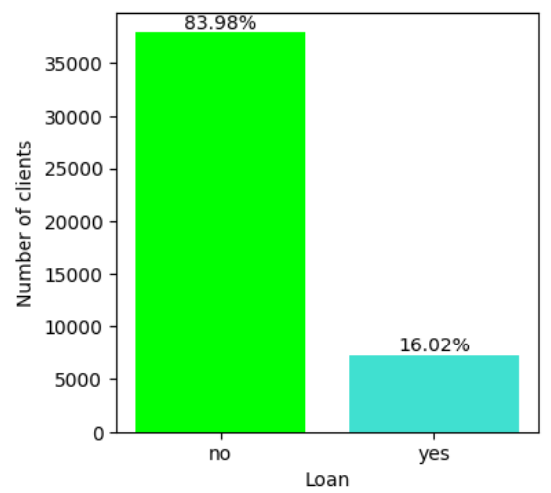
Loan
83.98% of clients haven't taken out any loans.
Focus is on this group since they are more likely to make term deposits without other financial commitments.

Slide 12
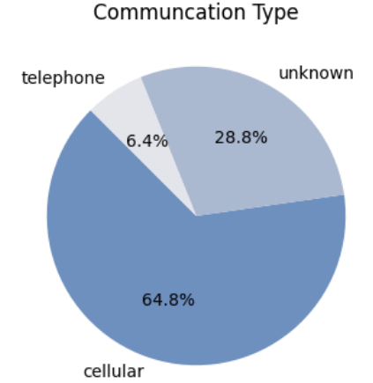
Communication Types
Two-thirds of clients are contacted via cellular means.
Approximately 28.8% of contact methods are unknown, which could likely increase the cellular contact percentage.

Slide 13
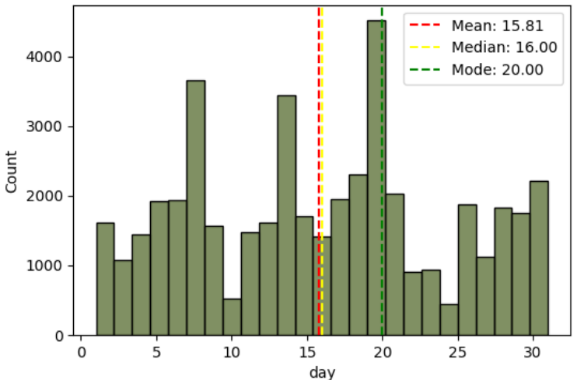
Last Day Contacted in the Month
Nearly uniform distribution, so no strong conclusions can be drawn.
However, the company could improve by implementing a structured reminder plan instead of calling clients randomly after various intervals.

Slide 14
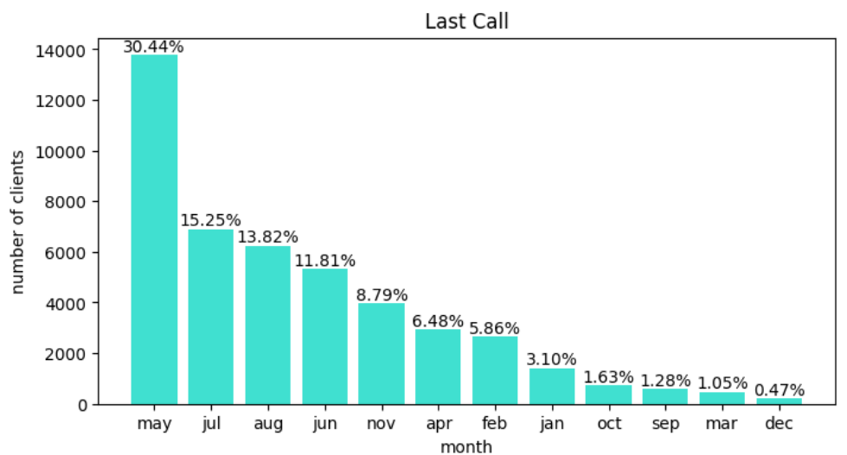
Last Month Contacted in the Year
May month has the longest interval.

Slide 15
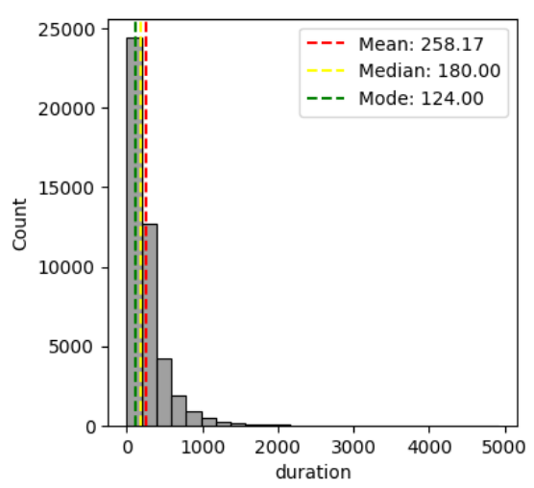
Duration of Call
The average contact duration is about four minutes.
Longer conversations typically indicate client interest, as they often seek detailed information on terms and conditions.

Slide 16
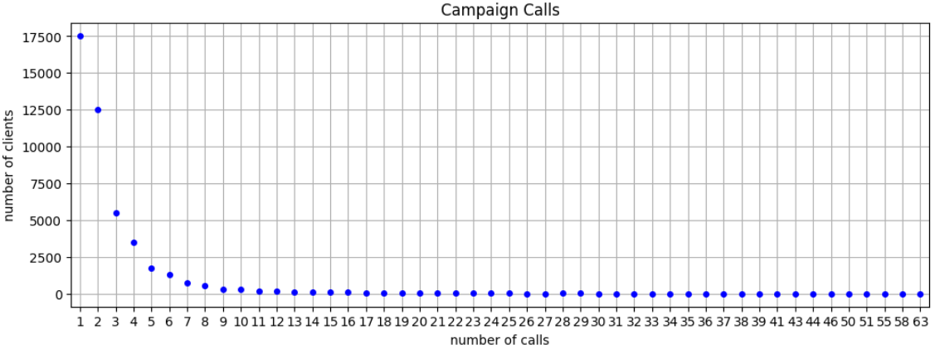
Number of Calls made to Each Client
Most calls were made only once during the campaign.
Multiple calls often indicate client interest, as clients may seek detailed information and need more time for consideration.

Slide 17
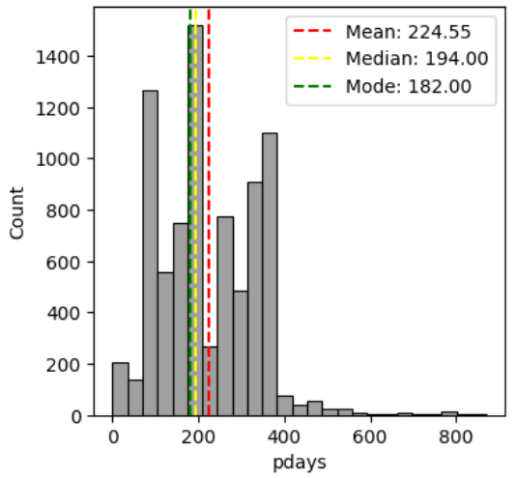
Days Since Last Contact
high percentage of calls are made after six months.
Calls could be made earlier to increase the chances of convincing clients.

Slide 18
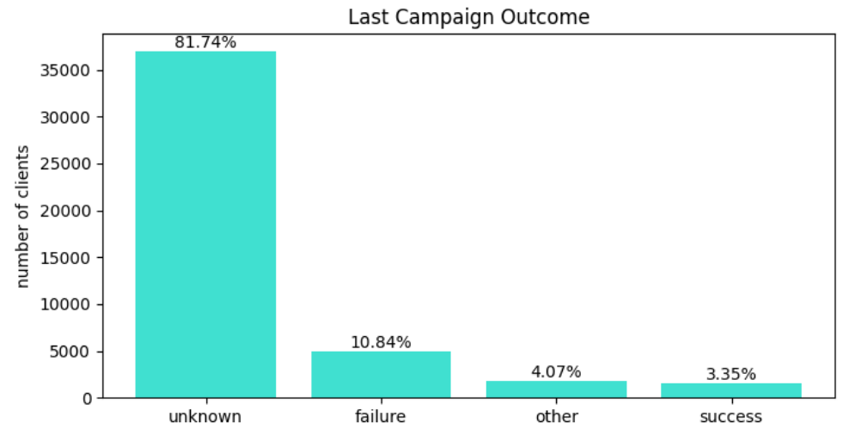
Outcomes of Previous Marketing Strategies

Slide 19
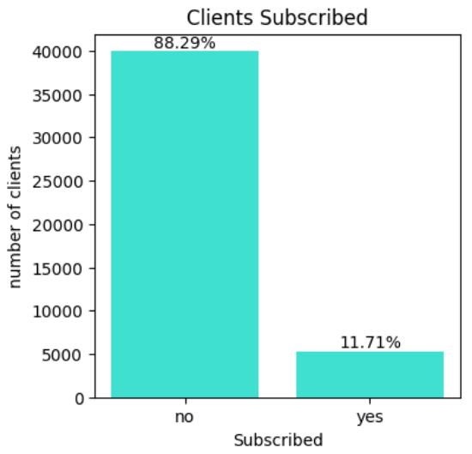
Subscription
The probability of success is only about 0.1.
To improve outcomes, more targeted calls need to be made by computing the correlation of various attributes contributing to increased subscriptions.

Slide 20
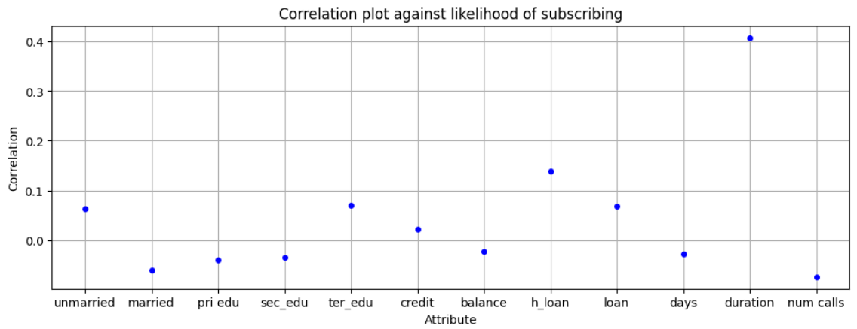
Correlation
Only the duration of the call is correlated with a higher success rate.
Increase the number of calls and ensure thorough explanations of the plans to boost success chances.

Slide 21
Conclusion
Calls can be made earlier and more frequently to increase the likelihood of success.
Implement a structured reminder plan instead of relying on random call intervals.
The duration of calls correlates with a higher success rate, so ensure calls are thorough and informative.
Prioritizing clients who haven't taken out any housing loans can be done.
Most clients are contacted via cellular means, and a significant portion of contact methods is unknown, which could affect strategy.
By refining targeting strategies and enhancing communication efforts, the chances of successful term deposit conversions can be significantly improved.

